Slide 1
Exploring Medicare Opportunities to Use Auxiliary Workers to Address Health-Related Social Needs
Tara Adams Ragone, J.D.
ASLME Health Law Professors Conference
June 7, 2024

Slide 2
Roadmap
Who/What/Why - Community Health Workers/Sustainability
Where We’ve Been/How
What’s New: CHW Reimbursement Opportunities in Medicare Part B
Some Challenges
Next Steps

Slide 3
Who/What/Why – Community Health Workers/Sustainability
“A community health worker is a frontline public health worker who is a trusted member of and/or has an unusually close understanding of the community served. This trusting relationship enables the worker to serve as a liaison/link/intermediary between health/social services and the community to facilitate access to services and improve the quality and cultural competence of service delivery. A community health worker also builds individual and community capacity by increasing health knowledge and self-sufficiency through a range of activities such as outreach, community education, informal counseling, social support and advocacy.”
CHW Section of the American Public Health Association
Notes:
Additional names: health educators, promotores, traditional health workers, community health representatives or advisors
-related to peers
-dft settings: within public health, the community, and in healthcare settings
-dft scopes: chronic disease, BH, reentry, more general

Slide 4
Who/What/Why – Community Health Workers/Sustainability
https://www.astho.org/globalassets/pdf/community-health-workers-summary-evidence.pdf
Notes:
-see some improvements in outcomes as well as some cost-effectiveness – systemic reviews and RCTs
-Improving individual and community health (hopefully outcomes)
-Building trust and relationships
-Addressing social and behavioral determinants of health
-Maybe reducing costs?
“Community health workers (CHWs) are critical to improving individual and community health through their ability to build trust and relationships and deepen communication between patients and providers. CHWs have a deep understanding of their communities through lived experience, which makes them uniquely qualified to address social and behavioral determinants of health. As states advance efforts to expand financing for and use of this workforce, it will be critical to make an evidence-based business case for policymakers and providers. Existing studies on CHWs focus on assessing their effectiveness in improving health outcomes, reducing healthcare costs, and bridging the gap in health disparities. The number of research articles on the impact of CHW-led interventions and programs has escalated dramatically over the past fifty years, and the scientific rigor of study designs has improved notably.”
“The sections below serve as a summary of research studies demonstrating the effectiveness of CHWs across multiple settings and health issues. This wide array of research allows CHW champions to demonstrate what research already exists or to select evidence that is most resonant with their audience. ”

Slide 5
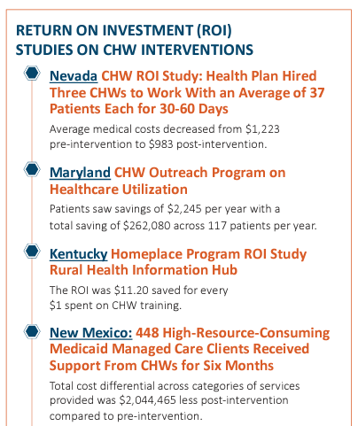
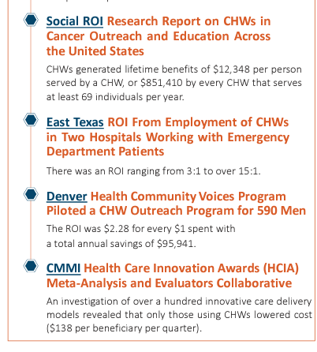
Who/What/Why – Community Health Workers/Sustainability
https://www.astho.org/globalassets/pdf/community-health-workers-summary-evidence.pdf
Notes:
-some cost savings (although shouldn’t be our focus)
-Improving individual and community health (hopefully outcomes)
-Building trust and relationships
-Addressing social and behavioral determinants of health
-Maybe reducing costs?
“Community health workers (CHWs) are critical to improving individual and community health through their ability to build trust and relationships and deepen communication between patients and providers. CHWs have a deep understanding of their communities through lived experience, which makes them uniquely qualified to address social and behavioral determinants of health. As states advance efforts to expand financing for and use of this workforce, it will be critical to make an evidence-based business case for policymakers and providers. Existing studies on CHWs focus on assessing their effectiveness in improving health outcomes, reducing healthcare costs, and bridging the gap in health disparities. The number of research articles on the impact of CHW-led interventions and programs has escalated dramatically over the past fifty years, and the scientific rigor of study designs has improved notably.”

Slide 6
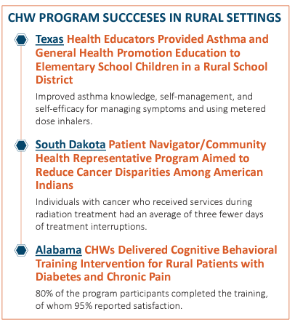
Who/What/Why – Community Health Workers/Sustainability
https://www.astho.org/globalassets/pdf/community-health-workers-summary-evidence.pdf
Notes:
-Improving individual and community health (hopefully outcomes)
-Building trust and relationships
-Addressing social and behavioral determinants of health
-Maybe reducing costs?
“Community health workers (CHWs) are critical to improving individual and community health through their ability to build trust and relationships and deepen communication between patients and providers. CHWs have a deep understanding of their communities through lived experience, which makes them uniquely qualified to address social and behavioral determinants of health. As states advance efforts to expand financing for and use of this workforce, it will be critical to make an evidence-based business case for policymakers and providers. Existing studies on CHWs focus on assessing their effectiveness in improving health outcomes, reducing healthcare costs, and bridging the gap in health disparities. The number of research articles on the impact of CHW-led interventions and programs has escalated dramatically over the past fifty years, and the scientific rigor of study designs has improved notably.”

Slide 7
Where We’ve Been/How
Grants
Private
Public
Medicaid
State Plan Amendments, 1115 waivers
See, e.g., Connecticut Health Foundation, Environmental Scan on Community Health Workers: A 50-State Scan of Medicaid Reimbursement Approaches for the CHW Workforce (Jan. 2024)
FFS, health homes
Notes:
SPAs: CA – preventive services
1115: NJ – MCO pilot over 5 years – SLOW
Get other strong examples

Slide 8
What’s New: CHW Reimbursement Opportunities in Medicare Part B
CY 2024 Medicare Physician Fee Schedule Final Rule (effective 1/1/24) includes “coding and payment changes to better account for resources involved in furnishing patient-centered care involving a multidisciplinary team of clinical staff and other auxiliary personnel”
CMS created new HCPCS codes for:
Social Determinants of Health (SDOH) Risk Assessment (G0136)
Community Health Integration (CHI) Services to address unmet HRSN that affect the diagnosis and treatment of a patient’s medical problems (G0019 1st 60 min/mon; G0022 each add’l 30 min/mon)
Principal Illness Navigation (PIN) Services to help people with Medicare diagnosed with high-risk conditions identify and connect with appropriate clinical and support resources
G0023 1st 60 min/mon; G0024 each add’l 30 min/mon
PIN-PS (PSS to support individuals w/ BH conditions (SMI and SUD)) : G0140 for 1st 60 min/mon; G0146 each add. 30 min/mon
CMS, Health Related Social Needs FAQ
Notes:
Exploring Medicare Opportunities to Use Auxiliary Workers to Address Health-Related Social Needs
There is strong evidence that auxiliary workers like community health workers (CHWs) help improve health outcomes and can reduce health care costs by providing critical linkages between vulnerable populations and clinical and social services that address health-related social needs. Yet sustainable funding has been elusive. Many CHWs have had to rely on time-limited, unreliable, and insufficient grants to support their positions. There has been mounting momentum in recent years to open up pathways to insurance reimbursement of CHWs. A number of states have pursued Medicaid waivers to permit some reimbursement of CHWs, and now Medicare is taking steps to support CHW sustainability. This presentation will evaluate nascent opportunities within Medicare to reimburse for the services of CHWs and other community connectors such as peers and navigators, including new codes that are available in Medicare Part B as part of the 2024 Physician Fee Schedule Final Rule.
JVJ: Consistent with statements and guidance from CMS in recent years encouraging state Medicaid agencies to address SDOH (or health related social needs (HRSN), to use CMS’s language).
-focusing on services/functions rather than CHW as profession
-from Tim McNeill’s slides at Envision webinar: “Persons enrolled in Original Medicare (Part A & Part B)
• 34,171,419
• 51.64% of all persons eligible for Medicare are enrolled in Original Medicare (November 2023)”
From Tim: “Benefits structured similarly to the Chronic Care Management (CCM) Benefit
• CCM originally approved in 2015
•Time-based billing
•Billed once per calendar month
•General supervision approved”
-from Tim McNeill slides at Envision webinar: “MA plans have a statutory requirement to cover all Part A & Part B benefits, but
the MA model is care is complete in June of the prior year.
• Some MA plans will reimburse for these services in CY2024
• All MA plans will reimburse for these services in CY2025”
Recent guidance: https://www.cms.gov/files/document/mln9201074-health-equity-services-2024-physician-fee-schedule-final-rule.pdf-0
Creates HCPS Code G0136, Administration of a standardized, evidence-based SDOH risk assessment, 5-15 minutes, not more than every 6 months (per practitioner, per beneficiary)
Distinguished from routine screenings – has some reason to believe unmet SDOH needs may be impacting ability to diagnose or treat the patient
Flexibility re: specific evidence-based RA tool used BUT tool must include domains of food insecurity, housing insecurity, transportation needs, and utility difficulties
Possible, non-exhaustive evidence-based tools include the CMS Accountable Health Communities (AHC) 24 tool, the Protocol for Responding to & Assessing Patients’ Assets, Risks & Experiences (PRAPARE) 25 tool, and instruments identified for Medicare Advantage Special Needs Population Health Risk Assessment.
FAQ: “Physicians and other practitioners may also choose to use a tool or ask additional questions to assess other areas of SDOH risk that are prevalent in or culturally important to your patient population, including combining questions from multiple standardized, validated tools.”
-staff can help but billing provider must review/coordinate …
CHI:
-need initiating visit first
Community Health Integration (CHI) services (cont’d):
New code HCPCS G0019 permits billing for 60 minutes per calendar month
HCPCS code G0022 for each additional 30 minutes per calendar month
No frequency limit for G0022, as long as reasonable and necessary
only one practitioner may furnish and bill the services in a given month
Patient consent is required in advance of providing CHI services:
either in writing or verbally, as long as it’s documented in medical record
must include explaining that cost sharing applies and that only one practitioner may bill/ month
may be obtained by auxiliary personnel (although best by billing practitioner)
must obtain if there is a change in the billing practitioner
May be in person, virtually, or through a mix, but expectation that most elements will involve direct contact between providers and patients
PIN: “we proposed for PIN services a parallel set of services to the CHI services, but focused on patients with a serious, highrisk illness who may not necessarily have SDOH needs”
PIN services will be reimbursable where a patient has a “serious, high-risk condition” PLUS condition:
is expected to last at least 3 months
place patient at “significant risk of hospitalization, nursing home placement, acute exacerbation/decompensation, functional decline, or death”
requires development, monitoring, or revision of a disease-specific care plan
N.B.
“SDOH needs are not required to use PIN services but may be applicable”
definitive diagnosis is not required before the practitioner makes a clinical determination that the patient has a serious high-risk condition
-mention training lang? not really needed for scope of this presentation …

Slide 9
What’s New: CHW Reimbursement Opportunities in Medicare Part B
Community Health Integration (CHI) services:
CMS lists 8 broad categories of CHI services:
person-centered assessment
practitioner, home-, and community-based care coordination
health education
building patient self-advocacy skills
health care access / health system navigation
facilitating behavioral change
facilitating and providing social and emotional support
leveraging lived experience when applicable to provide support, mentorship, or inspiration to meet treatment goals
Notes:
“we proposed for PIN services a parallel set of services to the CHI services, but focused on patients with a serious, highrisk illness who may not necessarily have SDOH needs” – slightly different, e.g., knowledge of specific disease condition; slightly dft for PIN-PS to recognize dft scope of work for peer (e.g., not care coordination; leveraging lived experience)
Again, focus on services and not CHW as profession
NACHW asked CMS to go broader – recognize full range – community strengths – should pay to promote health and well-being in the community and not just for specific indl
From Jan 2024 guidance: “We currently make separate payment under the PFS for a number of care management and other services that may include aspects of CHI services. Those care management services focus heavily on clinical, rather than social, aspects of care. You can furnish CHI services in addition to other care management services if you: ● Don’t count time and effort more than once ● Meet requirements to bill the other care management services ● Perform services that are medically reasonable and necessary” - https://www.cms.gov/files/document/mln9201074-health-equity-services-2024-physician-fee-schedule-final-rule.pdf-0
More details:
• Person-centered assessment, performed to better understand the individualized context of the intersection between the SDOH need(s)
and the problem(s) addressed in the initiating visit.
++ Conducting a person-centered assessment to understand patient’s life story, strengths, needs, goals, preferences and desired outcomes,
including understanding cultural and linguistic factors and including unmet SDOH needs (that are not separately billed).
++ Facilitating patient-driven goalsetting and establishing an action plan.
++ Providing tailored support to the patient as needed to accomplish the practitioner’s treatment plan.
• Practitioner, Home-, and Community-Based Care Coordination
++ Coordinating receipt of needed services from healthcare practitioners, providers, and facilities; and from home- and community-based service
providers, social service providers, and caregiver (if applicable).
++ Communication with practitioners, home- and community-based service providers, hospitals, and skilled nursing facilities (or other health care facilities) regarding the patient’s psychosocial strengths and needs, functional deficits, goals, preferences, and desired outcomes, including cultural and linguistic factors.
++ Coordination of care transitions between and among health care practitioners and settings, including transitions involving referral to other
clinicians; follow-up after an emergency department visit; or follow-up after discharges from hospitals, skilled nursing facilities or other health care
facilities.
++ Facilitating access to communitybased social services (e.g., housing, utilities, transportation, food assistance) to address the SDOH need(s).
• Health education—Helping the patient contextualize health education provided by the patient’s treatment team with the patient’s individual needs, goals, and preferences, in the context of the SDOH need(s), and educating the patient on how to best participate in medical decision-making.
• Building patient self-advocacy skills, so that the patient can interact with members of the health care team and related community-based services
addressing the SDOH need(s), in ways that are more likely to promote personalized and effective diagnosis or treatment.
• Health care access/health system navigation
++ Helping the patient access healthcare, including identifying appropriate practitioners or providers for clinical care and helping secure
appointments with them.
• Facilitating behavioral change as necessary for meeting diagnosis and treatment goals, including promoting patient motivation to participate in care and reach person-centered diagnosis or treatment goals.
• Facilitating and providing social and emotional support to help the patient cope with the problem(s) addressed in the initiating visit, the
SDOH need(s), and adjust daily routines to better meet diagnosis and treatment goals.
• Leveraging lived experience when applicable to provide support, mentorship, or inspiration to meet treatment goals.

Slide 10
What’s New: CHW Reimbursement Opportunities in Medicare Part B
CY 2024 Medicare Physician Fee Schedule Final Rule (cont’d):
From CMS Fact Sheet: “we are finalizing to pay separately for Community Health Integration, Social Determinants of Health (SDOH) Risk Assessment, and Principal Illness Navigation services to account for resources when clinicians involve certain types of health care support staff such as community health workers, care navigators, and peer support specialists in furnishing medically necessary care. While these types of health care support staff have been able to serve as auxiliary personnel to perform covered services incident to the services of a Medicare-enrolled billing physician or practitioner, the services described by the finalized codes are the first that are specifically designed to describe services involving community health workers, care navigators, and peer support specialists.”
Notes:
JVJ: Consistent with statements and guidance from CMS in recent years encouraging state Medicaid agencies to address SDOH (or health related social needs (HRSN), to use CMS’s language).
-preamble – not just CHWs = aux pers: “codes do not limit the types of other health care professionals, such as registered nurses and social workers that can perform CHI services (and PIN services, as we discuss in the next section) incident to the billing practitioner’s professional services, so long as they meet the requirements to provide all elements of the service included in the code, consistent with the definition of auxiliary personnel at § 410.26(a)(1)”
Harvard summary: “CMS has created new codes for (1) Social Determinants of Health (SDOH) Risk Assessment,
(2) Community Health Integration (CHI) Services to address unmet HRSN that affect the diagnosis and treatment of a
patient’s medical problems, and (3) Principal Illness Navigation (PIN) Services to help people with Medicare who are
diagnosed with high-risk conditions identify and connect with appropriate clinical and support resources”

Slide 11
What’s New: CHW Reimbursement Opportunities in Medicare Part B
From CMS Fact Sheet:
“Community Health Integration (CHI) and Principal Illness Navigation (PIN) services involve a person-centered assessment to better understand the patient’s life story, care coordination, contextualizing health education, building patient self-advocacy skills, health system navigation, facilitating behavioral change, providing social and emotional support, and facilitating access to community-based social services to address unmet social determinations of health (SDOH) needs.”
“CMS is further clarifying that the community health workers, care navigators, peer support specialists, and other such auxiliary personnel providing these services may be employed by community-based organizations (CBOs) as long as there is the requisite supervision by the billing practitioner for these services, similar to other care management services. Access to these services should help contribute to reduced health care disparities in underserved populations with Medicare.”
Need clinical integration, too
Notes:
-preamble at 78930 defines CBOs re CHI services and talks about needed clinical integration and communication so billing practitioner can still evaluate whether SDOH is standing in way of tx, etc. need to document – could be audited
--Tim said final rule is clear who can be billing practitioner/do general supervision: physician, NP, PA, psychologist (other slide says MD, DO, NP, CNS, CNM, or PA for CHI, and slide #9 says CMS rejected psychologist for CHI); for Risk Assessment also LCSWs; other slide says (MD, DO, NP, CNS [certified nurse specialist], CNM, or PA; Dr. Douglas Jacobs said to look at rules on incident to billing (sec. 410.26)– sets forth who can supervise
.
-” we are finalizing as proposed that a billing practitioner may arrange to have CHI services provided by auxiliary personnel who are external to, and under contract with, the practitioner or their practice, such as through a community-based organization (CBO) that employs CHWs, if all of the ‘‘incident to’’ and other requirements and conditions for payment of CHI services are met, and that there must be sufficient clinical integration between the third party and the billing practitioner in order for the services to be fully provided.”
-Tim egs of CBOs: community care hubs, Area Agencies on Aging, Centers for Independent Living, Community Action Agencies, Housing Agencies, Aging and Disability Resource Centers, et al. nonprofits that perform social services …

Slide 12
What’s New: CHW Reimbursement Opportunities in Medicare Part B
Notes:
Certainly some positive
-another example of CMS recognizing importance of addressing SDOH/HRSN
– role for CHWs and CBOs;
Effort to leave some discretion re: who can provide services, how services are provided, and how often services can be provided
-no cap on services at least as of this time …​

Slide 13
Some Challenges
This Photo by Unknown Author is licensed under CC BY-NC-ND
This Photo by Unknown Author is licensed under CC BY-ND
This Photo by Unknown Author is licensed under CC BY-SA-NC
Notes:
But …

Slide 14
Overview of Medicare’s Final CY 2024 PFS Rule to Reimburse CHI Services
What would not count as an initiating visit?
Source: slides shared by Raquel Mazon Jeffers
Visits that are in-patient/observation, ED, and SNF are not considered eligible.
Visits performed in academic medical centers and other facility-based providers cannot furnish services because they cannot bill for services performed by auxiliary personnel incident to professional services.
Visits with patients receiving the home health benefit, due to the overlap between CHI and home health services.
Visits at CBOs with NPIs, because they don’t have a statutory benefit that allows them to bill to PFS directly.
4
1
Subsequent CHI services can be performed by CHWs or other auxiliary personnel incident to the practitioner on a monthly basis.
Billing practitioners can have CHI services performed via auxiliary personnel who are external to and under contract with the practitioner or their practice – ex, CBO that employs CHWs – as long as “incident to” & other CHI requirements are met, and there is sufficient clinical integration between the third party and billing practitioner.
The patient goes to see a Medicare billing provider (MD, DO, NP, CNS, CNM, or PA) for an evaluation or management visit (E/M) – including transitional care management (TCM) E/M – or an annual wellness visit (AWV).
The practitioner must have a statutory benefit and be able to enroll and bill Medicare as they would for other fee schedule services.
2
The patient shares a social need that directly impacts the billing practitioner’s ability to diagnose or treat the medical problem.
3
If the visit meets all requirements, the CHI initiating visit is billed separately and serves as a prereq to billing for CHI services.
7
6
5
What requirements do auxiliary personnel need to meet to bill CHI?
For time spent beyond the initial 60 minutes, auxiliary personnel can bill to G0022 for each additional 30-minute block per calendar month.
In-person and telehealth services will be paid for at the same rate.
Auxiliary personnel providing CHI services can bill to G0019 for the initial sixty minutes per calendar month.
In-person and telehealth services will be paid for at the same rate.
The patient must provide verbal or written consent to the billing practitioner or auxiliary personnel, which must be documented in the medical record prior to the provision of CHI services.
Patients must be told that cost-sharing will apply, and only one practitioner can bill the service. Additionally, the provider cannot elect to waive the deductible or cost-sharing requirement.
Consent is only obtained once rather than annually, but if the billing practitioner changes, new patient consent is required.
If State Requirements Exist
Auxiliary personnel who provide services must be certified and trained to perform all included service elements, and must be authorized to perform them under applicable State laws and regulations.
They must also meet any requirements to provide services performed “incident to” the billing practitioner imposed by the state.
If State Requirements Don’t Exist
Auxiliary personnel must be trained to provide CHI services and regarding all listed competencies (based on C3): patient & family communication, interpersonal & relationship-building skills, patient & family capacity-building, service coordination & system navigation, patient advocacy, facilitation, individual & community assessment, professionalism and ethical conduct, and the development of an appropriate community base, including local resources.
If, during this visit, the auxiliary personnel identifies an SDOH need(s) that the furnishing practitioner did not identify, they need to inform the billing practitioner of the unmet SDOH need, and the billing practitioner needs to identify that the need would impact the ability of the billing practitioner to diagnose and treat the problem for the auxiliary personnel to address it.
Medicare does not specify a minimum number of training hours they require.
Additionally, if a national accreditation program trains or certifies and meets Medicare’s requirements, which include applicable State requirements, then those auxiliary personnel would meet requirements to provide CHI services (assuming all other billing requirements are met).
Notes:
Part B practitioners are central - control the initiation of SDOH risk assessment, CHI & PIN services​
Expectation that HRSN interventions will be responsive to and integrated into a patient’s care plan​
General supervision​
Onus on billing practitioners to ensure that all payment rules and applicable State requirements are met including licensure, certification, and/or training​
Initiating visit and general supervision – very important
Not ED, for example – need same person who did initiating visit to provide general supervision
From Jan 2024 guidance: “Note: Certain types of E/M visits, such as inpatient and observation visits, emergency department (ED) visits, and skilled nursing facility (SNF) visits, wouldn’t serve as CHI initiating visits because the practitioners providing the E/M visit wouldn’t typically be the one providing continuing care to the patient, including providing necessary CHI services in the subsequent months.” https://www.cms.gov/files/document/mln9201074-health-equity-services-2024-physician-fee-schedule-final-rule.pdf-0
From slide deck from Raquel Mazon Jeffers (but not sure of source/author) - some nice details for those interested … especially pink boxes with more detail/clarifications from preamble
Prior to PIN services, must have an initiating visit:
can be an E/M visit (other than low-level by clinical staff), an annual wellness visit, a psychiatric diagnostic evaluation, or a visit involving Health Behavior Assessment and Intervention services
Required annually
PIN services must be furnished by the billing practitioner of the initiating visit or under the general supervision of the billing practitioner
The practitioner may arrange to have PIN services provided by auxiliary personnel who are external to, and under contract with, the practitioner or their practice, such as a CBO

Slide 15
Some Challenges
Cost-sharing (but …)
Incident to professional services – general supervision (42 CFR § 410.26)
Centrality of Medicare billing provider - gatekeeper
Clinical integration and communication
Documentation
Data infrastructure/security
Contracting and billing
1 provider/month – first to file?
Reimbursement rates
Clinical v. community-based focus
Notes:
-most obvious is just Part B, but will change … MA in next contract year; commercial may follow … but other bigger issues …
-deductible + 20% copay but Caid or other gap coverage?
-duals have statutory right to all a and B coverage even if state Caid would not cover
-Despite including CBOs …
-workflow changes – initiating visit, plan, feedback re plan, consent, closing loops, finding new needs with trust, etc.
-back and forth – e.g., if CHW identifies more needs with more time, trust, etc., needs to go back to initiating provider … Note: still assessed by CHW after referral – bc often need trusting relationship to get everything out; CHW needs to get info to billing practitioner so he documents findings in EHR and notes belief that these need to be addressed per rule bc of underlying medical issues/updated plan – CHW can’t just add on their own …
-for R/A: limited types of medical encounters; specific providers; reactive and not preventative – not a screening; generally not in advance of medical visit
-rates:
~$18.44 for RA;
CHI and PIN 60 min non-facility is ~$79.24 and facility is ~$48.79; CHI 30 min facility is ~$49.44 and nonfacility is ~$34.05; CHI FQHC is flat rate of ~$77.94 for each service
FAQ: “Office-based practitioners are paid approximately $80 for the first hour of services, and $50 for each additional half hour. Facility-based practitioners are paid approximately $50 for the first hour of services, and $35 for each additional half hour (these rates reflect that the facility is being paid for their part of the services under other payment systems, such as the hospital outpatient prospective payment system). Payment rates vary slightly annually, and can be looked up here by geographic area, facility type, and other parameters:”
Costs beyond auxiliary personnel and supervision: e.g., building clinical-community partnerships, workforce development and capacity building, professional development, program costs (e.g., bus tickets), research and evaluation
-will not pay for costs like bus, rent, etc., but will pay for CHW time spent trying to identify resources to meet pt’s needs; need clarification re if pays for travel time though – was unclear … ran out of time – but Mcare pays for collateral time, supposedly
e.g.. Of PIN consent and documentation reqs: Patient consent is required in advance of providing PIN services:
either in writing or verbally, as long as it’s documented in medical record
must include explaining that cost sharing applies and that only one practitioner may furnish and bill the services in a given month
may be obtained by auxiliary personnel either before or at the same time that they begin performing PIN services for the patient
Must obtain annually if there is a change in the billing practitioner
Documentation:
Document time spent furnishing PIN services for purposes of billing HCPCS codes G0023–4 in its relationship to the serious, high-risk illness; describe activities performed by the auxiliary personnel and how they are related to the treatment plan for the serious, high-risk condition; record identified SDOH need(s), if present
Encouraged to record associated ICD–10 Z-code (Z55–Z65) for data standardization
“What are the documentation requirements for CHI and PIN?
a. The amount of time spent by the auxiliary personnel, and the activities they performed in relation to the practitioner’s plan of care, should be reflected in the patient’s medical record. Auxiliary personnel may but are not required to enter this information themselves in the medical record. We do not specify who enters data in the medical record, as long as the billing practitioner reviews and verifies the documentation. When unmet social determinants of health (SDOH) needs are being addressed, those must be documented in the patient’s medical record and may be documented using a set of ICD-10-CM codes known as “Z codes” (Z55–Z65) which are used to document SDOH data to facilitate high-quality communication between providers. ”
” we are finalizing as proposed that a billing practitioner may arrange to have CHI services provided by auxiliary personnel who are external to, and under contract with, the practitioner or their practice, such as through a community-based organization (CBO) that employs CHWs, if all of the ‘‘incident to’’ and other requirements and conditions for payment of CHI services are met, and that there must be sufficient clinical integration between the third party and the billing practitioner in order for the services to be fully provided.”
-referral platforms, closed loops, integration with EHRs, data privacy …

Slide 16
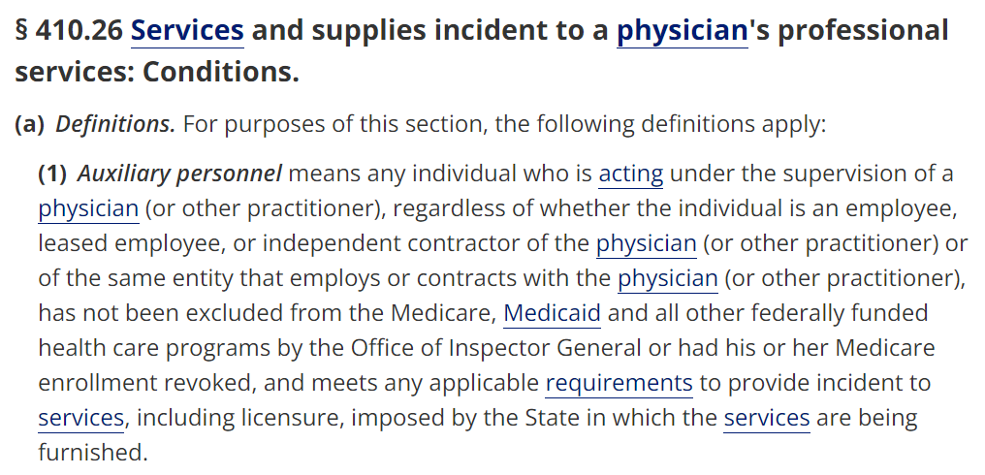
Some Challenges
42 CFR § 410.26 - Services and supplies incident to a physician's professional services: Conditions.

Slide 17
Some Challenges
42 CFR § 410.26 - Services and supplies incident to a physician's professional services: Conditions.

Slide 18
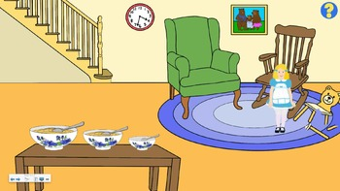
Some Challenges
Total cost of care/value-based contracts
CBOs?
Fee-for-service billing
This Photo by Unknown Author is licensed under CC BY-NC-ND
Notes:
-some ahead of pack – TCofC/value-based …
-plus CBOs – hospitals not interested; CBOs not organized and have infrastructure challenges …

Slide 19
Next Steps
Learning communities among
Health Systems
CBOs
Social care networks/community care hubs
NY’s Health Equity Reform 1115 waiver amendment includes up to $3.673 billion for building HRSN infrastructure, including social care networks
$500 million RFA re: social care networks
Coming soon: Administration for Community Living funding opportunity for infrastructure dollars to build CCHs
FQHCs
Special Needs Plans (SNPs)
PACE Plans
Notes:
-continuing our stakeholder outreach
-Interest/questions from health care providers, CHWs, CBOs, among others?​
How are stakeholders responding?​
Challenges to implementation?​
What can the CLGI/this Committee do to help maximize this opportunity for reimbursement of CHW services? ​
Convene interested parties in NJ?​
Learn from entities in other states?​
Hubs, contracting, technology​
-model contracts, DUAs –
-Partnership to Align Social Care Community of Practice
-NY: Up to $3.673 billion for building HRSN infrastructure, including the creation of new Social Care Networks (SCNs), and reimbursing for an array of HRSN services through the Medicaid program – Caid but still …
Special Needs Plans are Medicare Advantage plans that coordinate services between Medicare and Medicaid; SNPs are Medicare Advantage plans that provide benefits and services to people with specific chronic diseases, health care needs requiring institutional care, or dual eligibles (Medicare and Medicaid beneficiaries)
three types
D-SNPs: coordinated care for duals; come in a variety of forms depending on degree of integration services (dominant form in NJ)
C-SNPs: coordinated care for those with at least one major chronic illness
I-SNPs: coordinated care for those in institutions (e.g., nursing homes)
-DSNP enrollment is growing nationally
-New Jersey Medicaid contracts with D-SNPs that meet the requirements for Fully Integrated Dual Eligible SNPs (“FIDE-SNPs”), which provide
All Part A, B, and D Medicare service;
All Medicaid services, including LTSS services;
Coordination of delivery of covered services using aligned care management and specialty care network methods for high-risk beneficiaries;
Procedures for integration of communication materials, enrollment, communications, grievance and appeals, and quality improvement
-” SNPs have resources to address the heightened social needs of the dual eligible population:
“SNPs are somewhat more likely than other Medicare Advantage plans to offer nonmedical benefits. SNPs can afford to because the rebate payments they receive from CMS … are increased to account for members’ medical risks. More information is needed to assess whether these extra benefits are reaching those most in need…”
-Comm Fund, Taking Stock of Medicare Advantage: Special Needs Plans (2022)”
-SNPs must comply with MCO contracts …
Develop information on regulatory requirements ​
Survey best practices in other states​
Outreach to New Jersey providers
PACE: integrated care for elderly including on-site adult day care, home care, social services, care coordination, and other therapeutic and supportive services
-very well run; lots of resources; but more rare
-Program for All-inclusive Care for the Elderly plans provide integrated care for frail elderly to forestall or preclude the need for institutional care
-PACE is an innovative Medicare program that provides individuals aged 55 and older comprehensive medical and social services coordinated and provided by an interdisciplinary team of professionals in a community-based center and in their homes, helping program participants delay or avoid long-term nursing home care. The team meets regularly with each participant and his or her representative in order to assess the participant's needs. A participant's care plan usually integrates some home care services from the team with several visits each week to the PACE center, which serves as the hub for medical care, rehabilitation, social activities and dining.
See NJ DHS Division of Aging Services, https://www.nj.gov/humanservices/doas/services/l-p/pace/.
-regs may require clinical credentials – amend to envision role for CHWs for HRSNs?
-Effect on Medicare Advantage? Medicaid? Commercial? Domino effect …​

Slide 20
Tara.Ragone@shu.edu
"Feedback" by giulia.forsythe is licensed under CC BY-NC-SA 2.0. "Finger face with a question" by Tsahi Levent-Levi is licensed under CC BY 2.0. "Thank You - Danke" by Cornelia Kopp is licensed under CC BY 2.0.

