Slide 1
Health Equity Denied: The Role of Administrative Remedies in Access to Medicaid Benefits
DENIED
Jami Sayeed, J.D., Indiana University Robert H. McKinney School of Law

Slide 2
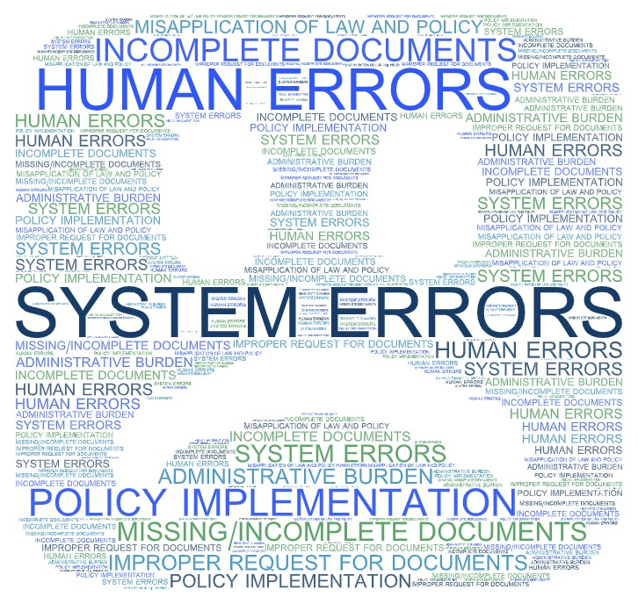
When Things Go Wrong

Slide 3
Medicaid
Medicaid At A Glance
Federal requirements offer states a lot of latitude in designing and administering their Medicaid programs with federal oversight by the Centers for Medicare and Medicaid.
The complex laws governing the Medicaid program and the variety of ways states design its programs oftentimes require multiple entities to administer benefits to Medicaid members.
MEDICAID

Slide 4
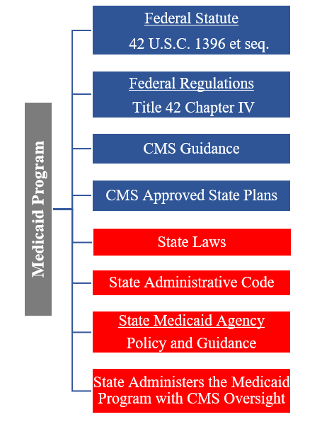
Administering the Medicaid Program— It’s Complicated!
Medicaid Program Federal to State Agency Flow
Medicaid
Medicaid Agency
Other State Agencies
Managed Care Entities
Claims Processing Vendors
CMS
Providers
Consultants
Eligibility Determination Contractors
Waiver Services Providers
MMIS Vendors

Slide 5
Medicaid and Health Equity
Individuals that are unable to secure employment due to structural and social barriers have a more difficult time accessing health coverage and consequently, face poor health outcomes.¹
Those who do not have access to health care have worse health than individuals who do.²
The populations that disproportionately face barriers to health equity make up a large share of the Medicaid population.³
Source: Interaction Institute for Social Change | Artist: Angus Maguire

Slide 6
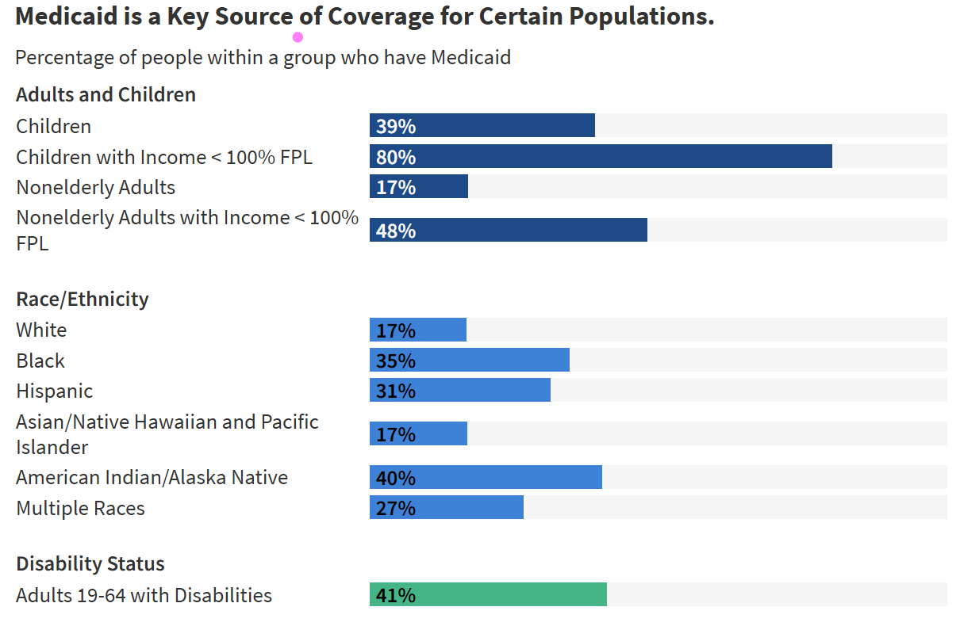
CMS Reported 78,444,837 people were enrolled in Medicaid and CHIP As of January 2025.¹
²
https://williamsinstitute.law.ucla.edu/publications/medicaid-lgbt/
A Person is Entitled to Medicaid Benefits
=
NOT ALWAYS!
A Person Receives Medicaid Benefits
1 Centers for Medicare & Medicaid Services, Report Highlights: Medicaid and CHIP Enrollment Data, Medicaid.gov, https://www.medicaid.gov/medicaid/program-information/medicaid-and-chip-enrollment-data/report-highlights.
2 Kaiser Family Foundation, 10 Things to Know About Medicaid, KFF (2025), https://www.kff.org/medicaid/issue-brief/10-things-to-know-about-medicaid/.

Slide 7
Errors and Issues Happen: Medicaid Member Impact
Pre-COVID
Population/Study | Estimated Administrative Disenrollment Rate
Children (early 2000s) | 12%-18% per year
Adults (early 2000s) | Up to 24%-36%
Dual-eligibles (2012-2016) | >50% regain coverage within a year
Medicaid Work Requirements
State/Policy | Coverage Lost/Enrolled | Time Period
Arkansas | 18,000+ lost (25%) | 2018-2019 (9 months)
Georgia (Pathways) | 6,500 enrolled | July 2023- January 2025
Federal Proposal | 4.6-5.2 million projected | 2026 (projected)
https://pmc.ncbi.nlm.nih.gov/articles/PMC4664196/
https://pmc.ncbi.nlm.nih.gov/articles/PMC4664196/
https://journalistsresource.org/home/dual-eligibles-medicaid-study/
https://www.kff.org/medicaid/issue-brief/5-key-facts-about-medicaid-work-requirements/
https://www.commonwealthfund.org/publications/explainer/2025/jan/work-requirements-for-medicaid-enrollees
Folse, M., Bridges, J. & DiGiorgio, A., How Will Medicaid Work Requirements Affect American Healthcare? A Look at What Past and Present Policy Tells Us, 61 Inquiry 469580241251935 (2024).
Post-COVID
14.3 million were terminated for "procedural reasons"—meaning failure to complete paperwork or administrative steps rather than a confirmed loss of eligibility
https://www.macpac.gov/wp-content/uploads/2024/11/State-Reported-Medicaid-Unwinding-Data-Brief.pdf

Slide 8
Agency Determinations and Access to Medicaid Benefits
Denial or discontinuance of eligibility for Medicaid coverage
Denial of prior authorization of health treatment and services
Denial of eligibility for Medicaid Waivers and Medicaid Waiver services
Payment of Medicaid claims for treatment and services
Level of care assessment for waiver services and long-term care

Slide 9
Administrative Remedies: Access to Justice
Administrative appeals of adverse agency determinations provide a forum for a final chance to challenge these determinations.
Administrative hearings are crucial for individuals to challenge state agency determinations related to the Medicaid program and serve to decrease disparities in health care access.
However, navigating the process of appealing these determinations and participating in the hearing process can present additional barriers to access to Medicaid benefits because of obstacles to procedural due process individuals may experience.

Slide 10
The Right to Request a State Fair Hearing
The state agency is required to provide timely, adequate notice of its adverse determination that includes the Medicaid beneficiary’s right to appeal the action and the process to appeal.
The Centers for Medicare and Medicaid Services encourages state Medicaid agencies to enact policies that minimize burden on individuals seeking to appeal a denial or determination of Medicaid benefits.⁵
The agency should provide assistance with appealing determination when needed.

Slide 11
Due Process Requirements
"The hearing system must meet the due process standards set forth in Goldberg v. Kelly, 397 U.S. 254 (1970), and any additional standards specified in this subpart." 42 CFR § 431.205(d).
Due process principles require that a Medicaid beneficiary have:
Timely and adequate notice detailing the reasons for a proposed termination.
An effective opportunity to defend by confronting any adverse witnesses and by presenting his own arguments and evidence orally.

Slide 12
Due Process: Notice and Opportunity
Notice means:
A pre-termination notice stating the basis for the action, when coverage is to be reduced or terminated, and informing the claimant of the right to continue benefits pending a final administrative decision.
AND
Meaningful opportunity:
An opportunity for a fair hearing allowing the claimant to orally confront and cross-examine the witnesses and the evidence relied on by the agency.
The right of the claimant to be represented by counsel or any person of their choice.
The right to an impartial decision maker that issues a reasoned decision, based solely on evidence presented at the hearing to provide resolution to the appealed issue.

Slide 13
The Right to Representation or to Self-Represent
No explicit right for the agency to provide an appellant attorney representation.
However, there may be a right to assistance during the hearing due to disability status.
Programs some states use to assist appellants with representation:
Qualified Representative programs
Pro bono projects
The hearing process timeframe is quick, so appropriate processes and procedures for these programs need to be established or there could be further delay to the individual receiving health care.

Slide 14
Barriers to Due Process
The right to meaningfully participate in the hearing process is key.
This cannot happen unless barriers to due process are addressed, which can be challenging due to the varying needs of appellants.
Common barriers:
English proficiency
Visual impairments
Literacy and comprehension barriers
Physical and mental conditions
Inexperience with the hearing process
Access to and experience with technology

Slide 15
Pro Se Appellants In Administrative Hearings
The majority of appellants in state fair hearings concerning Medicaid benefits are self-represented while trained advocates represent the state agency.
Administrative Law Judges can be a barrier to due process!
They play an important role in navigating the hearing process with self-represented parties to ensure due process is served and the parties can meaningfully participate.

Slide 16
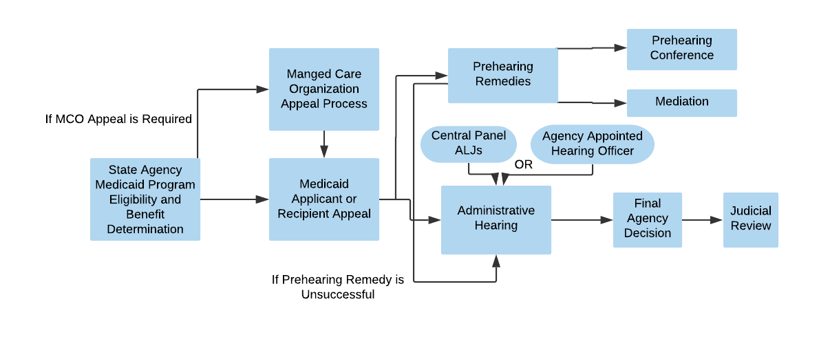
State Fair Hearing Process

Slide 17
Recommendations: Safeguard The Medicaid Hearing Process
States must make it easy to appeal and have assistance available to appeal
Add a federal requirement for states to perform prehearing conferences
Increased federal oversight and increased oversight by the State Medicaid Agencies
Use Medicaid mediation for more complex matters
More federal guidance on due process requirements

Slide 18
Conclusion
With significant legal and policy changes on the horizon, it is crucial to require best practices in administrative hearings and use new administrative remedies to ensure eligible individuals receive Medicaid benefits to promote health equity.

Slide 19
Questions?
jrsayeed@iu.edu

