Slide 1
Cutting Care: How Changes to the 340B Drug Pricing Program Impact Health Disparities for Patients Served by Federally Qualified Health Centers
ASLME Conference 6.6.2025
Notes:
Good afternoon-
My name is Alice Setrini, I'm a clinical teaching fellow at Loyola University Chicago School of Law in the Health Justice Project.
This project is looking at the impact that changes to a drug pricing program created in the 90's to reduce the cost of prescription medications covered by Medicaid will have on health disparities for patients served by Federally Qualified Health Centers or FQHCs.

Slide 2
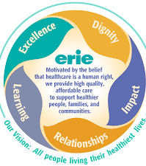
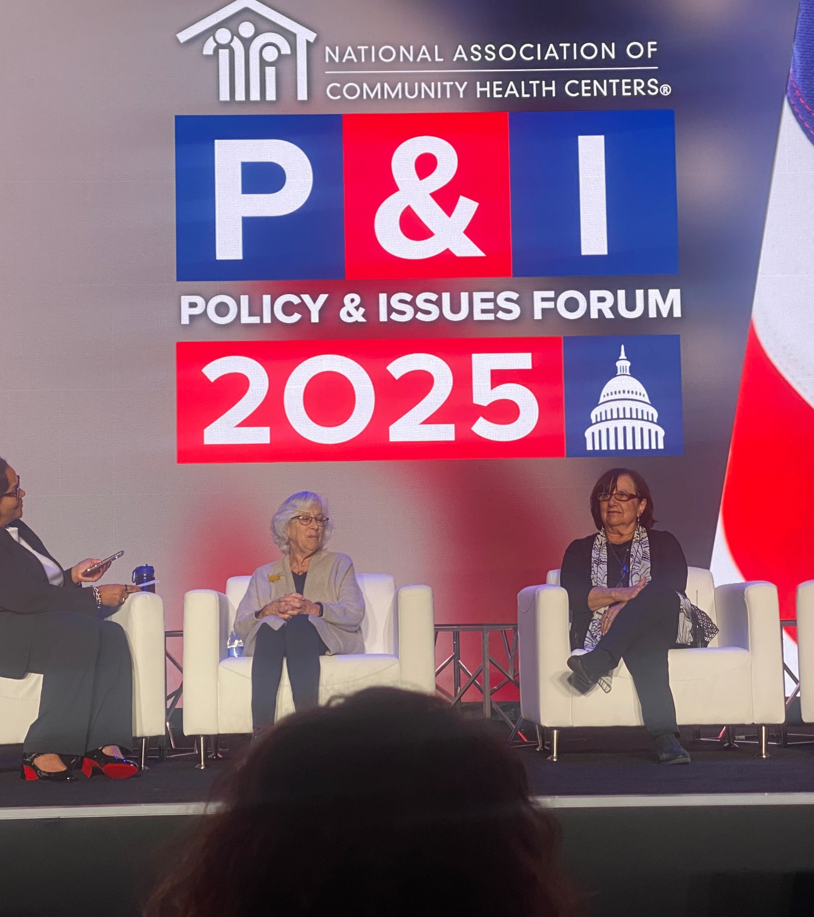
Project Background
Erie Family Health Board Member
Discussion on how an obscur drug pricing discount program is a major budget driver
National Association of Community Health Clinics Policy Forum
History of Community Health Center Movement
Notes:
A little about the background for this project. I am on the board of an FQHC in Chicago, called Erie Family Health, and over the past several years I have learned about what a big role the 340B program has in providing funding for patient services. I was also able to attend the NACHC policy forum in DC this year, and there I learned more about the challenges that are being brought by drug manufacterers to try to limit the scope of the program, and finally I am very interested in understanding challenges to providing health care to the poor using systems thinking principles, so looking at the history of the development of the community health center movement which is celebrating 60 yeas this year also lead me to this project.

Slide 3
Project Overview
History and Purpose of 340B program
Alignment with design and function of Federal Qualified Health Centers(FQHC) and look alike community health center mission
Nuts and Bolts of 340B
Challenges with the program currently
Impact on FQHC patient populations by restrictions on 340B program utilization
Current protective measures by FQHCs
Potential Legislative Solutions
Notes:
The paper starts out discussing the history and purpose of the 340B program and it's alignment with the development of the community health center movement. Then a description of how the program is designed to work, and how this program design has lead to challenges primarily from expansion of the program. Then I'll look at how efforts to restrict the program will impact the service provision of FQHCs, and who will be effected by these budget restrictions, and the current measures being taken by FQHCs to mitigate these challenges. Finally, I plan to discuss current legislative solutions that are being discussed.

Slide 4
History and Background of Medicaid
US welfare system originates from “poor laws” grounded in local responsibility over impoverished citizens
Genesis of Charity Care, Public Hospitals and concept of “deserving poor”
War on Poverty and the development of Medicaid
Cuts to Medicaid and expanding uninsured population
Notes:
One of the principles that systems thinking analysis forwards is that complex adaptive systems are influenced by their initial conditions. So looking into the history and development of the 340B program can help us understand how it has evolved, and what interventions can potentially be effective. I attended a recent presentation by Renee Landers, on current changes to Medicaid, and she introduced me to Lawrence Friedman's A History of American Law which inspired me to go further back from the start of the 340B program itself, and describe the foundation of US welfare system and Charity Care. US laws governing support for people living in poverty stems from the "Poor Laws" developed from the 16th century Elizabethan era laws. These influenced the colonial laws regulating who is responsible for caring for the poor and a key feature of those laws was that local governments were "responsible" for the support of their constituents that were living in poverty. This local control is something that we continue to contend with today.
Moving forward in time, with the aid of Johnathan Engel's Poor People's Medicine, we learn that our earliest hospitals were not really places that you would want to spend much time in, but as advancements in health care were being made, access to care for people in poverty was limited to those that the (primarily religiously affiliated hospitals) deemed as deserving of charitable care- those who have fallen on hard times despite their moral rectitude- orphans and widows; whereas young able-bodied adults, or those who suffered from "depraved acts of self-pollution" were excluded from this even most basic of care. After the Civil War, and the first WW, veterans unable to hold work that may have appeared able bodied were understood, due to their service to be included into the umbrella of deserving poor, and the Veteran's Administration Hospitals were created after the first WW to meet this need.
As we move forward in time, while much of the US post WW2 saw economic improvements, there continued to be entrenched pockets of poverty, due to social drivers of poverty- and access to health care being one of the levers kept people impoverished. As a more structural view of the drivers of poverty became accepted, different mechanisms were employed to alleviate poverty- the War of Poverty created investments in all social drivers of health- education, housing, and medical care. But this development of a public health insurance system soon met with retrenchment, and Reagan era cuts to the Medicaid program, along with an increasing uninsured population.

Slide 5
Development of Federal Qualified Health Centers and Look Alike Programs
War on Poverty and Office of Economic Development created the first “community oriented primary care” program the Tufts-Delta Health Center to address social drivers of health, and a root cause of poverty.
The expansion of these local health centers dedicated to primary care continued through the Community Health Center Program Section 330 of the U.S. Public Health Service Act and later the Rural Health Initiative
The mission and function of FQHCs is aligned with Medicaid and 340B
Communities served
Uninsured
Underinsured
Medically vulnerable
Notes:
Once the shift to a more structural understanding of poverty began, the War on Poverty and the Office of Economic Development created the first community oriented primary care program- one situated in an urban location- at Tufts, and the other in a rural site in the Mississippi Delta. These programs were designed to attack a root cause of poverty by addressing social drivers of health- including food insecurity, sanitation, infrastructure along with providing medical care.
These two pilot sites were the proof of concept to expand the model of primary care through the Community Health Center Program under sec. 330 of the US Public Health Service Act. The goals of these community health centers is aligned with both the purpose and function of Medicaid and 340B- to provide health care to people with low incomes. FQHCs have an additional mandate to provide care to patients regardless of ability to pay, therefore they serve patients that are uninsured, underinsured as well as medically vulnerable patients.

Slide 6
FQHC Funding Mechanism
Section 330 of Public Health Service Act permits the Health Resources and Services Administration (HRSA) to issue grants to support health centers
Annual appropriation
Community Health Center Fund (supplements annual appropriation)
Medicaid reimbursements through Prospective Payment System tied to a per visit rate for health service delivery
340B
Special grant funding
Private donor fundraising
Other Sources
Notes:
Moving out of the history of these programs and more into the mechanism of how they work, FQHCs get a large part of their funding through the HRSA administered grants under the Public Health Service Act, which provides annual appropriation along with a community health center fund that supplements this annual appropriation- as we heard from Matthew Lawrence yesterday, this yearly appropriation creates uncertainty in the stability of the funding stream to continue to provide services.
The second largest source of funding for FQHCs are medicaid reimbursements that are tied to a per visit rate
Then additional funding comes from a variety of other sources including other state/local grants, grants for special populations, private donations, and of course 340B revenue.

Slide 7
Development of 340B
In response to a Medicaid Drug Rebate Program 1990
Ended deep discounts by manufacturers to safety net providers
Resulted in reduction of services
Congress enacted 340B in 1992 Under the Veteran's Health Care Act to require manufacturers participating in Medicaid to sell medications at discounted rates
Notes:
Now we get to the development of 340B
In 1990, Congress passed the Medicaid Drug Rebate program, which was an effort to curb Medicaid spending. Under the program, a manufacturer who wants its drug covered under Medicaid must enter into a rebate agreement with the Secretary of Health and Human Services stating that it will rebate a specified portion of the Medicaid payment for the drug to the states, who in turn share the rebates with the federal government. Manufacturers must also enter into agreements with other federal programs that serve vulnerable populations. In exchange, Medicaid programs cover nearly all of the manufacturer’s FDA-approved drugs, and the drugs are eligible for federal matching funds.
However, prior to this program, safety net hospitals and fqhc's would receive deep discounts on medications from manufacturers, after those stopped.
This led these providers to have to limit services as their budgets were being consumed by increased price of medications.
To address this issue, Congress passed sec. 340B of the Veteran's Health Care Act, which again required manufacturers to provide discounted medication to safety net providers including FQHCs, who can then use revenue generated from the program to expand services to underserved communities.

Slide 8
340B Mechanics
Covered entities apply and register to participate
“Covered Outpatient Drugs” are purchased by the covered entity through a wholesaler or specialty distributor at discounted rate
Manufacturer cannot charge more than the ceiling price established by 340B
Price is calculated quarterly
Covered entity must have relationship with patient beyond dispensing medication
Services must be provided by healthcare professional employed or contracted by the covered entity
Notes:
Half way through, and we are finally getting to how a discount drug program can make money.
The program uses a statutory formula to determine pricing for discounted medications, with some of those discounted rates being over 100% for some medications. The program was designed to generate revenue by allowing the program participant known as a "covered entity" to purchase these medications at the discounted rate, but also allowing them to prescribe these discounted medications to patients with insurance whose reimbursement rate is higher than the 340B price ceiling. There is then a cost savings results from this transaction. This additional revenue can then be utilized to provide additional services for uninsured and underinsured and for services that are not covered by medicaid/grants etc.
Ryan Knox and Ameet Sarpatwari have a helpful flowchart of how the money flows throughout this process in their Oklahoma Law Review articles on the 340B program administration, litigation and reform.

Slide 9
Challenges with 340B
Transparency
Diversion
Duplicate Discounts
Notes:
So far sounds like a dream, what could go wrong?
It seems that program's efficacy is the problem! Since it's inception the program has grown from 1000 ce in 1992 to 50,000, and the program resulting in a reduction of over $41 billion between the drug manufacturers’ list prices and what pharmacies and health care institutions paid through the program. So there was bound to be push back and challenges to the program-
And there have been noted concerns related to transparency- how much revenue is being generated by each CE, where is it being spent? Diversion- are these drugs actually being sold to patients of the CE's? And Duplicate Discounts- are the manufacturers selling a drug at a discounted rate, and then also providing a rebate under a claim filed with Medicaid. HRSA is able to audit CE's to make sure they are complying with the rules against diversion and duplicate discounts, while there are currently no reporting requirements on how the revenue generated is spent. More on this in a moment.

Slide 10
Notes:
Here's where I share that while yes, there has been an increase in the size/cost to pharma of the program, and the overall increase in the program is about 20% per year, the FQHC purchases have been pretty steady over at least the past 3 years, and is a small fraction of the overall purchases, so the cost drivers are not coming from FQHCs.

Slide 11
Notes:
In this slide from NACHC demonstrates that the two primary audit findings for FQHCs are related to duplicate discounts, and inaccurate entries into the Office of Pharmacy Affairs Information System- basically data entry errors.
This has provided enough cover to justify litigation challenges by drug manufacturers, as well as imposing data sharing requirements as conditions of utilizing contract pharmacies to provide drugs to FQHC patients.

Slide 12
Impact on FQHC Functions
Financial Impact on service provision
Access to most commonly prescribed medications
Population served by FQHCs is already most affected by health disparities

Slide 13
Medicaid Uncertainty Adding to Funding Challenges
Notes:
And of course the biggest elephant in the room is how looming cuts to Medicaid will exacerbate the service restrictions challenges for FQHCs

Slide 14
FQHC Protective Tactics
Increasing use of Entity-owned pharmacies
Participation in Administrative Dispute Resolution process
Potential litigation strategies
Compliance with data sharing requirements
Notes:
What are FQHCs doing

Slide 15
Potential Legislative Interventions
State initiatives
Partial protective actions but acknowledgment of federal action needed
Federal initiatives
Relentless v. Dept. of Commerce and Loper Bright Enterprises v. Raimondo require unambiguous Congressional guidance to ensure 340B continues to operate as initially intended

Slide 16
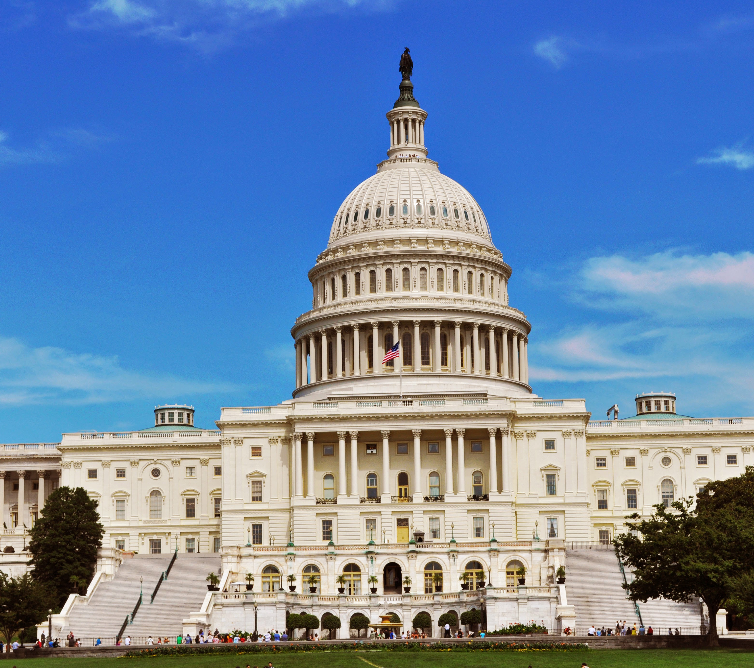
Conclusion
Federal legislative solutions are necessary
Protect funding at existing levels to maximize public health care benefits of the program
Balance administrative burden on FQHCs with need for transparency and compliance

