Slide 1
The Role of Attorneys in End-of-Life Equity and Access: From the Community to the Legislature
Presented by: Jaspreet Chowdhary, JD, MPH - Senior Legislative Counsel
June 2025

Slide 2
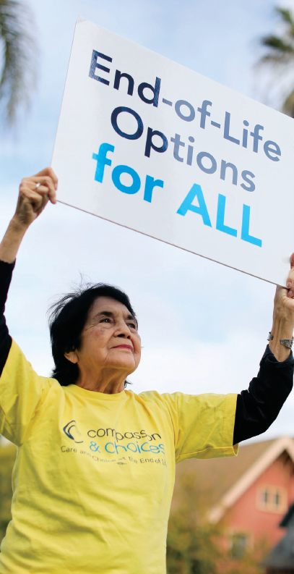

Slide 3
Objectives
Attendees will be able to …
Identify what end-of-life inequities look like
Identify at least two ways attorneys can address equity and access at the end of life
Notes:
Context check: When I first proposed this idea, the world looked different.
With the changing global landscape advocacy is more important than ever and is also scarier than ever.

Slide 5
Factors Leading to Disparities
Inaccessible socioeconomic resources
Geography
System and provider discrimination and bias
Lack of evidence based cultural competency
Provider-patient race and ethnicity discordance
Current political and global landscape
Any of these drivers or a combination of them may lead to inequities at the end of life
Notes:
These factors are compounded by recent changes to DEI efforts, threats to academic freedom, concern about system stability, and stress about sources of funding

Slide 6
The Role of Attorneys
Notes:
Important to acknowledge privilege and intersectionality.
There is privilege that comes with our education, but there are also challenges for how we advocate when our identities as attorneys intersect with race and gender.

Slide 7
The Role of Attorneys
Inform
Advocate
Defend/Enforce
Empower
Notes:
Inform community members about resources, rules and regulations.
Advocate for policies to expand access to the full range of end-of-life options.
Defend and enforce existing laws and regulations through litigation.
Empower all people to access and receive end-of-life healthcare consistent with their values and priorities.

Slide 8
How Attorneys Can Address End-of-Life Inequities
Contextualize the range of end-of-life care options for various audiences.
Communicate end-of-life planning and care components, regulations and clinical criteria.
Participate in an interdisciplinary team, serving as an educator and advocate.
Identify strategies and resources that assist in discussing end-of-life options with potential clients, community members and healthcare teams.
Notes:
Again, important to note that this has become extra challenging in the current healthcare landscape. Inequities grow as worries about insurance and access to specific healthcare services grows.

Slide 9
Highlight Advocacy
Notes:
At our core, attorneys are advocates– whether we are working with clients, in a classroom, or in our communities.

Slide 10
Why do we advocate?
Definition of advocacy: “Public support for or recommendation of a particular cause or policy.”
Advocating for improved care is an opportunity to:
share your expertise,
engage in legislative process,
make your voice heard and
be part of a community doing good work.
It’s also the chance to establish ongoing dialogue and relationship in your community; you can become a trusted voice in end-of-life issues.
Notes:
We advocate because change doesn’t happen on its own.
Advocating for improved care and the issues you care about is more than just taking a stand—it’s an opportunity to share your expertise, engage in the legislative process, and make your voice heard.
By getting involved, you become part of a dedicated community working to ensure compassionate, patient-centered care for all.
Advocacy also opens the door to building lasting relationships within your community, allowing you to become a trusted voice on issues that are important to you and your community.
Through ongoing dialogue and engagement, you can help shape policies, educate others, and drive meaningful change.
-next slide-

Slide 11
Advocacy for EOL Care
Long history of advocacy for equitable care, access to hospice, and authorization of end-of-life options.
All kinds of advocacy is needed to make change
Grassroots advocacy, lobbying, media, community education, professional education, information and resource sharing, storytelling, individuals giving of their time.
Challenges that come with advocating for this topic
Notes:
Compassion & Choices has been engaged in end-of-life healthcare advocacy for many decades.
Early laws specific to self-determination and what some call “right to die” laws introduced as early as the 1960s.
Collaborated to pass the first medical aid in dying legislation in Oregon in 1994.
While most recently known for leading medical aid in dying legislative efforts, our focus has always been to expand and improve all EOL care options.
End-of-life issues require advocacy of all kinds to make waves and foster needed change
Grassroots advocacy, lobbying, media, community education, professional education, information and resource sharing, storytelling, individuals giving of their time.
The history of advocacy for end-of-life care has involved every single one of these types of advocacy.
Recognition of the especially tender topic we choose to advocate on behalf of, which can lead to discomfort
Acknowledge it is challenging for professionals to advocate in this space.
People will almost certainly talk about EOL issues in ways that are offensive and incorrect. This means keeping ourselves focused on the issues and the people impacted and those who need improvements in end-of-life care.

Slide 12
Types of advocacy
Direct Advocacy (Legislative & Policy Advocacy)
Grassroots Advocacy (Community-Led Efforts)
Media & Public Awareness Advocacy
Personal Storytelling & Lived Experience Advocacy
Digital & Online Advocacy
Notes:
Advocacy takes many forms, and as attorneys or those in the legal space, your voice carries unique weight in shaping policies and ensuring patients have access to compassionate care. Whether through direct outreach, engaging with lawmakers, or simply sharing accurate information within your community, every action—big or small—contributes to meaningful change. Here is a list of the types of advocacy you might do as an individual or with an allied organization.
Again, with a changing landscape, the risk associated with each of these must be assessed constantly and vigorously.

Slide 13
Advocacy in Motion What does it look like?

Slide 14
Advocating when it’s hard
Each area of the work has its own “hard”
Advocating when facing opposition
Constantly assess risk
Following up & ongoing engagement
Notes:
Finding Your Role in Advocacy can be hard - For those exploring how to step into advocacy, it can feel vulnerable to speak up, even when you're deeply passionate and knowledgeable about the issue. That’s normal. Advocacy takes courage, and everyone starts somewhere.
The stakes seem higher than ever and so does the importance.
What can you do when you face opposition in your advocacy?
Meeting with someone who is unsure or even opposed to your message is one of the hardest parts of this work. Some helpful approaches include:
Avoid defensiveness or blame—lead with empathy.
Share credible, accessible resources to help ground the conversation.
Validate legitimate fears or concerns—even when you disagree.
Share your personal story or the stories of those who have inspired you.
Follow-up is key. Even if a conversation seems one-sided, your respectful engagement often leaves a lasting impression.
Reminder: The End-of-life issues that my organization works on are deeply personal and emotionally complex. Resistance may come from fear, grief, or lack of understanding. Acknowledge those emotions while gently offering facts and compassion can help to…
One meeting isn’t the finish line—it’s the beginning of a relationship.
Always follow up. Express gratitude, reiterate your key message, and offer yourself as a resource.
A thoughtful follow-up email or note can position you as a trusted guide for future conversations.
You are the bridge between the policy and the people it affects—keep that connection strong.
CLOSING STATEMENT-
Advocacy work is hard—truly hard. It asks us to be vulnerable, patient, persistent, and brave in the face of discomfort, resistance, and sometimes even silence. And advocacy around end-of-life issues (the work that we do) is emotionally layered, deeply personal, and sometimes misunderstood. But it matters. Every conversation, every story shared, every bit of truth and compassion we offer moves the needle. You don’t have to be perfect—just present, informed, and committed. Together, we’re not just changing policies—we’re changing the way people live and… possibly die. And that is powerful, meaningful work. And we would encourage you to get involved with the issues that are important to you.

Slide 15
Jaspreet
info@compassionandchoices.org

