Slide 1
Mapping Medical Aid in Dying
Kathryn Kucyk
Legislative Counsel, Compassion & Choices
Health Law Professors Conference, June 2025

Slide 2
About Compassion & Choices
Mission
Vision
A society that affirms life, accepts the inevitability of death, and supports everyone in choosing end-of-life care that reflects their values, priorities and beliefs
To improve care, expand
choice and empower patients
at the end of life

Slide 3
What is policy surveillance?
The systematic, scientific collection and analysis of laws with public health significance.
Legal epidemiology is the study of law as a factor in the case, distribution, and prevention of disease and injury.
Final Product: Interactive map

Slide 4
Defining Medical Aid in Dying

Slide 5
Medical aid in dying is the preferred term for the end-of-life care option by which a mentally capable, terminally ill adult with six months or less to live requests a prescription from their healthcare provider for medication that they can choose to self-administer.

Slide 6
Authorized Jurisdictions
Oregon
Washington
Montana
Vermont
California
Colorado
Washington, D.C.
Hawai’i
New Jersey
Maine
New Mexico
Delaware
MAID is currently authorized in 11 states and D.C.
Authorization through ballot measure, legislation, or court decision.

Slide 7
Eligibility Requirements
1. An adult, 18 years or older
2. Terminal illness with prognosis of six months or less to live
3. Mentally capable of making their own healthcare decisions
4. Acting voluntarily
5. Is able to self-administer the medication

Slide 8
Medical Aid-in-Dying Policy Map

Slide 9
How do medical aid-in-dying and related laws and their components impact patient access to end-of-life healthcare options?

Slide 10
Data Captured by the Map
Authorization and mechanism
Eligibility Requirements
Types of qualified healthcare providers
Oral request process and waiting periods
Written request and witness requirements
Immunity for good faith compliance
Criminal liability
Requirements for unwilling providers
Legal epidemiology is the practice of taking features of the law – some of which vary across time and place – and turning them into a dataset.

Slide 11
Multi-Step Request Process
2 healthcare providers (attending and consulting)
Terminal diagnosis and 6-month prognosis
Verify decision-making capacity
2 verbal requests with waiting period between
Written request
Notes:
MAID laws vary across authorized jurisdictions, but all include a multi-step request process. In general, 2 healthcare providers (attending and consulting) evaluate the patient and determine or confirm the patient’s terminal diagnosis and 6-month prognosis. These providers also determine that the qualified patient has decision-making capacity; if they have concerns, the patient must see a mental health specialist for an additional capacity assessment. The patient makes multiple requests for MAID, generally 2 oral requests with a waiting period in between, and one written request, which is witnessed by 2 individuals. In some places, additional waiting periods also apply.

Slide 12
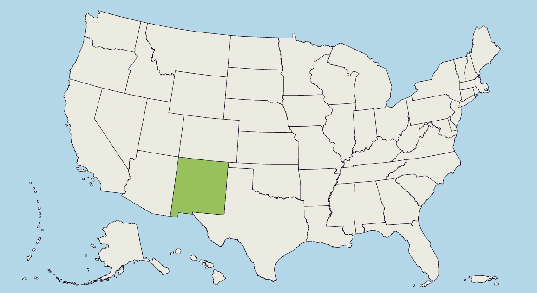
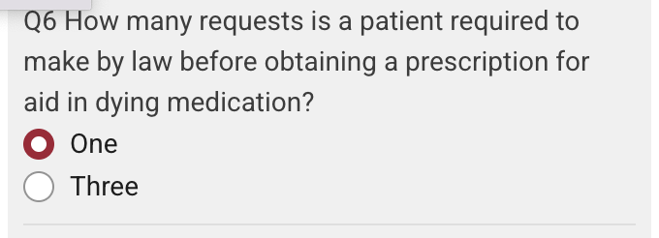
Statutory Snapshot: Waiting Periods
Notes:
1 state - New Mexico

Slide 13
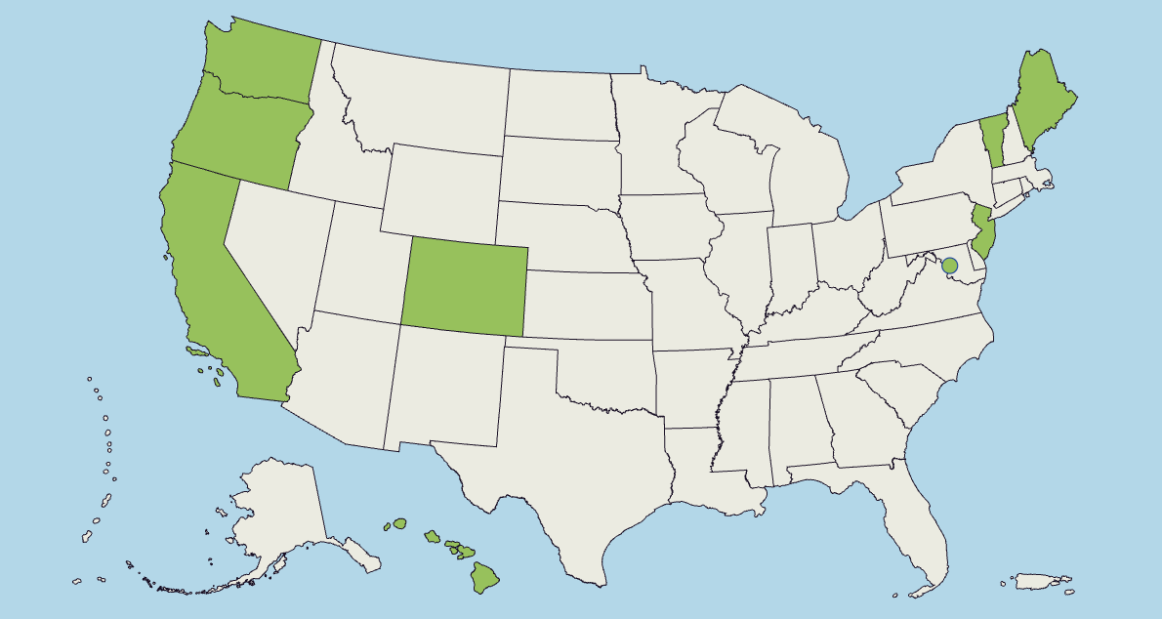
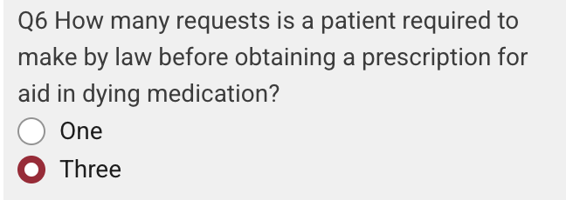
Statutory Snapshot: Waiting Periods
Notes:
9 jurisdictions

Slide 14
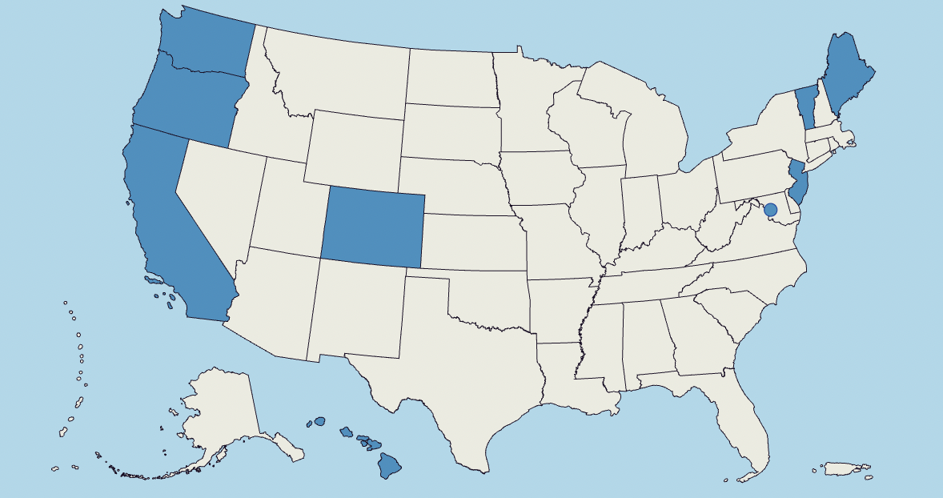
Statutory Snapshot: Waiting Periods
Where the law requires that patients give multiple oral requests, are waiting periods required?

Slide 15
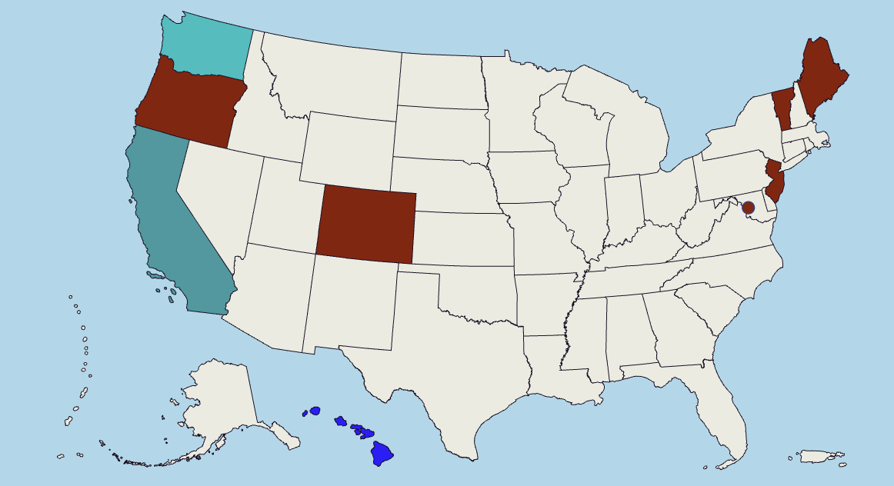
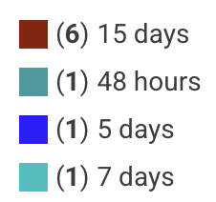
Statutory Snapshot: Waiting Periods
How long is the waiting period between the first and second oral requests?

Slide 16
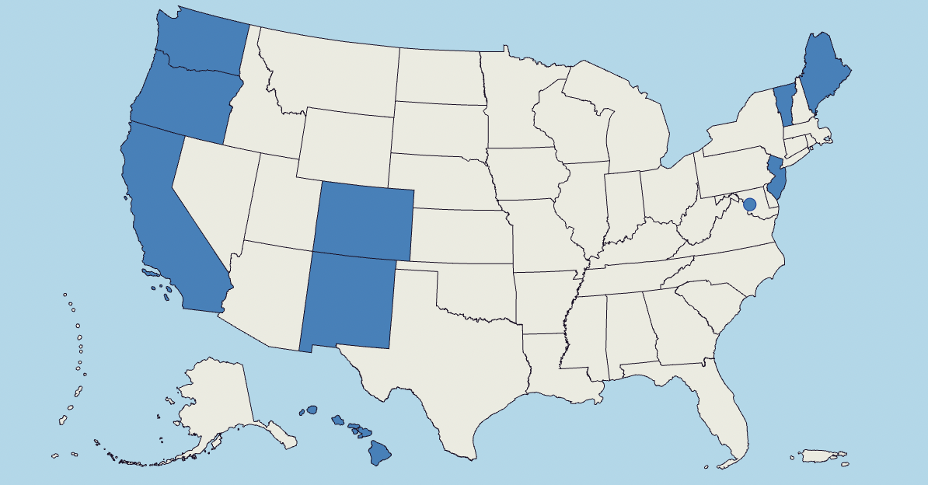
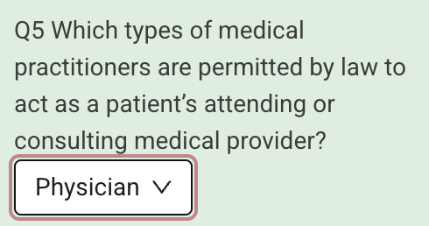
Statutory Snapshot:
Qualified Healthcare Providers

Slide 17
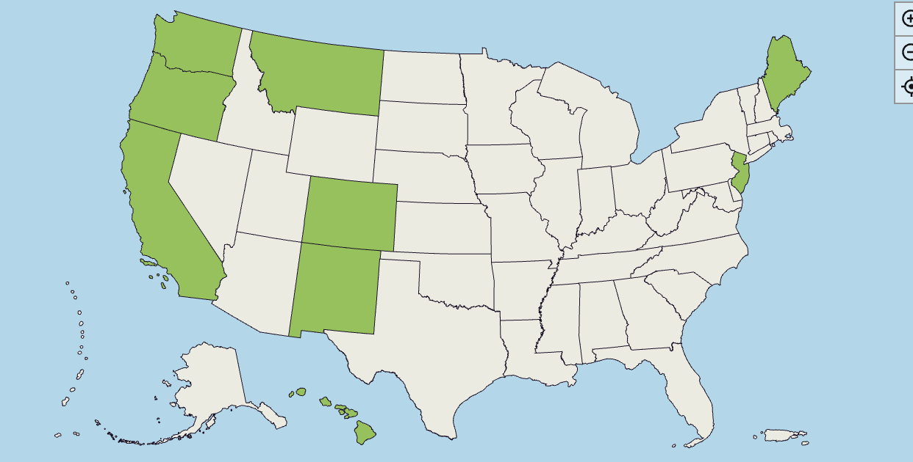
Assisted Suicide Prohibitions
Is assisted suicide prohibited in the jurisdiction?
Is medical aid in dying authorized in the jurisdiction?
Notes:
Our MAID Map also tracks assisted suicide prohibitions, most of which are criminal prohibitions.
9 jurisdictions meet both criteria

Slide 18
Legal Mapping as an Advocacy Tool

Slide 19
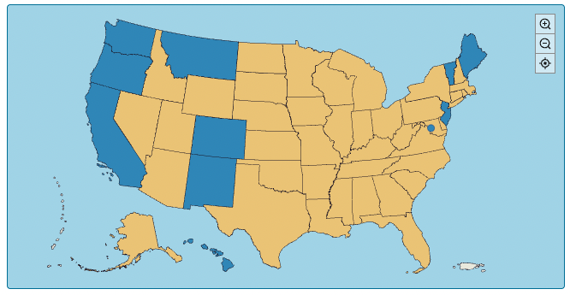
Visualizing Regional Gaps in Access

Slide 20
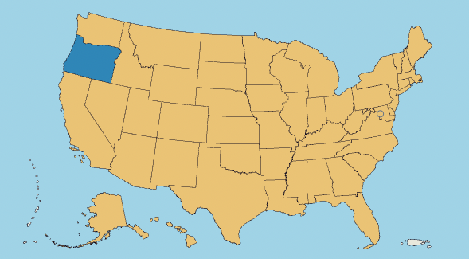
Showing Movement Momentum Over Time
1997

Slide 21
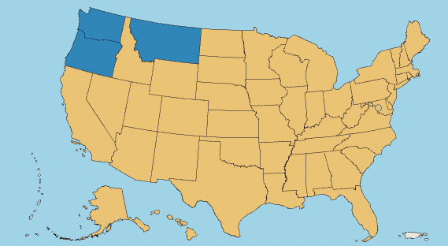
Showing Movement Momentum Over Time
2010

Slide 22
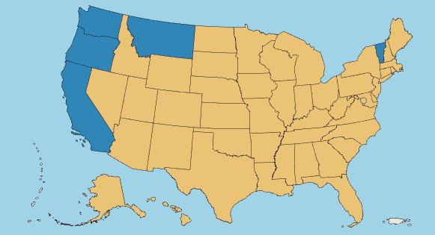
Showing Movement Momentum Over Time
2016

Slide 23
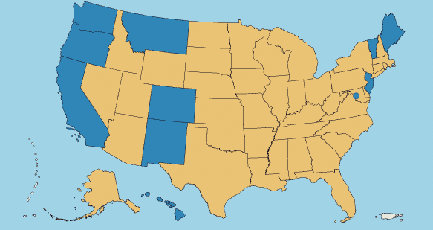
Showing Movement Momentum Over Time
2023

Slide 24
Thank you!
Contact us:
MAIDmap@compassionandchoices.org

