Slide 1
A Comprehensive Labeling Framework for AI/ML-Based Medical Devices: Lessons Learned from Food Labeling
Health Law Professors Conference
June 6, 2025
SARA GERKE Associate Professor of Law
Richard W. & Marie L. Corman Scholar
Associate Professor, European Union Center
University of Illinois Urbana-Champaign College of Law
504 E Pennsylvania Ave
Champaign, IL 61820
gerke@illinois.edu

Slide 2
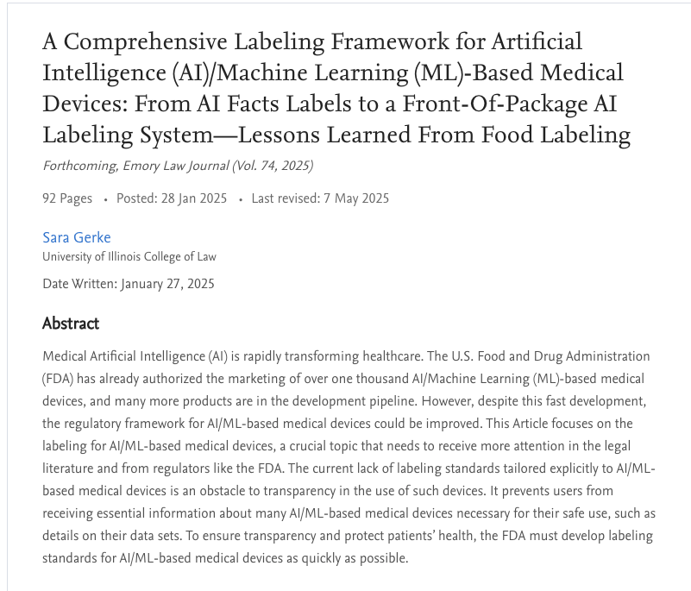
https://papers.ssrn.com/sol3/papers.cfm?abstract_id=5113487

Slide 3
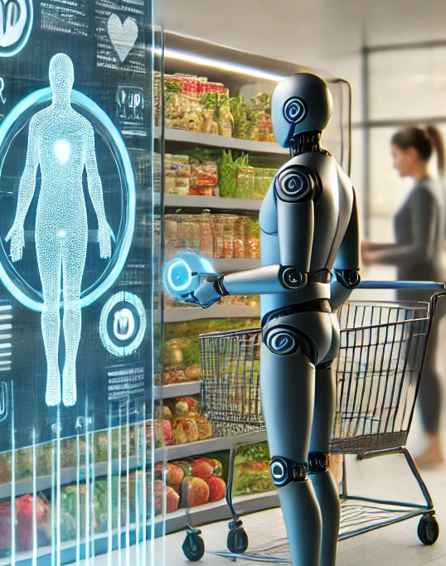
1.
Central Argument
This image was created with the assistance of DALL E.

Slide 4
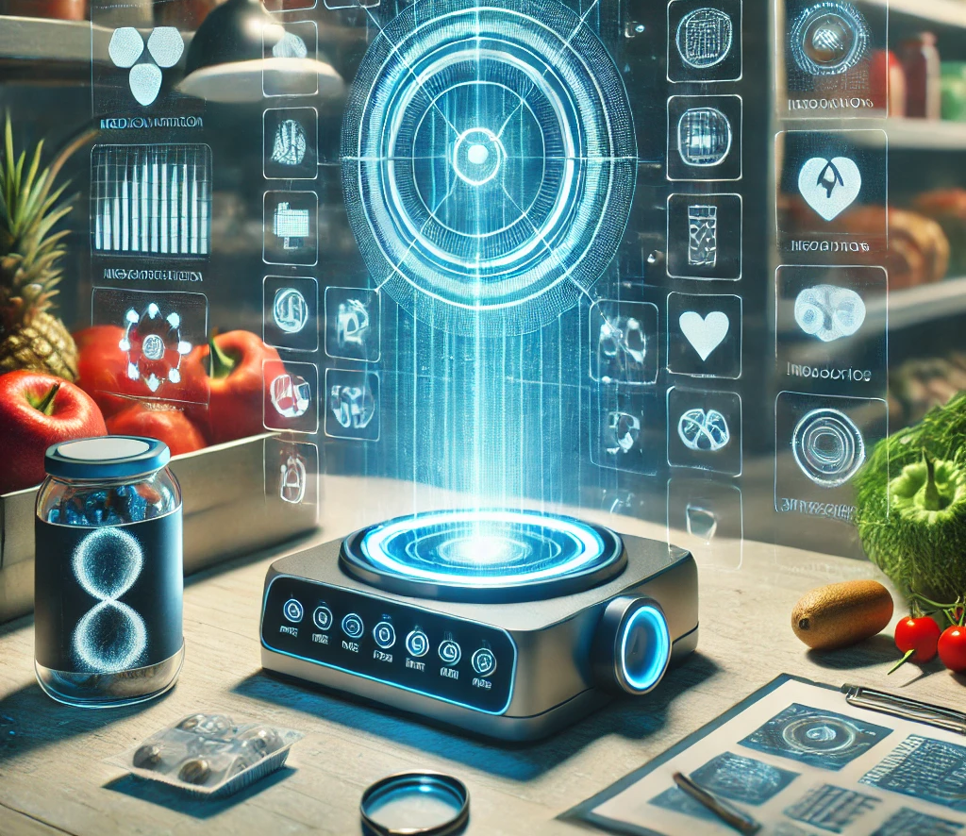
Central Argument
Regulators like the FDA can learn valuable lessons from food labeling for the development of urgently needed labeling standards for AI/ML-based medical devices.
4
This image was created with the assistance of DALL E.

Slide 5
2. Relevance
Image credit: The Little Hut - stock.adobe.com (generated with AI)

Slide 6
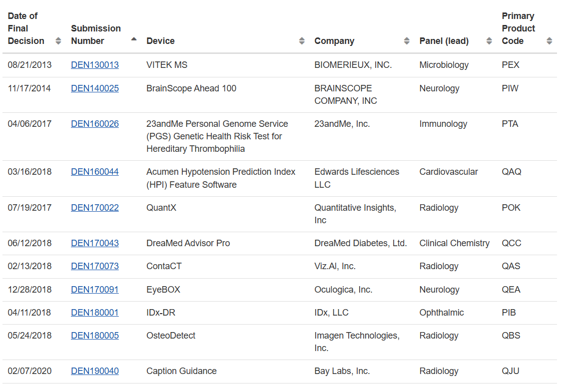
FDA Marketing Authorization
Total: 1,016 AI/ML-Based Medical Devices
510(k): 980
De Novo: 32
PMA: 4
https://www.fda.gov/medical-devices/software-medical-device-samd/artificial-intelligence-and-machine-learning-aiml-enabled-medical-devices

Slide 7
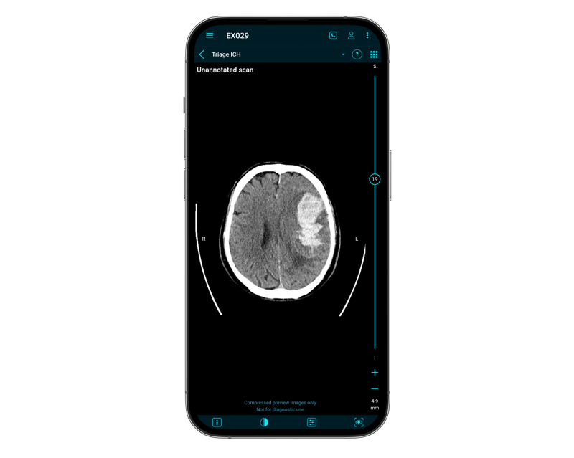
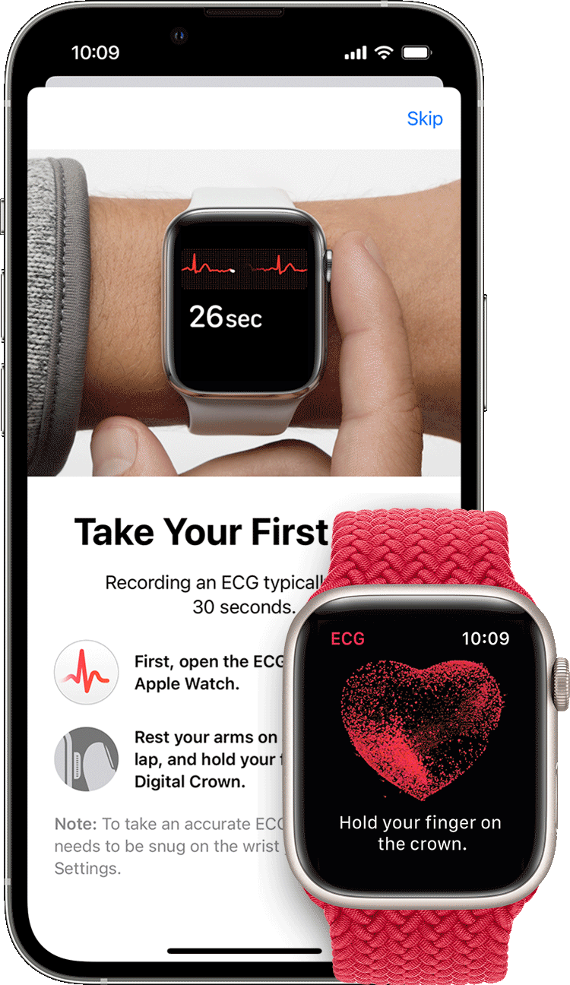
Current Applications
Apple’s ECG App
Brainomix
360 Triage ICH
Image Credit: https://www.brainomix.com/stroke/triage-ich/
Image Credit: https://support.apple.com/en-us/HT208955

Slide 8
Labeling
“all labels and other written, printed, or graphic matter
(1) upon any article or
any of its containers or
wrappers, or
(2) accompanying such
article.”
FDCA Section 201(m)
Image credit: Man888 - stock.adobe.com (generated with AI)

Slide 9
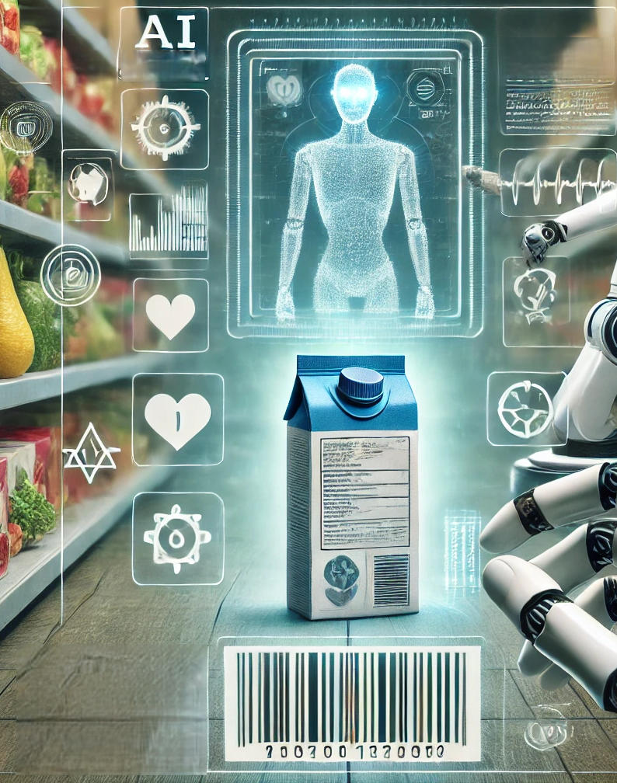
3. Lessons Learned & Suggestions
This image was created with the assistance of DALL E.

Slide 10
Food Labeling Offers Valuable Lessons For the Labeling of
AI/ML-Based Medical Devices
Key Components of Modern Food Labeling
Key Components of AI/ML-Based Medical Device Labeling
Nutrition facts labels
Front-of-package (FOP) nutrition labeling system
Use of modern technology like apps
Additional labeling (e.g., designation of ingredients)
AI Facts labels ;;;;;;;
FOP AI labeling system ;;;;;;;;;;;;;;;
Use of modern technology like apps
Additional labeling (e.g., instructions for use)

Slide 11
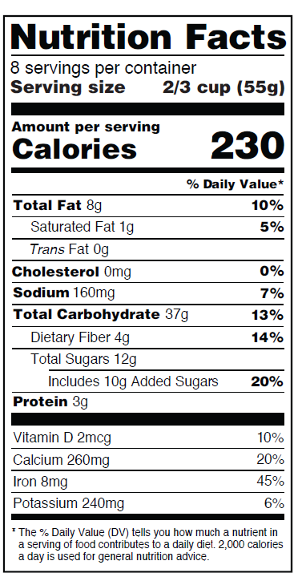
AI Facts Labels (“Nutrition Facts Labels”)
Food Labeling
Nutrition Facts labels
AI/ML-Based Medical Device Labeling
AI Facts labels
(1) The Primary Addressee of the AI Facts Label
(4) A Uniform Design
(5) Location
(6) A Mandatory Label
(7) A Dynamic Label
(8) A Collaborative Stakeholder Approach and Conducting Empirical Studies
(9) Widespread Education and Communication Campaigns
(3) Challenges Raised by GenAI
(2) The Content of the AI Facts Label
Image credit: https://www.fda.gov/media/13519a7/download

Slide 12
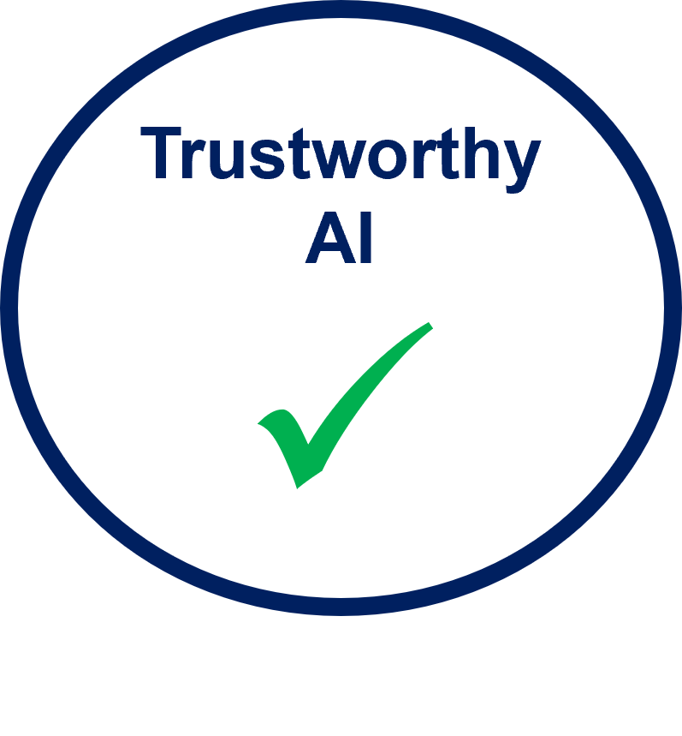
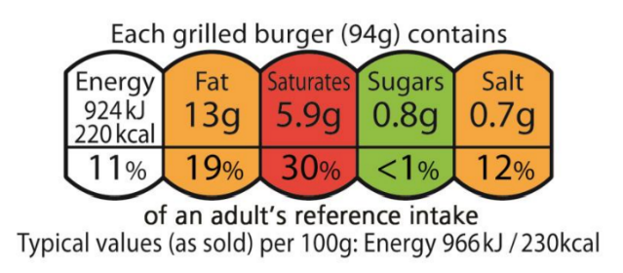
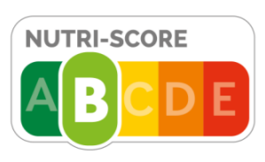
FOP AI Labeling System
(“FOP Nutrition Labeling System”)
Food Labeling
FOP Nutrition Labeling Systems
AI/ML-Based Medical Device Labeling
FOP AI Labeling System
(1) One Standardized FOP AI Labeling System
(2) The Primary Purpose of the FOP AI Labeling System
(3) A "Summary Indicator" System or a “Nutrient-Specific” (“AI Facts Label-Specific Information”) System
(4) A “Trustworthy AI” Symbol
(5) The Criteria
(6) One Location
(9) Collaborative Efforts with All Stakeholders and Empirical Studies
(10) Extensive Education and Communication Initiatives
(7) A Voluntary or Mandatory System
(8) A Dynamic Program
Summary Indicator
Nutrient-Specific

Slide 13
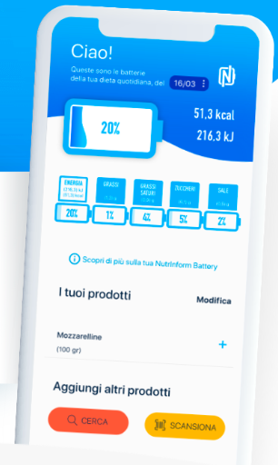
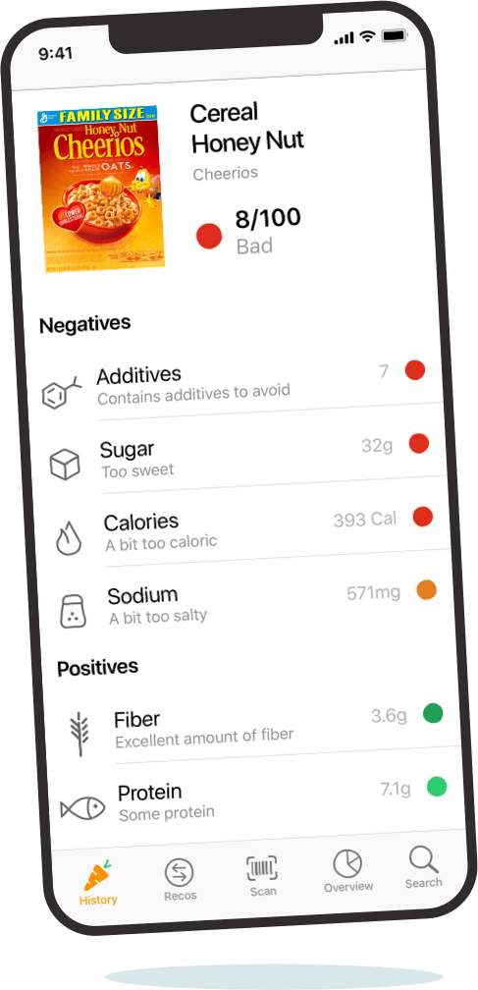
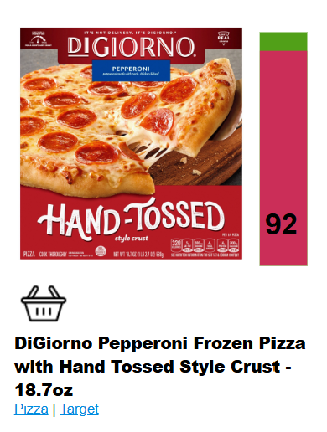
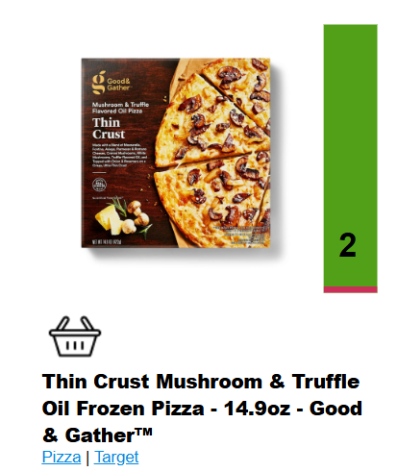
The Use of New Technology to Enhance User Literacy
Food Labeling
Use of modern technology like apps
AI/ML-Based Medical Device Labeling
Use of modern technology like apps
Technology, such as apps or online tools, can additionally be utilized to enhance user literacy
User-friendly
Transparent about the methods used
Made available by a federal agency like the FDA or independent third party

Slide 14
Additional Labeling
Food Labeling
Additional Labeling
AI/ML-Based Medical Device Labeling
Additional Labeling
Examples:
Name of the product, its ingredients, manufacturer/distributor/packer information, and the net quantity of contents
Specific health or nutrient content claims
Leaflets and manuals, website links, or QR codes on the food package
(1) Instructions for Use
(2) Fact Sheet for Patients
(3) Labeling for AI/ML-Generated Content

Slide 15
gerke@illinois.edu
This image was created with the assistance of DALL E.

