Slide 1
Choosing Ignorance in the Courts and at the FDA
George Horvath, UC Law San Francisco
48th Health Law Professors ConferenceBoston University School of Law
June 6, 2025
Panel 8A: Devices

Slide 2
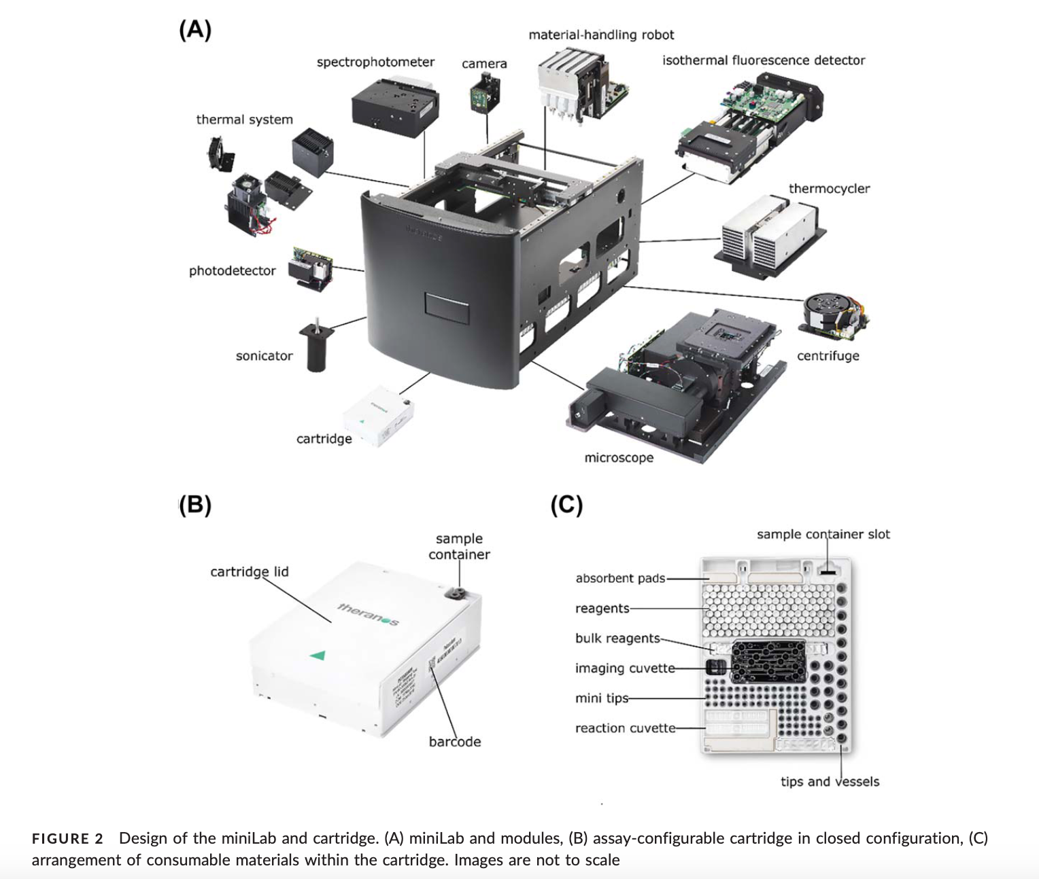

Slide 3
Risk Uncertainty
Devices may pose hazards that have not yet been unidentified, even after clinical studies and, in some cases, even after long use in clinical practice.
The seemingly concrete values for device risks that are derived from clinical studies are really just point estimates that sit within a range of possibilities (the “confidence interval”).

Slide 4
New Class II
Modified Class II
New Class III
Modified Class III
PMA Supplement
De Novo
510(k)
Original PMA

Slide 5
New Class II
Modified Class II
New Class III
Modified Class III
PMA Supplement
De Novo
510(k)
Original PMA
Robust Information-Forcing
Weak Information-Forcing
Robust Information-Forcing
Weak Information-Forcing

Slide 6
New Class II
Modified Class II
New Class III
Modified Class III
PMA Supplement
De Novo
510(k)
Original PMA
Robust Information-Forcing
Weak Information-Forcing
Robust Information-Forcing
Weak Information-Forcing

Slide 7
Special Liability of Seller of Product for Physical Harm to User or Consumer
(1) One who sells any product in a defective condition unreasonably dangerous to the user or consumer or to his property is subject to liability for physical harm thereby caused to the ultimate user or consumer, or to his property, if
(a) the seller is engaged in the business of selling such a product, and
(b) it is expected to and does reach the user or consumer without substantial change in the condition in which it is sold.
(2) The rule stated in Subsection (1) applies although
(a) the seller has exercised all possible care in the preparation and sale of his product, and
(b) the user or consumer has not bought the product from or entered into any contractual relation with the seller.
Restatement (Second) of Torts § 402A (1965)

Slide 8
New Class II
Modified Class II
New Class III
Modified Class III
PMA Supplement
De Novo
510(k)
Original PMA
Robust Information-Forcing
Weak Information-Forcing
Robust Information-Forcing
Weak Information-Forcing

Slide 9
New Class II
Modified Class II
New Class III
Modified Class III
PMA Supplement
De Novo
510(k)
Original PMA
Robust Information-Forcing
Weak Information-Forcing
Robust Information-Forcing
Weak Information-Forcing

Slide 10
“There are some products which, in the present state of human knowledge, are quite incapable of being made safe for their intended and ordinary use. These are especially common in the field of drugs. An outstanding example is the vaccine for the Pasteur treatment of rabies, which not uncommonly leads to very serious and damaging consequences when it is injected. Since the disease itself invariably leads to a dreadful death, both the marketing and the use of the vaccine are fully justified, notwithstanding the unavoidable high degree of risk which they involve. Such a product, properly prepared, and accompanied by proper directions and warning, is not defective . . . . The same is true of many other drugs, vaccines, and the like, many of which for this very reason cannot legally be sold except to physicians, or under the prescription of a physician. It is also true in particular of many new or experimental drugs . . . . The seller of such products . . . is not to be held to strict liability . . . . merely because he has undertaken to supply the public with an apparently useful and desirable product, attended with a known but apparently reasonable risk.”
Restatement (Second) of Torts § 402A cmt. k (1965)

Slide 11
“There are some products which, in the present state of human knowledge, are quite incapable of being made safe for their intended and ordinary use. These are especially common in the field of drugs. An outstanding example is the vaccine for the Pasteur treatment of rabies, which not uncommonly leads to very serious and damaging consequences when it is injected. Since the disease itself invariably leads to a dreadful death, both the marketing and the use of the vaccine are fully justified, notwithstanding the unavoidable high degree of risk which they involve. Such a product, properly prepared, and accompanied by proper directions and warning, is not defective . . . . The same is true of many other drugs, vaccines, and the like, many of which for this very reason cannot legally be sold except to physicians, or under the prescription of a physician. It is also true in particular of many new or experimental drugs . . . . The seller of such products . . . is not to be held to strict liability . . . . merely because he has undertaken to supply the public with an apparently useful and desirable product, attended with a known but apparently reasonable risk.”
Restatement (Second) of Torts § 402A cmt. k (1965)

Slide 12
“There are some products which, in the present state of human knowledge, are quite incapable of being made safe for their intended and ordinary use. These are especially common in the field of drugs. An outstanding example is the vaccine for the Pasteur treatment of rabies, which not uncommonly leads to very serious and damaging consequences when it is injected. Since the disease itself invariably leads to a dreadful death, both the marketing and the use of the vaccine are fully justified, notwithstanding the unavoidable high degree of risk which they involve. Such a product, properly prepared, and accompanied by proper directions and warning, is not defective . . . . The same is true of many other drugs, vaccines, and the like, many of which for this very reason cannot legally be sold except to physicians, or under the prescription of a physician. It is also true in particular of many new or experimental drugs . . . . The seller of such products . . . is not to be held to strict liability . . . . merely because he has undertaken to supply the public with an apparently useful and desirable product, attended with a known but apparently reasonable risk.”
Restatement (Second) of Torts § 402A cmt. k (1965)

Slide 13
