Slide 1
CPR for the Patient Self-Determination Act
Julie L. Campbell, JD, LLM, CHC
Assistant Professor of Law
University of Louisville School of Law

Slide 2
Overview
The problem: People falsely believe that CPR is effective at the end of life
Medical communities attempts to mitigate the use of CPR at the end of life
The solution: a legislative “nudge”

Slide 3
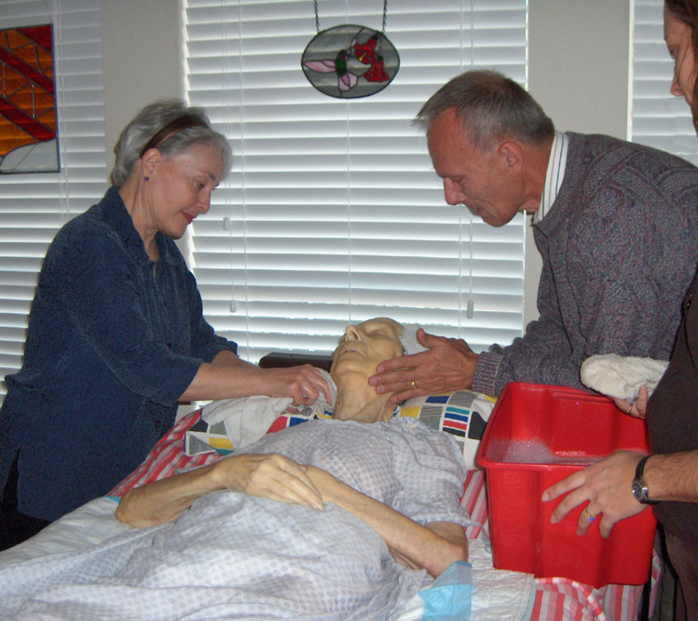
How People Experience Death at the End of Life
Traumatic Death
(CPR – Default)
No Consent Required
Peaceful Death
(No-CPR Order)
Patient Consent Required
*Inst. of Med., National Academy of Sciences, Dying in America: Improving Quality and Honoring Individual Preferences Near the End of Life, xi-xii,16, 23, 24 (2015).
Notes:
Most People Envision Their Own Death as a Peaceful and an Ideally Rapid Transition*

Slide 4
89% of people believe CPR to be highly effective and therefore 20% insist that CPR be performed even when told it has a 0% chance of working.*
The Problem - Information Asymmetry
Patients
Medical Providers
Clinicians know that aggressive treatments at the end of life are ineffective and choose much less aggressive treatments than they offer their patients**
*Julie Campbell and Gina Piscitello, 167(1) CHEST 211-221 (2025).
**Inst. of Med., National Academy of Sciences, Dying in America: Improving Quality and Honoring Individual Preferences Near the End of Life, xi-xii,16, 23, 24 (2015).

Slide 5
Information Asymmetry Causes Conflict
Patients - Positive right to CPR
“[P]eople may interpret the default option as a recommendation or guideline”*
Sudden change in recommendation leads to distrust in the medical recommendation
Physicians - Negative right to avoid inappropriate interventions
Harm outweighs the benefit
Being forced to perform ineffective and harmful interventions causes moral distress in medical providers
*Scott Halpern, et al., Harnessing the Power of Default Options to Improve Health Care, 357(13) N Engl J Med. 1341 (2007).

Slide 6
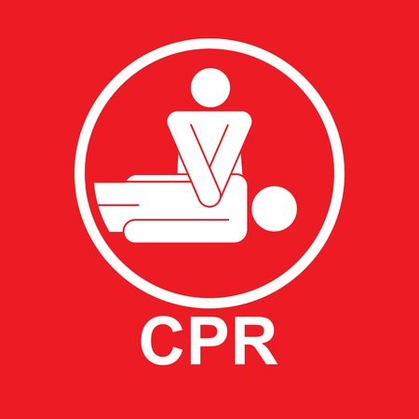
Cardiopulmonary Resuscitation FACTS
Efficacy of CPR
Adverse Events
Procedure
20-40 Minutes of:
Rapid, forceful chest compressions
Intubation (a tube passed down your throat)
Electric shocks (called defibrillation)
Needle sticks for IV medication
Survival to Discharge
In-hospital arrest (10-20%)
Out-of-hospital arrest (9%)
Add an underlying health condition
Cancer (7%)
COVID-19 (3%)
Liver Failure (7%)
Sepsis/Infection (8%)
Broken chest bones (81%)
Neurologic deficit (33%)
Aspiration pneumonia
Internal bleeding
Damaged airways
Collapsed lungs
Cuts of the liver and spleen
CPR induced consciousness (CPRIC)
Prolonged stay in ICU and discharge to LTSS

Slide 7
Why Do People Think CPR is Highly Effective At the End of Life?
Television and media depiction of CPR
70% - 75% effective
“The Pitt” accurately depicts CPR (no one survived)
CPR training classes only teach the benefits of CPR
All healthcare workers are required to have CPR training
48 states mandate or recommend CPR training in high schools
CPR as a default intervention
Implies it is highly effective
Bypasses the informed consent process

Slide 8
Informed Consent is the Bedrock Principle of Patient Autonomy and Self-Determination
Mandates disclosure of the risks, benefits, alternatives, and potential consequences of the proposed intervention.
Allows the patient to make an informed decision about whether to proceed with the intervention.
Only two interventions do NOT require informed consent:
CPR
Intubation

Slide 9
The History of CPR and the Medical Community’s Actions to Mitigate its Use at the End of Life
1960
Kouwenhoven et al. reported in JAMA a novel technique using closed chest cardiac massage.
The intending use was for acute medical emergencies (drowning, electric shock, anesthetic accident, etc.)
1962
Endorsed by the American Red Cross and the American Heart Association.
CPR becomes the default intervention for any individual suffering cardiac arrest while hospitalized.
Mid 1970s
Hospitals began using unilateral DNR orders because they were concerned that CPR could harm some patients more than help.
Still in use but in rare situations
1982
The President’s Commission for the Study of Ethical Problems in Medicine and Biomedical and Behavioral Research issued a report coining the term “shared decision-making.”
Mid 1980s
Slow codes and show codes used on patients who refused a DNR.
Still in use – 2/3 of physicians admit to being present during a slow code
1995
SUPPORT Study finds increased discussions with patients at the end of life does not impact patient acceptance of DNR orders.
Late 1990s
The Reverend Chuck Meyer started a campaign to change the DNR policy to the gentler allow-natural-death (AND) policy.
Still in use but mixed efficacy
2025
Study changing DNR to Beneficial Care Only (BCO) found no impact on patient acceptance of no-CPR orders.
Notes:
History of CPR: developed in the early 1960s and originally intended for patients suffering anesthesia-induced cardiac arrest. This made sense because the induction of general anesthesia often produces respiratory or circulatory instability. If the patient's cardiac and respiratory functions decreased too much, CPR, which included assisted ventilation, tracheal intubation, or cardiovascular medications were needed to reverse the effects of the anesthesia. (1547) Unfortunately, it became routine for any patient who suffered a cardiopulmonary arrest to receive CPR, leading to new problems. (1543) More often than not, CPR only transiently restored physiologic functioning, often leading to a prolonged death and suffering. (1543) By the late 1960s, medical literature began reporting the agonizing deaths many terminally ill patients were experiencing after repeated attempts at CPR. (1543) As a result, when staff could foresee that CPR would not be effective, they began performing less than full resuscitation attempts, often known as “chemical codes,” “show codes,” “Hollywood codes,” or “slow codes.” This became so prevalent that institutions developed deceptive ways to communicate with staff that particular patients were not to receive full resuscitation. This included the use of purple dots on charts or verbal orders passed shift to shift. Controversy ensued with many arguing that such practices prevented adequate informed consent from patients or their families. In the early 1970s, the DNR was created allowing physicians to discuss with their patients the option of not receiving CPR if they experienced a cardiac arrest while hospitalized. (1543)

Slide 10
U.S. Population’s Knowledge (as of 2023) About CPR Effectiveness
Overly Optimistic
Survival to Discharge Rate | “BCO” group (n = 299) | “DNR” group (n = 300) | Total (n = 599)
10 – 20 % (%) | 33 (11.0) | 30 (10.0) | 63 (10.5)
30 – 40 % (%) | 51 (17.1) | 51 (17.0) | 102 (17.0)
50 – 60 % (%) | 111 (37.1) | 123 (41.0) | 234 (39.1)
70 – 80% (%) | 104 (34.9) | 95 (31.7) | 199 (33.2)
Over 72% of participants believed CPR is effective over 50% of the time.
33% believe CPR is effective 70 to 80% of the time.
Survival to discharge
Julie Campbell and Gina Piscitello, 167(1) CHEST 211-221 (2025).
Notes:
Only 10.5% of participants correctly knew the likelihood of patient survival to hospital discharge following an in-hospital cardiac arrest was between 10 – 20%. Over 72% of participants believed CPR is effective over 50% of the time, with 33% believing CPR is effective 70 to 80% of the time.

Slide 11
Common Themes for Choosing CPR Even When Clinicians Say It Will Likely Not Work
Still time to live
Miracle/chance/hope
Doctor could be wrong
Fear of regret
No downside to CPR
Julie Campbell and Gina Piscitello, 167(1) CHEST 215 (2025).

Slide 12
What Did We Learn
For framing to be effective the message must be consistent with the recipient’s
knowledge​
experience​
intentions​*
We can’t wait until they are in a medical crisis to tell them CPR won’t work.**
*Maule J, Villejoubert G, What lies beneath: reframing framing effects, Thinking and Reasoning 2007; 13(1): 25-44.
**The Support Study Principal Investigators, A Controlled Trial to Improve Care for Seriously Ill Hospitalized Patients, The Study to Understand Prognosis and Preferences for Outcomes and Risks of Treatments (SUPPORT), 274 JAMA 1596 (1995). ​

Slide 13
The Solution to Information Asymmetry: A Legislative “Nudge”
In a behavioral economics context, a "nudge" is a small change in the way information is presented, or a decision-making environment is structured, to encourage people to make choices that are in their best interest or align with a desired outcome, without restricting their freedom of choice.
Patients can still opt for CPR at the end of life
Richard H. Thaler, Cass R. Sunstein, Nudge: The Final Edition 7 ( 2021).

Slide 14
What Can Be Used to Implement this Legislative Nudge?

Slide 15
Problems the PSDA Was Designed to Fix
Patient’s lack of knowledge about advance directives which contributed to poor communication between the patient and physician on end-of-life care.
Health care providers were entering DNR orders without the patient’s consent.
The Act “was needed to offset an imbalance in the relationship between health care consumers and providers.”
Off. Of Inspector Gen., Dep’t of Health and Hum. Serv., Patient Advance Directives: Early Implementation Experience, at 1-3 (1993).

Slide 16
Advantages of Using the PSDA to Address Information Asymmetry for CPR
SCOPE: Nationwide Coverage
Applies to all Medicaid/Medicare facilities
All hospitals, nursing facilities, and home health agencies.
COMPLIANCE MONITORING SYSTEMS ALREADY IN PLACE
JCAHO monitors facility compliance with the PSDA.
CMS requires state survey agencies to periodically survey and report data.
PRIOR SUCCESS IN CONVEYING INFORMATION
In less than 2 years, there was a 21% increase in patient's knowledge of advance directives.*
By 1995 nearly all providers were informing patients about their right to have an advance directive.**
*Off. Of Inspector Gen., Dep’t of Health and Hum. Serv., Patient Advance Directives: Early Implementation Experience, 15 (1993).
** U.S. Gov’t Acct. Off., Patient Self-Determination Act: Providers Offer Information on Advance Directives but Effectiveness Uncertain, 5 (1995)

Slide 17
What Provisions Should Be Added to the PSDA?
Hospitals must inform patients at the time of admission that CPR and intubation will be administered to the patient if they experience a cardiac or pulmonary arrest.
Hospitals must explain the benefits and risks of these interventions and the effectiveness as it relates to the patient’s current medical condition.
Hospitals must use a video decision aid and checklist to cover all relevant topics and confirm whether the patient understands and agrees to the use of these interventions.
All health care facilities engage in community education efforts about the efficacy and potential harms of CPR.
High school CPR curriculum (48 states mandate or recommend
Outreach to community senior centers.
CPR training for medical providers must include the risks, harms, and efficacy of CPR for various medical conditions.

Slide 18
A Promising Template 2025 Study in Switzerland Published in NEJM
Setting and Methods:
General medical divisions of 6 Switzerland hospitals (NOT ICUs)
Patients with a low likelihood of survival to discharge were NOT included in the study.
Code status discussions were initiated at hospital admission.
Intervention group was exposed to a checklist and decision aid with information about prognosis and potential side effects of CPR, including neurologic deficits.
Results:
A significantly higher frequency of choosing DNR as their code status (50% vs 37.2%)
A lower preference for mechanical ventilation in case of clinical deterioration (65.7% vs. 72.0%)
Lower decisional uncertainty.
No increased anxiety between intervention group and control group.
Christoph Becker et al., A Randomized Trial of Shared Decision-Making in Code Status Discussions, 4(5) N Eng J Med Evid 1-12 (2025).

Slide 19
Why We Must Act Now
The number of Americans ages 65 and older is projected to increase from 58 million in 2022 to 82 million by 2050 (a 47% increase).*
At today's population numbers, there are over 500,000 cardiac arrests in the U.S. per year.**
The financial cost of successful CPR (meaning surviving for 6 months) is estimated between $555,300 to $1,559,162 per patient, and this does not include the cost of treatment for the 60-98% of patients who do not survive CPR.***
MOST IMPORTANTLY - People are needlessly suffering traumatic deaths because of a lack of knowledge.
*U.S. Census Bureau, 2023 National Population Projections Tables: Main Series.
**Adam Cheng, et al., Resuscitation Education Science: Educational Strategies to Improve Outcomes from Cardiac Arrest, 138 Circulation e83 (2018).
***Craig Klugman, Forget the DNR, Time for Opt-In CPR, Bioethics Today Blog (July 12, 2017) https://bioethicstoday.org/blog/forget-the-dnr-time-for-opt-in-cpr/
WE CAN SOLVE THIS!

Slide 20
Questions?

Slide 21
CPR: Economic Incentive Structures
Proposed - Informed Choice
Money Saver
Current – CPR as Default
Money Maker
Incentives for the industry (i.e., AHA, Red Cross, etc.)
The cost health care providers pay for biannual BLS ($164) and ACLS ($150-$300) training is significant.
Public courses range from $14-$100
Incentives for hospitals
CPR is always covered by insurance.
Hospitals are dinged for patient mortality by US News and World Report.
Incentives for the automated CPR device market
The global market is estimated to be worth USD 150.6 million in 2024 and is projected to reach a value of USD 255.7 million by 2034.
Medicare Potential Savings
The financial cost of successful CPR (meaning surviving for 6 months) is estimated at $555,300 to $1,559,162 per patient.
Obviously, this does not include the cost of treatment for the 60-98% of patients who do not survive CPR attempts but nonetheless undergo it.
Patient Potential Savings
Long-term care is not covered by Medicare; therefore, a patient discharged to a LTSS facility who has used all their Medicare days would likely have a monthly bill over $10K.
Medicaid Potential Savings
Once the patient has depleted their assets, Medicaid will begin to cover LTSS.
In 2021, Medicaid spent 207 billion in LTSS.

Slide 22
Why Do So Many Clinicians Perform CPR When They Know it is Not Medically Appropriate?
Failure to perform CPR might expose clinicians to liability (i.e., standard of care):
Hospital policies have made CPR the default intervention.
The legal definition of death is irreversible cessation of cardiopulmonary function.
American Heart Association (AHA) guidelines state that absent decapitation, rigor mortis, or decomposition, full resuscitation should be offered.

Slide 23
Bioethics Scholarly Proposals
Kathleen Boozang
Argues for abolishing the CPR presumed consent/DNR actual consent model in favor of a system that requires informed patient consent before performing CPR – CPR Actual Consent Model
Craig Klugman
Advocates for making CPR an opt-in intervention, with DNR as the default code status unless a patient or their family opts in for full-code status
Unfortunately, neither proposal offers a legislative mechanism for implementing these changes.
Kathleen M. Boozang, Death Wish: Resuscitating Self-Determination for the Critically Ill, 35 ARIZ L. REV. 27 (1993).
Craig Klugman, Forget the DNR, Time for Opt-In CPR, Bioethics Today Blog (July 12, 2017) https://bioethicstoday.org/blog/forget-the-dnr-time-for-opt-in-cpr/

Slide 24
Possible Limitations of this Solution
TIMING:
Initiation of the informational process upon admission could:
Lead to patients making involuntary or unreasoned decisions.
Make the patients feel as though the hospital was trying to tell them they were going to die.
Swiss study seems to suggest these are not valid concerns
EXPENSE:
Increased staff time needed during the admission process.
The development of materials.
The changing of forms and hospital policies.
The need to educate and train staff and clinicians.
The need to engage in community education efforts.

Slide 25
Performing CPR When it is Not Medically Appropriate
For the Patient
Traumatic death
CPR-induced consciousness (PTSD)
Increased end of life healthcare costs
For Clinicians
Moral distress
Inflicting harm on the patient
Not using resources correctly
For Society
High end-of-life healthcare costs

Slide 26
Assume that a patient has a terminal illness and is not likely to live more than six months. The patient is already receiving maximum life support care, and the medical team is certain that CPR will not reverse death if the patient's heart stops beating. Which medical order would you be more likely to agree with for yourself or a loved one?
General Vignette Language
The general vignette showed no difference in participant preference for BCO or DNR (p = 0. 7616)
20% of participants choose FC over BCO
21% of participants choose FC over DNR
40% of participants opted for FC when we introduced facts about the patient despite the likelihood that CPR would work (0%) remaining the same
(35 YO female with terminal cancer)
Results
Julie Campbell and Gina Piscitello, 167(1) CHEST 215 (2025).

