Slide 1
Direct-to-Prescriber Marketing & maha Wendy E. Parmet, Center for Health Policy & Law Northeastern University

Slide 2
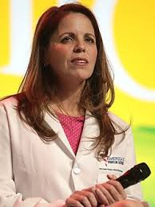

Slide 3
Agenda
The Roots of D-t-P
The Roots of MAHA
Risk to Public Health
Saving Public Health & Medicine

Slide 4
The Roots of D-t-P
Dissatisfaction with the Health Care System
Lack of Access to Primary Care
Lower Costs
Avoiding Stigma
COVID & The Rise of Telehealth
Influencers and the Rise of DIY Care
Bypassing Onerous State Laws (e.g. abortion bans)

Slide 5
The Roots of MAHA
Dissatisfaction with the Health Care System
Declining Trust in Institutions & Expertise
Influencers/Alternative Medicine
Social Media Algorithms
Rising Rates of Chronic Disease & Lower Life Expectancy Rates
Unhealthy foods; unhealthy environments
COVID and the Resistance to Public Health

Slide 6
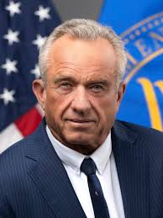
Some Tensions
The corporate capture of media, primarily through lavish advertising campaigns that are uniquely targeted to American consumers (no other developed country allows direct advertising of drugs to consumers, other than New Zealand …) confers a notable level of reliance on the industry by those that benefit financially.
President’s MAHA Commission

Slide 7
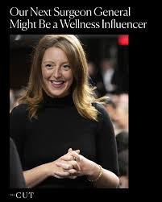
Maha & d-t-p: A symbiotic relationship Bypassing Expertise Promoting Individualism Undermining Regulatory capacity

Slide 8
The Roots of MAHA
Notes:
.

Slide 9
The Public Health Danger
Continuing Erosion of Primary Care & Secondary Prevention
Contagion! From Measles to Bird Flu
Widening Inequities: The Most Vulnerable are the Most Vulnerable

Slide 10
Reconsidering D-t-P: Saving Public Health & Medicine
Transparency and informed consent are necessary but not sufficient.
Any regulatory approach (however unlikely) needs to consider the public costs of D-t-P.
Public health & health care professionals need to understand and respond to the forces that are undermining their roles.
Notes:
So where do we go from here?

