Slide 1
Salus Populi: Developing, Implementing, and Evaluating a Judicial Education Program on the Social Determinants of Health
Mehreen Butt, Marjani Green, Dr. Katerine Hazen, Jasmine Howard

Slide 2
A collaboration of the Center for Health Policy and Law and the Institute for Health Equity and Social Justice Research​. With support from the Robert Wood Johnson Foundation and the W.K. Kellogg Foundation.
This work would not have been possible without the contributions of our funders and team:
Wendy E. Parmet
Alisa K. Lincoln
Anna Kane
And many, many students (both public health and law)!
Notes:
Mehreen
Elaine, does it make sense to just list names instead? Getting all the pictures to look semi-decent was hard due to the large/odd number.

Slide 3
Health Law Professors Conference, Boston, MA, June 2025
The objective of the panel is to describe an innovative judicial education program (JEP) designed to increase judges understanding of the social determinants of health (SDOH).
The Rationale and Development of the Judicial Education Program
Implementing the Salus Populi Program
Evaluation - Share findings form the mixed methods evaluation

Slide 4
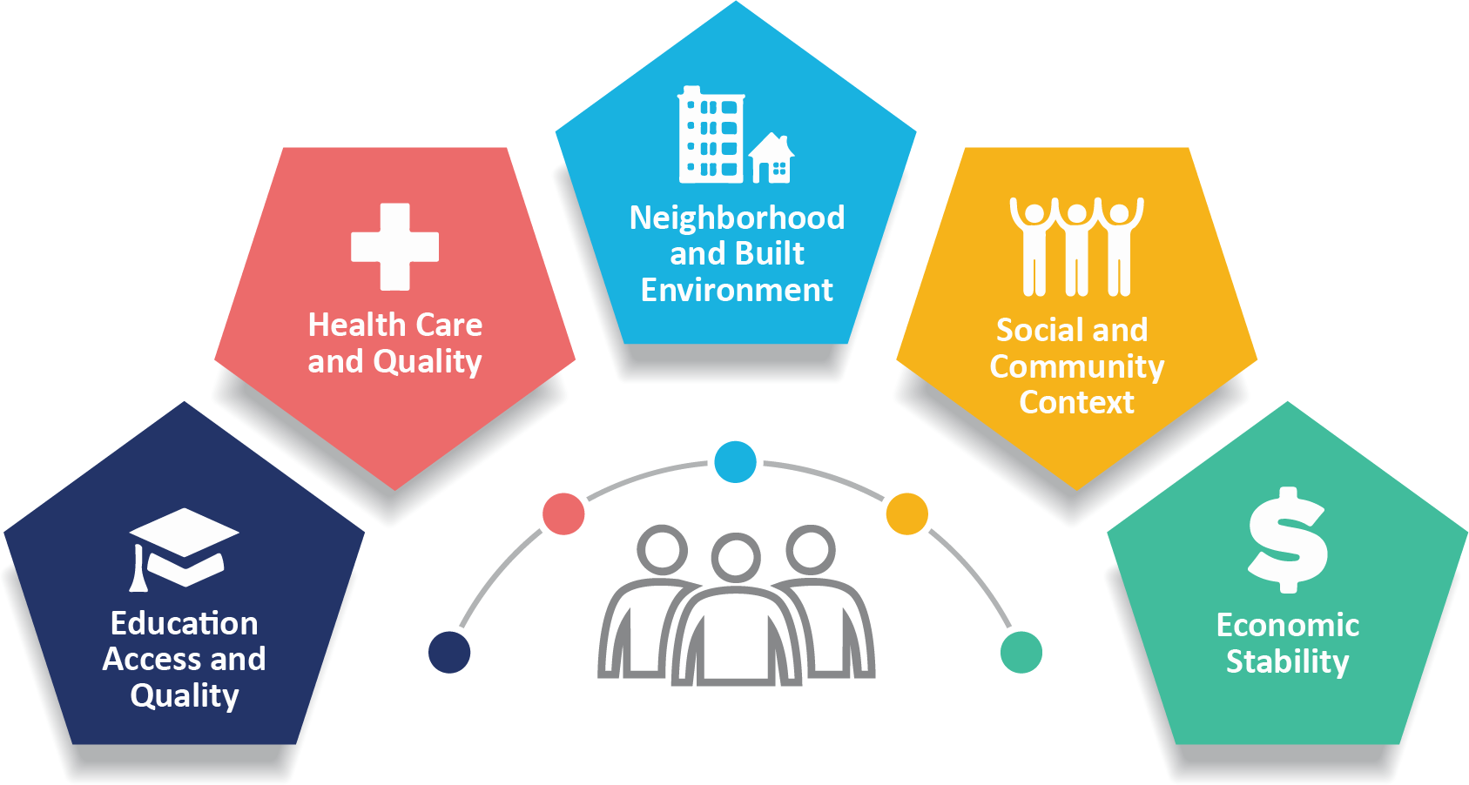
The Social Determinants of Health
Health Law Professors Conference, Boston, MA, June 2025
The conditions in the environment that impact health such as poverty, housing, and racism.
The SDOH are responsible for an estimated 80-90% of the modifiable contributors to human health.
Health Equity – the SDOH are socially patterned.
(Magnan, 2017; Healthy People 2030, n.d.)

Slide 5
What led to the Program
Health Law Professors Conference, Boston, MA, June 2025
Started in June 2020
Most empirical research on how law impacts health focused on legislation, regulation, and law enforcement with small subset demonstrating judicial impacts on health.
In the U.S. legal system, trial and appellate judges wield enormous authority over critical SDOH.
Despite their influence over SDOH, judges’ legal education does not usually discuss SDOH or their relationship to law.
Project aims to fill the gap by informing judges about the SDOH and their relationship to law.
Notes:
Research has shown that laws can significantly impact population health and health equity.
Most empirical research on how law impacts health has focused on the impact of legislation, regulations, and law enforcement, but a small subset of this research demonstrates that judges can impact health
In the U.S. legal system, with its strong tradition of judicial review, trial and appellate judges wield enormous authority over critical SDOH, such as housing stability, socio-economic position (as impacted by education and income), access to health care, structural racism, and the quality of the environment.
Despite their influence over SDOH, judges’ legal education does not usually discuss SDOH or their relationship to law.
This project aims to fill that gap by informing judges about the SDOH and their relationship to law and by developing and conducting a judicial education program to better equip judges to resolve cases in which the SDOH are implicated.

Slide 6
Law as a Social Determinant of Health
Upstream
The Constitution
Fair Housing Act
Fair Housing Act Complaints
Housing access and quality
Health Inequities
Downstream

Slide 7
Judicial Decisions as a Social Determinant of Health
Upstream
Interpreting the Constitution
Reviewing questions of law
Sentencing or Verdicts
Health Inequities
Downstream

Slide 8
How do legal decisions impact health?
UPSTREAM DOWNSTREAM
 | Legal Question | Judicial Decision | Result of Decision | Societal Effect | Population Effect
Students for Fair Admission v. Harvard | Whether the admission system is lawful under the Equal Protection Clause of the 14th Amendment? | Violation of 14th Amendment | Changes to admission practices | Reduced access to higher education | Decrease, change, or magnify health disparities.
U.S v. Occidental Chemical Corp. | Whether the birth defects, cancer, and deaths were due to waste disposal practices? | No, due to genetics | No change to laws; no remediation or settlement | Increased burden on health care system | Decrease, change, or magnify health disparities.
 |  | Yes, OCC omissions caused health hazards. | Settlements for families and policy changes | The development of the Superfund Program | Local cleanup and remediation programs; financial settlements.

Slide 9
Current Climate
Increased demand for the SP full day programing on campus.
Some loss of funding is creating a void in access of spaces to openly discuss issues.
Created more opportunities for partnerships.

Slide 10
Implementing the Salus Populi Program
Health Law Professors Conference, Boston, MA, June 2025
Salus Populi Suprema Lex Esto: “let the welfare of the people be the supreme law of the land”.
Notes:
To evaluate the impact of Salus Populi on knowledge and applicability of SDoH, we invited 712 registrants of 13 trainings to complete a survey. We shared a link to the Qualtrics survey to participants before and after the trainings. We received 502 unmatched survey responses, with a larger pre-survey response rate.
Although the survey included questions about their satisfaction with the training, for today we will focus on five constructs we measured on our surveys – including knowledge of SDOH, knowledge of research on the impacts of SDOH, understanding of the relationship between SDOH and judicial decision making, applicability of new knowledge of SDOH, and applicability of research about impacts of SDOH in their work. Participants rated their agreement with the items on a 4-point likert-type scale, higher scores indicate greater agreement.
Methods
The program evaluation plan includes pilot testing a pre-post survey design including several open-ended response questions.
The surveys investigated participants’ knowledge, attitudes, and beliefs regarding SDOH to determine whether they changed from before versus after the SP training.
The surveys were distributed using anonymous links to an online survey, hosted on Qualtrics. When possible, the surveys were emailed to participants before and after the training.

Slide 11
Salus Populi Objectives:
Educate
Evaluate

Slide 12
Salus Populi Programs
Judicial Education Program
Legal Education Program
Racial Health Equity

Slide 13
Judicial Education Program
4 Units:
Introduction to SDOH and the public health frameworks
Macro SDOH: Poverty
Macro SDOH: Racism
Macro SDOH: Housing
Notes:
This full-day, interactive, seminar-style program is designed to give judges an introduction to the social determinants of health and their relationship to judicial decision-making, plus the tools they need to apply their knowledge to their work on the bench.
Topics covered include:
introduction to population health
socio-ecological health
poverty
structural racism
housing
public health research methods. ​

Slide 14
Legal Education Program
3 Units
Introduction to SDOH
Poverty as a SDOH
Racism as a SDOH
Notes:
3 hours instead of full day.

Slide 15
Racial Health Equity
3 Units:
Introduction to the SDOH
Racism as a SDOH
Law as a SDOH

Slide 16
Salus Populi’s Tools and Strategies
Publications ​
Legal research ​
Case presentations​
Adult Learning Framework MEL ​
Method Minutes ​
Menti ​
Interactive discussion ​
Guest Speakers ​
Local community engagement

Slide 17
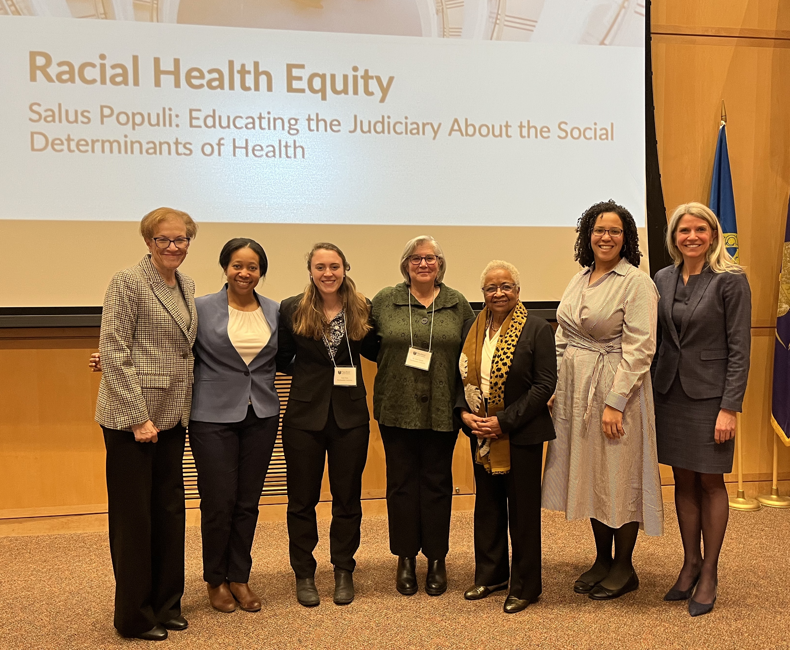
2025 Programs
January 23, 2025
National Association of Women Judges Webinar
53 attendees
February 12, 2025
Racial Equity Course Pilot with Flaschner Judicial Institute
22 attendees
April 7 & 22, 2025
National Association of Counsel for Children Webinars
197 attendees across both webinars
May 16, 2025
JEP with Minnesota Judicial Branch
22 attendees

Slide 18
Upcoming Programs
Boston Full-Day Judicial Education Program
June 20, 2025
Racial Equity Course
San Francisco, California
October 24, 2025
Webinar with Health Law Advocates
July 16, 2025
Boston Full-Day Judicial Education Program
November 14, 2025
National Association of State Judicial Educators Annual Meeting
Philadelphia, Pennsylvania
September 7-10, 2025
Ohio 8th Judicial District Seminar
Cleveland, Ohio
November 21, 2025
Ohio Judicial Conference Annual Meeting
Columbus, Ohio
September 12, 2025
Racial Equity Course
TBD
December 4, 2025

