Slide 1
Governance by CONSENT?
When Health Policy Is Made Through Agreement Rather Than Regulation
Professor Wendy Netter Epstein
DePaul University College of Law
June 2026

Slide 2
An Observation AND QUESTIONS
Government is doing all sorts of things on the basis of what it claims is negotiation/voluntary assent rather than legislation or regulation. But is there consent? Does public law have a robust account of what makes consent meaningful? Should it? Do we care that invoking language of contract if wouldn’t pass contractual muster?

Slide 3
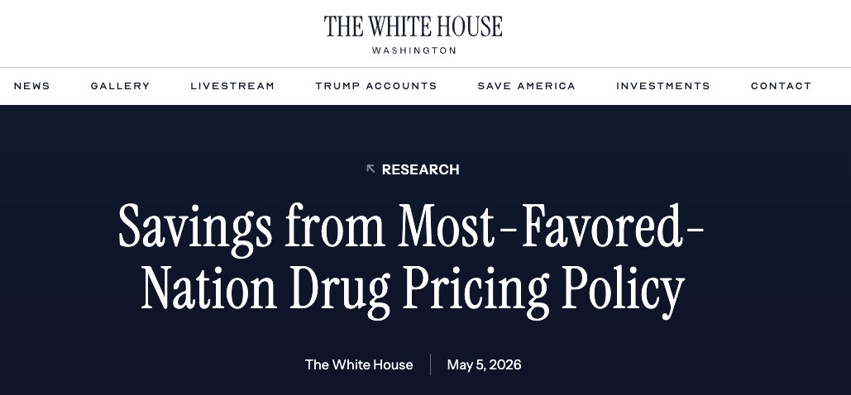

“To date, the Administration has reached voluntary MFN pricing agreements with 17 of the largest pharmaceutical manufacturers in the world. Moving forward, the Administration expects to reach similar agreements with most manufacturers of sole-source brand name drugs and biologics in the nation. In parallel, the Administration is working with Congress to codify those voluntary agreements into law to ensure that patients continue to benefit from price discounts.”
“Under the voluntary MFN framework, manufacturers will offer all new drugs launched in the U.S. at prices comparable to those in other high‑income countries.1 This prospective MFN construct applies across all markets in the U.S., inclusive of the private insurance market, and is expected to generate $529B in domestic savings in the next 10 years across all markets.”
“voluntary” appears 6 times in exec summary
https://www.whitehouse.gov/research/2026/05/savings-from-most-favored-nation-drug-pricing-policy/

Slide 4
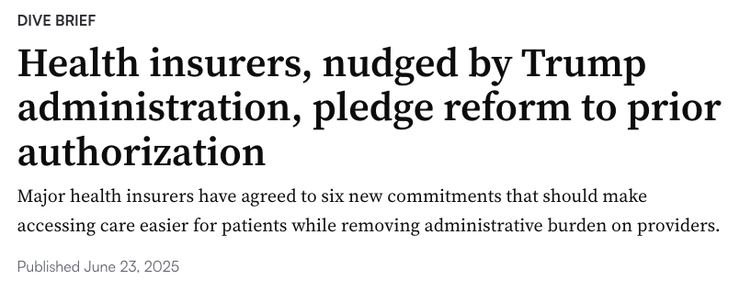
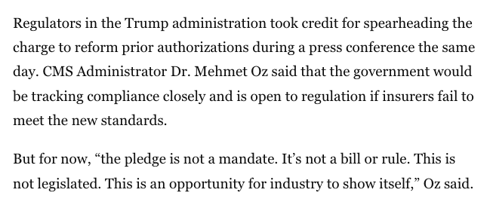
https://www.healthcaredive.com/news/health-insurers-pledge-prior-authorization-reform-trump-hhs/751309/

Slide 5
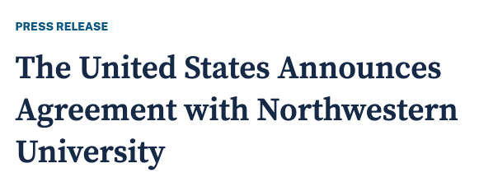
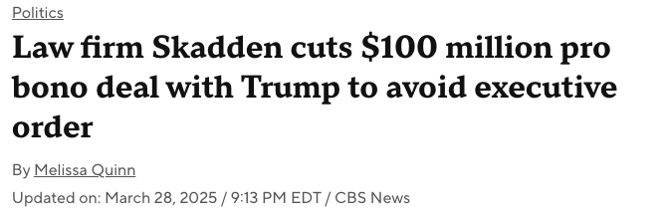
Beyond the health context
“President Trump announced . . . that the law firm Skadden, Arps . . . agreed to provide more than $100 million in pro bono work for initiatives backed by his administration. The agreement makes Skadden Arps the second major firm to reach a deal with Mr. Trump amid a recent blitz of executive orders targeting law firms that have employed his purported political opponents.”
“As part of the agreement, Northwestern University will pay $75 million to the United States through 2028. . . we are grateful to Northwestern for negotiating this historic deal.”
https://www.justice.gov/opa/pr/united-states-announces-agreement-northwestern-university
https://www.cbsnews.com/news/law-firm-skadden-cuts-100-million-pro-bono-deal-trump-avoid-executive-order/

Slide 6
Other examples?
Hospitals agreeing to suspend gender-affirming care (under threat from Exec Order to lose federal funding)
Medicaid work requirements (although that gets into Spending Clause territory)
What else??

Slide 7
Why do government actors repeatedly describe these arrangements using the language of contracts, deals, agreements, negotiation, voluntariness?
If consent matters enough to invoke, why doesn’t the law care more about whether that consent is meaningful?

Slide 8
Is the gov’t negotiating in situations where it could not regulate?
Category 1: The Government Could Regulate Directly
  FDA has statutory authority to require certain postmarket studies; CMS has authority to establish participation requirements
  Gov’t negotiates because faster, more flexible, politically easier, less vulnerable to lit
Category II: Government Authority is Uncertain
  MFN drug pricing; university agreements
  Agreement may accomplish what regulation cannot, agreement legitimizes
Category III: Government Cannot Regulate Directly
  Agreement achieves through consent what command could not

Slide 9
WHY NEGOTIATE?
Used to think of as binary, gov’t has authority and can regulate vs. gov’t doesn’t have authority and can’t regulate
Now, the “can’t regulate” category becomes governance by negotiated commitment
Should we say:
  Consent cures the authority problem?
  Consent legitimates the outcome?
  Consent is meaningful under certain conditions?
  Contract law has spent centuries asking: When does consent actually legitimate an arrangement?

Slide 10
Contract doctrine
According to Legal Information Institute: “Consent means that a person voluntarily and willfully agrees in response to another person's proposition. The person who consents must possess sufficient mental capacity. Consent also requires the absence of coercion, fraud or error. Consent is an essential constituent of a contract”
Relevant doctrine:
  Duress (key elements = no reasonable alternative and the threat induced assent)
  Undue Influence (transaction that results from relationship of dependency and excessive pressure or influence)
  Unconscionability (extreme bargaining power disparities and lack of meaningful choice)
A lot of contracts literature on meaning and role of consent:
Randy E. Barnett, A Consent Theory of Contract, 86 Colum. L. Rev. 269 (1986)
Nancy Kim, Relative Consent and Contract Law, 18 Nev. L.J. 165 (2017) (
Nathan B. Oman, ESSAY: Reconsidering Contractual Consent: Why We Shouldn't Worry Too Much About Boilerplate and Other Puzzles, 83 Brook. L. Rev. (2017).
Available at: https://brooklynworks.brooklaw.edu/blr/vol83/iss1/16

Slide 11
Contracts approach
different FOCUS OF DIFFERENT FIELDS
PUBLIC LAW approach
Did the parties agree?
Was the agreement entered into voluntarily and without undue pressure or dependency?
Should the agreement be enforced?
Does the government have authority?
Did the government follow proper procedures?
Does the Constitution permit the action?

Slide 12
Don’t Want this to be about spending clause / nfib v. Sebelius
If the gov’t is simply offering money subject to conditions, then Spending Clause doctrine kicks in.
There is a coercion component (which is why Medicaid expansion became voluntary)
But Spending Clause is usually about fed gov’t vs. state gov’t / Underlying constitutional value is:
  preserving state autonomy,
  preserving the federal-state balance,
  preventing states from becoming mere administrative subdivisions.
No equivalent constitutional commitment to preserving the autonomy of private actors (e.g. hospitals, pharma companies . . .)

Slide 13
My QUESTIONS FOR YOU
Is there anything interesting here or is this something that has always happened and coverage just makes it more prominent?
Is there public law doctrine/con law principles other than Spending Clause or general admin law stuff that I should be thinking about?
What is more interesting: Consent as a substitute for authority? Whether there can ever be consent by dependent actors?
What examples come to mind? And does it matter to you if you agree with the policy being promoted or not?

