Slide 1
Regulating Nursing Home Ownership Through State Health Care Transaction Review Laws
Professor Joan Foley
Touro University Jacob D. Fuchsberg Law Center
Health Law Professors Conference
June 3, 2026

Slide 2
Private Equity in Nursing Homes
Negative Impacts of Private Equity Investment in Nursing Homes
State Health Care Transaction Review Statutes
Implications

Slide 3

“Private Equity and Nursing Homes Are a Match Made in Hell”
  6/24/24 Editorial blames private equity for more than 20 bankruptcy filings by local nursing homes in just a few weeks

Slide 4
Private Equity Trends: Nursing Homes
More than 15,000 nursing homes in U.S. caring for more than 1.2 million residents
70% of nursing homes are for-profit with about 11 % of nursing homes owned by private equity

Slide 5
Why are Nursing Homes Appealing to Private Equity?
Aging U.S. population
Steady stream of income
Desirable real estate

Slide 6
What is the Private Equity Model in Nursing Home Ownership?
Complex corporate structure
Leveraged buyouts (LBOs)
Sale-leaseback agreements – real estate investment trusts (REITs)
Vertical integrated structure
Tunneling
Cost cutting – staff reduction & low wages
Short holding period

Slide 7

How Does Private Equity Acquisition Impact Nursing Home Care?
Study: Private equity acquired nursing homes
  Going to a PE-owned facility increased short-term mortality by 10% during and for 90 days after the patient stay, while taxpayer spending over the same time period increased by 11%
  50 % increase in prescription of antipsychotic drugs for residents
  3% decrease of hours of frontline nursing staffing
  Atul Gupta, Sabrina T. Howell, Constantine Yannelis, & Abhinav Gupta, Owner Incentives and Performance in Healthcare: Private Equity Investment in Nursing Homes, Nat’l Bureau of Economic Research, Working Paper 28474 (2021, rev. 2023), https://doi.org/10.3386/w28474.
Study: Residents in nursing homes acquired by private equity
  11% more likely to have a preventable emergency department visit
  8.7% more likely to experience a preventable hospitalization
  when compared to residents of for-profit nursing homes not associated with private equity
  Robert Tyler Braun, et al., Association of Private Equity Investment in US Nursing Homes With the Quality and Cost of Care for Long-Stay Residents, 2 JAMA Health Forum e213817 (2021).

Slide 8
Federal Antitrust Gap
High threshold: The Harts-Scott-Rodino Antitrust Improvement Act (HSR) mandates pre-merger notification for certain large mergers and acquisitions to the Federal Trade Commission and Department of Justice
2022 study estimated that over 90% of private equity deals are not subject to this review

Slide 9

Limits of Federal CMS Oversight
11/17/2023
CMS Final Rule on Nursing Home Ownership Disclosure
Center for Medicare & Medicaid’s rule implements portion of the Patient Protection and Affordable Care Act and requires Medicare and Medicaid certified-skilled nursing facilities (SNFs) to disclose private equity and Real Estate Investment Trust (REIT) ownership
Disclosure post-transaction
12/11/ 2025
CMS “Indefinitely” Suspends Off-Cycle Revalidation Process for Nursing Homes
CMS suspends the January 1, 2026, deadline for reporting SNFs’ ownership and control data
“Enrolled skilled nursing facilities (SNFs) should continue collecting data on ownership, managerial, and related party information … . However, there is no submission deadline until further notice.” CMS 12/11/25 Newsletter.

Slide 10

“States Aim to Combat Private-Equity Healthcare Take Over: More than a dozen states are pushing back against private-equity-backed consolidation of medical businesses”
4/18/24

Slide 11

State Health Care Transaction Review Laws (TRLs)
Require a qualifying “health care entity” to provide notice to a designated state authority (e.g., state agency or state Attorney General) of a proposed “material change transaction” (i.e., merger, acquisition, other qualifying entity reformation)

Slide 12
Key Components
Covered health care entity
Qualifying transaction
Review authority
Ongoing reporting

Slide 13
Massachusetts – Mass. Gen. Laws ch. 6D § 1 et seq. (2025)
Covered Entities | Qualifying Transactions | Review | Post
“’Provider’, any person, corporation, partnership, governmental unit, state institution or any other entity qualified under the laws of the commonwealth to perform or provide health care services.” “'Health care services', supplies, care and services of medical, …, rehabilitative, supportive or geriatric nature...” “Facility'', a licensed institution providing health care services or a health care setting, including…skilled nursing centers ‘’ and rehabilitation and other therapeutic health settings.” ''Health care real estate investment trust'', a real estate investment trust, as defined by 26 U.S.C section 856, whose assets consist of real property held in connection with the use or operations of a provider or provider organization.” Mass. Gen Laws ch. § 1. Notice of Material Change Form: Provider types includes skill nursing facilities | “Every provider or provider organization shall, before making any material change to its operations or governance structure, submit notice to the commission, the center and the attorney general of such change, not fewer than 60 days before the date of the proposed change.” “Material changes" includes transactions involving: "significant equity investors," which specifically covers private equity companies; “significant acquisitions, sales or transfers of assets including, but not limited to, real estate sale lease-back arrangements” Mass. Gen Laws ch. 6D § 13(a). | The Commission may initiate a Cost and Market Impact Review (CMIR) & consider the size and market share of any corporate affiliates or significant equity investors of of provider organization. CMIR may examine such factors that include “quality of service it provides, including patience experience,” ”role of the provider in serving at risk, undeserved and government payer patient population,” “or any other factors the commission determines to be in the public interest.” Mass. Gen Laws ch. § 13(d). “For any material change involving a significant equity investor, the commission may specify certain information required to be submitted as part of the notice, including, but not limited to, information regarding the significant equity investor's capital structure, general financial condition, ownership and management structure and audited financial statements.” Mass. Gen Laws ch. § 13(c)(2). A material change cannot be completed until at least 30 days after the Commission issues its final report. The change cannot be completed if the AG brings an action challenging the change. Notice of Material Change Form: Description including but not limited to “any anticipated impact of reimbursement rates, care referral patterns, access to needed services, and/or quality of care” | “The commission may also require, for a period of 5 years following the completion of a material change, that any provider or provider organization submit data and information necessary for the commission to assess the post-transaction impacts of a material change.” Mass. Gen Laws ch. 6D § 13(c)(3)..
Model Act for State Oversight of Proposed Health Care Mergers – National Academy for State Health Policy

Slide 14
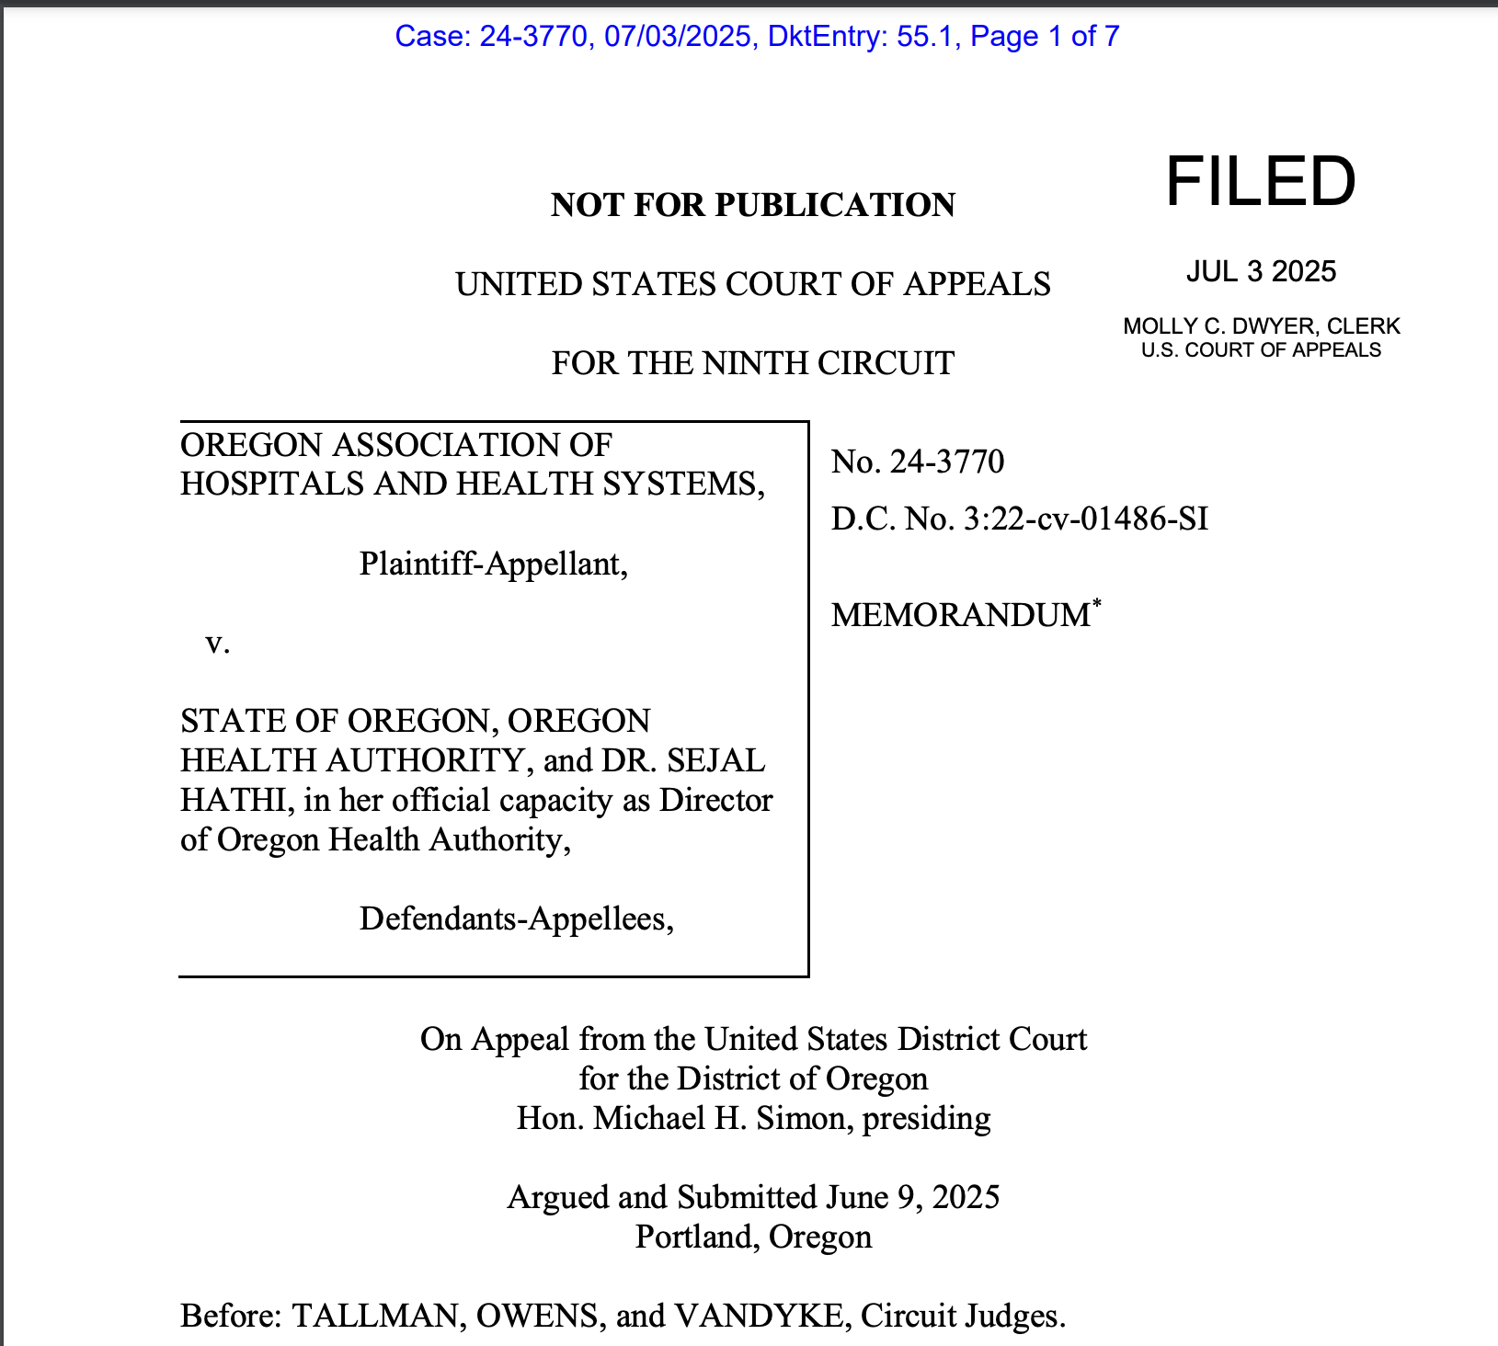
Implications
The Ninth Circuit affirmed district court’s summary judgment in favor of the Defendant Oregon and Oregon Health Authority dismissing Plaintiff Oregon Association of Hospitals and Health Systems’ claims that the Oregon Health Care Market Oversight law was void for vagueness under the Due Process Clause of 14th Amendment and violated the non-delegation clause of the Oregon Constitution.

Slide 15

“A Unique Oregon Law Allows It to Block Healthcare Deals. In Five Years, the State Hasn’t Done So Once.”
5/14/26

Slide 16
Thank you
Joan Foley
Touro University Jacob D. Fuchsberg Law Center
jfoley@touro.edu

