Slide 1



Strengthening Public Health Litigation through Amicus Briefs
2026 Health Law Professors Conference
Wendy E. Parmet
Mehreen Butt
Shannon Rempe
Jami Crespo

Slide 2




Speakers
Wendy E. Parmet
Mehreen Butt
Professor of Law, Co-faculty Director
Northeastern University, Center for Health Policy and Law (CHPL)
Managing Director
Northeastern University, CHPL
Shannon Rempe
Jami Crespo
Program Director
Advancing Public Health & Health Equity in the Courts,
Northeastern University, CHPL
Senior Attorney
ChangeLab Solutions

Slide 3
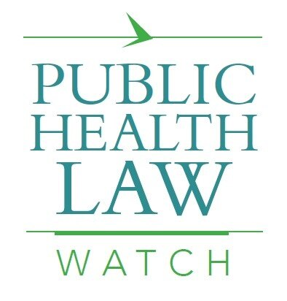

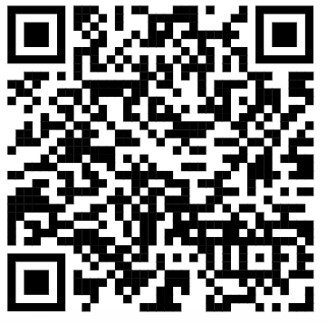

Slide 4

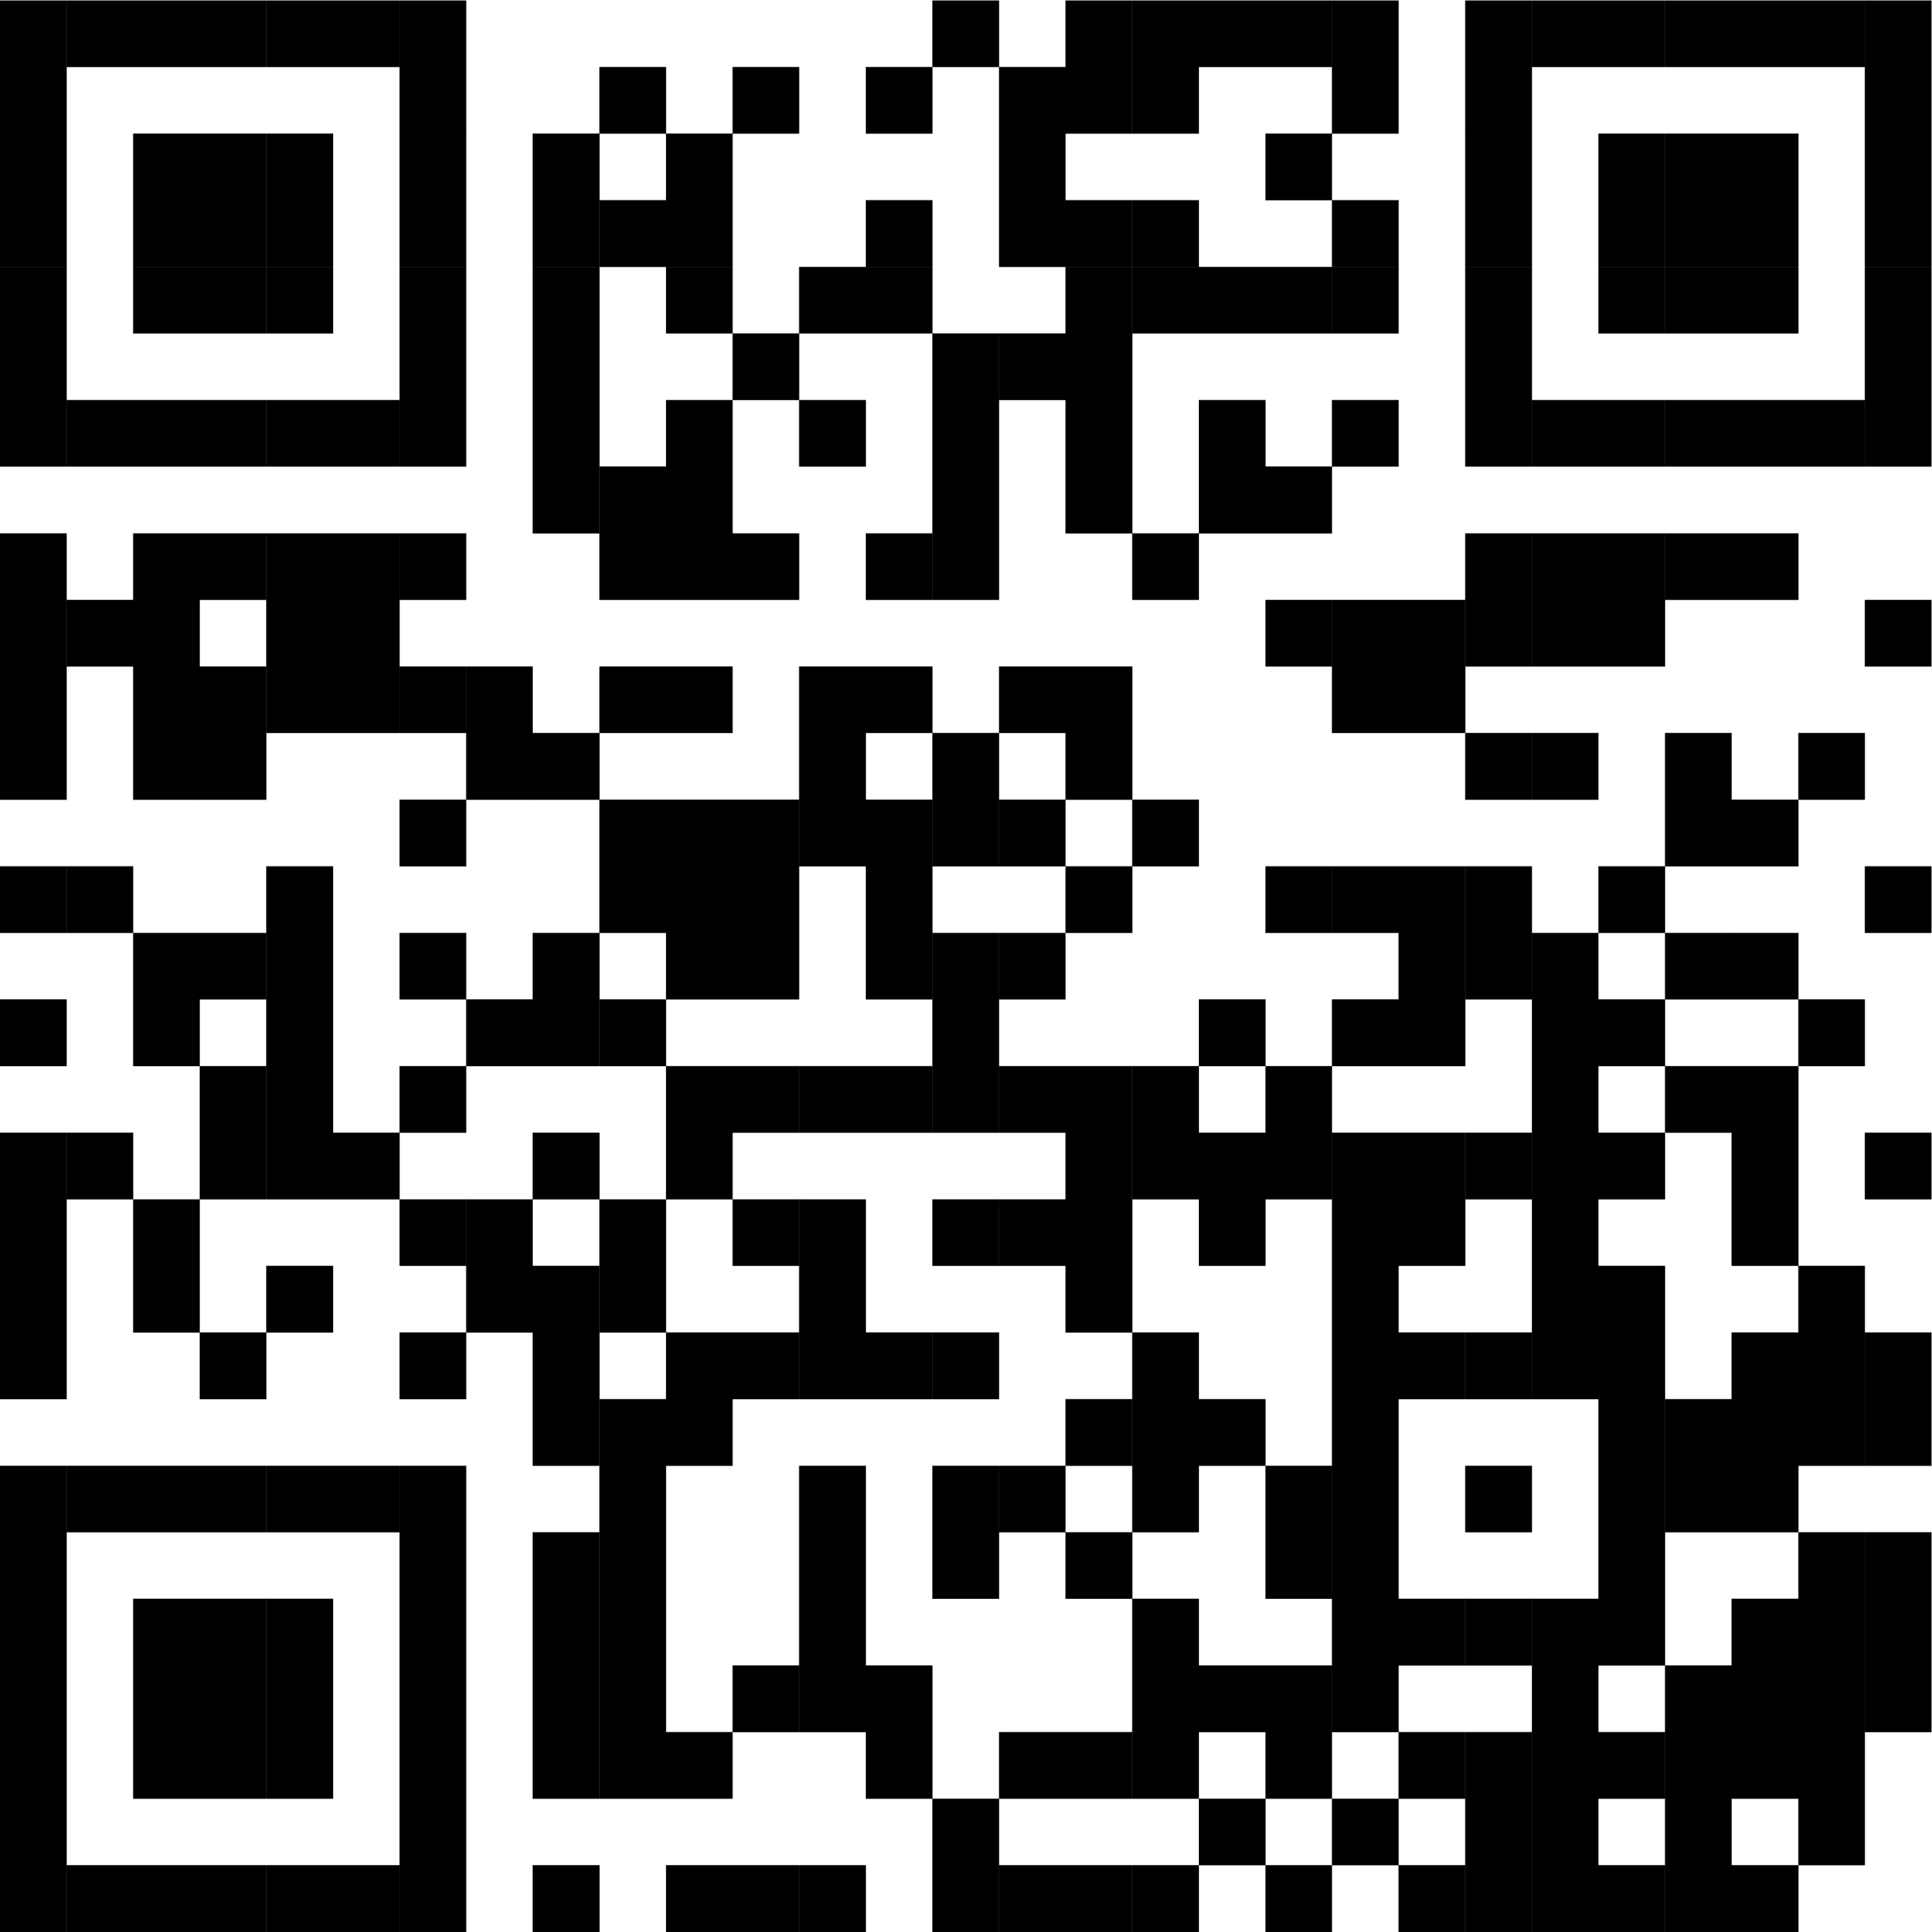

ChangeLab’s Mission
Healthier communities
for all through equitable
laws & policies.

Slide 5
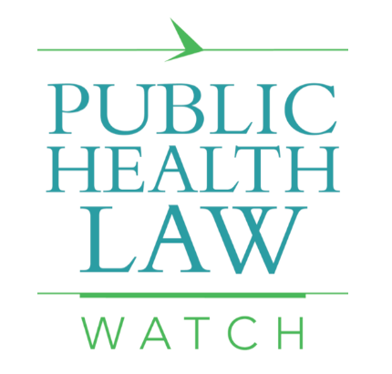

Disclosures and Disclaimers
Support for this program is provided by the Robert Wood Johnson Foundation. The views expressed here today do not necessarily reflect the views of the Foundation.
Support for this project is also provided by ChangeLab Solutions. As a non-profit, non-partisan organization, there is no intent to reflect views on specific legislation.
We’re not providing legal advice.

Slide 6
Agenda
Responding to the Changing Judicial Climate
Moving Forward
AAP v. Kennedy Amici: How it Worked
Why Amicus Briefs? Benefits and Challenges
Q&A
The Amicus Project
Litigation Tracking
Notes:
-----

Slide 7
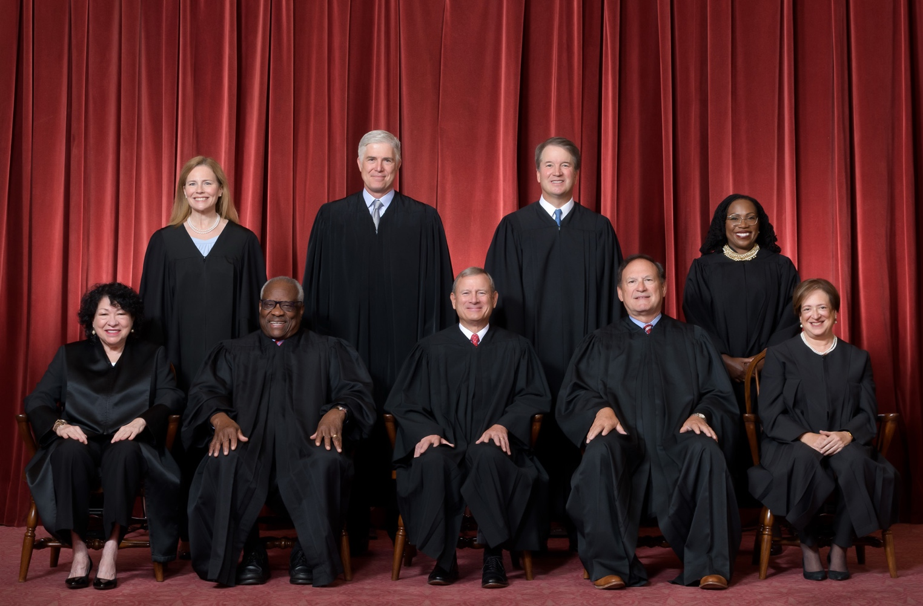
The Changing Judicial Climate: 2020-2024
Traditionally, public health and medicine received a great deal of deference and respect from the courts
That changed during the pandemic, as increasingly conservative courts became more skeptical of scientific authority and regulatory efforts
This trend accelerated across legal doctrines during the COVID-19 pandemic and since

Slide 8

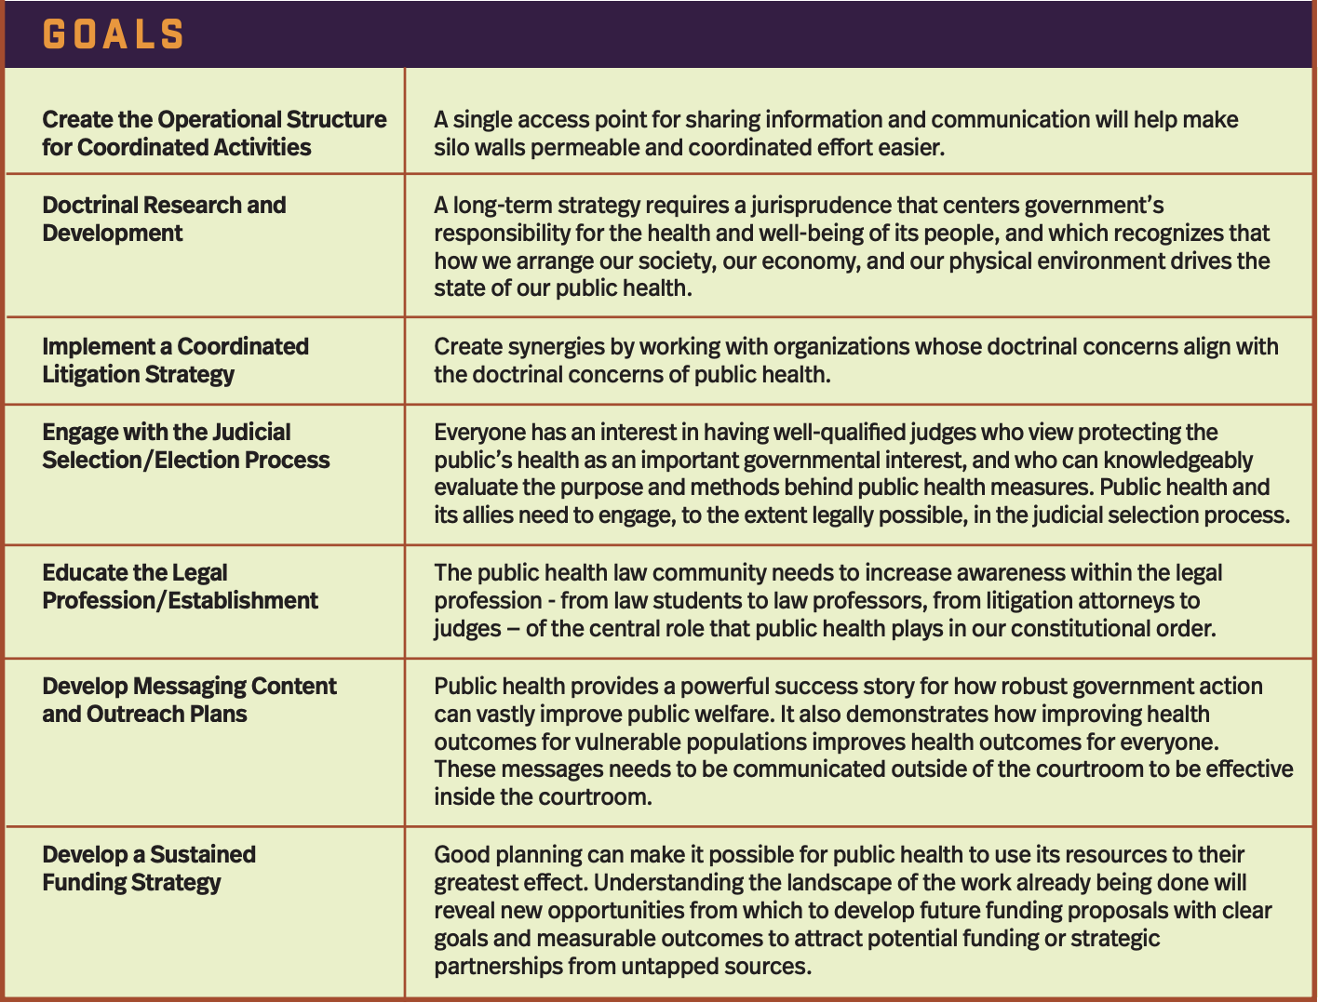
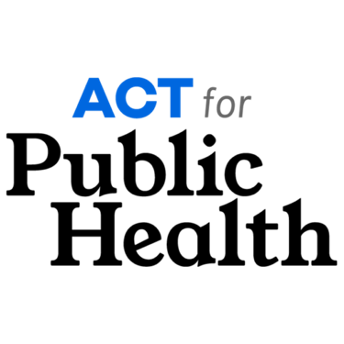
How We Responded
May 2024 Convening
Action Plan Developed
Includes:
Enhancing Public Health’s Capacity to File Amicus Briefs

Slide 9
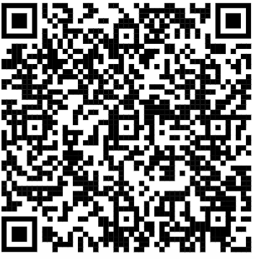
Goal 3: Coordinated Litigation Strategy
  Track litigation
  Draft amicus briefs
  Build relationships
Goal 4: Engage with Judicial Selection/Election Process
  Educate public on importance of judicial elections
  Educate judicial nominees on public health
  Develop judicial report cards
  Recruit and mentor judicial nominees
Goal 7: Develop a Sustained Funding Strategy
  Educate funders on importance of legal advocacy
  Develop new funding partnerships

Slide 10
Litigation Tracking Goals
Track state and federal lawsuits of public health significance
Monitor and analyze doctrinal changes impacting public health
Assess long-term implications for equity and public health

Slide 11
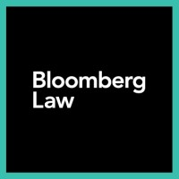



Litigation Tracking Approach
Legal databases
Litigation trackers
Organizational websites
AI tools
Partner sharing

Slide 12
Litigation Tracking Challenges
Legal databases have incomplete state court docket information
Imperfect key word searches
Cases dismissed not on the merits
Missing threats of litigation and preemptive compliance
Small team

Slide 13
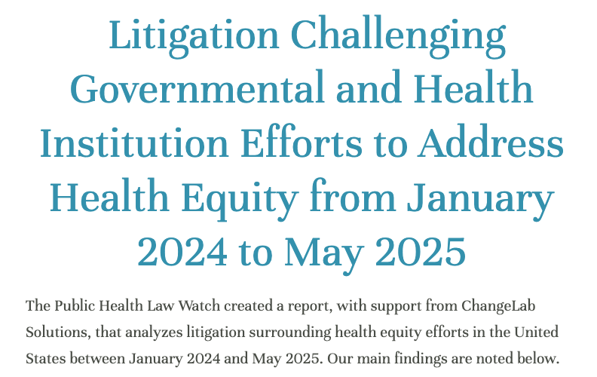
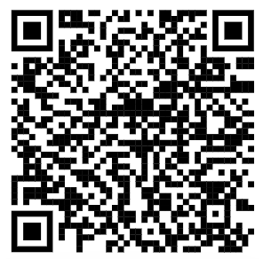
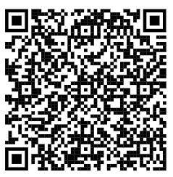
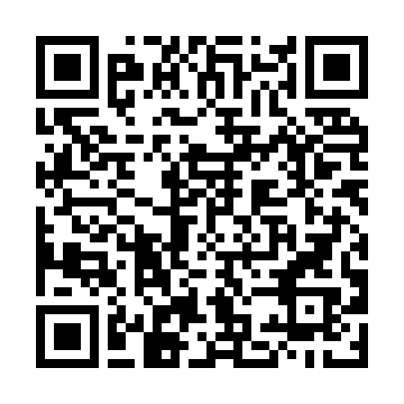

Key Learnings
Newsletters
Report
Newsletter Sign Up

Slide 14
Lawsuits Challenging Expanded Civil Rights Protections for Gender Identity and Sexual Orientation
Following Bostock v. Clayton County (2020), new rules and guidance across several federal departments strengthened protections against sex-based discrimination and harassment and clarified protections for LGBTQI+ individuals under Title IX
19 lawsuits with the most prominent claims arguing violations of
  Administrative Procedures Act
  Spending Clause
  Major Questions Doctrine
  First Amendment
Judicial rulings
  Department or agency didn’t have authority to issue rules or guidance
  Rules or guidance were contrary to law, arbitrary and capricious, violated the major questions or nondelegation doctrines, and implicated freedom of speech and religious expression

Slide 15
Lawsuits Challenging Health Equity Programs, Services, or Advisory Groups with Racial or Gender Preferences or Requirements
Following Students for Fair Admissions v. Harvard (2023), several groups started bringing lawsuits aimed at striking down race considerations across numerous sectors, including in the healthcare sector
11 lawsuits with the most prominent claims arguing violations of
  Equal Protection Clause
  Citizenship Clause
  Civil Rights Acts of 1866 and 1964
Case dismissals
  Majority of cases dismissed because defendant removed racial or gender preferences or requirements

Slide 16
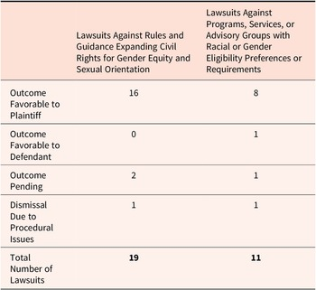
Summary of Lawsuit Outcomes
Summary of Outcomes of Lawsuits Against Health Equity, January 2024-25

Slide 17
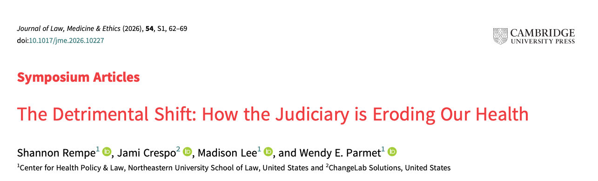
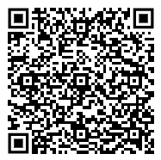

Slide 18
Recent Doctrinal Shifts Impacting Public Health
Favoring Free Exercise challenges
Limiting deference to administrative agencies & the scope of their authority
Undermining equal protection & attempts to broaden civil rights protections

Slide 19
Recent Doctrinal Shifts Impacting Public Health
Favoring Free Exercise challenges
Limiting deference to administrative agencies
Undermining equal protection & Civil Rights
Unitary Executive
Procedural Access
Daniel G. Aaron and Wendy E. Parmet, The Supreme Court’s 2024–2025 Term: Eroding Public Health, Health Equity, and Access to Justice, Am. J. of Public Health 115, 1773-1778, Nov. 2025.

Slide 20
Favoring Free Exercise Challenges
Early pandemic: courts upheld most public health orders
Post-2020: Supreme Court applied strict scrutiny
Religious activity granted 'most favored nation' status
Impact on vaccine policy
Medical Freedom movement

Slide 21

Limiting Administrative Authority
Expansion of the Major Questions Doctrine
End of Chevron deference in Loper Bright (2024)
Corner Post (2024)
Braidwood allowing appointees to replace experts + Judicial interpretation replacing agency expertise

Slide 22
Undermining Equal Protection & Civil Rights
SFFA v. Harvard and the colorblind constitution
Attacks on DEI frameworks
Renewed challenges to LGBTQ+ protections
Unequal protection of immigrants

Slide 23
Upcoming Supreme Court Decisions Impacting Public Health
In the remainder of the 2025-2026 Supreme Court term, the Court will decide cases on several topics impacting public health:
Transgender athletes participating in sports
State authority to regulate pesticides
Birthright citizenship
Gun Control

Slide 24
Amicus Project: Approach
Connect
Connect public health experts, community organizations, legal scholars, and practitioners
Monitor
Monitor emerging litigation impacting public health and health equity
Inform & Disseminate
Inform the public health community about emerging litigation with timely analysis of its impact
Support
Support strategic litigation to elevate public health and equity considerations before the courts through amicus briefs
Inform & Disseminate

Slide 25
Amicus Project: Components
Litigation tracking
Publications
External engagements
Partnership development
Amicus briefs

Slide 26
Why Amicus Briefs?
Amicus briefs can bring scientific expertise to the courts in ways that party briefs cannot
Research has shown that courts place special value on amicus briefs which discuss medical and scientific issues
Opportunity for diverse coalitions to come together and ensure public health perspectives are presented to the court
Specific to our project – less salient (state-level) cases
Importance of partnership + coordination

Slide 27
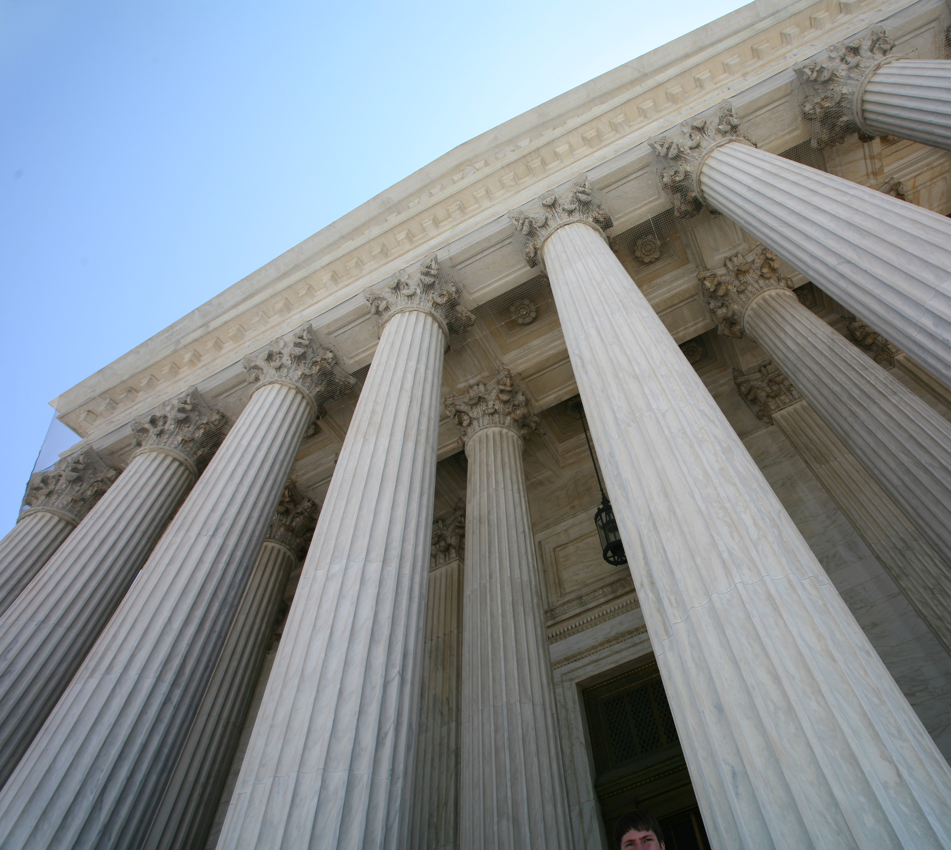
Amicus Efficacy & Importance
In last 80 years, 800% increase at SCOTUS
  2019-2020 term = 940 briefs submitted
Citation rates climbed sharply
Increase at trial court level too
Loper Bright → increasingly important

Slide 28

Amicus-Related Challenges
Identifying cases early enough and accepting the merits
Finding pro bono counsel in this current political climate
Politicization of court
Litigation timing constraints

Slide 29
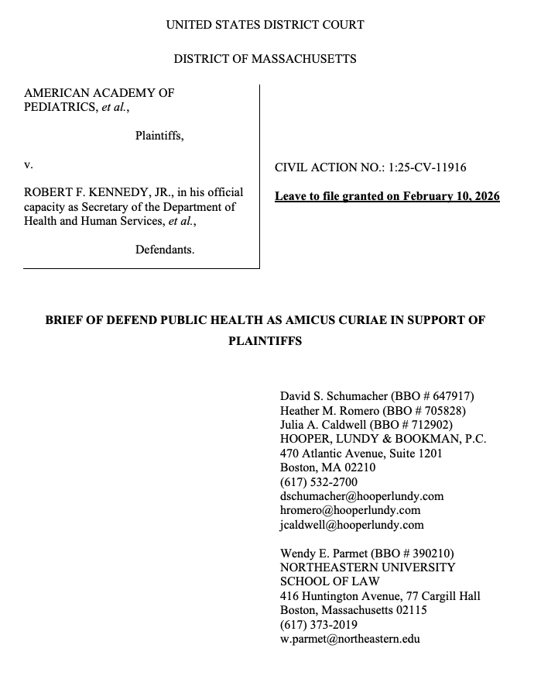
AAP v. Kennedy: How it Worked
Coordinated with Defend Public Health
Found outside counsel
Worked with volunteer epidemiologists
Turned scientific information into legal language
What worked?
What was challenging?

Slide 30
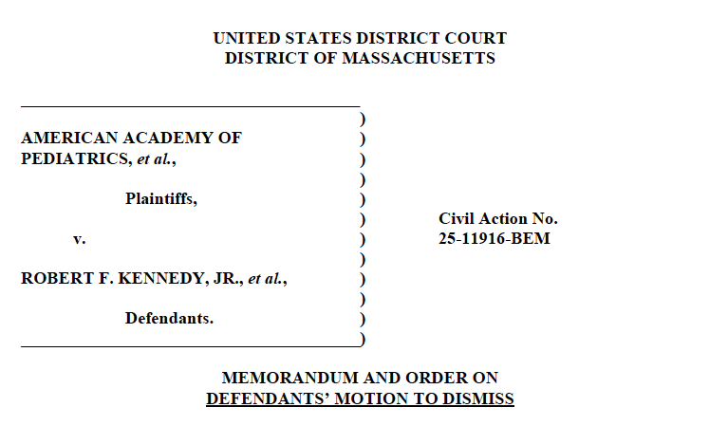
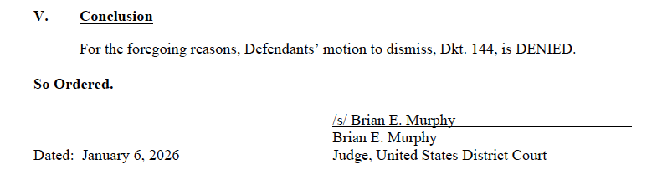
Two Victories!
First Brief: December 2025
  Judge Murphy denied Kennedy's motion to dismiss, citing to our brief in his decision
Second Brief: February 2026
  Judge issued wide-ranging stay of changes to childhood vaccine schedule.
  Judge Murphy wrote: “Plaintiffs and amici have demonstrated that there is a substantial risk to public health absent preliminary relief.”
Third Brief: TBD

Slide 31
Moving Forward
Convening Experts & Lawyers
Building Scientist-Litigator Teams

Slide 32
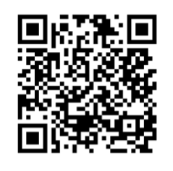
Call to Action: Partner With Us
Information Sharing
Building a Network
Password: amicus
Tell us about state or local cases impacting public health or health equity
Flag cases already filed or on the horizon
Help ensure public health & scientific perspectives reach the courts
Compiling a network of scientific experts
Seeking leads on attorneys with relevant expertise
Opportunities for collaboration on amici and strategic litigation

Slide 33
Discussion
Password: amicus
Questions and comments
Prompt: How do we continue to develop a long-term strategy for improving public health law when we’re continually responding to crises?

Slide 34
Come Chat Some More!
George Consortium Meet-and-Greet tomorrow, June 4, during lunch!
Room 304, 12:30-1:30pm

Slide 35
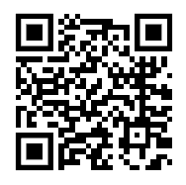
References
Northeastern University Center for Health Policy and Law, Public Health Law Watch, Act for Public Health, Protecting Public Health in the Courts: Convening Report and Action Plan, 2024.
J. Crespo et al., Litigation Challenging Governmental and Health Institution Efforts to Address Health Equity from January 2024 to May 2025. Public Health Law Watch; 2025.
Rempe S, Crespo J, Lee M, Parmet WE. The Detrimental Shift: How the Judiciary is Eroding Our Health. Journal of Law, Medicine & Ethics. 2026;54(S1):62-69.
Daniel G. Aaron and Wendy E. Parmet, The Supreme Court’s 2024–2025 Term: Eroding Public Health, Health Equity, and Access to Justice, American Journal of Public Health 115, 1773; Nov. 2025.
Our Amicus Work
Our Litigation Tracking Newsletter

Slide 36
References
Amicus efficacy research:
  Karen U. Lindell & Claudia De Palma, Friendly Gatekeepers: Lessons from an Empirical Analysis of Amicus Briefs in Federal District Courts (October 31, 2025), U of Penn Law School.
  Sahar Abi-Hassan, The Signals of Unlikely Allies: Ideologically Diverse Amicus Coalitions and Judicial Behavior, 54 American Politics Research 167 (September 8, 2025).
  DeMatteo & Wiltsie, When Amicus Curiae Briefs are Inimicus Curiae Briefs, 72 Am. U.L. Rev. 1871, 1887 (2023).
  MaryBeth Musumeci et al., How a Supreme Court Decision Is Changing the Way Federal Laws Are Interpreted, Commonwealth Fund (Oct. 31, 2024).
Our Amicus Work
Our Litigation Tracking Newsletter

