Slide 1

Lauren Roth
Haub School of Law at
Pace University
Private Health Governance
Ethan Thorpe
Vanderbilt Private Climate Governance Lab
Vanderbilt Law School

Slide 2

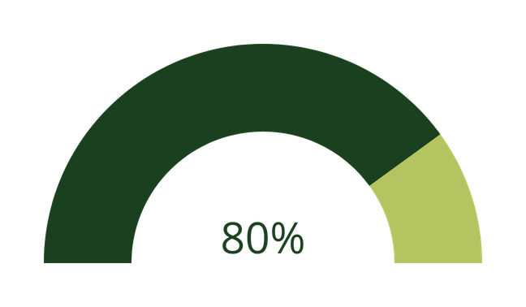
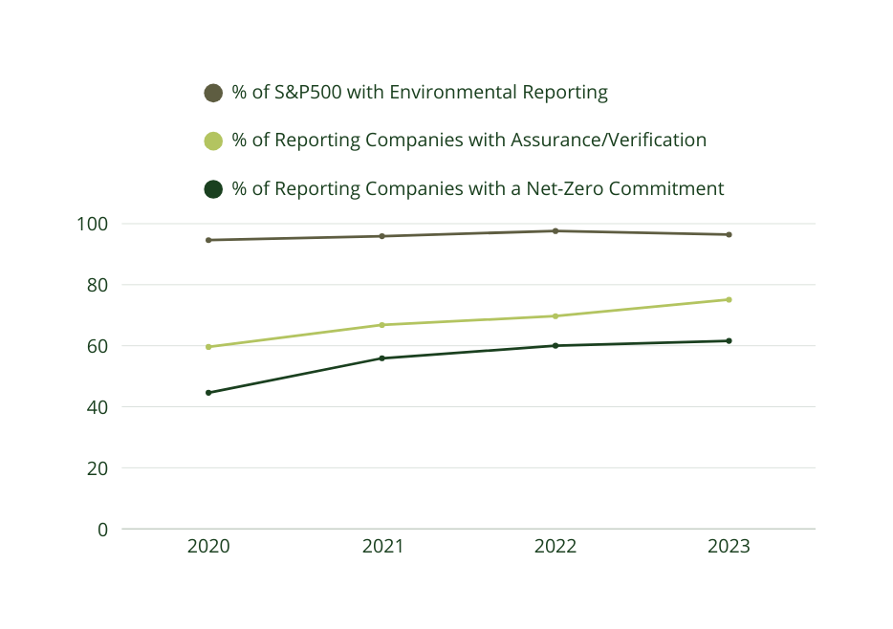
01/ Private Environmental Governance
Private environmental governance (PEG) occurs when private organizations perform environmental and climate adaptation and mitigation functions typically associated with governments.
80% of the 10 largest companies in 7 global sectors impose environmental requirements on their suppliers
Federal gridlock and state fragmentation have left major gaps in environmental governance. PEG can and does play an important gap-filling role.

Slide 3
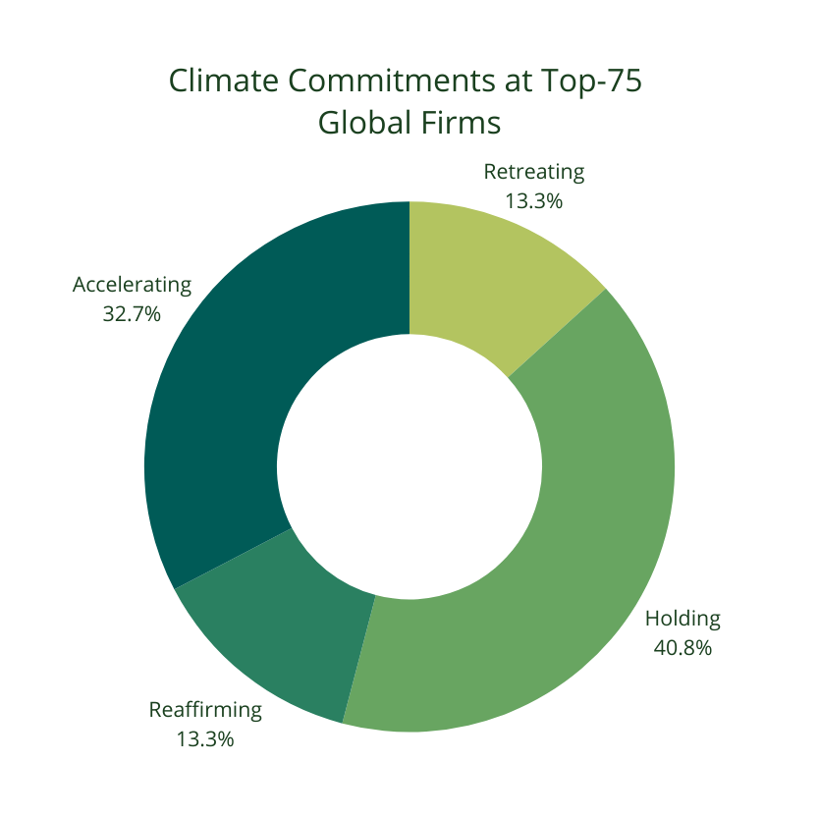

02/ Is PEG Going Away?
Despite federal retrenchment and escalating opposition to climate action, most companies are maintaining their commitments for reasons including:
Risk mitigation
Consumer preferences
Manager preferences
Workforce needs
Contractual obligations
Efficiency

Slide 4

03/ Private Health Governance
Financing retrofits & redesigns
Medical quality standards (e.g. Joint Commission)
Recruitment & retention
Group purchasing organizations

Slide 5

04/ Climate as Health Quality
Safety | Effectiveness | Equity
Patient-Centered | Efficiency | Timeliness

Slide 6

05/ The Health Challenge
  8-10% of U.S. annual emissions from healthcare sector (global average = 4-5%)
  >$1 trillion in annual waste
  Inferior health outcomes than peer nations
  Hospitals:
    18.5-23.6 lbs hazardous waste/bed/day
    24/7/365 power, high energy intensity
    Organizational complexity

Slide 7

06/ The Health Opportunity
Hospitals can adapt, even in the current political moment.
Mitigation | Adaptation/Resilience
Clean energy Supplier contracting Review radiological procedures Building retrofits & upgrades | Include climate risks in CHNAs and HVAs Train students and practitioners on enviro-health as preventive care Invest in green space & low-impact development
 | On-site clean energy generation & storage (e.g., microgrids) Preventive care

Slide 8
Borcelle University
Thank you!

