Slide 1
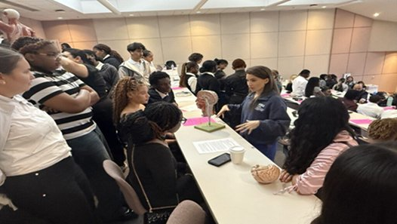
Building Bridges Across the Educational Continuum
A Three-Tier Medical-Legal Partnership Model at Nova Southeastern University
Dr. Lauren Fine, Dr. Arkene Levy, Professor Marilyn Uzdavines
Nova Southeastern University · NSU MD & Shepard Broad College of Law
Notes:
Lauren

Slide 2
Roadmap for Today
TIER 1
TIER 2
TIER 3
CLOSING
Ad Law-Med Program
LAW 0403 JD/MD Course
Cleveland Clinic MLP
Discussion & Implications
High School Pipeline
Graduate Interprofessionalism
Emerging Community Model
Health equity · Scalability
Notes:
Lauren

Slide 3
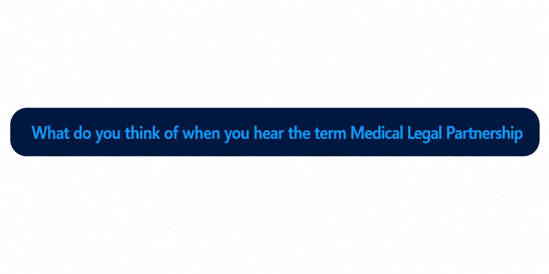
Notes:
Marilyn

Slide 4
What Is a Medical-Legal Partnership?
Medical-Legal Partnerships (MLPs) embed legal professionals in health care settings to address the social, structural, and political determinants of health — housing, benefits, immigration, advance care — that clinical care alone cannot remedy.
First introduced in 1993 by Dr. Barry Zuckerman at Boston Medical Center. Today ~450 MLPs operate across the U.S. (up from 81 in 2008).
The gap: 80% of physicians lack confidence addressing social issues. Most low-income patients face ≥2 legal needs yet rarely seek help independently.
MLPs work because neither profession can bridge this gap alone — together they close it.
~450
MLPs in the U.S. today
80%
of physicians lack confidence
addressing social issues
≥2
legal needs per low-income
patient, on average
Notes:
Marilyn - what do you think of when you hear MLP? Have you been part of an MLP? (maybe bring up example of mold case)

Slide 5
The NSU Three-Tier MLP Educational Continuum
A longitudinal architecture spanning awareness → competency → practice
1
2
3
HIGH SCHOOL
GRADUATE
COMMUNITY
Ad Law-Med Program
LAW 0403 JD/MD Course
Cleveland Clinic MLP
Awareness & mentorship
Broward County schools
Near-peer mentoring model
Paid summer internships
Interprofessional competency
Joint enrollment JD & MD
Flipped classroom model
IPEC framework
Community-based practice
End-of-life legal counseling
Supervised law students
(Emerging — prospective)
Notes:
Marilyn

Slide 6

TIER ONE
Advancing Underrepresented Youth in Law and Medicine (Ad Law-Med Program)
High School Pathway program: NSU MD & Shepard Broad College of Law
Notes:
Arkene

Slide 7

Interprofessional Collaboration Between Law and Medicine: Opportunities for Health Equity Through Pathway Programs, Academic Medicine, Journal of the Association of American Medical Colleges, Vol. 100, No. 10 (October 2025)
Published Article Communicating Pilot Program and Approach
Notes:
Arkene to speak - Add QR code to our Article

Slide 8
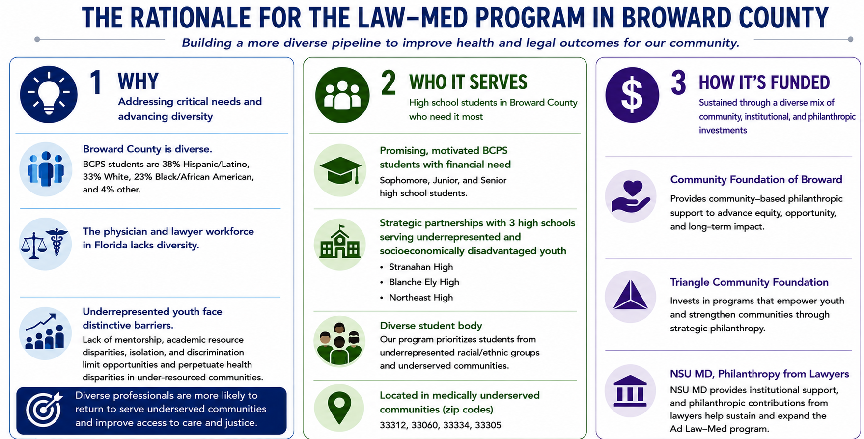
Notes:
Arkene to speak.
Lauren to remove Fort Lauderdale High here

Slide 9
Interprofessional Education & the IPEC Core Competencies
A nationally recognized framework preparing health professionals to collaborate across disciplines to improve patient, community, and systems-level outcomes.
The Four IPEC Core Competencies
IPE Day
1
Values & Ethics
Shared values, ethics, and mutual respect
Students from across NSU's health professions train side by side in team-based simulations and shared case work, practicing collaboration before they reach the bedside.
2
Roles & Responsibilities
Apply each profession's knowledge and role
An Accreditation Priority
Interprofessional collaborative skills are required by health professions accreditors. The IPEC competencies are embedded in curricula and accreditation standards, including LCME standards for M.D. programs.
3
Communication
Communicate to support a team approach
NSU Health Professions
4
Teams & Teamwork
Build effective, collaborative teams
Allopathic Medicine (KPCAM), Osteopathic Medicine, Pharmacy, Dental Medicine, Optometry, Nursing, Medical Sciences, and Health Care Sciences.
Notes:
"The Ad Law-Med Program demonstrates that meaningful interprofessional education can begin well before students enter professional school. Through shared teaching, mentorship, and experiential learning, law and medical students develop the same competencies expected of practicing professionals: understanding one another's roles, communicating effectively, working as a team, and grounding decisions in shared ethical values. An important secondary outcome is that both groups gain experience teaching and mentoring high school students, strengthening communication skills while fostering the next generation of diverse professionals."

Slide 10
NSU AD Law–Med Program: Alignment with IPEC Competencies
The program prepares graduates to lead at the intersection of law, health care, and dispute resolution by developing the interprofessional competencies that drive effective collaboration.
1
Values & Ethics
Ethics and professionalism are integrated throughout the curriculum; legal, ethical, and policy issues are examined through an interprofessional lens.
✓
2
Roles & Responsibilities
Students learn the roles of legal and health professionals across the care continuum, and how legal expertise supports clinical and policy decisions.
✓
3
Communication
Curriculum includes negotiation, mediation, and advocacy training; simulations and role-plays build clear, respectful communication.
✓
4
Teams & Teamwork
Team-based, problem-solving courses ask students to collaborate on cases requiring multiple professional perspectives.
✓
Notes:
While the primary goal is to inspire underrepresented high school students to pursue careers in law and medicine, we also wanted to understand the impact on our law and medical student mentors. The results show strong gains in understanding health equity, appreciation for law-medicine collaboration, and motivation to serve underserved communities. Notably, every participant reported gaining valuable teaching or mentorship skills, and over 80% expressed interest in participating again. These findings suggest that pathway programs can simultaneously strengthen workforce diversity and interprofessional professional development.

Slide 11
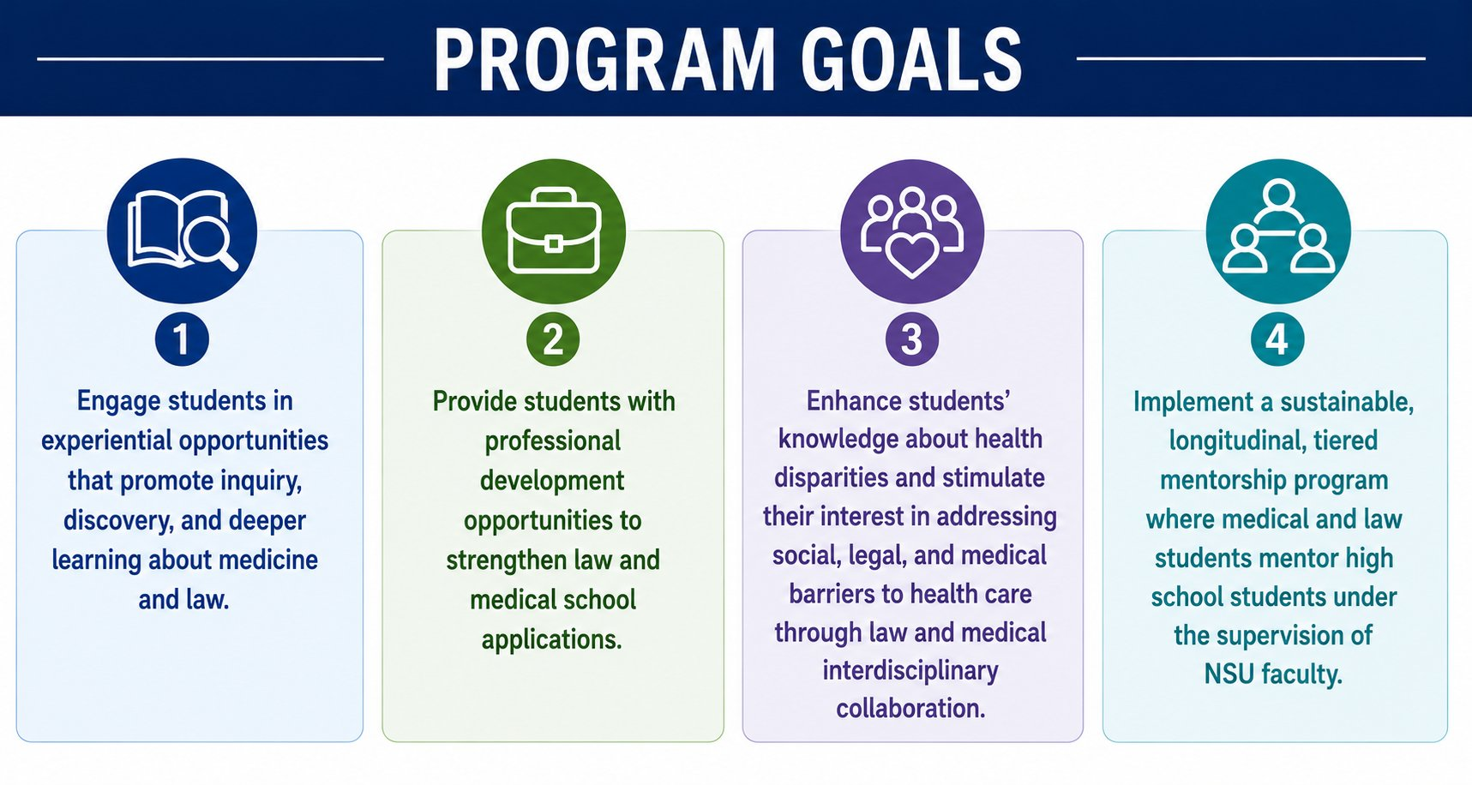
Notes:
Lauren to speak on this one – Also, include secondary goal of exposing law and medicine students to teaching to high school students with also getting the IPE exposure between the two colleges

Slide 12
Ad Law-Med Program: Student Survey Results
Post-program survey of law and medical student mentors
Law & medical student responses | Strongly Agree (%) | Agree (%) | Disagree (%)
The program enhanced my knowledge about health disparities and health equity | 56 | 38 | 6
I gained knowledge about how law and medicine can collaborate to advance health equity | 56 | 31 | 13
My interaction with high school students from underrepresented backgrounds motivated me to learn more about health disparities | 63 | 31 | 6
My interaction with high school students from underrepresented backgrounds inspired my desire to practice in underserved areas | 50 | 44 | 6
I enjoyed the opportunity to teach high school students and learned valuable skills about communicating with diverse populations | 80 | 20 | 0
I enjoyed mentoring high school students and learned valuable skills about mentorship | 69 | 31 | 0
81% of participants want to join the program again next year (13% maybe, 6% no)
Notes:
Lauren to speak on this which dovetails from previous slide on secondary benefits to law/med students. This is the data on law/med student survey – we want to include a small piece of this to share regarding the secondary objectives on how it benefitted the law/med students

Slide 13
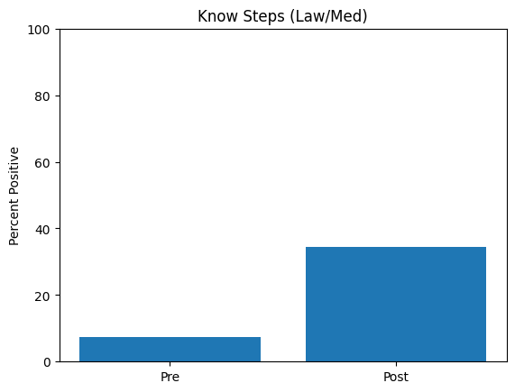

Ad Law-Med: Broward Program Successes
100% completion rate
> 80%+ increase in medical/law knowledge
Strong growth in college readiness and self-efficacy
Concordant mentorship → strong identity formation
+27% increase in students reporting “Very Confident”
Confidence in Knowledge of Steps to Pursue Law/Medicine
Notes:
Arkene to speak
Lauren – some of the words are cut off and moving to line below which makes it hard to read, can you edit it to make a word stay on only one line (example see “Completion rate”)

Slide 14
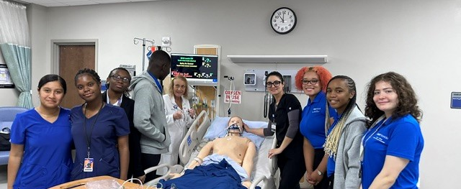
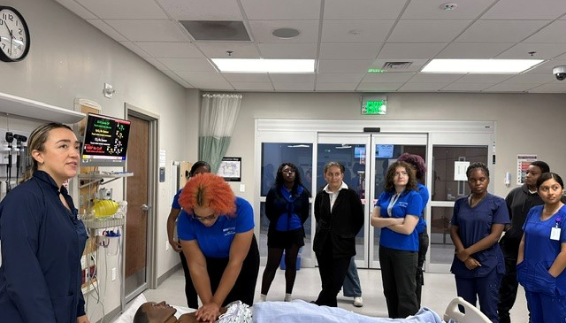
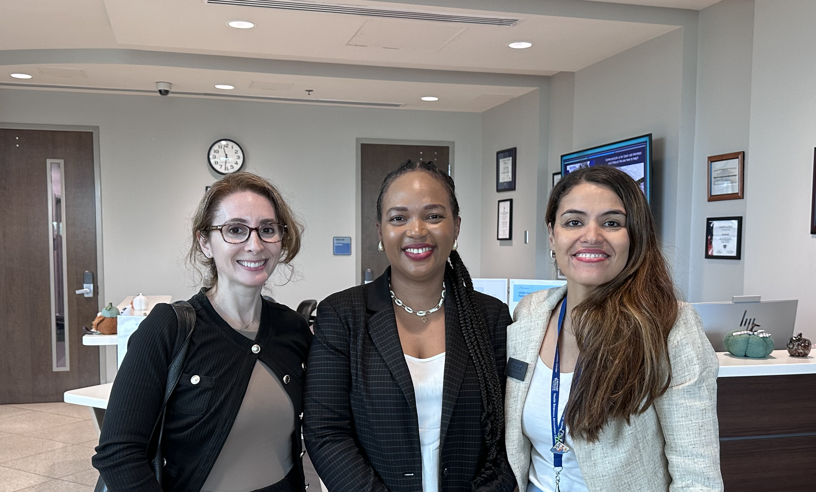
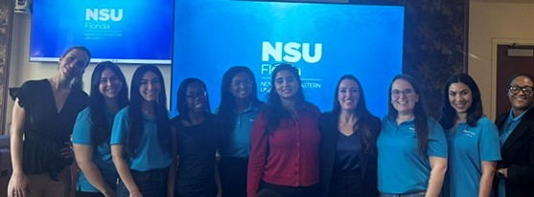
Notes:
I would love to add the picture of Arkene, Lauren, and Lilia on this slide. I can’t get my computer to open it. It is in an HEIC format. If you either of you can add it to the right corner, please do. Feel free to edit this to look more aesthetic. I intentionally cut off the law student on the most left side to make space for the picture of the faculty. That student was not an ambassador, but helping me with the Guardianship teaching session from the clinic.

Slide 15
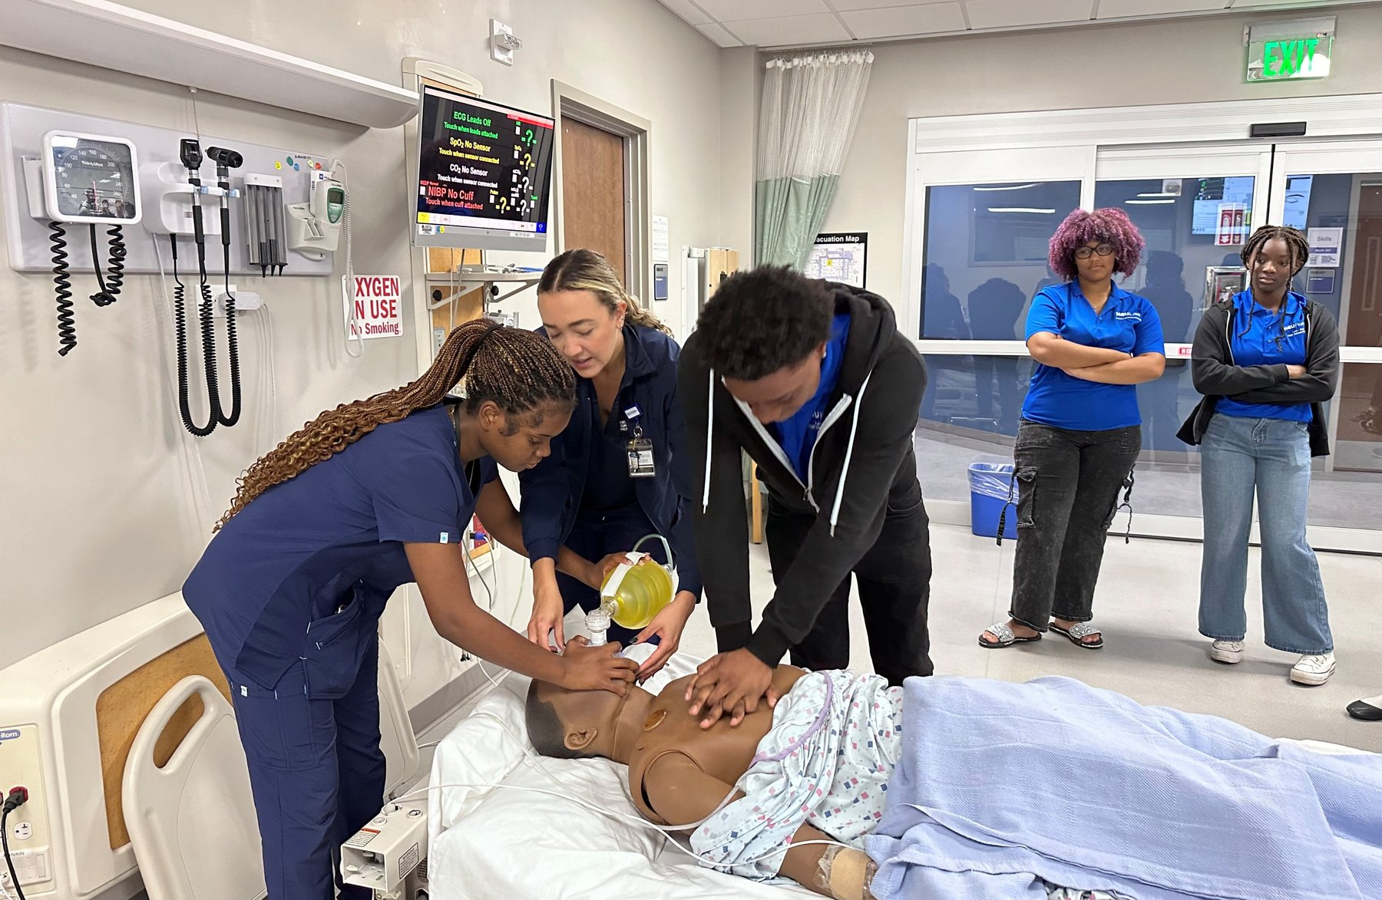
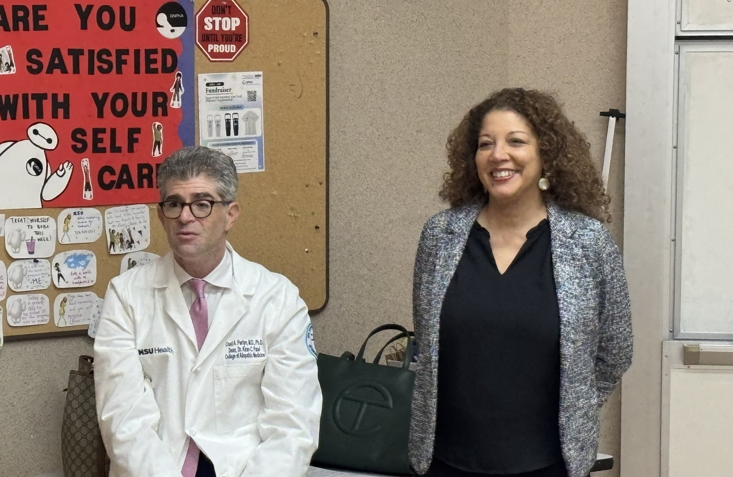
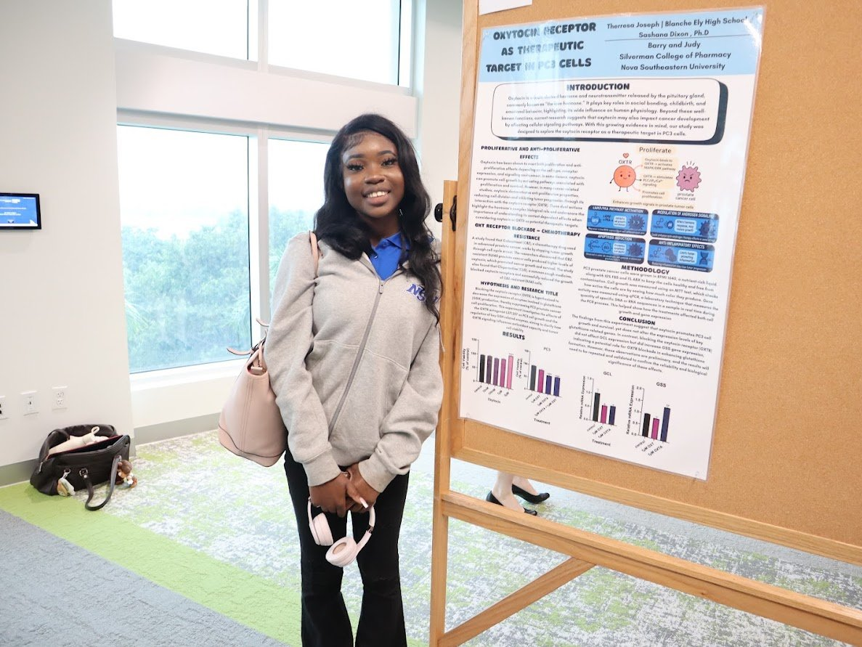
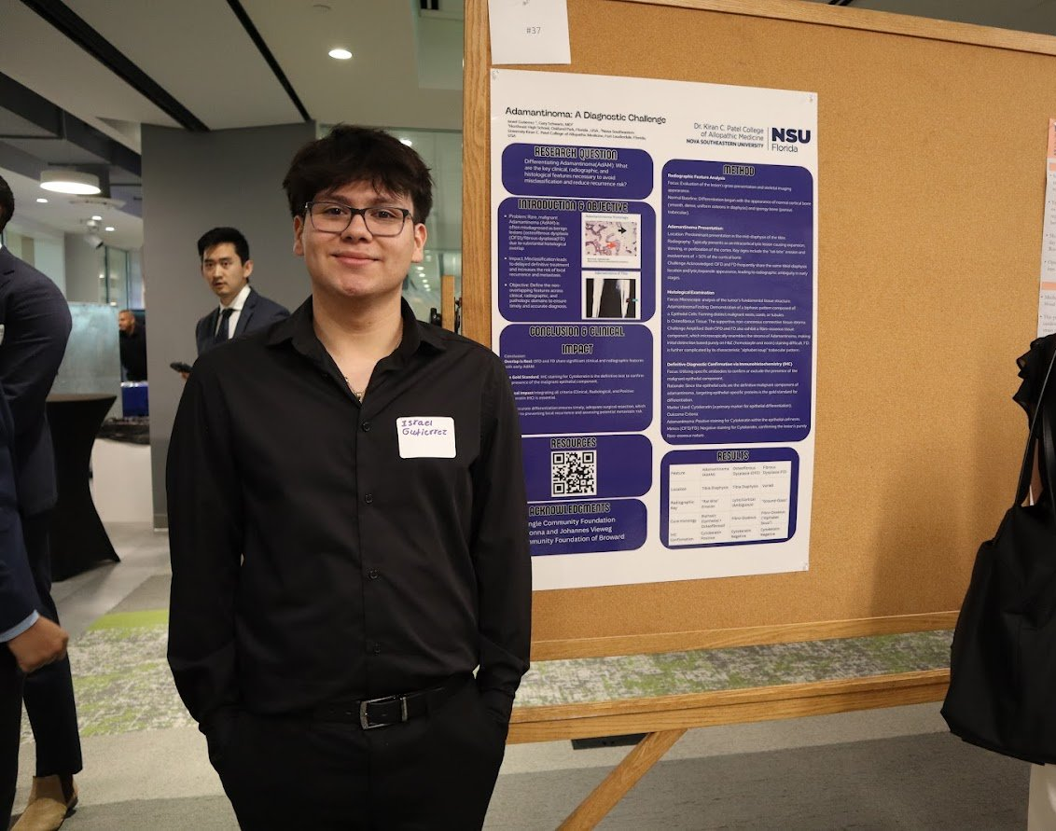
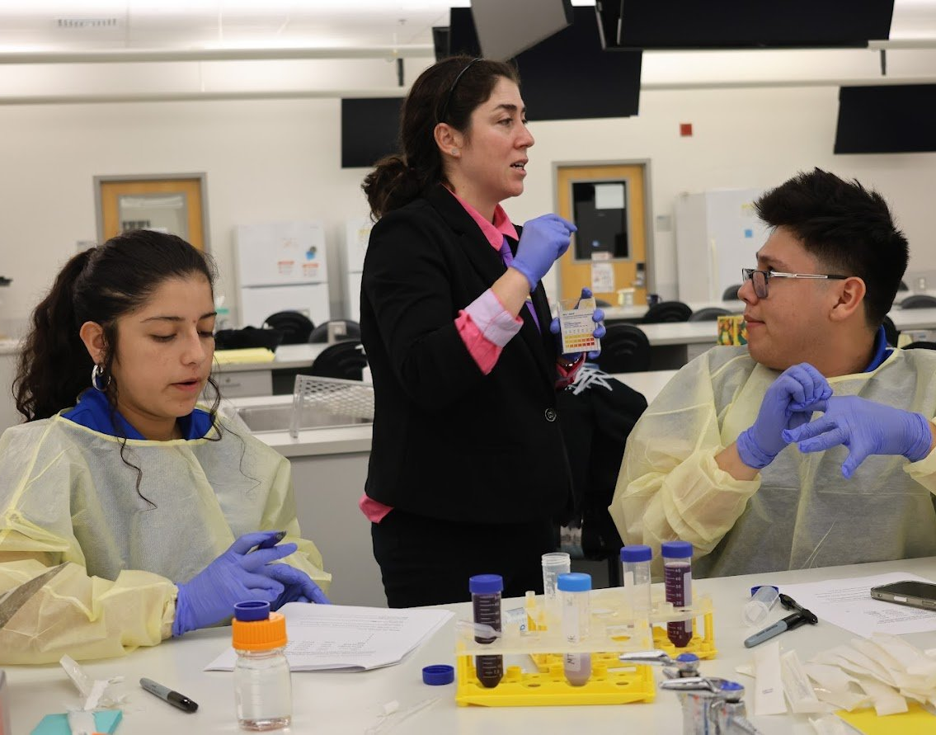
Notes:
Lauren – discuss success of student internships and academies
One Year program Jan- Dec 2025:
60 students: Stranahan, Blanche Ely, Northeast High
High financial need
>60% eligible for free/reduced lunch
Health Professional/ Law career trajectories
Broward Program Components:
4 experiential day-long academies
Biomedical & law summer internships
Mentorship circles
College coaching, SAT/ACT prep
Capstone presentations/RISE conference

Slide 16
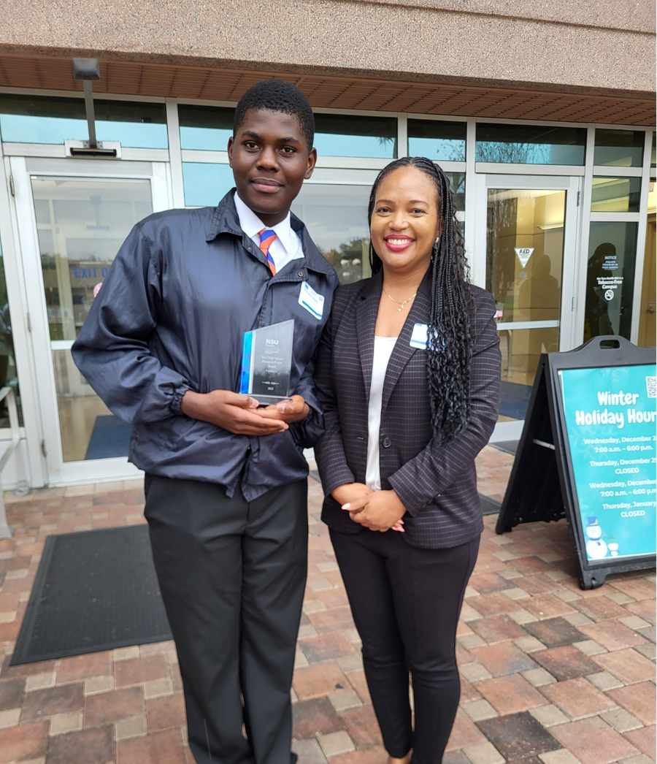
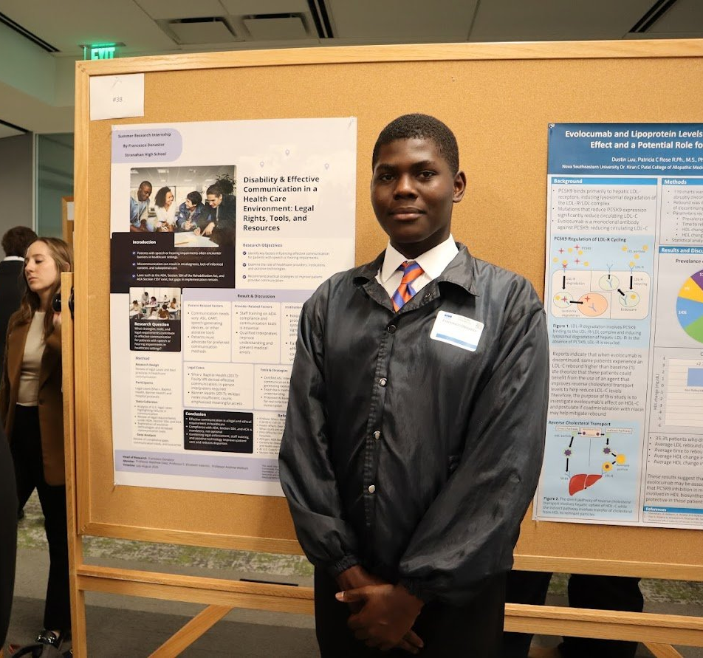
Francesco Donastor
Stranahan High School
2025 NSU MD RISE Conference Poster Winner High School Category
Notes:
Arkene– discuss RISE conference and Francesco’s award

Slide 17
TIER TWO
LAW 0403 — Legal & Medical Interprofessionalism
Graduate Cross-Listed Course · JD & MD Students Learning Together
Notes:
Marilyn

Slide 18
Tier 2 · Course Overview
Course Basics
3-credit, fully online course (LAW 0403)
Synchronous + asynchronous design
Joint enrollment: JD and MD students in the same course (M4 and Health Law Concentration Students)
One of the very few law school courses in the U.S. to formally enroll both professions together
Weekly Rhythm:
Caucus Colloquium Model
Thu–Sun: independent research; 5 peer-reviewed sources
Monday: interprofessional small-group discussions – create talking points (caucus)
Wednesday: live faculty-facilitated class discussion, each group shares research and ideas (colloquium)
Notes:
Marilyn

Slide 19
Tier 2 · Why Caucus Colloquium?
Why Caucus Colloquium Classroom?
Addresses AI reliance
Deepens active learning
Creates productive AI tension by moving discussion from discussion boards to the small group meetings and class engagement
Mirrors real-world interprofessional collaboration: read, prepare, then engage together
Students bring different professional frameworks to every discussion, deepening learning on both sides
Assessment
Grades are dependent on participation in weekly class sessions and small group meetings
Each student brings their own research and talking points to share with their small group each week
Final capstone: interprofessional group presentations – interactive and only one slide
Tied to the four IPEC competency domains
Notes:
Marilyn

Slide 20
Tier 2 · IPEC Competency Framework Aligns with Course
1
2
Shared Values & Ethics
Roles & Responsibilities
Mutual respect across professions; commitment to patient-centered, equity-focused care
Understanding what each profession uniquely contributes — and where they overlap
3
4
Interprofessional Communication
Teams & Teamwork
Speaking across professional cultures; translating legal concepts for clinicians and vice versa
Collaborative problem-solving; practicing the dynamics of real-world law-medicine partnerships
Notes:
Lauren to revisit the IPEC competencies shared by Arkene and apply them to the class objectives

Slide 21
Tier 2 · Topics Covered — Where Law & Medicine Intersect
Medical-Legal Partnerships
Reproductive Justice
Agentic AI in Law & Medicine
Burnout & Mental Health
Private Equity in Healthcare
End-of-Life Ethical Dilemmas
Patient Rights, Informed Consent & Malpractice
Misinformation, Social Media & Professional Identity
★ End-of-life module directly bridges to Tier Three — Cleveland Clinic MLP
Notes:
Lauren – topics included change each year depending on emerging areas in law and medicine, faculty meeting extensively before the semester to plan course content, faculty meet weekly prior to class to discuss problems to raise for discussion in each class session.

Slide 22
Tier 2 · Significance
  One of the only law school courses in the country to formally enroll JD and MD students together with shared credit-bearing coursework
  Creates a pipeline of graduates already versed in MLP principles who are ready to serve communities from day one of practice
Interprofessional exposure at the graduate level:
  Builds comfort communicating across professional cultures
  Expands students' sense of what advocacy can look like
  Ensures neither JD nor MD graduates enter practice having never meaningfully engaged with the other profession
Notes:
Lauren

Slide 23
Student Feedback – Extremely Positive
Law Student
“Working alongside medical students has made me approach client advocacy with a stronger focus on practical implementation, not just legal theory. It has helped me better understand clinical decision-making, which improves how I assess risk, foresee compliance issues, and advise on realistic outcomes. I’m more attentive to how legal strategies affect patient care in real time, especially in high-stakes or time-sensitive situations. Overall, it has made my advocacy more collaborative and outcome-oriented, rather than purely doctrinal. Also, fostering these connections is invaluable.”
Medical Student
“It has helped immensely; this course gave me a better perspective on how multiple professions aid in medical care.”
Notes:
Marilyn

Slide 24
TIER THREE
Cleveland Clinic MLP
Emerging Community Model · Prospective at This Stage
Notes:
Marilyn

Slide 25
Tier 3 · The Cleveland Clinic Partnership — Anticipated Structure
⚠ This tier is nascent — the model described here reflects anticipated structure and prospective goals
The Partnership:
NSU law clinic students embedded at Cleveland Clinic to provide end-of-life legal counseling to patients with chronic illness
Why this population?
Patients with chronic illness and those approaching end of life face pervasive unmet legal needs: advance directives, healthcare proxies, guardianship alternatives, Medicaid planning, disability benefits, including other issues that directly affect treatment adherence, care transitions, and quality of life.
Anticipated referral flow:
Cleveland Clinic clinician identifies patient with legal need → referral to NSU law clinic → supervised student handles intake, document preparation, and counseling
Notes:
Marilyn

Slide 26
The Continuum in Action
Each tier feeds the next — intentionally, not incidentally
TIER 1
JD and MD students lead in Ad Law-Med program - Awareness
▼
TIER 2
Enrolls in LAW 0403 as JD or MD student - Competency
▼
TIER 3
JD student serves patients at Cleveland Clinic MLP; end-of-life module directly prepared them - Practice
Notes:
Marilyn

Slide 27
DISCUSSION
Implications & Significance
Framework · Health Equity · Scalability
Notes:
Arkene
"This model is best understood as a developmental continuum rather than three separate programs. Each tier builds on the previous one: early exposure creates interest and purpose, graduate education develops collaborative competencies, and community practice provides opportunities to apply those skills in real-world settings. What makes the framework unique is its intentional design. Regardless of where an institution begins, the goal is to create repeated opportunities for learners to engage across professions and progressively deepen their commitment to health equity and collaborative practice."

Slide 28
Discussion · The Continuum as a Framework
More than the sum of its parts:
Early awareness creates motivation. Graduate training builds capability. Community practice provides relevance and accountability. Together: a sustainable educational ecosystem.
Grounded in educational theory:
Professional identity formation develops through repeated exposure to values, language, role modeling, and authentic participation over time (Cruess et al., 2015). Each tier provides that exposure in a developmentally appropriate form.
The model is dynamic, not prescriptive:
A rural center may start with graduate coursework; an urban partner may lead with community practice. The core principle — intentional movement from awareness → competency → applied practice — remains constant regardless of local structure.
Notes:
Lauren

Slide 29
Discussion · Health Equity Implications
Upstream — Workforce:
Pipeline programs that recruit from underrepresented communities before professional silos form create a generation of physicians and attorneys whose equity orientation is experiential and relational — not just theoretical
Addresses the gap:
80% of physicians lack confidence addressing social issues; our model builds that confidence from high school onward
Diversifying who enters law and medicine:
By reaching Broward County students from underserved schools, Ad Law-Med broadens the pipeline itself
Downstream — Patient Care:
Patients with chronic illness and those approaching end of life carry the heaviest unmet legal burden — and those burdens directly influence treatment adherence, care transitions, and quality of life
MLPs have demonstrated:
Addressing legal needs reduces stress, improves care engagement, and enhances health outcomes (Regenstein et al., 2018; Murphy et al., 2015)
The result:
A model that addresses equity upstream through professional formation and downstream through direct patient advocacy simultaneously
Notes:
Lauren

Slide 30
Discussion · Replicability & Scalability
What institutions need to replicate this model:
A medical school or health professions program
A law school or legal services partner
A community-based health system or clinic anchor
Pipeline school partnerships (ideally in underserved communities)
Modular adoption — institutions do not need all three tiers at once:
Start with one tier. Build toward the others. The framework is flexible because its core is developmental integration, not uniform replication.
Future evaluation priorities:
IPEC competency growth · advocacy confidence · workforce tracking · clinical outcomes (advance directive completion, patient satisfaction) · longitudinal outcome data across the continuum
Notes:
Arkene
"The central message of this work is that medical-legal partnerships should not be viewed solely as service delivery models. They can also serve as powerful educational frameworks that prepare future professionals to address the social determinants of health through collaboration. By connecting pathway programs, interprofessional coursework, and community-based practice, the NSU model creates a continuum that supports workforce development, professional identity formation, and health equity. We hope this framework encourages other institutions to rethink how law and medicine can learn, teach, and serve together.

Slide 31
Conclusion
MLP principles need not be confined to the clinic.
They can — and should — permeate education from high school through professional practice.
NSU's three-tier continuum is the first model to bring faculty, graduate students, and high school students together under a unified MLP framework
Legal and medical educators should ask: are our curricula building bridges — or reinforcing silos?
Future directions: longitudinal outcome tracking, scaling Ad Law-Med to additional counties, publishing Cleveland Clinic MLP clinical outcomes
Notes:
Arkene
"Thank you for your time and engagement. We welcome questions about any aspect of the continuum, including program development, curriculum design, partnership formation, evaluation strategies, or opportunities for replication at other institutions. We look forward to discussing how interprofessional medical-legal education can advance health equity and strengthen communities."

Slide 32
Questions & Discussion
Nova Southeastern University
Dr. Kiran C. Patel College of Allopathic Medicine · Shepard Broad College of Law
Three-Tier MLP Educational Continuum
Notes:
Arkene

