Slide 1
FDA’s Authority to Regulate Longevity Products
Camila Strassle, JD
Researcher, University of Pennsylvania
Incoming PhD student, UCLA

Slide 2
Acknowledgements
Holly Fernandez Lynch, JD, MBE
Associate Professor of Medical Ethics and Health Policy and Associate Professor of Law, University of Pennsylvania
Patricia J. Zettler, JD
John W. Bricker Professor of Law,
The Ohio State University Moritz College of Law

Slide 3
Roadmap
What are longevity products?
What is their regulatory status?
Why is it a good idea for FDA to enforce drug approval requirements for longevity products notwithstanding recent political developments?

Slide 4
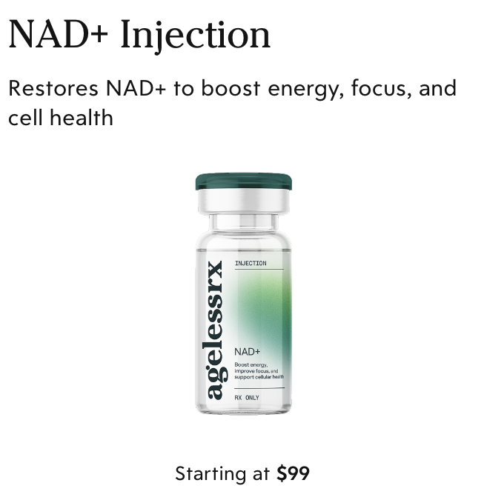
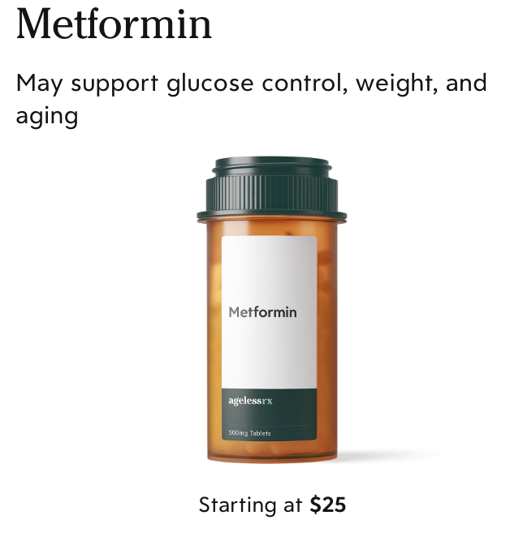
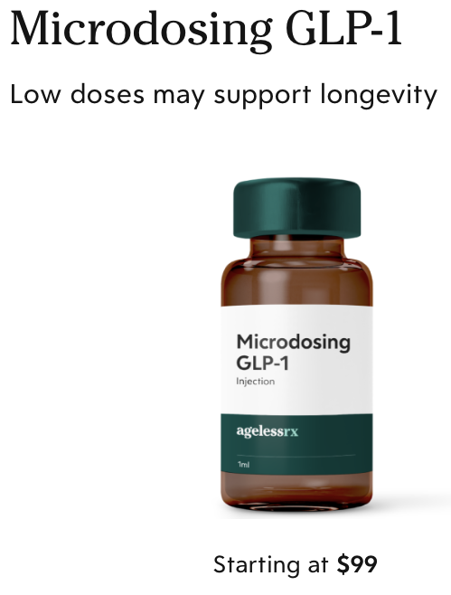
What are Longevity Products?
http://www.agelessrx.com/online/prescriptions

Slide 5
Does FDA have a regulatory construct for these products?
The FDA “does not classify aging as a disease, identifying it instead as a natural, universal process. As a result, there is no regulatory pathway to approve medications specifically targeted to aging.” - The Washington Post
“Because the [FDA] does not recognize aging as a disease, there’s no path forward for a drug to treat it.” - Stat News

Slide 6
Many Longevity Products are Drugs
The term “drug” means products intended for use not only in the diagnosis, cure, mitigation, treatment, or prevention of disease, but also products intended to affect the structure or any function of the body.
21 U.S.C. §321(g)

Slide 7

A Longevity Drug for Dogs
https://www.nytimes.com/2026/05/09/magazine/dog-longevity-treatments.html

Slide 8




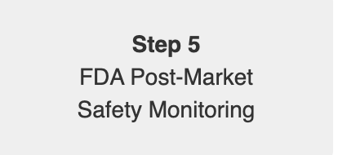
Drugs Need Premarket Approval
https://www.fda.gov/patients/learn-about-drug-and-device-approvals/drug-development-process

Slide 9
Is Compounding a Legitimate Strategy for Distributing Products without Approval?
Compounded drugs must be made for individual patients in response to a valid prescription order
Compounded drugs must be components of FDA-approved drug products or appear on an FDA-created list of permissible substances called the 503A Bulks List
21 U.S.C. §353a

Slide 10
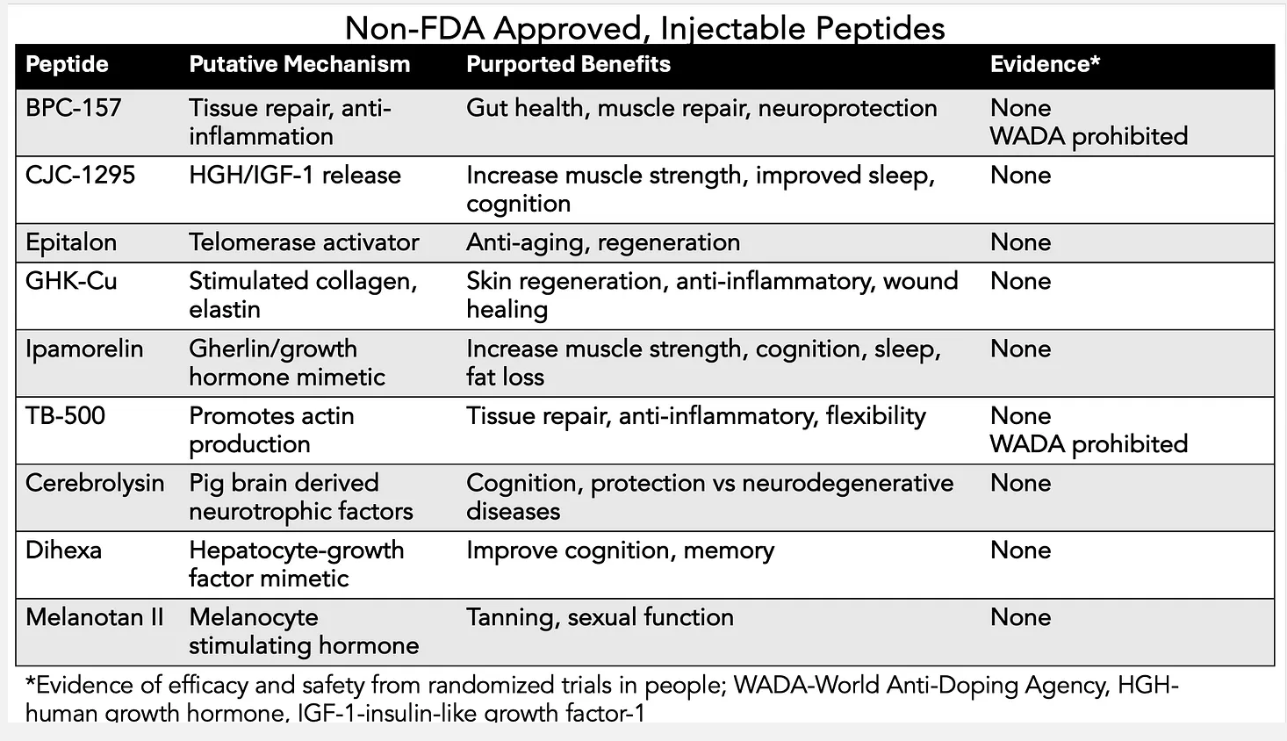
Recent Developments Around Compounding Peptides
https://erictopol.substack.com/p/the-peptide-craze

Slide 11
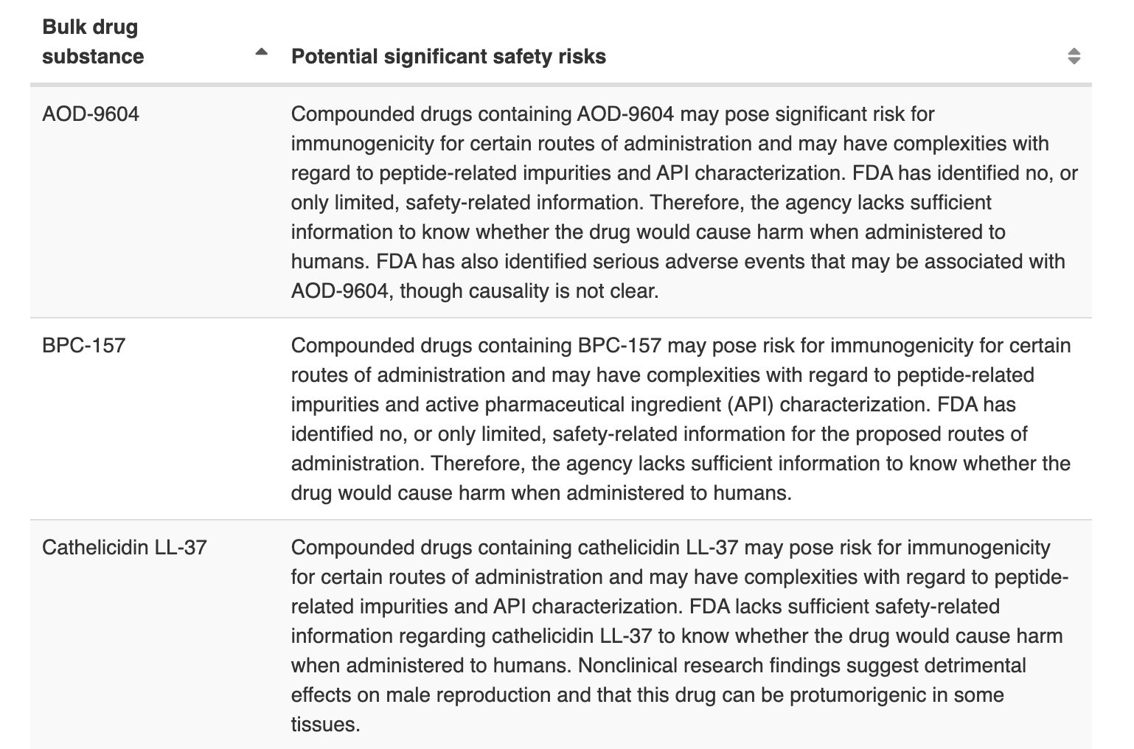
FDA Listed 19 Peptides Ineligible for Compounding in 2023
https://www.fda.gov/drugs/human-drug-compounding/certain-bulk-drug-substances-use-compounding-may-present-significant-safety-risks

Slide 12
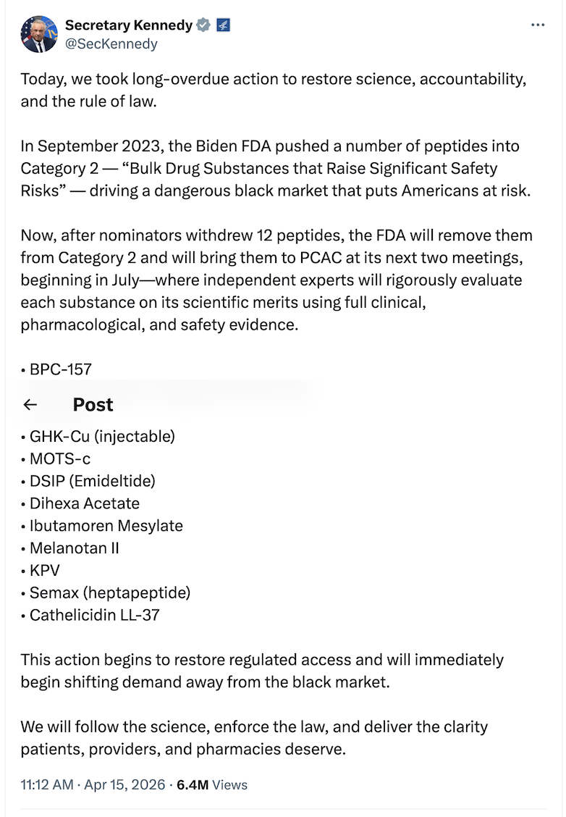
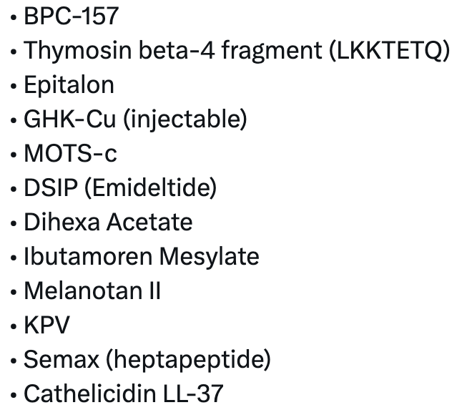
https://x.com/SecKennedy

Slide 13
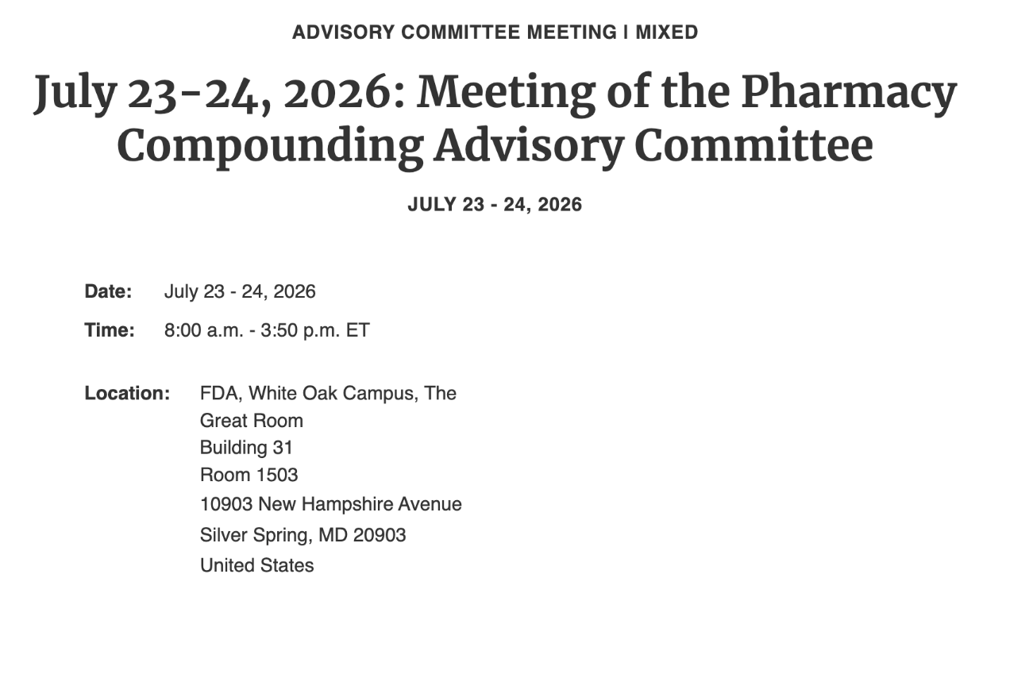
https://www.fda.gov/advisory-committees/advisory-committee-calendar

Slide 14

Why Enforce Drug Approval Requirements for Longevity Products?
Consumer protection
Innovation

