Slide 1
No Genome Left Behind
Enhancing Diversity in Genetic Research Databases
Robert I. Field · Anthony W. Orlando · Arnold J. Rosoff ·
Drexel University · Cal. Poly Pomona · U. of Pennsylvania ·
49th Annual Health Law Professors Conference · Atlanta, GA · June 2026
American Society of Law, Medicine & Ethics · Georgia State University College of Law
Field · Orlando · Rosoff
1

Slide 2
THE PROBLEM
The Diversity Gap in Genetic Databases
<2%
25+
↓
of global genome
sequencing comes from
African populations
years this problem
has been documented
Precision medicine
effectiveness for
non-European patients
Field · Orlando · Rosoff
2

Slide 3
STAKES
Clinical & Ethical Stakes
Precision Medicine
Treatment efficacy is compromised when the underlying research omits subjects with genetic profiles similar to the patient — possibly leading to misdiagnoses and suboptimal care.
GWAS and Polygenic Risk Scores
Genome-Wide Association Studies built on skewed databases produce findings of limited generalizability and compromise the predictive power of risk scores.
Health Equity
Groups most likely to be underrepresented are those already experiencing the greatest social and economic disadvantage — skewed databases exacerbate existing inequities.
Scientific Validity
Good science requires genetically diverse subject pools. Homogeneous databases reduce the ability to identify the full range of genetic variation.
Field · Orlando · Rosoff
3

Slide 4
METHODOLOGY
Our Study: Research Questions & Methods
Three Research Questions
Qualitative Methods
Expert interviews (Zoom,30-60 min. each)
1. Nature & extent of the diversity problem
21
2. Causes of the problem and obstacles to improvement
4
Respondent categories: academic researchers, biobank managers, industry scientists, journal editors
3. Strategies to increase representation of genetic subgroups
2-step recruitment
Purposive + snowball sampling (126 initial contacts)
Coding
Dedoose thematic coding — primary & secondary coders
IRB approved · Cal Poly Pomona · Transcripts de-identified before analysis
Field · Orlando · Rosoff
4

Slide 5
Interviewees’ Overall Observations
“…[T]he potential contributions of this research program are endless…opportunities for new discovery and…finding … new rare variants in a variety of populations. And new disease risks, … all of our applications … we're trying to use for precision medicine and genomic medicine…the sky’s the limit.” (gov’t database manager)
“[T]hose things need a long time to have … cumulative impact … [It] didn't automatically change overnight; the diversity is in the genomic databases.” (academic researcher)
Field · Orlando · Rosoff
5

Slide 6
Question 1: Nature and Extent of the Problem
Preponderance of European-Skewed Databases – Historically and Currently
Clinical Diagnosis and Precision Medicine
Lack of Diversity Impedes Good Science
Field · Orlando · Rosoff
6

Slide 7
Question 1: Problem of European-Skewed Databases – Historically and Currently
Genomes in the most widely used databases are collected predominantly in the U.S. and Europe — a structural bias baked into the infrastructure of genomic research.
“There is … huge underrepresentation and issues around the diversity, inclusion, and equity of database[s] when it comes to … black genetics data.” (academic researcher)
“[B]y not studying people who represent that vast other amount of diversity we’re not able to access a huge amount of information, … about how variation contributes to health and disease.” (researcher, for-profit genetic research company)
Field · Orlando · Rosoff
7

Slide 8
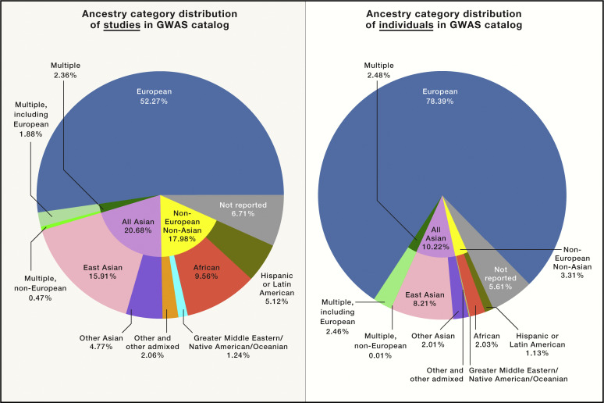
Database Diversity
Summary of GWAS Studies by ancestry for Studies in the GWAS Catalog through January 2019
Field · Orlando · Rosoff
8

Slide 9
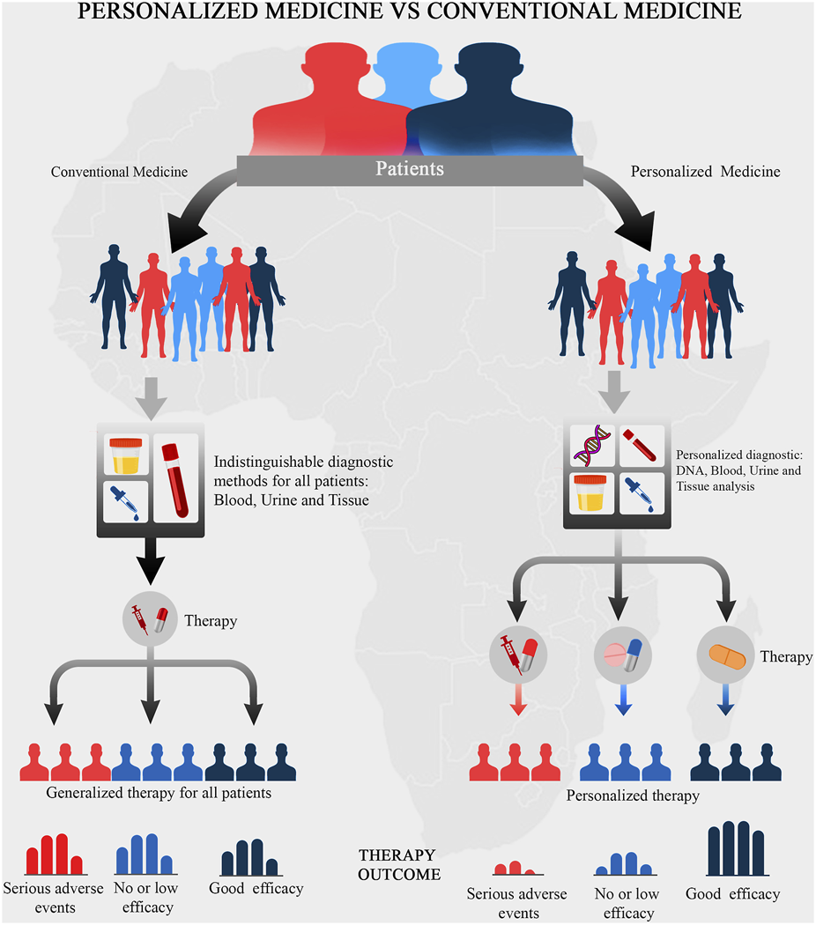
Precision Medicine
Field · Orlando · Rosoff
9

Slide 10
Question 1: Effect on Clinical Diagnosis & Precision Medicine
Pharmacogenetics and precision medicine are less effective for patients whose genetic profiles are absent from databases.
“And then drug metabolism. So, this drug is … [not] metabolized very well in Asia. So, you could have toxicity very fast if you give Asians the same dose as you give to Europeans.” (gov’t. database manager, non-U.S.)
“Choose your favorite underrepresented groups, and … all of these new SNPs (single nucleotide polymorphisms) showed up and all these points at which … [there are] differences … Just like basic understanding of [any] biological mechanisms is to look at the diversity of life -- whether you study bacteria, like I did, or human beings.” (database mgr., non-profit research inst.)
Field · Orlando · Rosoff
10

Slide 11
Question 1: Lack of Diversity Impedes Good Science
Researchers emphasized that the scientific validity of genetic studies depends on diverse subject pools. Homogeneous databases are not just inequitable; they are epistemically flawed.
“By studying only 16% of the world's population -- which is kind of what we're doing now --we are leaving on the table … all this other scientific information…that we're losing by not having a more diverse set of data and genomics.” (academic researcher)
“[W]e've mined the hell out of European ancestry genomes and we're only going to get so many answers.” (database mgr., non-profit research institute)
Field · Orlando · Rosoff
11

Slide 12
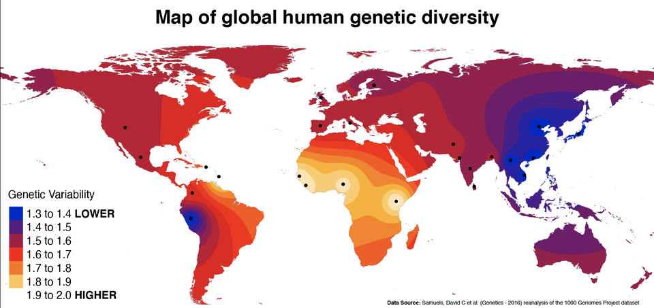
Field · Orlando · Rosoff
12

Slide 13
RESULTS — CAUSES & OBSTACLES
Issue 2: Structural Barriers
Funding Limitations
Publish-or-Perish Pressure for Academic Researchers
Historical Mistrust of Medicine
Socio-Economic and Geographic Barriers
Inconsistent Race and Ethnicity Reporting
Logistics of Subject Recruitment
Field · Orlando · Rosoff
13

Slide 14
Question 2: Funding Limitations
Recruiting diverse, hard-to-reach populations costs significantly more, and funders rarely provide adequate support to cover it.
“Yeah, it's expensive. It requires more money …, you know, billions of dollars. You're not going to get a grant to do that.” (gov’t database manager)
“… [T]here are certain levers … we can pull as a private funder that … the NIH can’t.… [F]or instance, I launched a program around all the ancestry networks … (in which) the goal explicitly … was to only do analysis or gather data from people from underrepresented groups. … the NIH as a federal group couldn't do that… particularly … in the Trump administration.” (database manager, non-profit research institute)
Field · Orlando · Rosoff
14

Slide 15
Question 2: Publish-or-Perish Pressure
for Academic Researchers
Career advancement incentives push researchers toward large, accessible databases rather than conducing time-consuming recruitment to expand them.
“The reward system incentivizes us going after low-hanging fruit…. [W]hen the resources [are not] out there…it's really tough to strike a new path, especially when you rely on those sorts of resources.” (academic researcher)
“A lot of it is data collection … using the same samples … you've run over and over… [O]nce you've collected a good cohort you want to reuse it.” (gov’t. database mgr., non-U.S.)
“If your objective is to learn some biology, it is easier … to approach data that's more homogeneous, and … more well-characterized and well-studied.” (academic researcher)
Field · Orlando · Rosoff
15

Slide 16

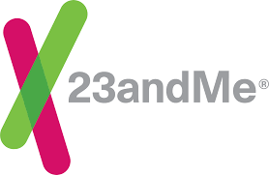








Direct-to-Consumer (DTC) Genetic Testing Companies:
Troves of Data Available, But Mostly Not Diverse
Field · Orlando · Rosoff
16

Slide 17
Question 2: Historical Mistrust of Medicine
Long-term medical mistreatment of minority communities — from Tuskegee to contemporary inequities — makes some minorities reluctant to participate in research.
“There's a fundamental history of mistrust in many populations about research in general for very good reasons, because people were harmed in the past and treated inappropriately before we had … good human protections laws in place.” (gov’t. database manager)
“We saw this: [T]here was a project a few years ago in the UK to roll out data-sharing and … [it] presumed consent on [sharing] certain types of health records. … [I]t got cancelled … because there was a huge drive in certain minority communities with a historical…distrust of the medical establishment … [to go out and tell] people to opt out.” (gov’t. database manager, non-U.S.)
Field · Orlando · Rosoff
17

Slide 18
Question 2: Socio-Economic and
Geographic Barriers
Access to major medical centers is required for some databases. Language, transportation, and insurance gaps compound the challenge.
“It really requires engagement with the communities…so that you've got, you know, African Americans enrolling the African American populations and really earning the trust of people is huge, which is why it takes a lot of effort.” (gov’t. database m)
“… [T]he reason why most people from only European ancestry were collected and used in genetic studies is just because the samples were collected in...richer, more funded countries… I don't think it was really intentional.” (academic researcher)
Field · Orlando · Rosoff
18

Slide 19
Question 2: Inconsistent Race and
Ethnicity Reporting
Arbitrary racial and ethnic classifications and unreliable self-reporting make it difficult to accurately measure and address genetic diversity.
“… [In many] healthcare settings in the US … apparently ethnicity or race is not a self-identified field but … [rather] a provider-assigned field. …[Y]our doctor looks at you and goes, ‘you're African American’ without actually double-checking...” (gov’t database manager, non-U.S.)
“[T]hese things are… sticky and messy, and there's no right answer…. … I think it’ll continue to evolve as these concepts evolve and as the discussion continues.” (gov’t database manager)
Field · Orlando · Rosoff
19

Slide 20
Question 2: Logistics of Subject Recruitment
Minority and non-Western populations are structurally harder to reach and classify.
“The first thing that stands out that everybody will tell you is infrastructure…And the second thing is- infrastructure, like the capacity to build the level of sequencing at the level of single cell and all that analysis part is one.” (academic researcher)
“… [t]he human genome reference…is largely European. You can find those SNP (single-nucleotide polymorphism) differences much better. But when you are looking at an individual … not of European descent and … aligning it to that reference genome … what pumps out … they call … variance of unknown significance.” (journal editor)
Field · Orlando · Rosoff
20

Slide 21
RESULTS — STRATEGIES
Issue 3: Strategies for
Increasing Database Diversity
01
Enhance Community Engagement and Outreach
02
Recruit More Researchers from Underrepresented Groups
03
Build on Pharma Industry Interest
04
Expand Infrastructure for International Collaboration & Global Recruitment
Field · Orlando · Rosoff
21

Slide 22
Question 3: Enhance Community Engagement
and Outreach
Personalized, culturally tailored engagement — by trusted community members — is the most consistently cited strategy for overcoming historical mistrust and increasing participation.
“… Having patient representatives on the project and … in the same way you could have community representatives. … [T]hey can be brought onto the project as advisors.” (gov’t. database manager, non-U.S.)
“In addition to that, we're trained to be at the bench. We're not trained to go out and try to do community engagement. …[C]ommunity meetings are hard…. I think scientists … are a conservative bunch; … so there is reluctance and concern, and fear…” (database manger, non-profit research institute)
Field · Orlando · Rosoff
22

Slide 23
Question 3: Recruit More Researchers from Underrepresented Groups
Researchers who are members of local or minority populations can dramatically improve recruitment. Diversifying the scientific workforce is both a means and an end.
“I think the lens … you're looking from … is a very American-centric lens. Community engagement is not a problem in Kenya because the Kenyan doctor looks like you [the patient]. It is not a problem in Brazil because there's a culture of … ‘[if] the doctor says to do this, I'll do it’.” (database manager, non-profit research institute)
Field · Orlando · Rosoff
23

Slide 24
Question 3: Build on Pharma Industry Interest
Pharmaceutical companies need genetically diverse data to develop drugs with broad efficacy. Aligning commercial incentives with genetic diversity goals can be a powerful lever.
“What has been interesting in the last five years -- which is a bit of a sea change in pharma -- is R&D pipelines are increasingly using genomic information and clinical trials pipelines are increasingly using some genomic information for the purpose of accelerating the clinical trials. … [T]hat means that pharma itself is becoming interested in not just genomic data, but diverse genomic data...” (academic researcher)
Field · Orlando · Rosoff
24

Slide 25
Question 3: International Cooperation Could Be
a Big Step toward Increasing GDB Diversity
Given the quality and extent of some other countries’ GDBs – such as the UK Biobank – sharing data and collection efforts could greatly improve data diversity essential for optimal medical research.
Interviewees described promising momentum in cross-border data- sharing initiatives.
Global recruitment could tap into vast sources of data not reachable through U.S. & European GDBs.
Industry and philanthropic players – e.g., the Gates Foundation – have aligned objectives and access to substantial non-governmental funding.
Field · Orlando · Rosoff
25

Slide 26
However, Achieving Such International
Cooperation Faces Challenges
Data privacy regimes differ -- e.g., the EU’s GDPR protections exceed U.S. standards – making some other countries less willing to share sensitive data with the U.S.
Nature vs. nurture: controlling for other factors (such as diet, the environment, education, & healthcare access) is important when applying data across borders.
Genetic diversity within countries and across continents (esp. across Africa) is considerable.
The U.S.’s recent position toward the WHO has greatly undermined the trust and spirit of cooperative endeavor needed for 21st Century medical progress.
Field · Orlando · Rosoff
26

Slide 27
We’re on the Threshold of a Major Advance
in Healthcare Knowledge & Progress
How can we move forward the way we want and need to with so many factors pointing in the wrong direction?
We must realize how much we have in common regarding our needs and objectives to fully appreciate how much more we must cooperate to use our diversity to achieve the goal that will benefit us all as one Great Society!
Field · Orlando · Rosoff
27

Slide 28
Thank you for your
interest & attention
and SPECIAL THANKS to our tireless Research Assistant,
Grace Wang, just graduated from the Univ. of Penna., whose exceptional talent and devotion helped make our research possible.
49th Annual Health Law Professors Conference · Atlanta, GA · June 2026
Field · Orlando · Rosoff
28

Slide 29
Let’s Continue the Conversation
We welcome colleagues who share an interest in genetic database diversity — please reach out!
Robert I. Field, JD, MPH, PhD
Professor of Law & Health Policy
Drexel University
rif24@drexel.edu
Anthony W. Orlando, PhD
Assoc. Professor, Finance, Real Estate & Law, Cal. Poly Pomona
aworlando@cpp.edu
Arnold J. Rosoff, JD
Professor Emeritus, Health Care Management & Legal Studies
Wharton School, U. of Pennsylvania
rosoffa@wharton.upenn.edu
49th Annual Health Law Professors Conference · Atlanta, GA · June 2026
Field · Orlando · Rosoff
29

