Slide 1

Ethical Obligations of Physicians in Clinical Research
Mark A. Rothstein, J.D.
Director of Translational Bioethics
Institute for Clinical and Translational Science
University of California, Irvine
© 2026

Slide 2

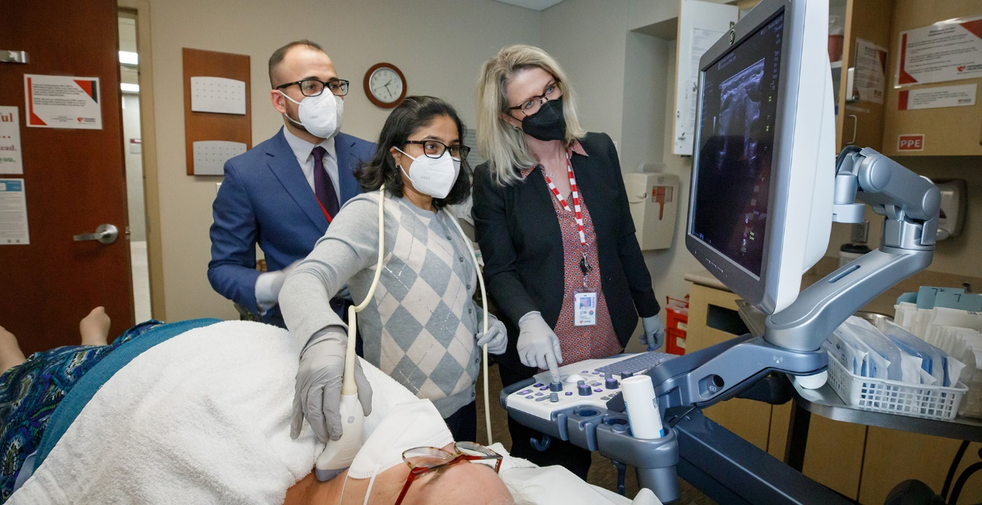
Physicians have dual roles in clinical research
Scientist: Discover generalizable knowledge.
Physician: “First, do no harm” and promote the well-being of even non-patients.

Slide 3
Research Ethics Challenge
If physicians regard research participants as their patients, they promote the well-being of the participants but possibly undermine research.
If physicians prioritize research, they might engage in medical practices lacking the transparency, fidelity, and beneficence of the physician-patient relationship.

Slide 4
Physician Roles in Clinical Research
Principal investigator
Inclusion/exclusion criteria
Baseline medical data
Invasive procedures
Effects of research intervention

Slide 5
Adverse consequences for participants of the dual obligations of physicians in clinical research
1. Therapeutic misconception
2. Forgoing regular medical care
3. Failing to weigh risks and benefits
4. Not being informed about incidental findings

Slide 6
The possibility of discovering generalizable knowledge to benefit society is the ethical justification for physicians to engage in research practices that fail to meet the standard of care or medical ethics principles if done in clinical settings.
Randomization
Placebo controls, sham surgery
Medically unnecessary scans and tests
Medically unnecessary invasive procedures
(e.g., cardiac catheterizations)

Slide 7

Prioritizing possible scientific discoveries over burdens on research participants is customarily approved by public and private research
funders, research regulators, research institutions, and IRBs.

Slide 8

But not the AMA
AMA Ethics Opinion 7.1.1
  [Physicians who are involved in research should]
  “Demonstrate the same care and concern for the well-being of research participants that they would for patients to whom they provide clinical care in a therapeutic relationship.”

Slide 9
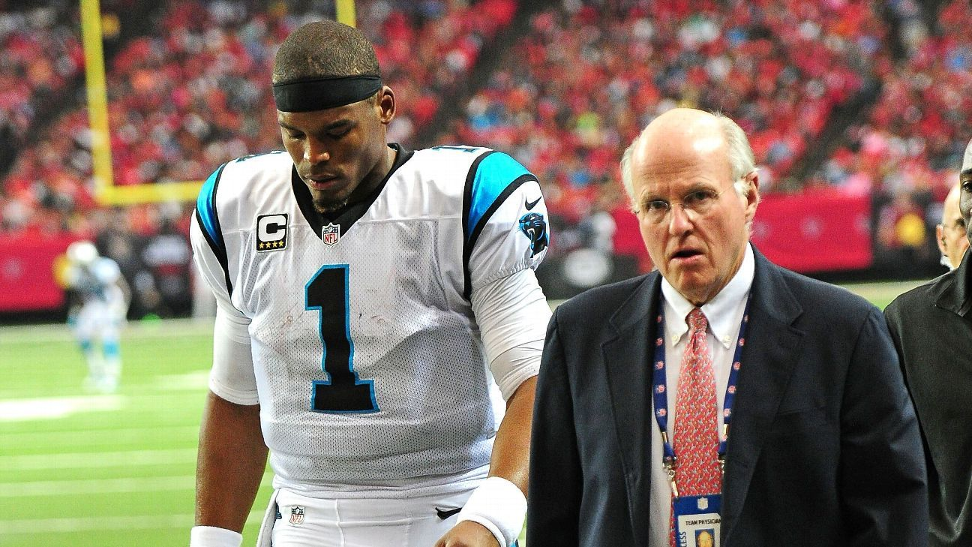
Other dual obligation relationships of
physicians
Employment medical evaluations
Insurance medical evaluations
Professional sports evaluations and care
Notes:
Cam Newton, QB

Slide 10
AMA Ethics Opinion 1.2.6 (2017)
Physicians employed by businesses or insurance companies who provide medical examinations should:
Disclose the physician’s relationship with the third party.
Explain the difference between this relationship and the traditional fiduciary role of a physician.
Protect the individual’s health information in accordance with professional standards.
Inform the individual about incidental findings and, when appropriate, suggest follow-up and assist in arranging further care.

Slide 11
Bill of Rights for Clinical Research Participants
Clinical research participants have the following rights:
To be told about the physician’s employment, credentials, role in the research, and any conflicts of interest.
To be informed about how a physician’s role differs in clinical practice and research.
To be told about the nature and purpose of medical procedures in the research.
To be told about privacy, confidentiality, security, and data sharing.
To be asked for consent for each medical test or procedure and be told about the right to decline or terminate any test or procedure.

Slide 12

6. To be offered information about important diagnoses and incidental findings.
7. To be offered to have medical information sent to their personal physician.
8. To be offered referral for medical follow-up.
9. To be offered to be recontacted if new medical information is later discovered.
10. To receive treatment and/or compensation for harms resulting from the research.

Slide 13

Bill of Rights for Research Participants = Obligations for Research Physicians
Even in the absence of a traditional physician-patient relationship physicians have an ethical obligation to conduct clinical research transparently and to protect the well-being of research participants.

Slide 14
Likely concerns or objections
Disclosures would reveal proprietary information.
Disclosures of medical test results would unblind the study.
Physician disclosures would be time consuming.
Participants have consented to this arrangement.
Disclosure duties for incidental findings could lead to liability.

Slide 15
Adoption of the Bill of Rights
Individual or groups of physicians
Commercial sponsors of research (Pharma)
Nonprofit sponsors of research (ACS)
Government research funders (NIH)
Healthcare and academic medical institutions
Research ethics regulators (OHRP)
IRBs
Drafters of codes of medical ethics (AMA)
Medical licensing boards
State or federal legislators (Cal)

Slide 16
Ethical precepts should protect research physicians
Many research physicians are employees of large institutions and are subject to the rules of their employer.
If the institution contracts with a research sponsor to limit disclosures to participants (e.g., incidental findings), physicians can be required to follow the employer’s rule.
Federal “conscience” law permits conscientious refusals to provide certain care but not conscientious provision of care (or disclosures) in violation of their employers’ rules.
See Dov Fox, The Conscience of Care (Harvard Univ. Press, 2025).

Slide 17
Reference
Mark A. Rothstein, Research Participant Bill of Rights: Clarifying the Role of Research Physicians, Ethics & Human Research 47(5) (2025): 29-37.

