Slide 1
The Voting Rights Act and Health Care
Gregory Curfman, MD
JAMA
Harvard Medical School

Slide 2
Louisiana v. Callais
Louisiana electoral map includes 6 districts
Following 2020 census, the new state map contained only 1 majority-minority district -- despite 1/3 of population being Black
Section 2 litigation was filed against the state: packing and cracking
Lower court ruled that a second majority-minority district was required to prevent vote dilution
Louisiana complied with creation of SB8 (District 6)

Slide 3
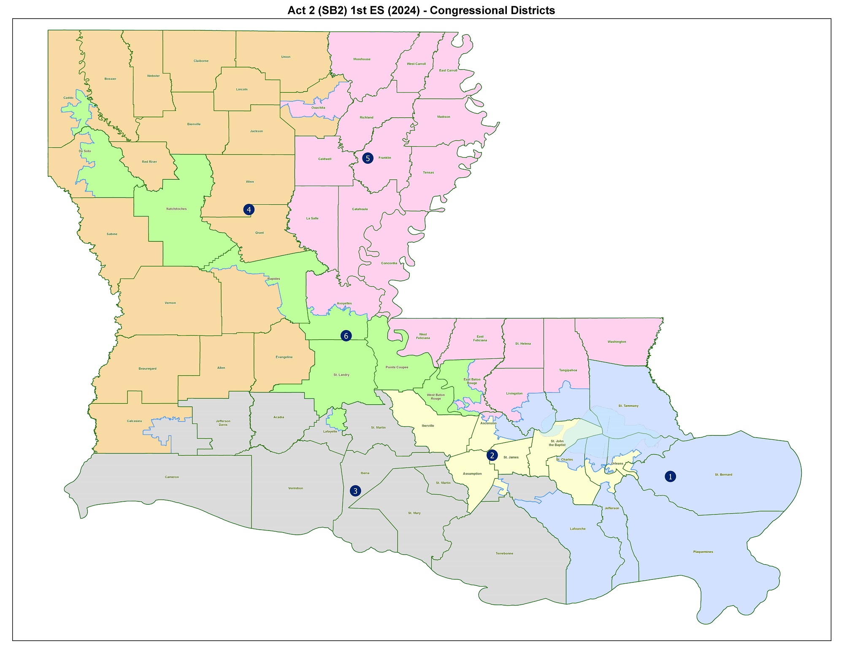

Slide 4
Louisiana v. Callais
Racial gerrymandering case filed against state by Callais plaintiffs
Complaint based on the Equal Protection Clause of the Fourteenth Amendment
Race predominated in the drawing of the SB8 map; strict scrutiny applies
Section 2 claims can survive only if there is intentional racial discrimination
Supreme Court heard oral arguments 10/15/25 and issued judgment 4/29/26

Slide 5
Louisana v. Callais
Justice Alito wrote the opinion for the 6-3 majority
Section 2 does not require a second majority-minority district
Partisan gerrymandering is accepted by the Court
Fifteenth Amendment mandates intentional racial discrimination
Results test is not sufficient
Because intentional racial discrimination is difficult to prove, Section 2 cases will now be challenging (i.e., nearly impossible) to win
Some legal observers say Section 2, though not overturned, is now rendered ineffectual

Slide 6
Louisiana v. Callais
The Supreme Court’s majority opinion overruled the lower court’s requirement for a second majority-minority district
District 6 (SB8) is being redrawn to become a non-majority-minority district, which will be controlled by Republican voters
Two of Louisiana’s six House representatives are currently Black
At least one of the two will lose their seat as a result of the map redrawing

Slide 7
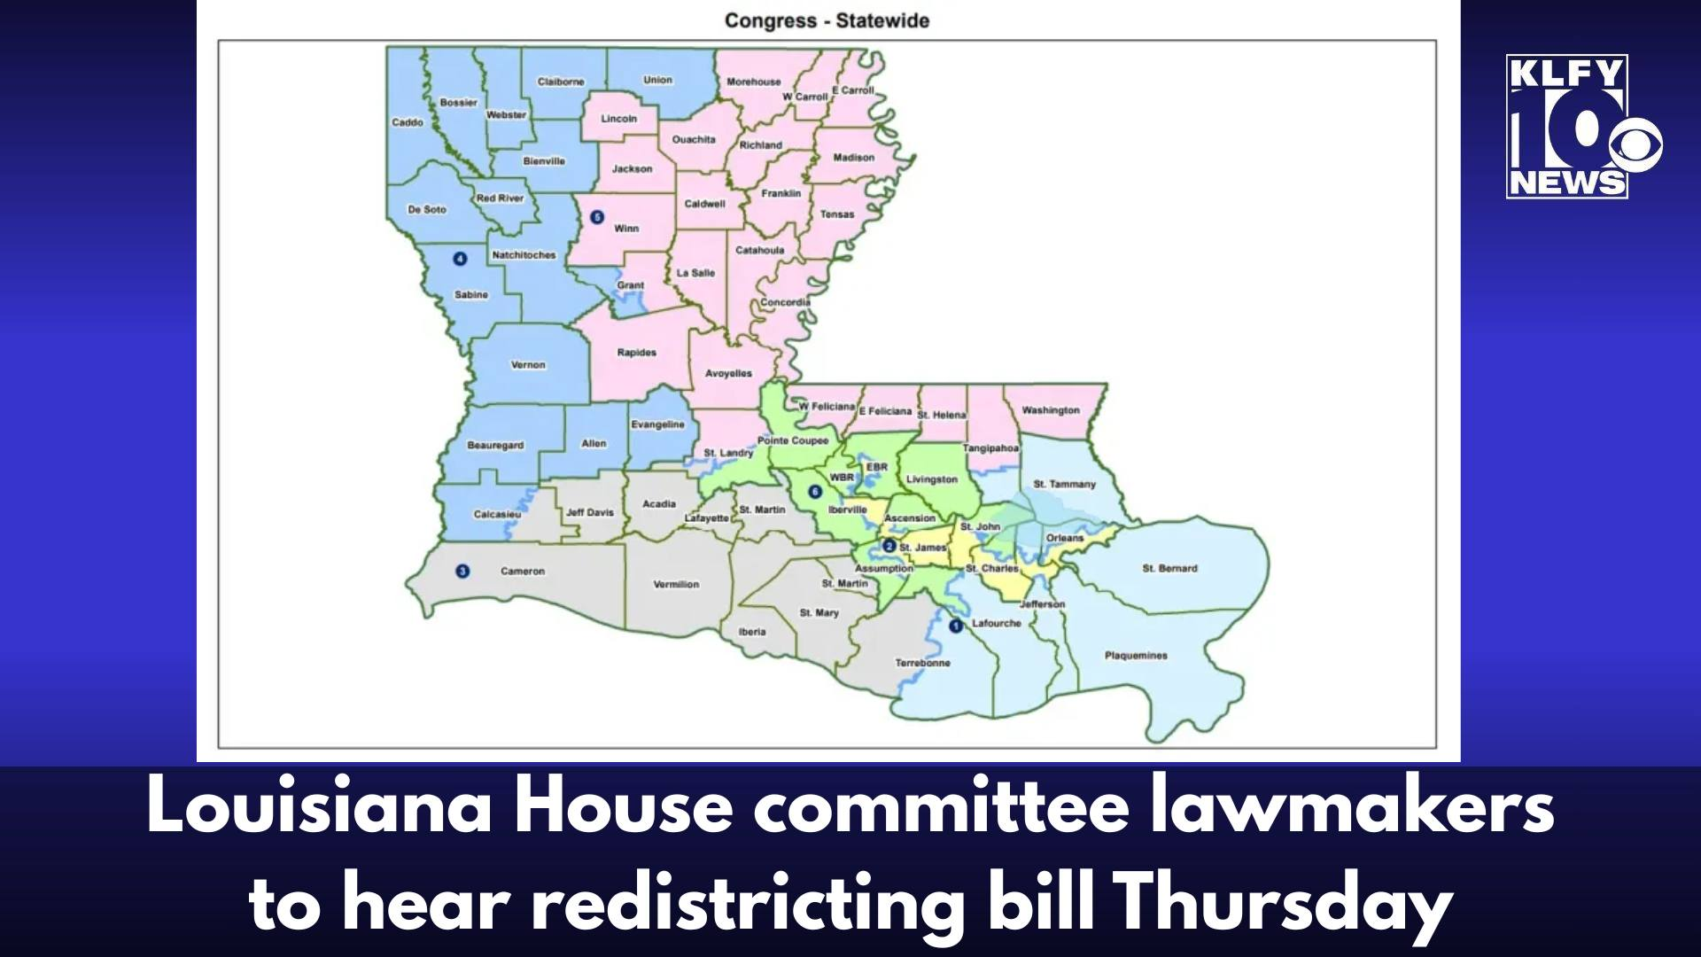

Slide 8
Implications for Health Care
In Louisiana, Blacks comprise 32.6% of the population
In contrast, 8.3% of physicians are Black
Not all patients prefer a physician of their own race
But some do have this preference
Significant racial disparities in health care exist in Louisiana
Louisiana and the Nation need a diverse physician workforce

Slide 9
Solution: Xavier Ochsner College of Medicine
Xavier Louisiana University is an HBCU in New Orleans
Xavier partnered with Ochsner Clinic to develop the all-Black Xavier-Ochsner College of Medicine
The College of Medicine will begin with a class of 50 students, then expand to 100
The College still needs to be accredited by the Liaison Committee on Medical Education (LCME), and this is a detailed process

Slide 10


Slide 11
Xavier-Ochsner College of Medicine
Louisiana’s two Black representatives are:
  Troy Carter, Democrat, District 2, New Orleans
  Cleo Fields, Democrat, District 6, Baton Rouge
The new map places both Black members in the same district, so at least one of them will lose their seat
Both have championed the Xavier-Ochsner College of Medicine
Troy Carter is an alumnus of Xavier, and fought for $5 million in federal funds for the College of Medicine; frequently advocates for the project in Congress

Slide 12
Xavier-Ochsner College of Medicine
The loss of one Black representative will diminish political support for the College of Medicine
Political support will be needed to ensure LCME accreditation
The Trump administration has pressured the LCME to eliminate DEI requirements for medical schools, and LCME responded by doing so
Senator Cassidy has supported the College, but he has lost his primary
Will the all-Black Medical College achieve accreditation?
The College is a vivid example of how the loss of the Voting Rights Act may affect health care

Slide 13
John Rawls – A Theory of Justice
“Perhaps the most obvious inequality is the violation of the precept of one person one vote.”
John Rawls, A Theory of Justice

