Slide 1
ASLME Health Law Professors Conference Wednesday, June 3, 2026
2:30 PM – 3:45 PM
AI Literacy: Preparing Law Students for Practice
Moderator: Asha Scielzo, American University Washington College of Law
Panelists:
Seth Chandler, The University of Houston Law Center
Michael Paulhus, King & Spalding LLP
Matthew Sag, Emory University School of Law
Notes:
Asha: Intros and Slides 1-4 (2:30-2:40 PM)

Slide 2
Agenda
Introduction
The Right Mental Model
A Field Guide to Legal AI Products
Capabilities of Legal AI Tools
Discussion
Q&A
Ethics and Responsibility
AI in Law Practice: Applications

Slide 3
Introduction
AI & The Future of Law
How Artificial Intelligence Is Transforming Legal Practice
$3.2B invested in legal AI in 2025 — a record high
Democratizing access · Accelerating outcomes · Augmenting expertise

Slide 4



THE TRANSFORMATION
Compressed Timelines
Speed.
Strategy.
Access.
Tasks once taking weeks — research, document review, case prep — now completed in days or hours.
Strategic Intelligence
Pattern analysis, success probability scoring, and data-backed projections inform every client conversation.
AI is reshaping every dimension of how legal work gets done — and for whom.
A Level Playing Field
High-quality legal analysis now accessible regardless of firm size or client budget — equity through AI.

Slide 5
The Right Mental Model
How to think about Large Language Models
-Matthew Sag

Slide 6

An LLM is not a magic thinking machine
An LLM is not a database
Part I

Slide 7
What is a large language model?
LLMs work with tokens
Think of “tokens” as words or parts of words
Notes:
Slides via Matthew Sag

Slide 8
a model trained to predict the next token in a series of tokens
What is a large language model?
LLMs generate by predicting one token at a time

Slide 9

Training an LLM – The Big Picture
Model weights are meaningless at first
Improve rounds of training
“pretrained model” e.g. GPT-4
Training data is collected and analyzed
ML model is exposed to fragments of the tokenized training data for a fleeting moment
Model makes a “guess”
Hosting Environment
Guess is evaluated
Finetuned Model
Training data converted into tokens (numbers)
Model weights are updated

Slide 10

>
The training data is much larger than the model

Slide 11

So, to be good at prediction, models memorize a few things and learn to generalize

Slide 12
A Field Guide to
Legal AI Products
What to Adopt, In What Order
June 2026 · Seth J. Chandler
One note before we begin. The models are now good enough at legal work — and spectacularly good at coding — that serious legal applications are being built every week. The explosion of this field cannot be overstated.
Notes:
Seth: Slides 12-28 (2:50 – 3:00 PM)(inclusive of demo)

Slide 13
Six Rungs. You don't have to climb all of them.
6
Build Your Own
Your time
A LOOSE ORDER
The rungs aren't strict.
A loose suggestion — skip ahead, double back, take what fits.
5
Open Source — Mike, Lavern
Free
4
Harvey & Legora
Harvey ~$300K/yr · Legora ~$30K/yr
3
Westlaw Protégé & Lexis CoCounsel
Through your school's database licenses
2
Claude Pro
$20/month
1
NotebookLM
Free

Slide 14
RUNG 1 · NotebookLM
FREE
Start here. The gateway drug.
WHAT IT IS
Browser app. Upload PDFs, articles, notes, transcripts
Ask questions; answers come only from your sources, with citations
Grounded — hallucination is structurally constrained
WHAT IT DOES
Audio Overviews: synthetic podcasts of your materials
Video overviews, mind maps, flashcards, study guides
Gemini 3 + LearnLM. Syncs with the Gemini app
WHY IT MATTERS
Free tier is generous. Workspace for Education campuses already have it
Enterprise data protections — uploads aren't used for training
The on-ramp: faculty come around hearing a podcast of their own draft
USE IT WHEN you want grounded answers from your own materials — and the easiest way to get faculty over the AI threshold.

Slide 15
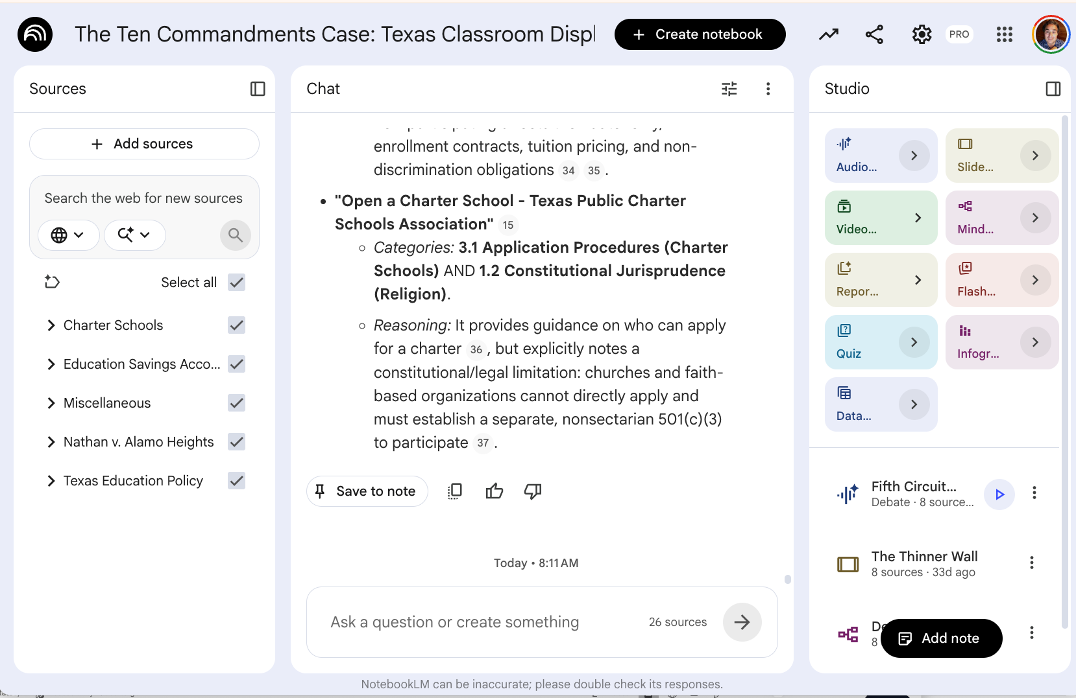
NOTEBOOKLM
The interface.
Left: sources, grouped by category.
Center: a report generated from those sources.
Top right: options to create audio, video, slide, and other artifacts.
Bottom right: artifacts already created — including a debate and a slideshow.

Slide 16
RUNG 2 · Claude Pro
$20 / MONTH
The single highest-leverage purchase a law professor can make in 2026.
WHAT $20 GETS YOU
Claude's strongest models with high message limits
Long conversations about 50-page drafts and 100-page records
The Claude desktop app — your doorway to Cowork
Claude for Word: Claude inside the document
CLAUDE FOR WORD
Highlight a paragraph; ask Claude to tighten or restructure — in the document
Skills and plugins from the side pane: opposing-counsel review, copy edit, cite check
I drafted this lecture this way — Claude in the side pane
COWORK: CHATBOT → AGENT
A chatbot answers questions. An agent does things.
Reads and edits files, builds decks and Word docs, connects to CourtListener and Midpage
Deploys programs to Netlify without leaving the conversation
USE IT WHEN you want one tool for every kind of serious legal writing — and 30 days inside Cowork to leap ahead of most practicing lawyers.

Slide 17
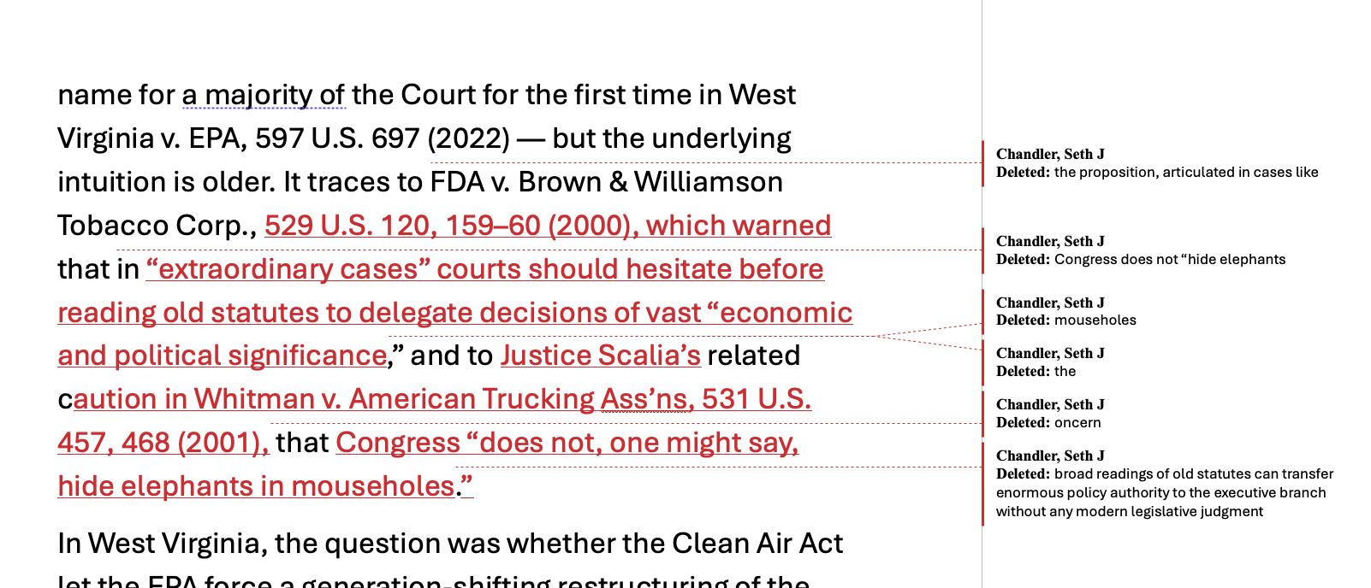
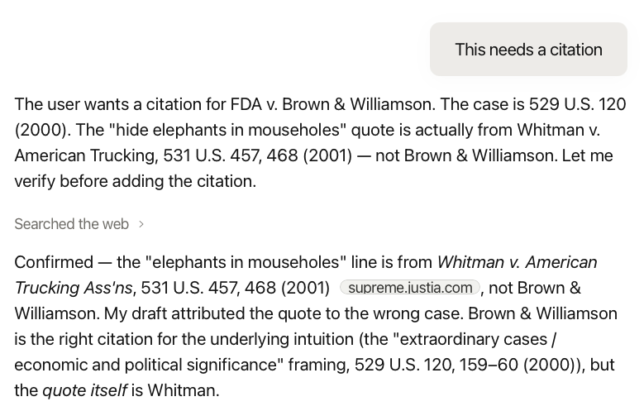
CLAUDE FOR WORD
The add-in, in two views.
Top left: edits Claude made in the document.
Bottom right: the editing discussion in the side pane.

Slide 18
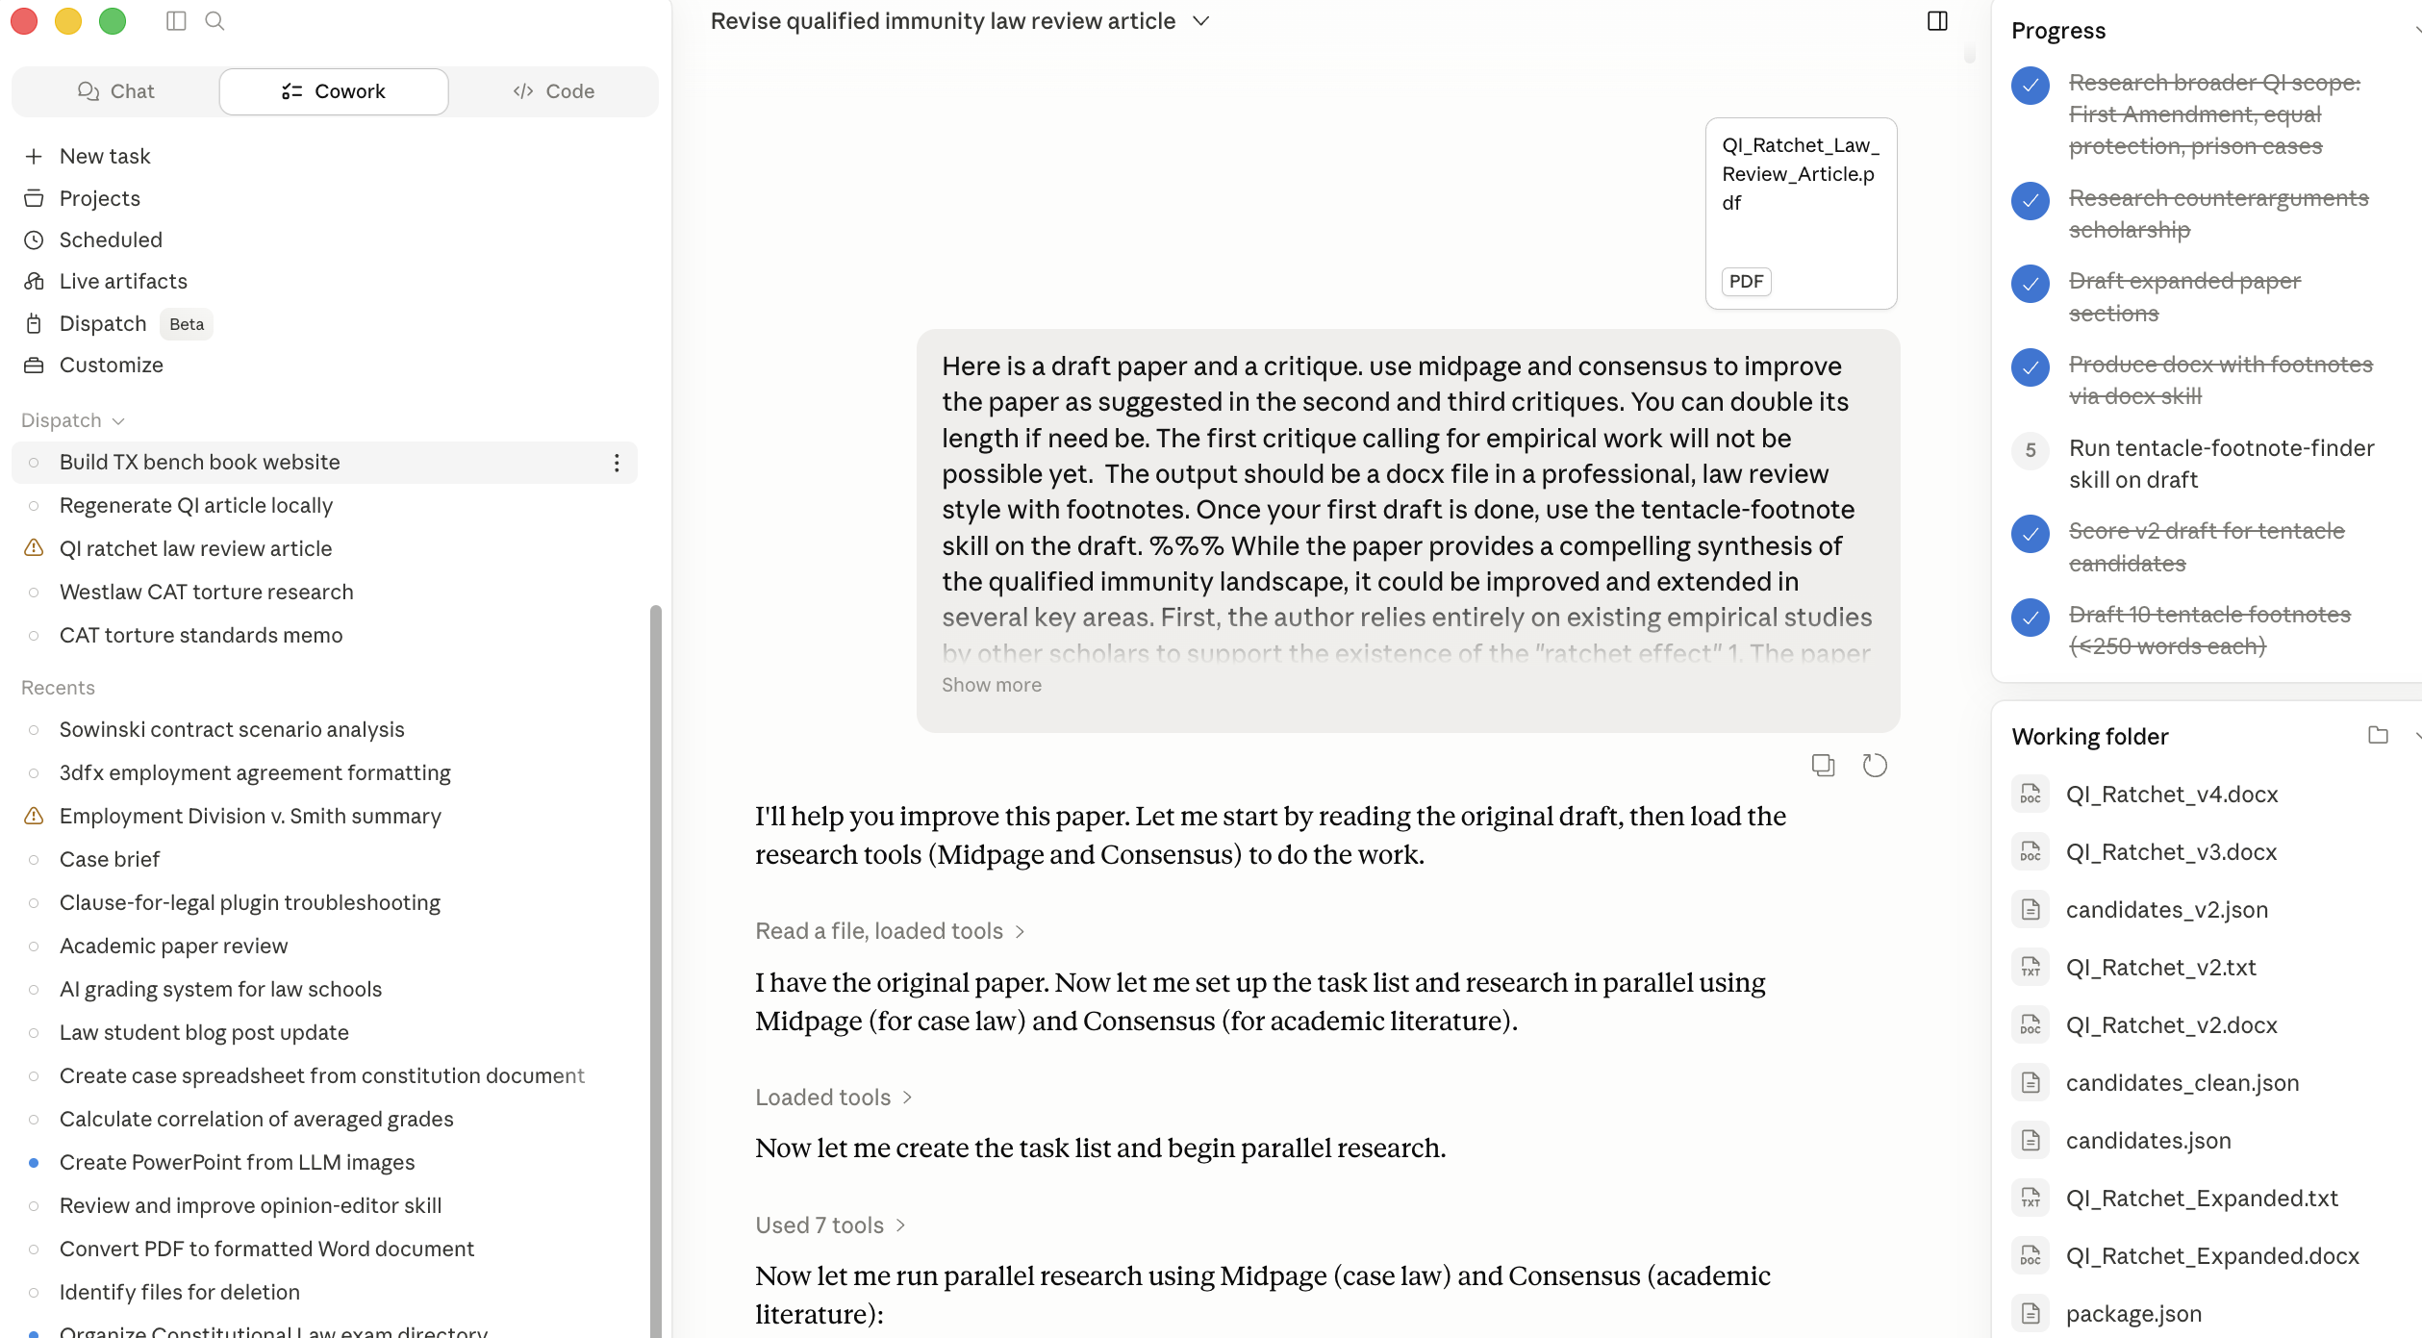
COWORK AT WORK
One draft. Two databases. One skill.
Claude Cowork takes a draft article and improves it through two connectors:
Midpage for primary legal authority
Consensus for academic papers
Then it invokes a Claude skill to add extensive tentacle footnotes to the draft.

Slide 19
RUNG 3 · Westlaw Protégé & Lexis CoCounsel
YOUR SCHOOL ALREADY PAYS
The database tools you already have. Finally usable.
WHERE THEY WERE
First-gen tools two years ago weren't usable for serious work
Stanford study: Westlaw hallucinated ~1/3; Lexis 17%
The writing was dreadful
WHERE THEY ARE NOW
Westlaw CoCounsel: agentic Deep Research, doc review, tabular analysis
Multi-model under the hood: OpenAI, Anthropic, Google
Lexis Protégé: Claude, GPT, Gemini inside Lexis with Shepard's on top
WHY THEY STILL MATTER
Tied to primary law: KeyCite, Shepard's, headnotes
Secondary materials too — law reviews, treatises, practice notes
Students will meet both in practice — let them touch these in school
USE IT WHEN citation accuracy and verified secondary law actually matter — and when your students need to see the toolchain they’ll meet in practice.

Slide 20
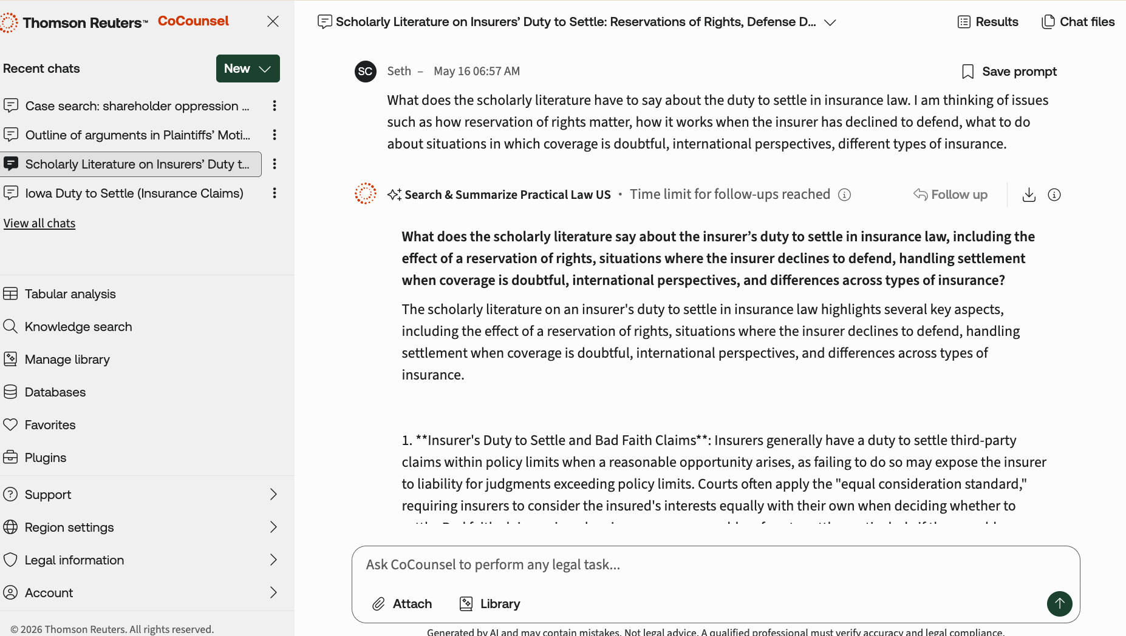
COCOUNSEL AT WORK
Traditional Westlaw, AI-fronted.
A typical CoCounsel workflow — the same Westlaw database you already know, with an AI interface on top.
A Claude → CoCounsel connector exists and could be powerful — but most law schools don't have the license.

Slide 21
RUNG 4 · Harvey and Legora
$30K – $300K / YEAR
The law-firm stack. Your students will be the customer.
HARVEY
AmLaw-firm leader. ~$11B valuation
Agentic capabilities embedded in M365 and Word
~$1,000–1,200/seat/month, 20-seat min, ~$300K/year
You are not buying this for yourself
LEGORA
Swedish challenger. ~$5.5B valuation, Nvidia-backed
Lives inside Word; contract review, due diligence
10-seat minimum, ~$30K/year to start
WHAT YOU PAY FOR
Scale: thousands of contracts, full data rooms, entire case files
Enterprise security: SOC 2, audit trails, no training on client data
Some call it a thick wrapper on the same frontier models
PUSH FOR THIS at your dean's office — not because Harvey is magic, but because fluency with the firm-standard interface is a placement advantage. Minnesota, Vanderbilt, and Penn already have.

Slide 22
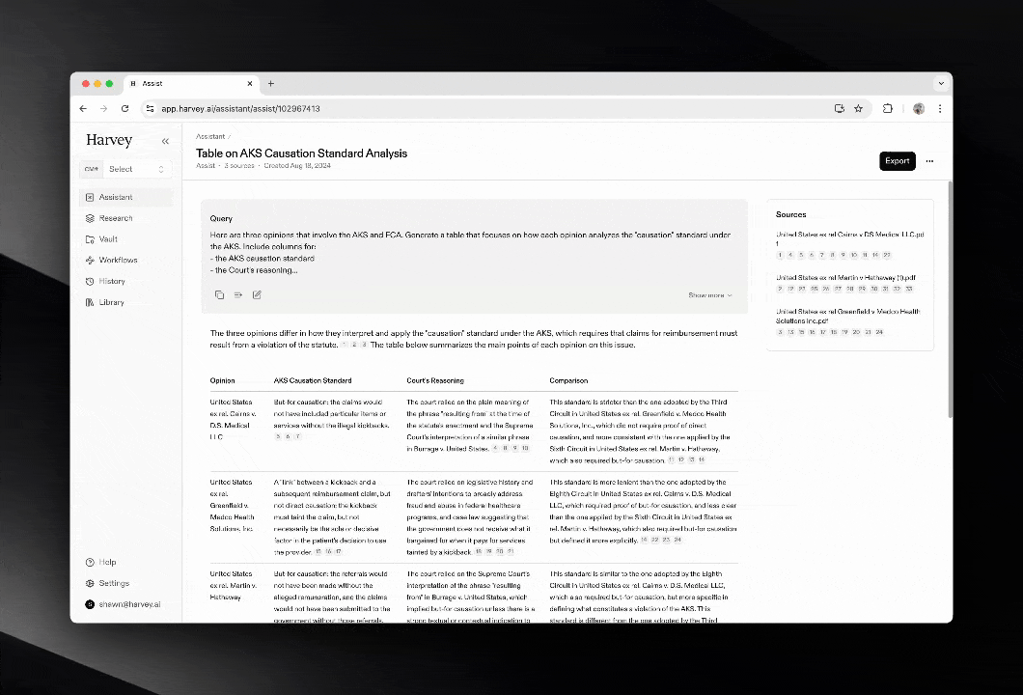
HARVEY IN ACTION
Video screen capture.
The interface a Cravath partner actually sees — agentic workflows running over a firm-grade matter.

Slide 23
RUNG 5 · Mike and Lavern
FREE · OPEN SOURCE
Open source is coming for the enterprise stack.
MIKE (MikeOSS)
Built in two weeks by Will Chen, ex-Latham associate
Does the Harvey core: vault, drafting, review, tabular analysis
Runs locally — documents never leave your machine
LAVERN
Released last week, Apache 2.0
67 specialist agents, evidence-backed debate, human gates — 155K lines
Runs against Claude, Mistral, or fully local via Ollama
WHAT IT MEANS
Drafted a Fifth Circuit cert petition for ~$11 in API charges
"Mike doesn't kill Harvey, but it changes the renewal conversation"
Value migrates from wrapper to model
WATCH IT even if you don't adopt it — this is the leading edge of where legal AI economics are heading.

Slide 24
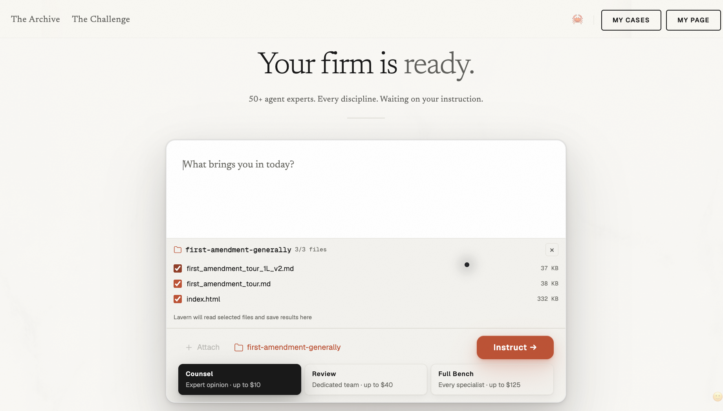
LAVERN
Screen capture from the open-source app.
The user uploads materials — the start of the workflow.

Slide 25
RUNG 6 · Build Your Own
YOUR TIME
English is the new programming language. Yes, even for you.
THE TOOLS
Claude Code, Codex — coding agents that write code from plain English
Deploy to Netlify or Vercel in an afternoon
No technical background — "vibe coding," and the point is real
THE WORKFLOW
Describe in English what you want — a widget, a grader, a timeline
Agent writes code. You refine the description. Agent revises.
Twenty iterations later you have a working app
WHAT MY STUDENTS BUILT
A military law advisor
An immigration office assistant
A mock trial scenario creator — and more
None had coded before. They walked in writing briefs, out shipping software
THE TEST If you can write a coherent paragraph of English describing what you want, you can build the thing.

Slide 26
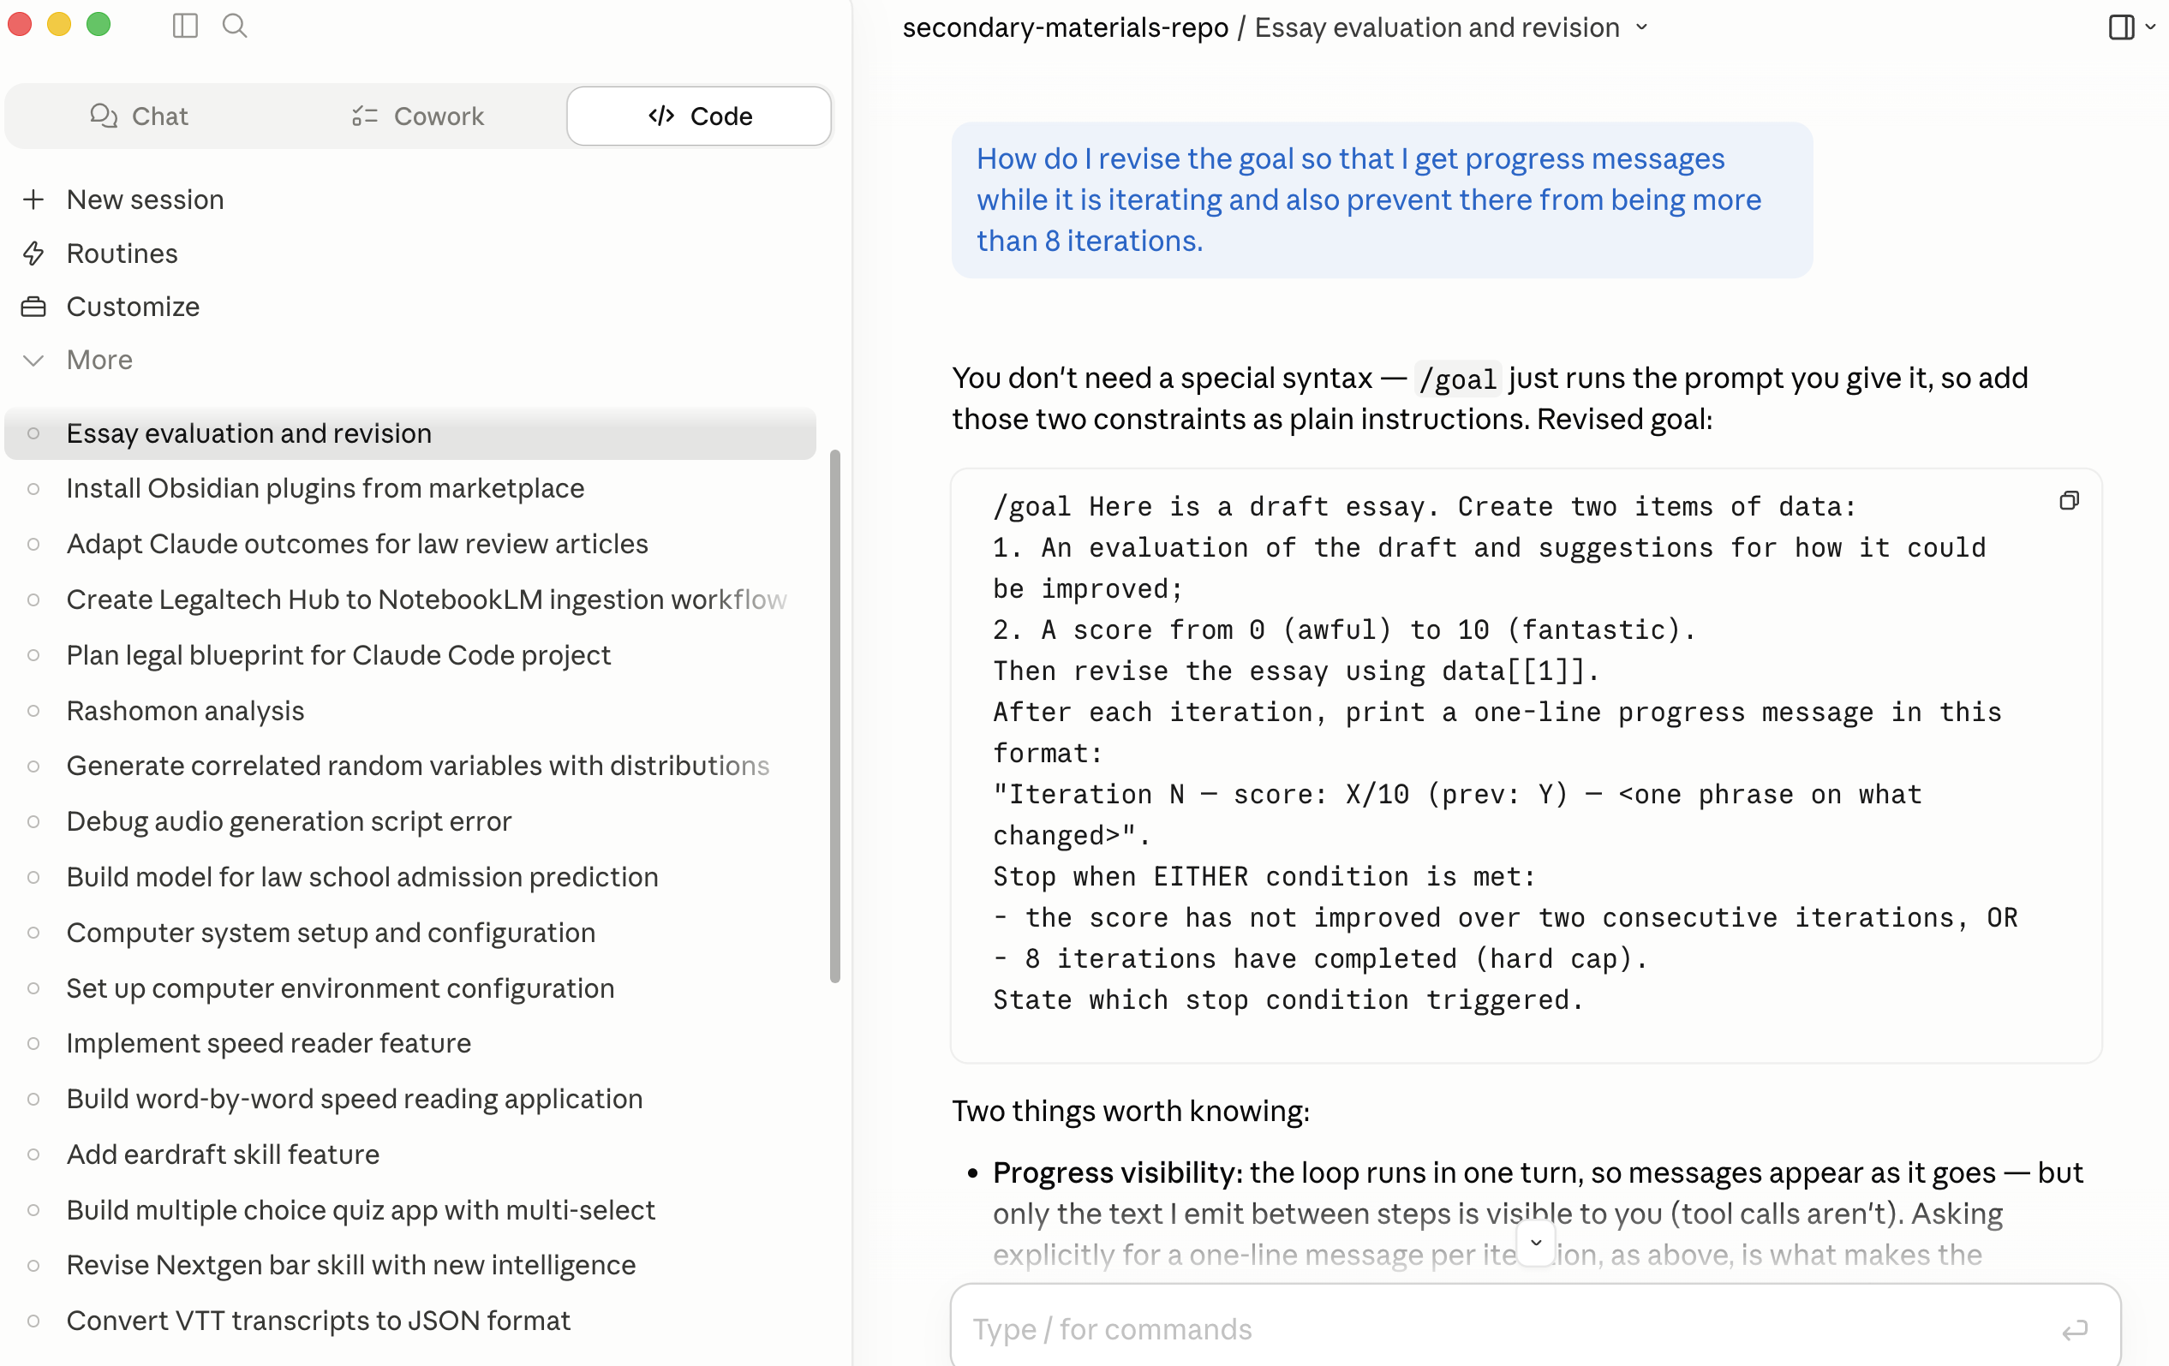
CODE WITHOUT CODE
The instructions are in English.
Claude Code runs procedures that look like programs but are written in prose.
Here: /goal drafts, critiques, and rewrites an essay in a loop until it converges.

Slide 27
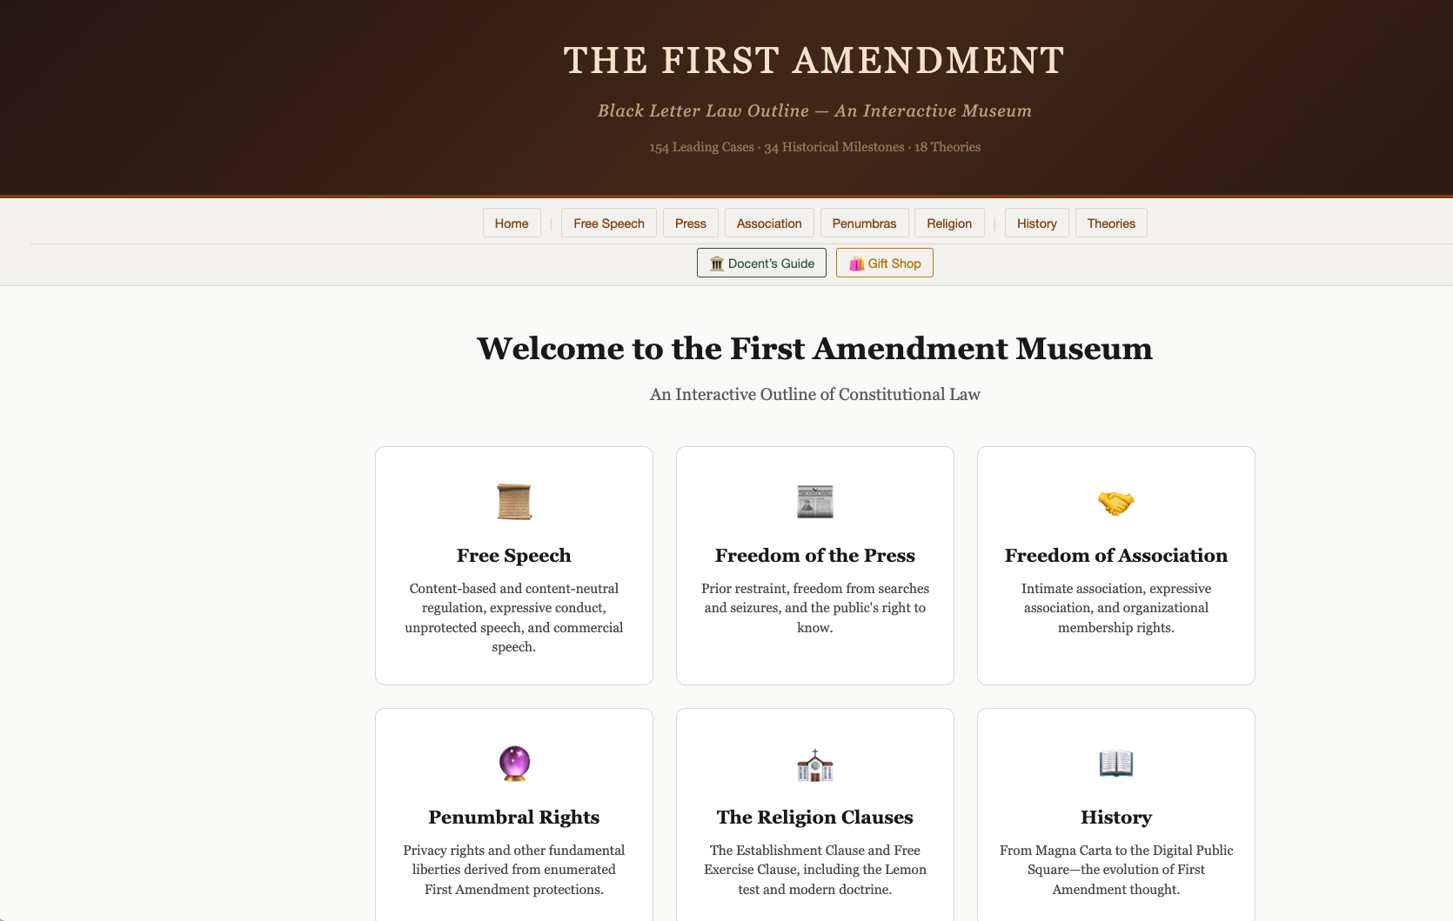
BUILD WHOLE WEBSITES
Claude Code or OpenAI Codex.
Elaborate, working sites — course portals, doctrine explorers, research dashboards.
No web-dev background. Describe what you want; the agent writes, tests, and deploys.

Slide 28
What to Do Next
1
Open NotebookLM today.
Free. Browser. Five minutes.
2
Subscribe to Claude Pro tomorrow.
$20/mo. Install Claude for Word. Live in Cowork for two weeks.
3
Touch Westlaw's and Lexis's AI offerings.
Know what your students will see in practice.
4
Advocate for a Harvey or Legora license at your school.
Fluency with the firm-standard interface is a placement advantage.
5
Watch the open-source wave.
Mike and Lavern are the leading edge. Try Lavern on a small task.
6
Try Claude Code on a problem you said you couldn't solve.
Find out you were wrong.

Slide 29
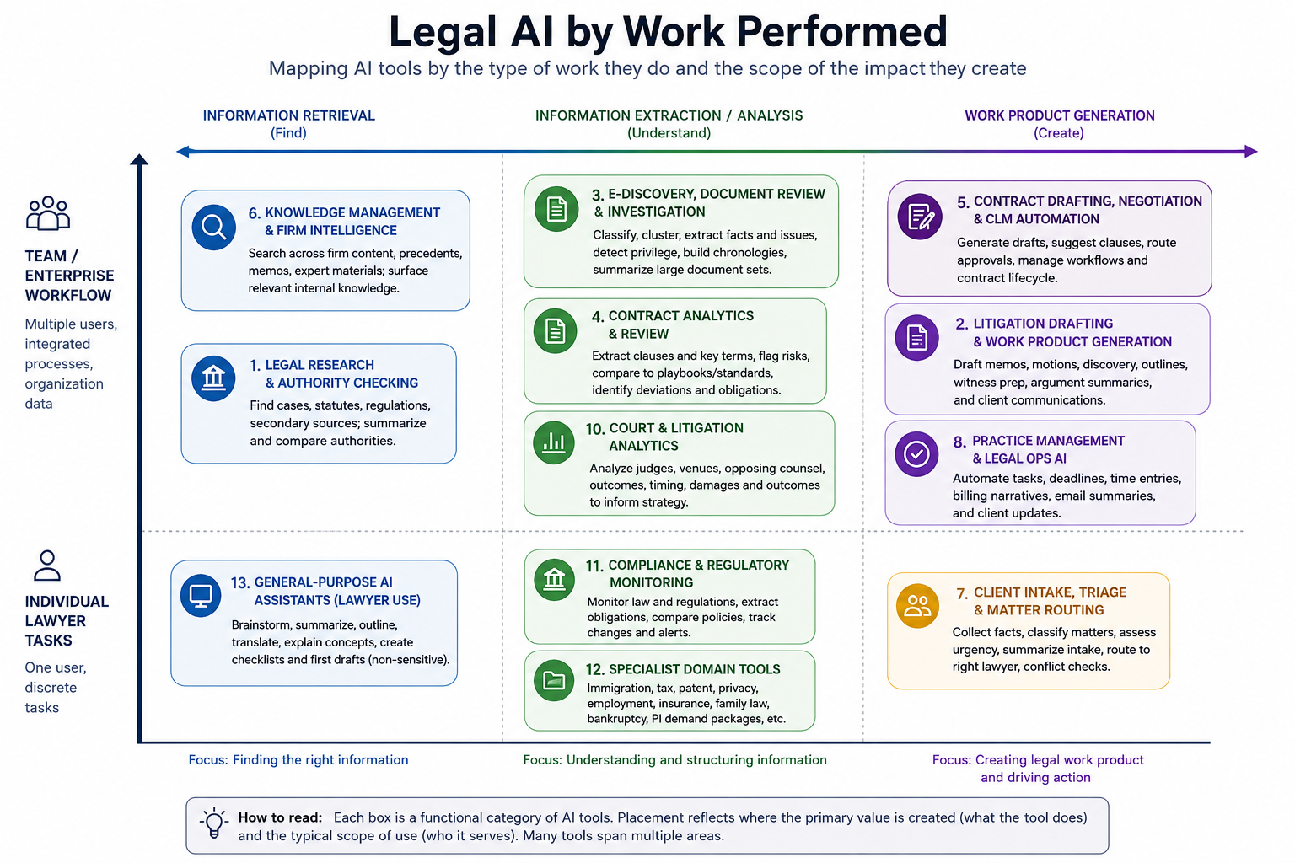

Slide 30
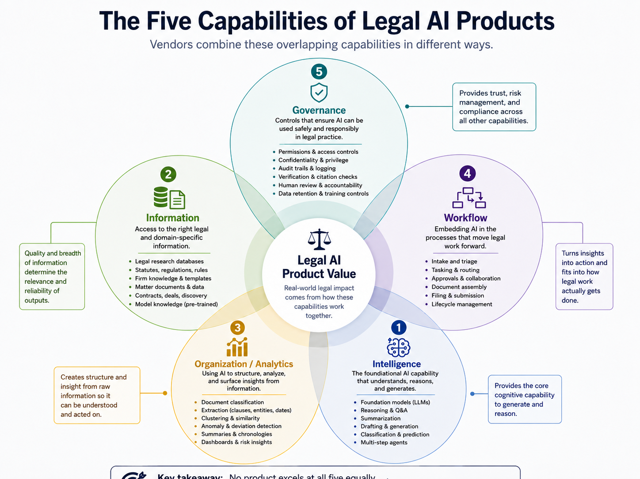

Slide 31
AI in Legal Practice: Applications, Ethics, and Responsibility

Slide 32

AI in Legal Practice
AI is here – 31% of respondents to ABA’s 2025 Legal Industry Report shared that they use AI for work, up from 27% in 2024.
AI can reduce administrative burdens and improve productivity but also carries risks.
“AI hallucinations” are pervasive:
  Fabricated cases or legal authorities
  Misrepresentation of facts or quotes
  Blending legal concepts or standards

Slide 33
ABA Formal Opinion 512
July 29, 2024
The ABA’s first formal guidance on this subject
- Applies to existing Model Rules of Professional Conduct to AI tool use
- Covers general-purpose tools (ChatGPT) and legal specific platforms (Lexis AI, Westlaw AI)
- Anticipates updating guidance in the future as technology evolves
Core ethical duties under Opinion 512
- Rule 1.1 (Competence), Rule 1.4 (Communication), Rule 1.5 (Reasonable Fees), Rule 1.6 (Confidentiality), Rules 3.1/3.3 (Candor & Meritorious Claims), and Rules 5.1/5.3 (Supervision)

Slide 34
What to Do In Response to AI-Related Errors
Be proactive in correcting AI-related errors
Model Rule 1.1: Competence requires not only understanding the substantive legal issues but also understanding the tools and technologies used to assist in legal work.
Model Rule 1.6: Confidentiality requires careful vetting of AI tools to ensure that privileged or sensitive information, including protected health information, is not improperly disclosed or used to train third-party systems.
Model Rule 4.1: Truthfulness in statements to others prevents counsel to knowingly make a false statement of material fact or law to another.

Slide 35
How to Safely Use AI in Legal Practice
Always question AI-generated results – AI can present hallucinated results with confidence.
Always verify AI-generated outputs – check citations, read cases, verify rules and regulations.
Understand AI’s limitations – designate an individual within the organization to stay current on the AI tool.
Implement institution-wide AI best practices – require human reviews, create an audit trail, implement reporting tools, and provide ongoing education to staff.
Vet AI tools for security and confidentiality – evaluate data handling practices to ensure compliance.

Slide 36
Open for Discussion
How should law schools and educators integrate AI into the classroom and prepare students for the future of law practice?
Does AI create an existential threat? Do we still need law schools? Educators? Lawyers?

Slide 37




Questions & Answers
Asha Scielzo
American University Washington College of Law
scielzo@american.edu
Michael Paulhus
King & Spalding LLP
mpaulhus@kslaw.com
Matthew Sag
Emory University School of Law
msag@emory.edu
Seth Chandler
The University of Houston Law Center
SChandler@UH.edu

