Slide 1



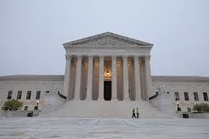
SCOTUS Health Law Updates & Impacts
2025-2026
ASLME Health Law Professors Conf. 2026
Georgia State University College of Law
June 3-5, 2026

Slide 2
Panelists
  James G. Hodge, Jr., JD, LLM, Peter Kiewit Found. Professor & Director, Center for Public Health Law & Policy, ASU Sandra Day O’Connor College of Law
  John Parsi, JD, PhD, Assistant Professor of Law, Louisiana State University Hebert Law Center
  Elissa Gentry, JD, PhD, Associate Professor, ASU Sandra Day O’Connor College of Law
  Laura C. Hoffman, JD, LLM, SJD, Assistant Professor of Law & Co-Director, William I. Weisberg Center for Health Law & Policy
  Lance Gable, JD, MPH, Interim Dean & Professor of Law, Wayne State University Law School

Slide 3

Premier SCOTUS Public Health Cases
Little v. Hecox (Title IX)
First Choice Women’s Res. Ctrs v. Davenport (§ 1983)
Miller v. McDonald (Vaccine exemptions)
Mirabelli v. Bonta
(Free exercise)
Trump v. Illinois
(Nat. Guard)
WA
VT
NH
MT
ND
ME
OR
ID
MN
SD
WI
NY
MA
WY
MI
RI
PA
CT
NV
NE
IA
NJ
IL
IN
OH
DE
CA
UT
CO
WV
MD
KS
MO
KY
VA
DC
NC
Learning Resources v. Trump (IEEPA)
AZ
OK
TN
Chiles v. Salazar
(1st Amdt)
NM
AR
SC
MS
AL
GA
TX
LA
West Virginia v. B.P.J. (Title IX)
Monsanto v. Durnell
(Product liability)
AK – Alaska
HI - Hawaii
PR - (Puerto Rico)
VI - (U.S. Virgin Islands)
FL
Danco Labs v. LA
(Mifepristone)
Hamm v. Smith
(Disability)
Wolford v. Lopez
(2nd Amdt)
U.S. v. Hemani
(2nd Amdt)
Doe v. Dynamic Phy. Ther. LLC (Liability)

Slide 4
Major Topics
Presidential Emergency Powers - James
LGBTQ+ Rights & Discrimination Protections - John
Standards of Care, Privacy & First Amendment - Elissa
Second Amendment Rights - Laura
Disability & Public Health Liability – Laura & Lance

Slide 5
Worthy of Note
  The Hain Celestial Group, Inc. v. Palmquist
  SCOTUS reviewed a procedural dispute whether Whole Foods was improperly dismissed from a case involving claims of child autism arising from heavy metal poisoning via Earth’s Best Organic products, ultimately vacating defendant’s judgement.
  Berk v. Choy - SCOTUS determined that DE’s affidavit requirement for medical malpractice suits does not apply in federal court under FRCP 8, which only requires a "short and plain statement" of the claim.
  Hikma Pharm. USA Inc. v. Amarin Pharma, Inc. – “When a generic drug label fully carves out a patented use, are allegations that the generic drugmaker calls its product a ‘generic version’ and cites public information about the branded drug (e.g., sales) enough to plead induced infringement of the patented use?”

Slide 6
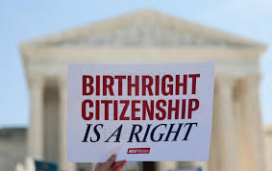
Worthy of Note
Trump v. Barbara

Slide 7

Sometimes It’s What SCOTUS Does Not Do That Matters

Slide 8

Major Topics
Presidential Emergency Powers - James

Slide 9


Trump v. Illinois
FACTS: In October 2025, President Trump mobilized state-based members of the Illinois and Texas National Guard to protect federal officials and property in Illinois. He relied on powers authorized under 10 U.S.C. § 12406(3) to deploy National Guard members when “regular forces” are unable to “execute the laws of the United States.”
LOWER COURTS: Fed. dist. court granted a TRO prohibiting the federalization and deployment of the NG in Illinois. The 7th Cir. Ct. App. affirmed in part, allowing the NG to be federalized but not deployed in IL. The Trump administration sought immediate relief via SCOTUS.
SCOTUS ? PRESENTED: Whether 10 U.S.C. § 12406(3) allows for the federalization and deployment of the NG under its “regular forces” provision?
SCOTUS DECISION: Following briefings on who constitutes “regular forces,” the Court determined that such personnel refers to U.S. military members. Since the Trump administration failed to show that the military could not execute the laws, it lacked authority under this specific statute to federalize the NG for the same purposes.
Request Filed:
10/17/25
Cert. Granted
Oral Argument
Decision Rendered
12/23/25

Slide 10
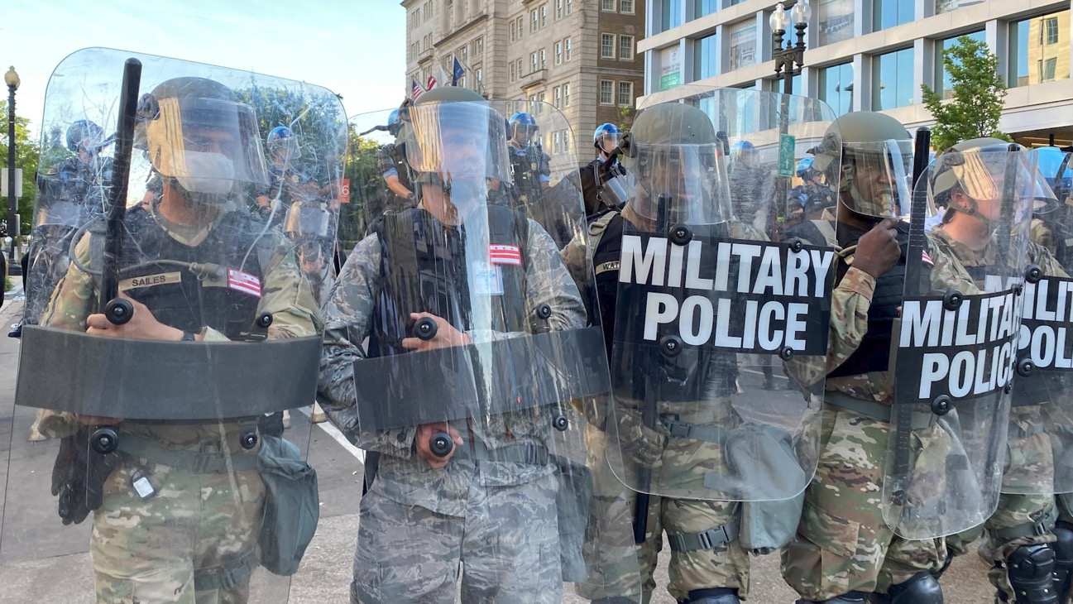
Trump: What’s At Stake
Role of U.S. Military &
National Guard to
Quell Civil Unrest
Image Source: https://www.washingtonpost.com/history/2020/06/03/insurrection-act-trump-history/

Slide 11

Trump: Forecasted Impacts
TREACHEROUS

Slide 12
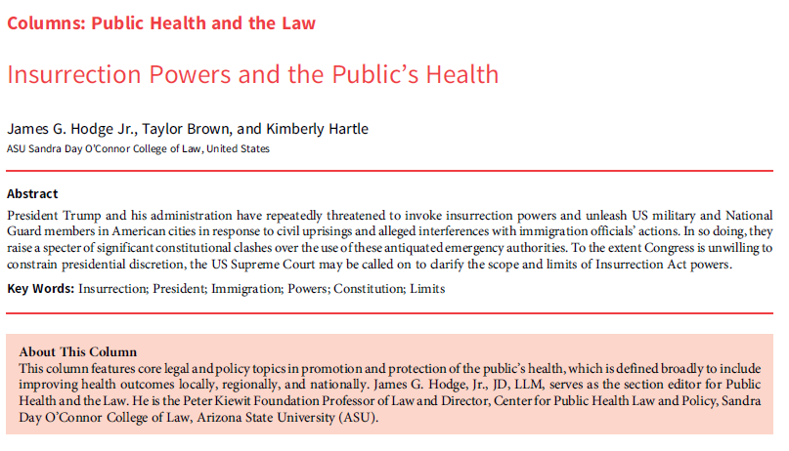
Trump: Potential Impacts

Slide 13
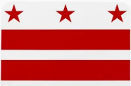

Learning Resources v. Trump
FACTS: After President Trump declared national emergencies and initiated a series of tariffs pursuant to the International Emergency Economic Powers Act (IEEPA), including to address a “public health crisis” from drug trafficking, small businesses and other plaintiffs claimed the tariffs were unlawful under IEEPA.
LOWER COURTS: Examining 2 cases, the U.S. Court of Intl. Trade determined that the IEEPA did not authorize President Trump to set tariffs, which the D.C. Cir. Ct. App. affirmed en banc.
SCOTUS ? PRESENTED: Whether IEEPA authorizes the President to impose tariffs to address public health crises, among other things?
SCOTUS DECISION: In a rebuke of executive emergency authorities, the Court affirms under its interpretation of the major questions doctrine in line with separation of powers principles that Congress did not explicitly authorize President Trump to impose tariffs under the IEEPA.
Petition Filed: 6/2/25
Cert. Granted: 10/20/25
Oral Argument: 11/5/25
Decision Rendered
2/20/26

Slide 14
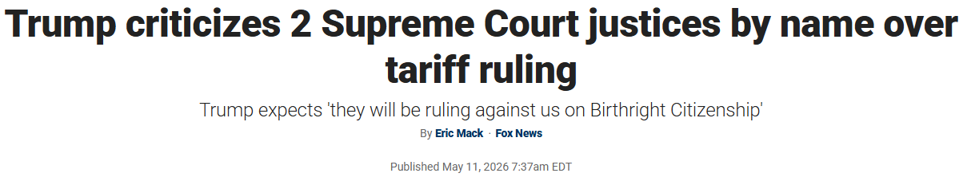
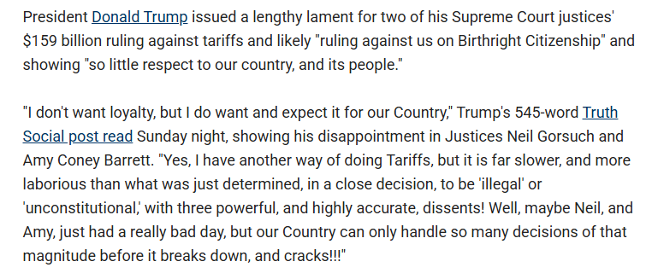
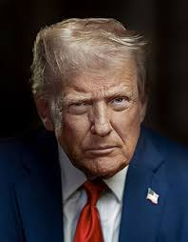
Learning Resources: What’s at Stake

Slide 15
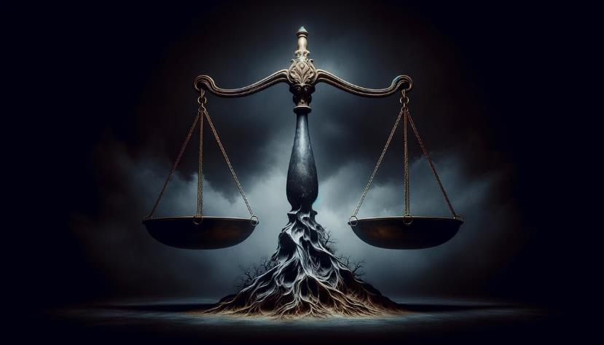
Learning Resources: What’s at Stake
Constitutional Balance in Crises
Image Source: https://www.usconstitution.net/checks-and-balances-in-the-constitution/

Slide 16

Learning Resources: Impacts
GLOOMY

Slide 17
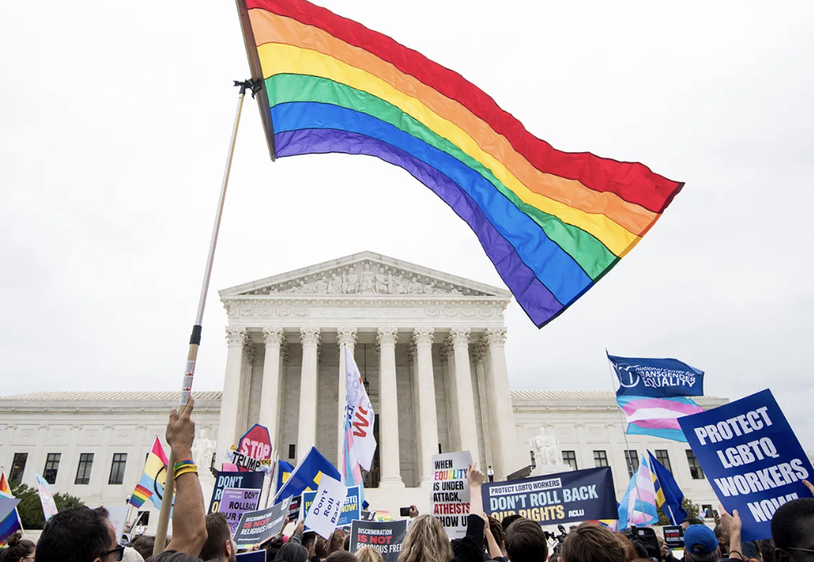
Major Topics
LGBTQ Rights & Discrimination Protections - John

Slide 18

Mirabelli v. Bonta
FACTS: Parents discovered their biologically-female child had socially transitioned (including use of male pronouns) in CA public school after the child attempted suicide. Under CA state law, school officials were prohibited from informing parents of their child’s transitioning unless the child consented.
LOWER COURTS: After the dist. court enjoined enforcement of CA’s law, the 9th Cir. stayed the injunction pending appeal on grounds that infringements of 1st Amdt. free exercise and substantive due process principles were not shown.
SCOTUS ? PRESENTED: Whether CA state law infringes 1st Amdt. religious free exercise principles or contravenes substantive due process?
SCOTUS DECISION: Relying in part on Mahmoud v. Taylor (2025), the Court finds the parents’ free exercise rights are likely infringed under strict scrutiny, and inviolate of substantive due process principles upholding parental interests in their child’s upbringing to the dissent of Justice Kagan.
Petition Filed: 1/8/26
Cert. Granted: N/A
Oral Argument: N/A
Decision:
3/2/26

Slide 19
Mirabelli v. Bonta – Procedural Issues
Per curiam Supreme Court decision
Granted an emergency application to vacate a Ninth Circuit stay of a district court’s class-wide permanent injunction
Not a full merits decision
The Court bypassed standard deliberative processes, ruling on novel, complex constitutional questions without full briefing or oral argument.

Slide 20
Not on the Merits, Merit based analysis
Free Exercise Clause
Substantive Due Process
Irreparable Harm and Balance of Equities
Standing and Class Certification

Slide 21

Little v. Hecox
FACTS: Idaho passed the Fairness in Women’s Sports Act in 2020 to ban transgender persons from female athletics and impose intrusive sex-verification procedures for disputed athletes. Transgender and cisgender female athletes sued, claiming violations of the Equal Protection Clause and Title IX.
LOWER COURTS: Fed. dist. court granted a preliminary injunction, finding the plaintiffs likely to succeed on their claims. The 9th Cir. Ct. App. affirmed, finding the Act unlawfully excludes transgender females from athletics without advancing state interests in sex equality.
SCOTUS ? PRESENTED: Whether laws seeking to protect female sports by limiting participation to cisgender females violate Equal Protection Clause?
SCOTUS ORAL ARGUMENTS: The Court seemed unwilling to recognize equal protection for transgender persons in women’s sports. Whether it goes go so far as to reassess (or overturn) Bostock v. Clayton County (2020) is uncertain. Such interpretation would substantially impact transgender claims of discrimination in sports and employment.
Petition Filed: 7/11/24
Cert. Granted: 7/3/25
Oral Argument: 1/13/26
Decision Rendered

Slide 22
Idaho’s Fairness in Women’s Sports Act
Imposes a blanket ban on transgender women and girls from participating in women’s student athletics at any level
From elementary school through college
From intramural to elite competition
Includes “sex dispute verification” process allowing anyone to challenge any athlete’s sex, requiring that athlete to submit to intrusive medical examination, including gynecological exams, to confirm her sex.

Slide 23
Government’s Asserted Interests and Means-Ends Analysis
Promoting competitive fairness and equal athletic opportunity for female athletes
Ninth Circuit heightened scrutiny
The Act discriminates against transgender women specifically because of their transgender status
Discrimination on the basis of transgender status constitutes discrimination on the basis of sex
The Act itself is classified on the basis of sex by imposing asymmetric burdens solely on women and girls.

Slide 24

West Virginia v. B.P.J.
FACTS: WV’s “Save Women’s Sports Act,” defining team eligibility strictly by sex assigned at birth, bars transgender girls from female sports teams. B.P.J., a transgender high school student living as a girl since 3rd grade, was excluded from her school’s cross-country and track teams, resulting in litigation.
LOWER COURTS: Fed. dist. court upheld WV’s law suggesting it advanced states’ interests in preserving equal athletic opportunities, thus avoiding Title IX violations. 4th Circuit Ct. App. reversed finding WV’s act as applied to B.P.J., violates Title IX and potentially equal protection, subject to further adjudication.
SCOTUS ? PRESENTED: Whether Education Amend. Act - Title IX and Equal Protection principles prevent a state from distinguishing or offering sports teams based on biological sex determined at birth.
SCOTUS ORAL ARGUMENTS: As in Little v. Hecox, the Court seemed unwilling to recognize equal protection for transgender persons in women’s sports and thus may deny them Title IX coverage. If the Court reassess (or overturns) Bostock it would substantially impact transgender persons’ claims of discrimination in multiple arenas.
Petition Filed: 7/11/24
Cert. Granted: 7/3/25
Oral Argument: 1/13/26
Decision Rendered

Slide 25
West Virginia’s “Save Women's Sports Act”
“Athletic teams or sports designated for females, women, or girls shall not be open to students of the male sex.”
Defining “male” as: “an individual whose biological sex determined at birth is male”
Does not restrict any student from participating in teams designated for males, meaning that biologically female students (including transgender boys) can play on any team

Slide 26
Government’s Asserted Interests and Means-Ends Analysis
Promoting competitive fairness and equal athletic opportunity for female athletes
Fourth Circuit as-applied
Gender identity classification
Sex-based classification

Slide 27

Major Topics
Standard of Care, Privacy & First Amendment - Elissa

Slide 28

Chiles v. Salazar
QUESTION PRESENTED:
Does Colorado law censoring “conversion” conversations between licensed counselors and minors regulate speech in violation of First Amendment?
SCOTUS DECISION: Law violated First Amendment (8-1)
State may ban physical forms of conversion treatments but cannot restrict conversion through speech.
“Professional speech” does not change the analysis.
Petition Filed: 11/8/24
Cert. Granted: 3/10/25
Oral Argument: 10/7/25
Decision Rendered
3/31/26

Slide 29
State Interference with Medical Judgment?
Other contexts in which the state intervenes in the standard of care:
  Negligence per se (general torts)
  Medical board rules
Compare with Skrmetti
  Legislature outlawed gender affirming care for minors
    Not subject to heightened scrutiny
General trend of treating conduct as speech
  And narrowing category of “factual information”
    National Institute of Family & Life Advocates v. Becerra
Notes:
Perception of political bias in the choices made in analysis
Separate concern broadening definition of speech

Slide 30
How Should States Regulate Talk Therapy?
  Can states enforce a viewpoint on dissuading suicide or self-harm?
    Does strength of medical evidence matter?
  How does this affect board discipline? Malpractice suits?

Slide 31

Danco Labs v. LA
QUESTION PRESENTED:
Did the FDA’s 2023 REMS for mifepristone (abortion drug) violate the APA in relaxing the in-person dispensing requirement?
Does Louisiana have standing to bring this APA challenge?
SCOTUS DECISION:
5th Circuit order to stay the 2023 REMS is stayed pending disposition of appeal and of petition for cert.
Petition Filed:
Cert. Granted:
Oral Argument:
Decision Rendered

Slide 32
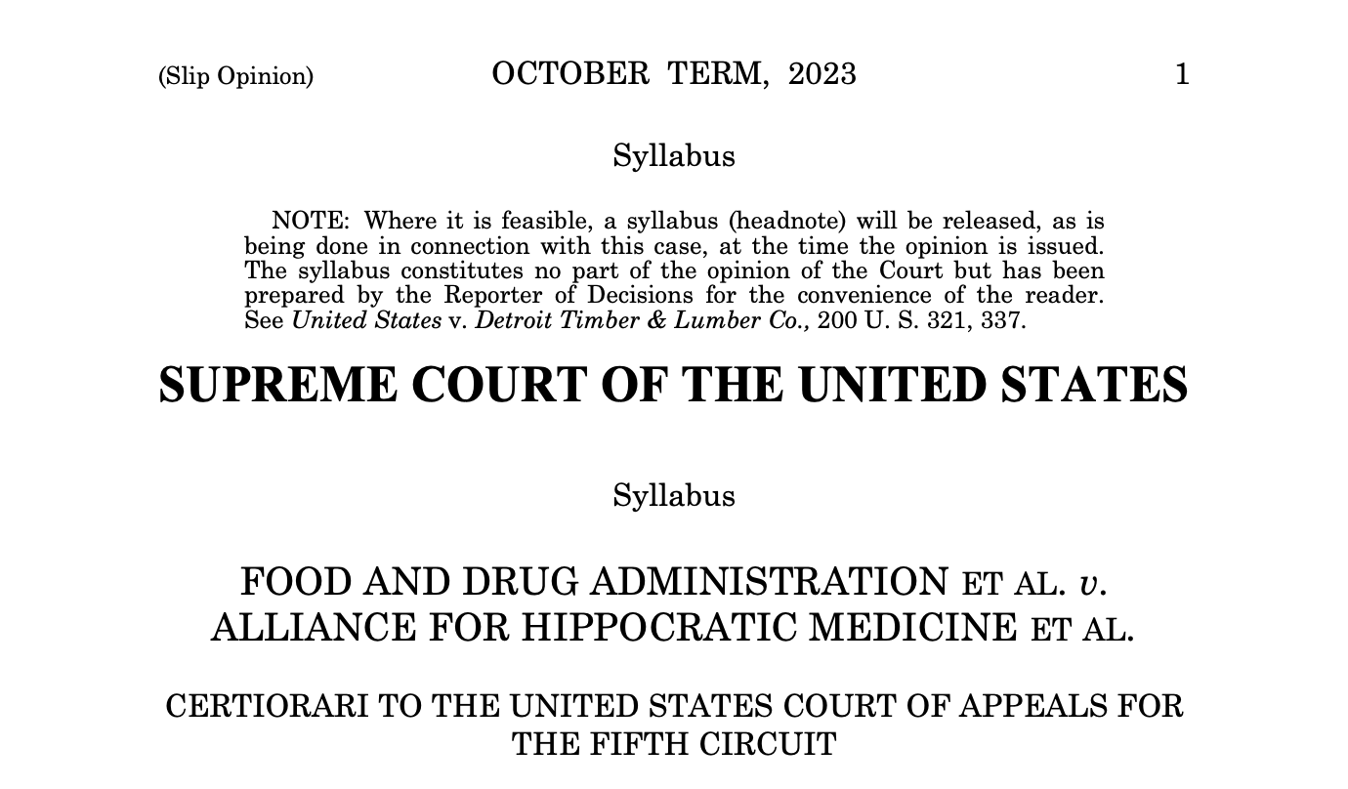
NO STANDING

Slide 33
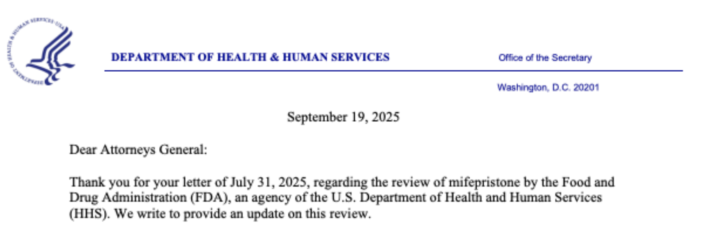
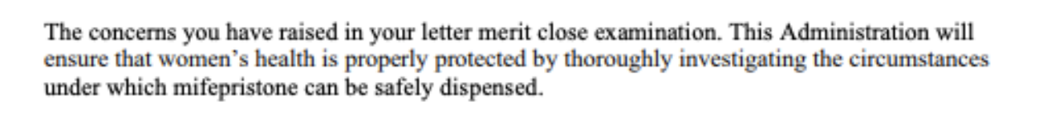
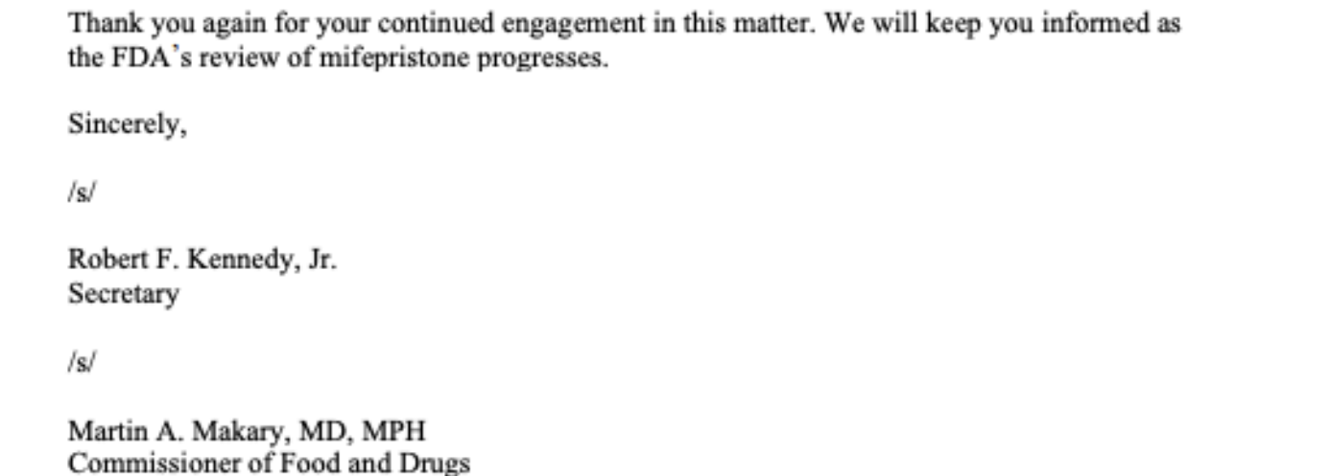
***
HHS/FDA agree to perform a safety review of mifepristone

Slide 34
Current briefing
Emphasis on standing
  Argument: further attenuated injury and causation than 2024 suit
Preemption barely addressed
  Affects the injury analysis
  Berman et al. (2024) raises preemption question in previous mifepristone action

Slide 35

Miller v. McDonald
QUESTION PRESENTED:
Does a NY law that categorically disallows religious exemptions but permits medical exemptions violate Free Exercise?
SCOTUS DECISION:
Vacated lower court judgments and remanded the case to the 2nd Circuit for “further consideration in light of Mahmoud v. Taylor (2025)” (per curiam)
Petition Filed: 7/31/25
Cert. Granted: 12/8/25
Oral Argument:
N/A
Decision Rendered
12/8/25

Slide 36
Implications of Miller
Smith: uphold neutral, generally applicable vaccine mandates against religious exemptions
  Strict scrutiny may apply if “substantial interference with religious upbringing of children” (Yoder)
Mahmoud v. Taylor (2025)
  LGBTQ+ curriculum without parental notice unconstitutionally burdens free exercise
  SCOTUS clarified that Yoder is not limited to its facts
Strong history of enforcing vaccine mandates (e.g., Jacobson)

Slide 37
What’s to Come?
How will the 2d Cir. respond to SCOTUS’s nudge?
Strong claim that vaccine mandates differ from LGBTQ+ storybooks (Mahmoud) or mandatory education (Yoder)
  Public health purpose creates a much more compelling government interest
  Medical exemption limited until no longer detrimental
More unsettled area of law than previously thought
  Chemerinsky & Goodwin (2016)
  Rothschild (2026)

Slide 38
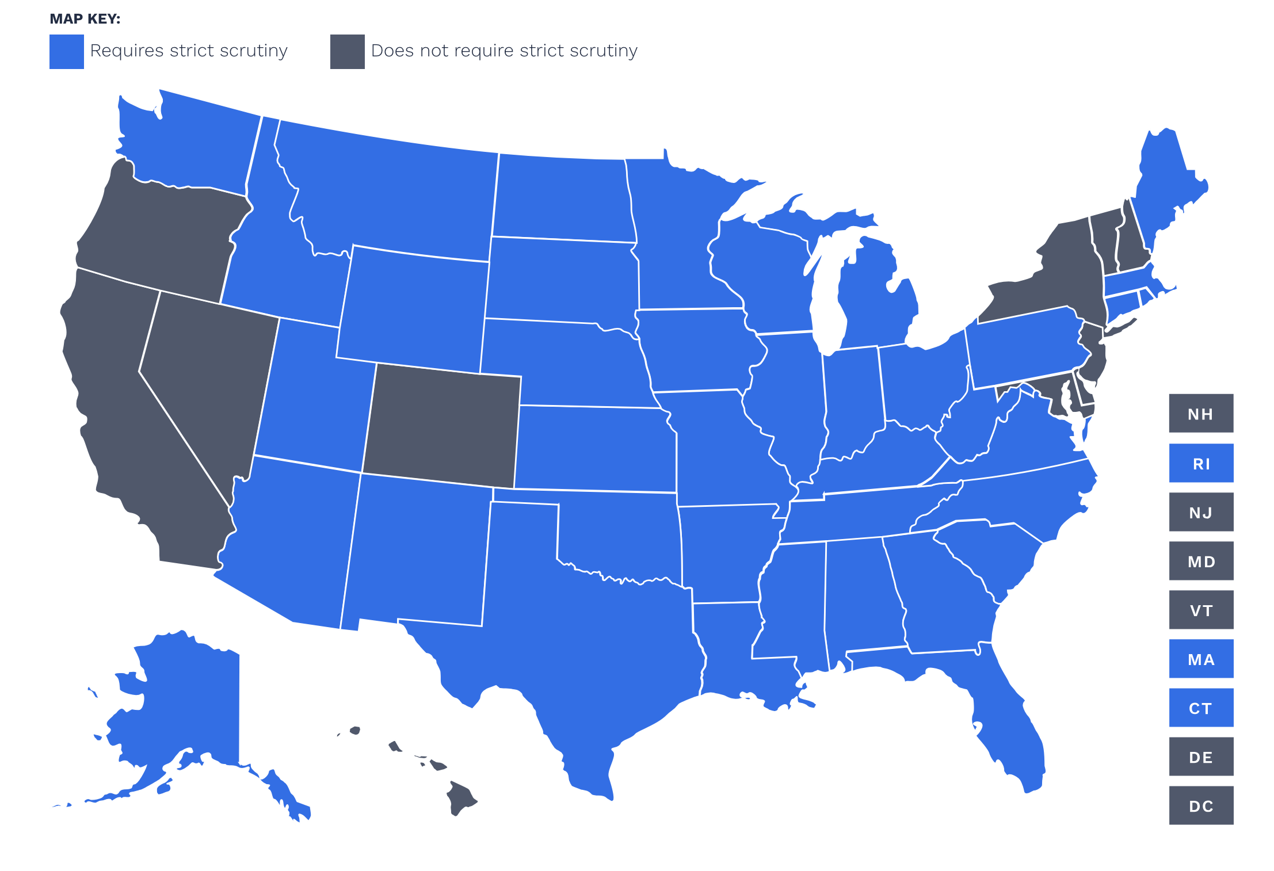
States Applying Strict Scrutiny
Source: https://becketfund.org/research-central/rfra-info-central/map/

Slide 39

First Choice Women’s
Resource Centers v. Platkin
QUESTION PRESENTED: Does an organization that received a subpoena for donor records fail to establish injury in fact for purposes of a First Amendment claim when
the subpoena has not yet been compelled and
the information was promised to be kept private?
SCOTUS DECISION: First Choice had sufficient standing to raise First Amendment rights to free association under § 1983 because the subpoena issue created injury in fact (9-0).
Petition Filed: 1/21/25
Cert. Granted: 6/16/25
Oral Argument: 12/2/25
Decision Rendered
4/29/26

Slide 40
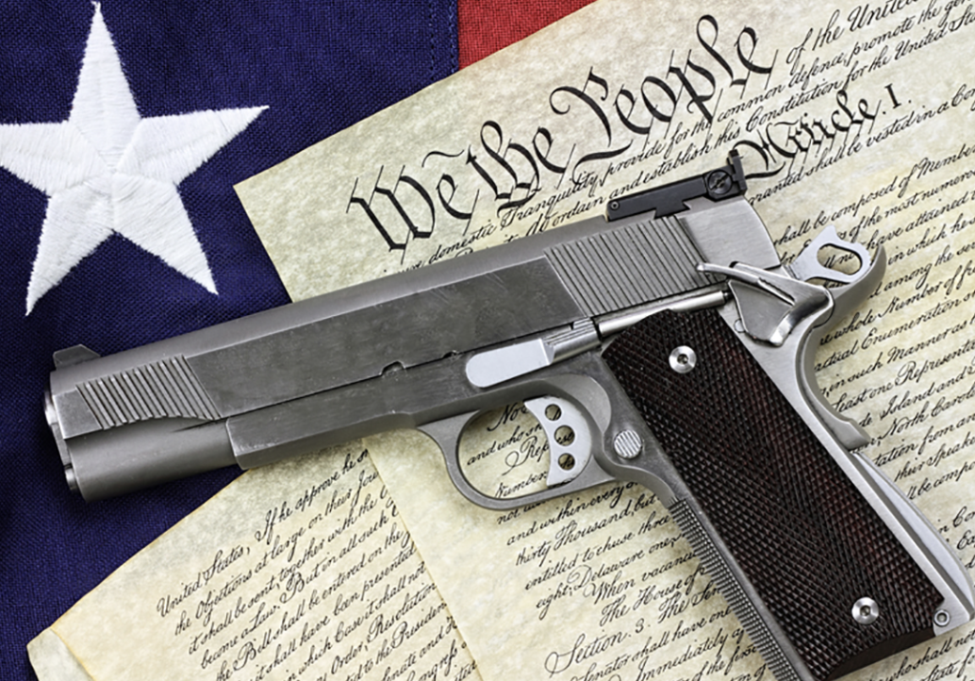
Major Topics
Second Amendment Rights - Laura

Slide 41

Wolford v. Lopez
FACTS: Hawaii bans carrying a firearm on private property open to the public (e.g., stores, parking lots) absent express consent of property owners. Gun advocates argue the law violates the 2nd Amend. by presumptively forbidding them from carrying firearms in most public places w/out permission.
LOWER COURTS: Fed. dist. court preliminarily enjoined HI from enforcing its law. 9th Cir. Ct. App. partially aff’d & rev’d, upholding HI’s “private property default rule,” rejecting other challenges, and denying a rehearing en banc.
SCOTUS ? PRESENTED: Whether under the 2nd Amdt. states may presume that firearms are prohibited on private property open to the public unless property owners affirmatively authorize their possession. However, analysts note there is really more at issue than this precise question. In post-Bruen cases, the case further presents the characterization of historical tradition used to determine the outcome.
SCOTUS ORAL ARGUMENTS: The Court’s majority appears to side with gun owners, suggesting that HI’s law reduces the 2nd Amdt. to a “second-class right.” Justice Jackson questioned whether HI’s law should be analyzed as a 2nd Amdt. or property rights issue.
Petition Filed: 4/1/25
Cert. Granted: 10/3/25
Oral Argument: 1/20/26
Decision Rendered

Slide 42
Relationship Between Guns & Public Health
Gun Violence as a Public Health Crisis
  In 2024, U.S. Surgeon General Dr. Vivek Murthy issued a “landmark” Advisory declaring gun violence a public health crisis, see https://www.ncbi.nlm.nih.gov/books/NBK605169/pdf/Bookshelf_NBK605169.pdf
  In 2023, “guns were involved in 46,728 deaths in the U.S. [John Hopkins Bloomberg School of Public Health]
    That’s one death every 11 minutes!
  Firearm injury has become the leading cause of death for U.S. children and teenagers [Sun S, Hudson DL, Lee H. Examining Long-Term Mental Health Outcomes Associated with Childhood Gun Violence Exposure: Variations by Race/Ethnicity and Gender. J Urban Health. 2025;102(6):1141-1151. doi:10.1007/s11524-025-01034-2]
Suicide
  “For the third straight year, gun suicides reached a new high: 27,300, or 58% of all gun deaths, were suicides” [John Hopkins Bloomberg School of Public Health]
  Suicides accounted for nearly 6 in 10 U.S. gun deaths in 2023 [Pew Research Center]
Witnessing Gun Violence & Mental Health
  “The mental health consequences of gun violence also manifest differently across various life stages.” (i.e. infancy, childhood, adulthood)
  “However, different types of violence, including gun violence, have unique impacts on mental health, a perspective often overlooked when gun violence is considered a subset of general violence research (Kennedy and Ceballo, 2014) ”
  “Indirect exposure to gun violence, such as hearing gunshots or witnessing gunfire, is widespread. Finklehor and colleagues estimated that approximately 13% of adolescents aged 14–17 in a nationally representative sample reported either hearing gunshots or witnessing someone being shot at some point in their lives [5]. Mitchell and colleagues reported that among a nonrepresentative sample of youth, ages 2 to 17, 41% reported ever seeing or hearing gun violence and 32% had such an experience within the past year.”
  [Sun S, Hudson DL, Lee H. Examining Long-Term Mental Health Outcomes Associated with Childhood Gun Violence Exposure: Variations by Race/Ethnicity and Gender. J Urban Health. 2025;102(6):1141-1151. doi:10.1007/s11524-025-01034-]

Slide 43
Shift of Standard Under Bruen Regarding 2nd Amendment Challenges
New York State Rifle and Pistol Association v Bruen (2022): the U.S. Supreme Court struck down New York’s law requiring “proper cause” for the public carrying of firearms. This allowed the right to bear arms to go outside the home, extending the Second Amendment to nonsensitive public spaces where confrontation may occur.
Shift of Standard under Bruen
  Previous: Balancing test acknowledging the state’s interest in public safety
  Post-Bruen: Balancing test is replaced with historical test--whether the law is consistent with “the Nation’s historical tradition of firearm regulation” as the standard for Second Amendment challenges. Under this test, "when the Second Amendment's plain text covers an individual's conduct, the Constitution presumptively protects that conduct." Accordingly, to justify regulation of that conduct, "the government must demonstrate that the regulation is consistent with this Nation's historical tradition of firearm regulation." The Court explained that, under this history-focused test, the government need only put forward "a well-established and representative historical analogue, not a historical twin" to the regulated conduct.
Hawaii’s law requiring permission from private property owners (where property is open to the public) to carry a weapon onto the property was challenged by guns rights advocates as being incompatible with Bruen’s history and tradition test.

Slide 44
Tension Between 2nd Amendment & Property Rights
What if the Court Strikes Down Hawai’i’s Law?
  Preservation of ”Guns Allowed” Presumption
    Guns would be presumptively permitted in every store, restaurant, grocerystore, mall, and parking lot unless/until an owner actively indicates a preference such as a “no guns allowed” sign, stripping the State’s power—gun owners/advocates here argue that this presumption is “flipped” in Hawai’i’s law by requiring the consent of the property owner.
  Effect on Public Health
    Illustrated by the statistics on an earlier slide, more firearms in everyday spaces could increase the number of accidental and incidental shootings, spurring suicides in our communities as a side effect
What if the Court Upholds Hawai’i’s Law?
  Preservation of State Choice
    State power will be protected, and states will be free to continue setting their own laws and rules that reflect the desires of their community
  Better Public Health and Safety
    Erasing a presumptive allowance on firearms in public spaces would make our communities safer
  Aligns with Public Beliefs
    The ‘no-carry’ default “codifies what most Americans already believe: [y]ou don’t walk into someone else’s home or business with a weapon unless you know you’re welcome to do so.” [Everytown]

Slide 45

U.S. v. Hemani
FACTS: Hemani admitted to using marijuana daily and owning a firearm. After he was indicted in Texas under 18 U.S.C. § 922(g)(3) (prohibiting unlawful users of controlled substances from possessing firearms) he challenged the charge as constitutionally infirm under the 2nd Amendment.
LOWER COURTS: Fed. dist. court dismissed the indictment on grounds the government failed to show that Hemani was intoxicated by a controlled substance at the time of his arrest, which the 5th Cir. Ct. App. affirmed on similar grounds.
SCOTUS ? PRESENTED: Whether 18 U.S.C. § 922(g)(3) violates the 2nd Amdt. by allowing criminal charges for firearm possession against a person without evidence of intoxication caused by the unlawful use of a controlled substance.
SCOTUS ORAL ARGUMENTS: A majority of Justices intimated that the 2nd Amdt. protects gun access sufficiently to exempt some drug users who lack violent background from the federal statutory ban on firearm possession.
Petition Filed: 6/2/25
Cert. Granted: 10/20/25
Oral Argument: 3/2/26
Decision:
?

Slide 46
Associations between Controlled Substance Use & Firearm Violence
Intimate Partner Violence (IPV) & Guns
  “There is strong evidence that presence of firearms in the home where IPV occurs increases the risk of homicide more than sevenfold. Furthermore, IPV survivors, when asked what factors they associated with a risk of being killed by their abuser, named firearm access and drug use by the abuser as two of four main factors.” [John Hopkins Bloomberg School of Public Health]
Evidence of a significant relationship between cannabis use and violence.
However, available evidence on the health impacts of firearm access within the context of controlled substances, such as cannabis, is limited.
  There is a fair amount of evidence that cannabis use is associated with increased violence, including preliminary findings that demonstrate dose-dependent relationship.
  There is strong evidence that substance use and access to firearms are common risk factors in male perpetration of intimate partner violence.
  There is strong evidence that presence of a firearm in the setting of intimate partner violence increases the risk of female homicide.
  There is strong evidence demonstrating a relationship between substance use and risky firearm behaviors in adolescents and young adults. These behaviors range from increased gun carrying to firearm violence, and in some studies, suicide.
  There is mixed evidence demonstrating a relationship between substance use, including cannabis, and gun related behaviors such as possession, carrying, and use.6 While several studies did not show a link between substance use and gun-related behaviors, including gun ownership and gun-carrying, other studies did.
  Johns Hopkins Bloomberg School of Public Health, Bloomberg American Health Initiative

Slide 47
Shifting Legal Precedents: Intersection of Public Health, Criminal Justice & 2nd Amendment
The Role of Federalism
  Expansive view of federal power under the Commerce Clause: Gonzales v. Raich (2005) held that Congress, under the Constitution’s commerce clause, had the authority to criminalize personal, medical use of marijuana even in states where it was legal.
  What About the Second Amendment?: The Gun Control Act of 1968 bars nine categories of individuals from possessing firearms or ammunition.
    One such prohibition, 18 U.S.C. § 922(g)(3), forbids any person "who is an unlawful user of or addicted to any controlled substance" from possessing a firearm or ammunition.
    Before 2024, federal circuit courts had routinely upheld Section 922(g)(3) against Second Amendment challenges
    In 2024 and 2025 the U.S. Courts of Appeals for the Fifth and Eighth Circuits issued a series of rulings—Daniels v. United States, Hemani v. United States, Sam v. United States, Cooper v. United States, and Baxter v. United States—each providing that Section 922(g)(3) violates, or could violate, the Second Amendment insofar as the statute was applied to the specific defendants
    The United States asked the Supreme Court to review these decisions (see Daniels, Hemani, Sam, Cooper, and Baxter). In response, the Court agreed to hear Hemani, rejected the petitions in Cooper and Baxter, and has taken no action as to the petitions in Daniels and Sam; these latter two petitions may be held pending the Court's disposition of the case in Hemani.

Slide 48
Rahimi Provides Further Elaboration of Standard Since Bruen in Second Amendment Challenges
In Rahimi, the Supreme Court held that Section 922(g)(8), which bars individuals subject to certain domestic violence restraining orders from possessing a firearm, is consistent with the Second Amendment, rejecting the facial challenge mounted by the defendant. The Supreme Court emphasized that the scope of the Second Amendment is not limited to those laws that "precisely match its historical precursors" or that are "identical" to laws from 1791, as if the Second Amendment were "trapped in amber.“
Instead, the Court explained, under Bruen, a court is required to assess whether a challenged law is "relevantly similar" to laws from the country's regulatory tradition, and the Court noted that "why and how" the challenged law burdens the Second Amendment right are "central" considerations in this inquiry.
Federal Government Argument for the Restriction based on Historical Analogue
  Federal government, Principal Deputy Solicitor General Sarah Harris told the justices that “[t]he Second Amendment does not prohibit the government from temporarily disarming habitual marijuana users while they persist in using frequently. That tailored restriction,” Harris said, “easily fits within the historical tradition of disarming categories of people who present a special danger of misuse.”
  And as the Supreme Court’s recent Second Amendment cases require, Harris argued, the government had provided a “historical analogue” to the modern law “that is relevantly similar [in] why and how it restricts Second Amendment rights”: early American laws providing for the imprisonment or confinement of “habitual drunkards.”
    Was Hermani a “habitual user” under the federal statute’s definition?
    Argument that a “habitual drunkard” had a much different meaning during its time—and it applied to “drunkards”, not “drinkers”

Slide 49

Major Topics
Disability & Public Health Liability –
Laura & Lance

Slide 50

Hamm v. Smith
FACTS: “In 1998, Joseph Smith was convicted of first-degree murder. At his sentencing hearing, Smith introduced evidence of intellectual disability, including an IQ score of 72 and testimony from the test’s administrator explaining that the test’s standard error of measurement indicated Smith’s IQ could be as low as 69 or as high as 75. 1 Smith [*2] also introduced his school records, which showed that he was previously administered two IQ tests resulting in scores of 75 and 74 and that he was classified as ‘educable mentally retarded’ in 7th grade. Smith v. State, 71 So. 3d 12, 19-20 (Ala. Crim. App. 2008). At the time of Smith’s sentencing, this Court had held that it did not violate the Eighth Amendment to execute an intellectually disabled person so long as the sentencers considered mitigating evidence of the defendant’s intellectual disability among other aggravating or mitigating evidence. See Penry v. Lynaugh, 492 U. S. 302, 328, 330-335, 109 S. Ct. 2934, 106 L. Ed. 2d 256 (1989). The jury in Smith’s case returned an advisory verdict recommending the death penalty, which the trial judge imposed. The Alabama Supreme Court affirmed Smith’s sentence.” Hamm v. Smith, No. 24-872, 2026 LX 273343, at *1-2 (May 21, 2026)
Hamm v. Smith, No. 24-872, 2026 U.S. LEXIS 2207, at *1-2 (May 21, 2026)
LOWER COURTS: The 11th Circuit had affirmed the district court’s order granting Joseph Clifton Smith’s 28 U.S.C. § 2254 petition seeking to set aside his death sentence for capital murder because he is intellectually disabled. The case was then remanded from the U.S. Supreme Court for the 11th Circuit to explain which approach it had taken to determine Clifton’s intellectual disability. The 11th Circuit responded a “holistic approach to multiple IQ scores that considers the relevant evidence, including as appropriate any relevant expert testimony.” Hamm, 2024 WL 4654458, at *1. The U.S. Supreme Court took the case in order to resolve which approach to take in making the determination given various approaches being utilized by states to determine intellectual disability as a clarification of legal standard involving Atkins v. Virginia, 536 U.S. 304, 321 (2002).
SCOTUS ? PRESENTED: Whether and how the use of multiple IQ scores impacts the determination of intellectual disability in capital punishment cases under Atkins. (*This was not Alabama’s original questions but one offered by the United States that the U.S. Supreme Court took with no specific court split.)
SCOTUS DECISION: Vote 5-4: Writ of certiorari DISMISSED as improvidently granted. Opinion per curiam. Justice Sotomayor, with whom Justice Jackson joins, concurring. Justice Thomas, dissenting. Justice Alito, with whom Justice Thomas joins, and with whom The Chief Justice and Justice Gorsuch join as to Parts I, III, and IV, dissenting.
Petition Filed: 2/12/25
Cert. Granted:6/6/25
Oral Argument: 12/20/25
Decision Rendered:
05/21/26

Slide 51
Determining Intellectual Disability
The U.S. Supreme Court held in Atkins v. Virginia, 536 U. S. 304, 122 S. Ct. 2242, 153 L. Ed. 2d 335 (2002), that it violates the Eighth Amendment to execute an individual who is intellectually disabled. However, the Court left it to the States to “‘develo[p] appropriate ways to enforce’” this limitation. Id., at 317, 122 S. Ct. 2242, 153 L. Ed. 2d 335.
The Alabama Supreme Court responded by adopting a definition of intellectual disability that requires the defendant to prove three prongs, all by a preponderance of the evidence: (1) “significantly subaverage intellectual functioning (an IQ of 70 or below)”; (2) “significant or substantial deficits in adaptive behavior”; and (3) manifestation of “these problems . . . during the developmental period (i.e., before the defendant reached age 18).” Ex parte Perkins, 851 So. 2d 453, 456 (2002).
  The “Significantly subaverage intellectual function” determination:
      Approach 1: solely “the fact that the lower end of the standard-error range for Smith’s lowest IQ score is 69” or
      Approach 2: a “holistic approach to multiple IQ scores that considers the relevant evidence, including as appropriate any relevant expert testimony.” Hamm, 2024 WL 4654458, at *1.

Slide 52
Response by Disability Advocates
“It is settled law that executing people with intellectual disability is unconstitutional. People with intellectual disability have a specific condition, not a rote IQ number. Alabama is asking the court to erase that precedent and focus exclusively on IQ scores in evaluating whether a person has an intellectual disability. The state’s request would upend decades of precedent, ignore science, and put people with intellectual disability at risk of unlawful execution. An intellectual disability diagnosis requires a holistic and comprehensive evaluation conducted by qualified individuals. Lives are on the line.” --Shira Wakschlag, Senior Executive Officer of Legal Advocacy and General Counsel for The Arc of the United States
“Courts and other decision-makers have long relied on this diagnostic framework as the established method for obtaining an accurate diagnosis in order to address a number of different clinical and legal issues. See AAIDD-12 at 40-41 (discussing contexts in which a diagnosis might be necessary). Because people who have intellectual disability generally need ongoing supports throughout their lives, a clinical diagnosis is of particular importance in accessing early intervention, special education, home and community-based services, Supplemental Security Income, and other such supports. Id. at 23 (noting that one of the primary purposes of a diagnosis of intellectual disability is to “establish eligibility for relevant benefits, supports and services”); AAIDD-11 at 11 (discussing the role of a diagnosis of intellectual disability in eligibility for services).” Amici Brief, pg. 8, https://thearc.org/wp-content/uploads/2025/09/Hamm-v-Smith-Amicus-Final.pdf

Slide 53
U.S. Supreme Court Decision: Dismissed as Improvidently Granted (“DIG”)
Concurring (Sotomayor)
  Right to dismiss the case
  Agreement by the parties involved
    1) “The Court is not equipped in this case to provide any meaningful guidance on how courts should assess multiple IQ scores. All the parties here agree that the Eighth Amendment does not prescribe a single formula for weighing multiple IQ scores.” Hamm v. Smith, No. 24-872, 2026 LX 273343, at *9 (May 21, 2026)
    2) Atkins gave States the primary role in “developing appropriate ways to enforce” Atkins. 536 U. S., at 317.
  What the lower courts did here
      Did not discuss or consider what to do/how to proceed when multiple IQ scores are taken
      No courts have adopted or declined the method used by Alabama, therefore, we don’t feel the necessity to get involved
Dissent (Thomas)
  Court’s decision in Atkins is “demonstrably erroneous” and should be overruled altogether
  Eighth Amendment’s ban on cruel and unusual punishment applies only to methods of execution –not to Smith’s claim regarding intellectual disability status
Dissent (Alito)
  There are different ways to determine a specific IQ score when multiple IQ scores are involved—any method as long as its reasonable
  By leaving this issue open, this becomes a particularly individualized assessment

Slide 54
Doe v. Dynamic Physical Therapy, LLC
FACTS: Petitioner suffered from severe back pain and HIV. After he was denied treatment allegedly because of his HIV status, he sued the provider under the federal ADA & Rehabilitation Act. Defendants claimed its prior COVID-19 state-based emergency declaration barred any liability.
LOWER COURT: The Louisiana Court of Appeals held that LA’s statutory liability protections barred the plaintiff from bringing federal claims.
SCOTUS ? PRESENTED: Whether a state procedural law immunizing healthcare providers from liability during a public health emergency overrides a federal substantive ADA/Rehab Act claim?
SCOTUS DECISION: While state procedural laws clarifying the scope of liability during PHEs are within a state’s authority, they cannot preempt federal claims or immunize parties from the same. Rev’d & remanded.
Petition Filed: 7/28/25
Cert. Granted: 12/8/25
Oral Argument:
N/A
Decision Rendered
12/8/25

Slide 55
Doe: Future Implications
The issue in the case was a narrow one that hinged on an issue of federal preemption – essentially that state immunity provisions do not apply to claims under federal law
The case has implications to the future application of state-level emergency immunity provisions, limiting the scope of these provisions
Many states have similar provisions, broadly-worded to provide immunity from liability to health care workers and organizations during public health emergencies
The plaintiff may not have a strong case on remand since courts have not ruled in favor of plaintiffs seeking emotional distress damages under the Rehabilitation Act and have only provided injunctive relief under Title III of the ADA
Unresolved are issues related to the applicability of state immunity provisions at the state level – e.g., should broadly-worded immunity provisions apply to this type of situation

Slide 56

Monsanto v. Durnell
FACTS: The Federal Insecticide, Fungicide & Rodenticide Act (FIFRA) preempts states from imposing labeling or packaging requirements. EPA maintains that Roundup’s® active ingredient is not a carcinogen requiring a specific cancer warning. Respondents seek to hold Monsanto, Roundup’s® manufacturer, liable for alleged cancer harms under MO’s failure to warn law.
LOWER COURTS: MO appellate court held that FIFRA does not preempt state failure to warn claims, which the 3rd Cir. Ct. App. affirmed.
SCOTUS ? PRESENTED: Whether state failure to warn claims are preempted by FIFRA following the determination by EPA that a cancer warning is not required.
SCOTUS ORAL ARGUMENTS: The Justices queried over the legal and practical impacts of allowing state-based lawsuits against a backdrop of national uniformity in product safety assessments and guidance.
Petition Filed: 4/4/25
Cert. Granted: 1/16/24
Oral Argument:
4/27/26
Decision Rendered

Slide 57
Monsanto: What’s at Stake
The issue emerges from an ongoing debate around the safety of glyphosate, the primary active ingredient in the pesticide Roundup
Oral arguments focused on whether the language in FIFRA explicitly or implicitly preempts a state failure to warn claim. It’s hard to predict based on the oral argument where the Court will come out
The outcome will have significant impact on the ongoing Roundup lawsuits
Preemption of failure to warn claims would undercut one of the primary theories of liability that can be imposed on manufacturer who distributes a potentially-dangerous product
The Trump administration has continued to support the manufacturer, both in the SCOTUS arguments and through executive order

Slide 58
Monsanto: Future Implications
The outcome may impact whether Bayer continues to produce Roundup and the size of lawsuit settlements
The use of multi-district litigation to address mass harm tort claims continues to evolve
The application of Loper Bright to this case may further erode presumptions of agency deference in determining the scope of preemption or may preserve agency deference for this type of determination
The Trump administration has been active in supporting the continued availability of glyphosate despite the opposition of the “MAHA” community

Slide 59


For More Information
Special thanks to Taylor Brown, Senior Legal Researcher, ASU Center for Public Health Law & Policy, for her research & contributions.
For more details on reported cases, please see:
  U.S. Supreme Court
  SCOTUSblog
  Reach us via email:
  James - jhodge2@asu.edu
  John - jparsi@lsu.edu
  Elissa - elissa.gentry@asu.edu
  Laura - l.c.hoffman@csuohio.edu
  Lance - lancegable@wayne.edu

