Slide 1
ERISA’s Fiduciary Duties &
Health Care Cost Containment
Karen Handorf
Full Professor of the Practice
June 4, 2026

Slide 2




ERISA’s Oversight of Spending by
Group Health Plans
ERISA requires prudent and loyal administration of health plans and prohibits employers from paying service providers more than reasonable compensation
Employers who pay excessive compensation or for unnecessary services may be held personally liable
Plan participants, plan fiduciaries, and the Secretary of Labor are authorized by ERISA to bring such lawsuits
Conclusion
Center on Health Insurance Reforms
Read more at chir.georgetown.edu

Slide 3
Questionable Conduct of Third-Party Administrators
Employers pay their TPA a per employee per month administrative fee for network access and administrative services
Recent evidence indicates that TPAs collect substantial additional compensation through practices that are only vaguely described in TPA contracts
The amount of additional compensation is not clearly reported to employers, making it difficult to determine whether TPA compensation is reasonable
Conclusion
Center on Health Insurance Reforms
Read more at chir.georgetown.edu

Slide 4
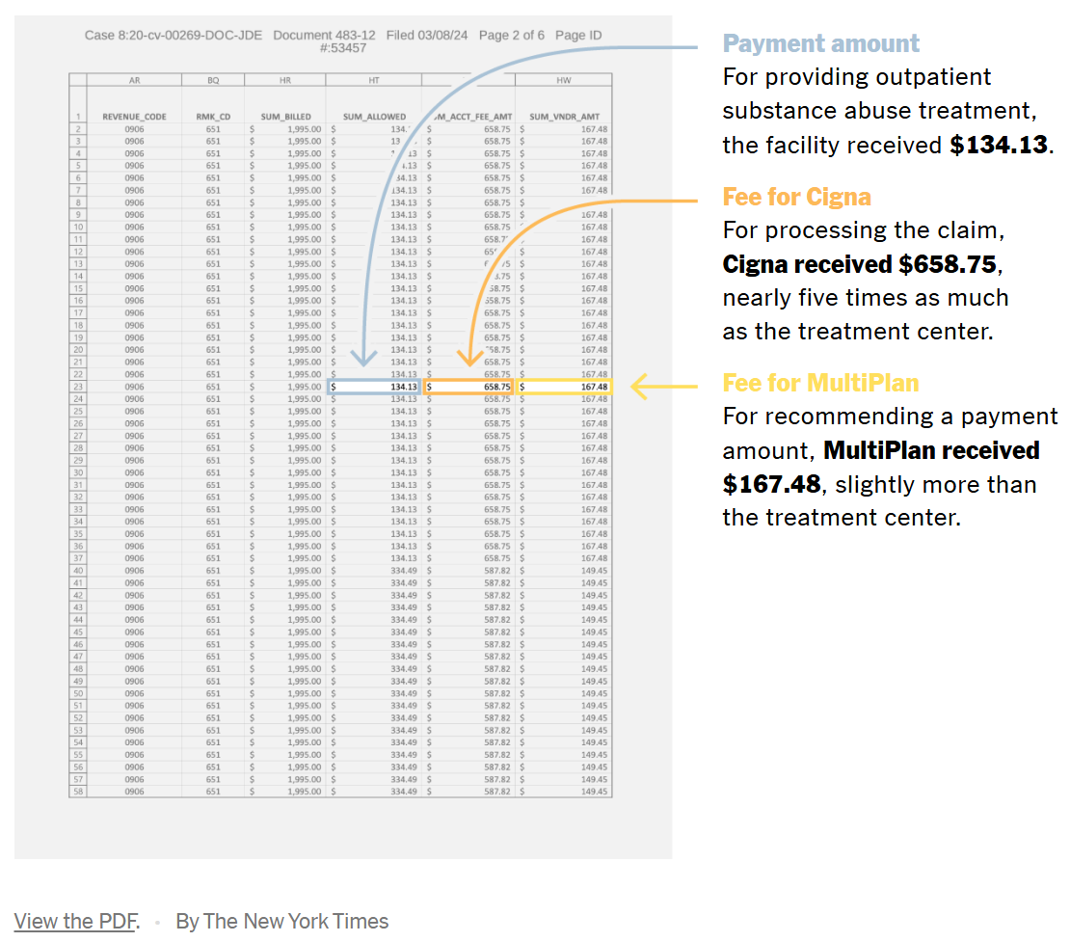
TPAs Collect “Savings” Fees
Savings fees are calculated as a percentage of the difference between billed charge and reimbursement amount
Fees can be wildly disproportional to the services rendered
Conclusion
Center on Health Insurance Reforms
Read more at chir.georgetown.edu

Slide 5
Where “Savings” Fees Can Appear
OON claims: No est’d payment rate; TPA pays small fraction of bill (increasing the fee), often leaving patient w/ balance bill
Payment “errors”: Fee for correcting overpayments, even if TPA played role in allowing overpayment (e.g., skip lists, lax bill review)
Network claims: TPA collects percentage of difference btw network provider’s billed amount and payment based on negotiated rate
Conclusion
Center on Health Insurance Reforms
Read more at chir.georgetown.edu

Slide 6

Other Hidden Fees Revealed in Lawsuits
Dummy Codes: Hide admin expenses in medical claims, resulting in higher OOP costs
  E.g., Peters v. Aetna (settled for $8.4m)
Payment of Provider Taxes by Plans: DOL lawsuit alleged that Blue Cross MN collected $66 million from self-funded plans from 2016 to 2020 to pay state taxes owed by network providers owned by TPA parent
Conclusion
Center on Health Insurance Reforms
Read more at chir.georgetown.edu

Slide 7
Third-Party Administrator Conflicts of Interest Impacting Costs
Carrier-Owned Providers: Patients are steered to carrier-owned providers paid more than non-carrier providers
Cross-Plan Offsetting: TPA recovers an overpayment to a provider under one plan it administers (often fully insured) by underpaying an amount owed to the same provider under a different plan it administers (often self-insured)
Neutrality Agreements: TPA incentivized to use self-funded plan assets to satisfy agreements with providers promising them a certain amount of revenue per year
Conclusion
Center on Health Insurance Reforms
Read more at chir.georgetown.edu

Slide 8

Transparency Reforms Inadequate
Hospital Transparency Rules: Require hospitals to disclose negotiated rates but compliance uneven and plans often pay more than negotiated rate
Gag Clause Prohibition (CAA ’21): Does not require TPAs to produce claims data; access barriers continue
Service Provider Compensation Disclosures: CAA ‘21 did not expressly apply to TPAs and PBMs; CAA ‘26 filled this gap
  DOL’s proposed disclosure rules more detailed, but apply only to PBMs and pharmacy benefit services
Conclusion
Center on Health Insurance Reforms
Read more at chir.georgetown.edu

Slide 9
Where This Leaves Employers
Employers significantly limited in determining whether the amount they are paying their TPA is reasonable
Even if employers had information, it is not easy to change carrier TPAs
  Membership doesn’t like change
  Alternative carriers are not available in area
  No better alternative because all carrier TPAs engage in these practices
Conclusion
Center on Health Insurance Reforms
Read more at chir.georgetown.edu

Slide 10
Employers Respond by Bringing Lawsuits Against Third-Party Administrators
A number of lawsuits have been brought by plan trustees against TPAs challenging savings fees and other self-dealing behavior
Key Issue: Was TPA acting as a fiduciary when it engaged in challenged activity? (I.e. Did it have or exercise control over plan assets or discretionary authority over plan administration?)
Conclusion
Center on Health Insurance Reforms
Read more at chir.georgetown.edu

Slide 11
Courts Reaching Contrary Decisions
Mass. Laborers’ Health & Welfare Fund v. Blue Cross Blue Shield of Mass., (1st Cir. 2023)
  Alleged that BCBSMA overpaid providers, collected savings fees when it recouped the overpayments, and repriced claims to pay more than the negotiated rate and kept the difference
  Court held that BCBSMA was not a fiduciary because it was merely following contractual terms and deviations from those terms were simply mistakes
  Court held that BCBSMA did not have control over plan assets held in a working capital account because it only exercised physical control of the assets and performed mechanical administrative tasks
Conclusion
Center on Health Insurance Reforms
Read more at chir.georgetown.edu

Slide 12
Courts Reaching Contrary Decisions
Tiara Yachts v. Blue Cross Blue Shield of Mich., (6th Cir. 2025)
  Employer alleged that BCBSMI systematically overpaid provider claims and kept 30% of the amount recovered through a “shared savings” program
  Sixth Circuit held that BCBSMI was acting as a fiduciary when it controlled and then failed to preserve assets held in the plan’s name
  Distinguished First Circuit decision because plan fiduciaries there had final decision-making authority over claim payments where Tiara Yachts did not
  Court held that BCBSMI was acting as a fiduciary by exercising discretion over the shared savings program because it controlled the claims-processing apparatus enabling it to determine its own compensation by controlling the number of overpayments and determining the amount that would be paid the providers
Conclusion
Center on Health Insurance Reforms
Read more at chir.georgetown.edu

Slide 13
Employees Sue Employers for Fiduciary Breaches Concerning PBM Contracts
Employees have brought ERISA lawsuits against Johnson & Johnson, Wells Fargo and J.P. Morgan Chase concerning PBM contracts
Allege that employer breached its fiduciary duties by overpaying for prescription drugs and administrative costs and failing to monitor PBM
With one exception dismissed on Article III standing grounds
  Prudence and loyalty claims dismissed because (1) Plaintiffs obtained benefits promised and (2) premiums and out-of-pocket costs choices were plan design functions, not fiduciary functions, that would not be changed by litigation
  Claim in J.P. Morgan Chase case that employer engaged in a prohibited transaction by paying more than reasonable compensation remained because burden was on employer to show that compensation was reasonable and could not be resolved on motion to dismiss
Conclusion
Center on Health Insurance Reforms
Read more at chir.georgetown.edu

Slide 14
Plan Fiduciaries Struck Between a Rock and a Hard Place
Plan fiduciaries that file suit may face counterclaim alleging they enabled the breach
  E.g., Tiara Yachts, Inc. v. BCBSMI
Plan fiduciaries that do not ask risk lawsuits by employees alleging fiduciary breaches related to plan mismanagement
  E.g., Johnson & Johnson, Wells Fargo, JP Morgan Chase
Conclusion
Center on Health Insurance Reforms
Read more at chir.georgetown.edu

Slide 15
Remedies Issue Lurking in the Background
Most cases are brought under Section 502(a)(3) of ERISA which limits recovery to “appropriate equitable relief”
The Supreme Court clarified in Cigna v. Amara that “appropriate equitable relief” included make whole relief (surcharge) when the claim is brought against a fiduciary
Almost all circuits reversed previous decisions holding otherwise after Amara but, based on a footnote in a later Supreme Court case, have retreated to their earlier holdings.
Supreme Court asked the government if it should take a Sixth Circuit case now holding that surcharge is not available; Fifth Circuit considering issue en banc.
Conclusion
Center on Health Insurance Reforms
Read more at chir.georgetown.edu

Slide 16
Supplemental Benefit Cases
Several lawsuits filed this year by employees targeting employers and their brokers/consultants for breaching fiduciary duties related to voluntary benefit plans
Claim that employers failed to ensure that the costs of the programs were reasonable resulting in employees paying excessive premiums
Also targets brokers who are alleged to be fiduciaries who engaged in unlawful self-dealing
Early stages but raise questions about (1) whether these plans are covered by ERISA, and (2) whether brokers became fiduciaries when they withheld information about lower-cost options to maximize commissions
Conclusion
Center on Health Insurance Reforms
Read more at chir.georgetown.edu

Slide 17

U.S. Dep’t of Labor in Litigation
Enforcement Actions: Lawsuits against TPAs for fiduciary breaches related to plan administration
  Cross-plan offsetting, hidden fees
Amicus Briefs: Support for private plaintiffs against TPAs
  Peterson v. UnitedHealth Group (8th Cir.) (cross-plan offsetting violates ERISA)
  Mass. Laborers’ Health & Welfare Fund v. BCBSMA (1st Cir.) (TPA fiduciary status)
  Tiara Yachts v. BCBSMI (6th Cir.) (TPA fiduciary status)
Conclusion
Center on Health Insurance Reforms
Read more at chir.georgetown.edu

Slide 18
U.S. Dep’t of Labor Compliance Assistance
DOL provides compliance assistance for health plan fiduciaries
  Health plan fiduciary responsibilities
  Gag clause prohibition compliance
  Service provider disclosures
Conclusion
Center on Health Insurance Reforms
Read more at chir.georgetown.edu

Slide 19
Questions?
Karen Handorf
Full Professor of the Practice
karen.handorf@georgetown.edu

