Slide 1
Alternative Coverage Arrangements for Employer-Sponsored Coverage
Lindsey Murtagh
Distinguished Senior Fellow in Health Law, Brown University School of Public Health
June 4, 2026

Slide 2
Disclosures
During prior employment at the Department of Health and Human Services, I worked on regulations that created ICHRAs.

Slide 3
Agenda
Context
Alternative “Insurance” Products
  Level-Funded Plans
  “Skinny” Plans+
  ICHRAs
State Policy Options

Slide 4
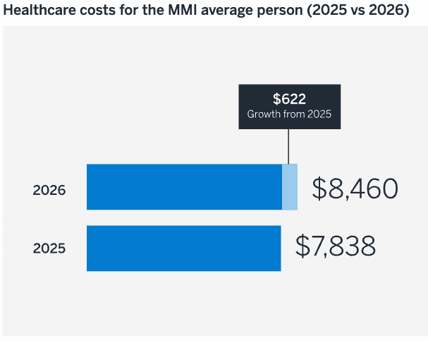
Context
Cost & Affordability
Milliman Medical Index (MMI) = estimates annual U.S. healthcare costs for employer-sponsored insurance
2026 will mark the highest increase in over a decade.
Costs will grow by 7.9%.
Pharmacy and outpatient facility care are primary drives of cost increases.
Notes:
https://media.milliman.com/v1/media/edge/images/millimaninc5660-milliman6442-prod27d5-0001/media/Milliman/PDFs/2026-Articles/2026_Milliman-Medical-Index.pdf
Milliman: consulting and actuarial firm

Slide 5
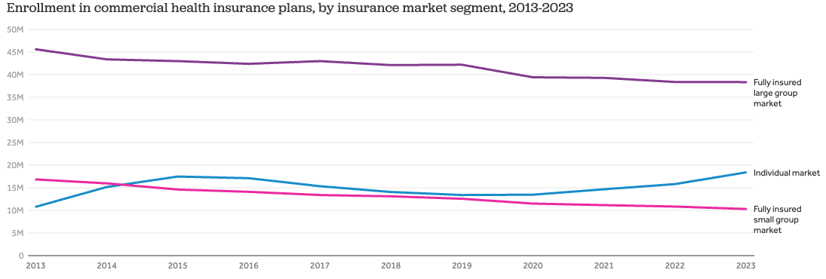
Context
Enrollment Trends
Source: Peterson-KFF Health System Tracker
Notes:
Peterson-KFF Health System Tracker, Recent trends in commercial health insurance market concentration
Enrollment in fully insured plans in the large group market declined from about 46 million to 38 million between 2013 and 2023. Despite the decrease in enrollment, the number of enrollees in ESI has remained steady, suggesting that employers have been shifting to self-insured plans.
https://www.healthsystemtracker.org/chart-collection/recent-trends-in-commercial-health-insurance-market-concentration/#Enrollment%20in%20commercial%20health%20insurance%20plans,%20by%20insurance%20market%20segment,%202013-2023

Slide 6
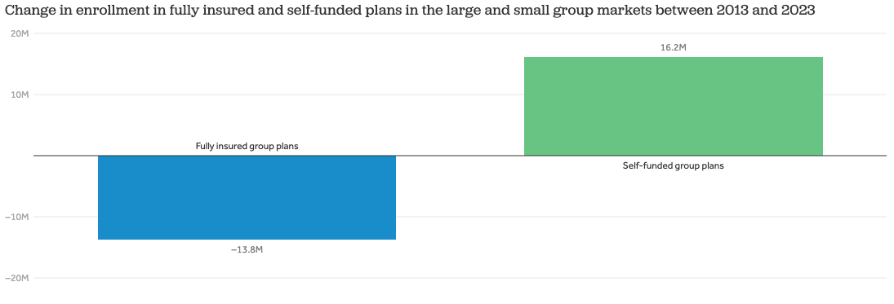
Context
Source: Peterson-KFF Health System Tracker
Notes:
Peterson-KFF Health System Tracker, Recent trends in commercial health insurance market concentration
Between 2013 and 2023, enrollment in fully insured group plans declined by about 14 million while enrollment in self-insured group plans increased by about 16 million. While large employers are typically enrolled in self-insured plans, small and medium-sized employers are increasingly shifting to self-insured plans. In 2025, 44% of insured workers in small firms were enrolled in a self-insured plan.
https://www.healthsystemtracker.org/chart-collection/recent-trends-in-commercial-health-insurance-market-concentration/#Change%20in%20enrollment%20in%20fully%20insured%20and%20self-funded%20%20plans%20in%20the%20large%20and%20small%20group%20markets%20between%202013%20and%202023

Slide 7
Context
Switching from fully-insured coverage to self-funded coverage
Allows employers – particularly small employers – to lower costs by avoiding requirements applicable to fully-insured market
Exposes switching employers to more risk
Creates adverse selection for small group markets, increasing fully-insured premiums
The emergence of alternative coverage arrangements is offering new options for employers looking to leave the fully-insured group market.

Slide 8
Alternative “Insurance” Products

Slide 9
Three Examples:
Level-Funded Plans
“Skinny” Plans Plus
Individual Coverage Health Reimbursement Arrangements (ICHRA)
Notes:
-What they are
-Regulatory framework
-What these options offer for employer, employees, and states

Slide 10
Individual Coverage Health Reimbursement Arrangements (ICHRA)
Individual Coverage Health Reimbursement Arrangements (ICHRA)
Level-Funded Plans
Claims Fund
Admin Costs
Monthly Payment
Stop Loss Insurance Premiums
Self-funded arrangement through which employer limits its risk.
Under a level-funded plan, employer typically pays an administrator a monthly payment.
Claims fund is a fixed amount covering expected claims.
Stop-loss insurance covers group’s health expenditures that exceed the “attachment point” (dollar threshold).
Notes:
Most common of the three examples.

Slide 11
Individual Coverage Health Reimbursement Arrangements (ICHRA)
Individual Coverage Health Reimbursement Arrangements (ICHRA)
Level-Funded Plans
Significant and growing uptake among small employers.
Among covered workers at small firms (size 10-199), the percentage of enrolled in a level funded plan has increased from 6% in 2018 to 37% in 2025.
Key Concern: Where stop-loss coverage has a low attachment point, the coverage plays a role akin to a health insurance issuer – but without the same regulatory oversight.
Notes:
U.S. Department of Labor, Technical Release No. 2014-01
Stop-loss insurance with attachment points are particularly attractive for employers with a healthy pool of employees. As these employers choose to self-insure, fully funded employers are left with a sicker pool, increasing premiums (death spiral). To prevent adverse selection, states have attempted to establish regulations that set minimum attachment points for stop-loss insurance in the market, in an attempt to meaningfully drop employers from self-insured plans and balancing the risk pool.

Slide 12
Individual Coverage Health Reimbursement Arrangements (ICHRA)
Individual Coverage Health Reimbursement Arrangements (ICHRA)
Level-Funded Plans
Self-funded plan is subject to federal consumer protections under ERISA, exempt from state oversight.
Stop loss insurance exists in a regulatory gray area.
  Not subject to federal consumer protections under ERISA or Public Health Service Act.
  Not treated as a fiduciary for the plan.
  States can regulate the stop-loss insurance portion of level-funded plans within limits.
  In American Medical Security, Inc. v. Bartlett, the court ruled that ERISA preempted Maryland’s regulation that deemed stop-loss insurance to be health insurance.
  Department of Labor has explained that state can instead regulate stop-loss insurance and if “the law regulates the insurance company and the business of insurance”
  Several states adopted laws that prohibit the sale of stop-loss insurance with attachment points below specific thresholds.
Notes:
U.S. Department of Labor, Technical Release No. 2014-01
American Medical Sec., Inc. v. Bartlett, 915 F. Supp. 740 (D. Md. 1996)
Stop-loss insurance with attachment points are particularly attractive for employers with a healthy pool of employees. As these employers choose to self-insure, fully funded employers are left with a sicker pool, increasing premiums (death spiral). To prevent adverse selection, states have attempted to establish regulations that set minimum attachment points for stop-loss insurance in the market, in an attempt to meaningfully drop employers from self-insured plans and balancing the risk pool.
States vary in how they approach these – Should they be treated like health insurance? Or like casualty insurance?

Slide 13
Individual Coverage Health Reimbursement Arrangements (ICHRA)
Individual Coverage Health Reimbursement Arrangements (ICHRA)
Impact of Level Funded Plans
Employer
Risk management strategy.
Employees
Fewer consumer protections compared to fully-insured coverage (e.g., Essential Health Benefits, state requirements).
State
Adverse selection, with healthier employer groups moving out of the fully-insured risk pool.
Potential cost savings by avoiding rules applicable to fully-insured plans.
Leaves employer exposed to risk associated with minimally regulated stop-loss insurer
Comparable experience to other self-funded plans, when functioning well.
Leaves employee exposed to risk associated with minimally regulated stop-loss insurer
Level-Funded Plan
Notes:
High fixed monthly premium payments. In some states premiums can be reset mid-year. Most states premiums can be underwritten and changes significantly based on prior year’s costs.

Slide 14
Individual Coverage Health Reimbursement Arrangements (ICHRA)
Individual Coverage Health Reimbursement Arrangements (ICHRA)
What’s a “Skinny” Plan+?
Employer sponsored plan covering preventive services ONLY
Excepted Benefits
Skinny Plan+
Notes:
I haven’t been able to find good data on how common these are.

Slide 15
Individual Coverage Health Reimbursement Arrangements (ICHRA)
Individual Coverage Health Reimbursement Arrangements (ICHRA)
What’s a “Skinny” Plan+?
Self-funded plan.
Satisfies ACA requirements regarding preventive services and max out-of-pocket.
Qualifies as minimum essential coverage.
Does not meet minimum value standards.
Does not meet federal or state standards applicable to insured group coverage.
ESI covering preventive services ONLY

Slide 16
Individual Coverage Health Reimbursement Arrangements (ICHRA)
Individual Coverage Health Reimbursement Arrangements (ICHRA)
What’s a “Skinny” Plan+?
Excepted from federal requirements applicable to group health plans.
Could be fixed indemnity, coverage for on-site medical clinics, employee assistance programs, specified disease coverage, stand-alone dental or vision coverage, or combination.
Fee schedules often similar to major medical.
Key federal consumers protections don’t apply (e.g., essential health benefits, max out-of-pocket, non-discrimination requirements, mental health parity).
Minimal to no state oversight.
Excepted Benefits
Notes:
Unclear how common these combo arrangements are.
When I was at CMS, we received a handful of inquiries about preventive-only plans per year.
Excepted benefits with detailed fee schedules are quite common in the fixed indemnity space.

Slide 17
Individual Coverage Health Reimbursement Arrangements (ICHRA)
Individual Coverage Health Reimbursement Arrangements (ICHRA)
Impact of Skinny+ Plans
Employer
Offers combination product that mimics health insurance.
Avoids larger 4980H penalty, if offered to at least 95% full-time employees.
Employees
Increased financial risk.
Doesn’t get consumer protections applicable to major medical plans (except w/r/t preventive only plan).
State
Likely has a negative impact on state small group risk pool, compared to if employees were in fully-insured coverage.
Potential costs related to uncompensated care.
Contains costs, limits risk, and lowers administrative burden.
Skinny+ Plan

Slide 18
Individual Coverage Health Reimbursement Arrangements (ICHRA)
Individual Coverage Health Reimbursement Arrangements (ICHRA)
ICHRA
Employee uses funds from ICHRA to purchase individual coverage
ICHRA & individual coverage become “integrated”
Individual coverage
(or Medicare)
Employer contribution to coverage

Slide 19
Individual Coverage Health Reimbursement Arrangements (ICHRA)
Individual Coverage Health Reimbursement Arrangements (ICHRA)
Relatively new form of coverage that appears to be growing.
Self-funded, account-based group health plan that reimburses employees for the cost of premiums for coverage purchased in the individual market (or Medicare).
Offer a defined level of funding, rather than a defined set of benefits
Employer contributions to ICHRAs excluded from gross income.
Non-discrimination protections discourage employers from dumping risk.
Treated like traditional group coverage for purposes of employer shared responsibility payment and employees’ eligibility for premium tax credits.
ICHRA is exempt from state oversight, under ERISA. States have authority to regulate the fully-insured individual coverage.

Slide 20
Individual Coverage Health Reimbursement Arrangements (ICHRA)
Individual Coverage Health Reimbursement Arrangements (ICHRA)
Impact of ICHRA
Employer
Defined contributions limit risk.
Employees
Has the burden/opportunity to shop for coverage.
State
Experiences risk pool impacts that are dependent on who adopts.
Higher costs for older employees.
Cost of offering affordable coverage depends heavily on local market.
Benefits from state and federal consumer protections applicable to individual coverage.
Pulls employer $$ into individual market.
Creates incentives for issuers to offer new products.
ICHRA

Slide 21
Policy Options for States

Slide 22
State Policy Options
Level-Funded
Prohibiting low attachment points. Form review. Other policies that avoid regulating the self-funded ERISA plan?
Skinny+
Cannot regulate preventive-only plan. Applying state standards to insured excepted benefits. Adopting individual coverage mandates that require MEC+.
ICHRA
Offering state subsidies. Establishing off-Exchange enrollment pathways. Individual market-targeted policies.
Notes:
Level funded: With state laws regulating stop-loss insurance attachment points, small employers not subject to the employer mandate may drop coverage entirely, leaving employees uninsured.

Slide 23

Thank You

