Slide 1
A Course on Anti-Science and Public Health Law and Policy
Patty Skuster, JD MPP
University of Pennsylvania MPH Program
skusterp@pennmedicine.upenn.edu

Slide 2
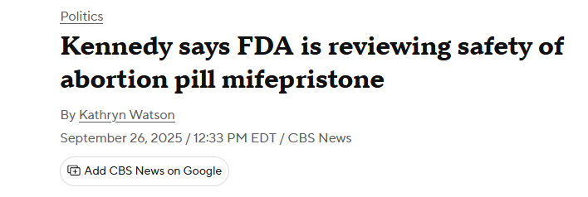

Slide 3
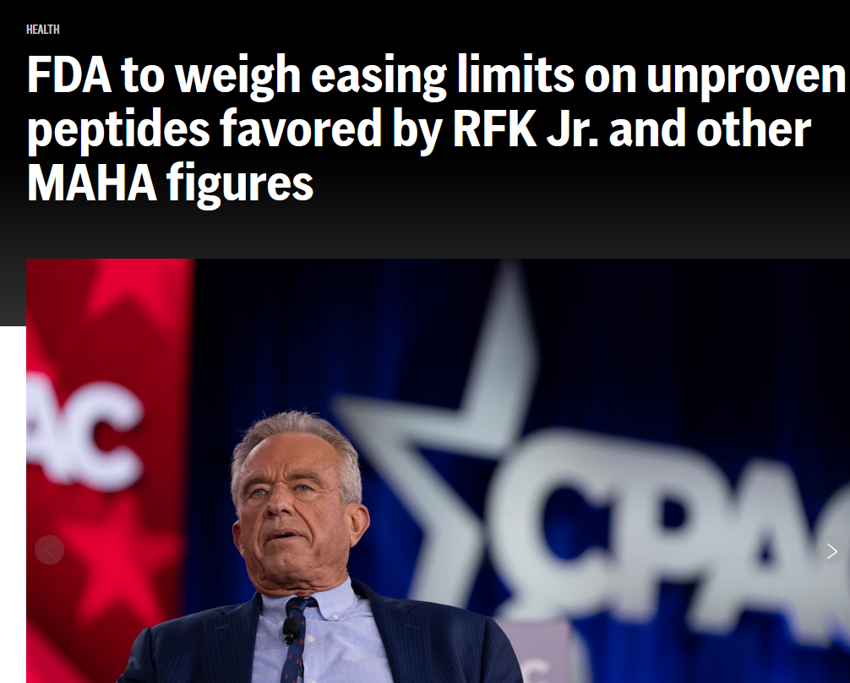

Slide 4
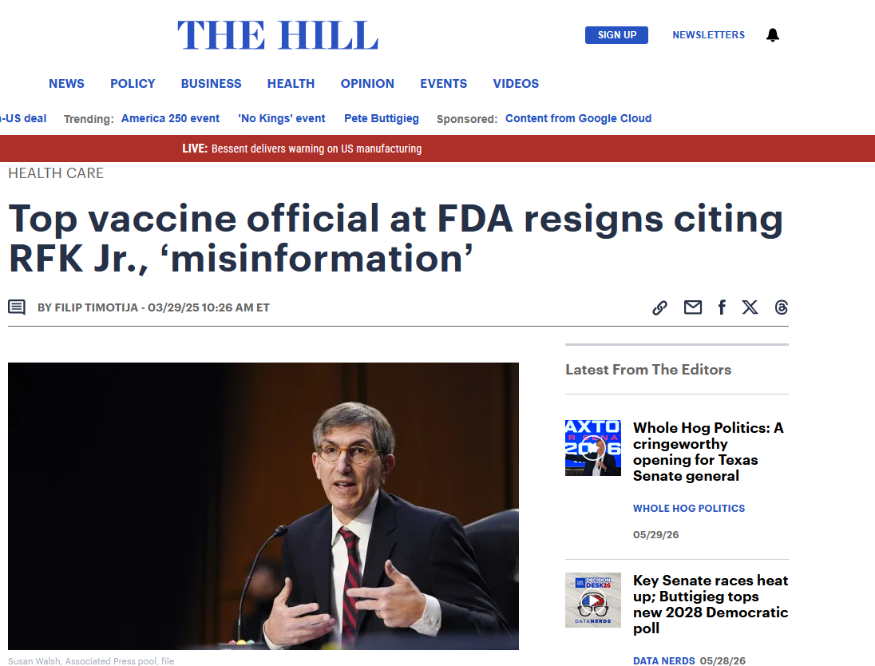

Slide 5
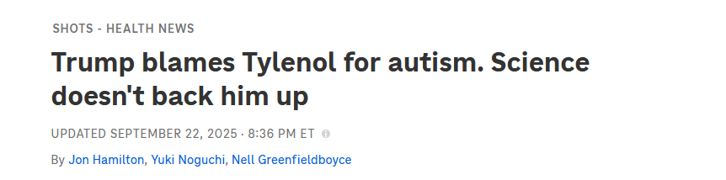

Slide 6
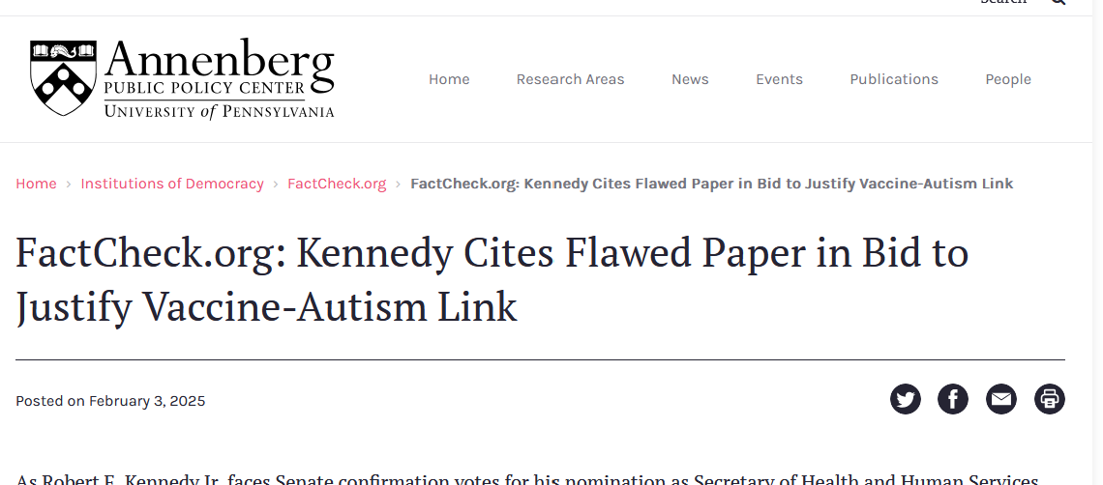

Slide 7
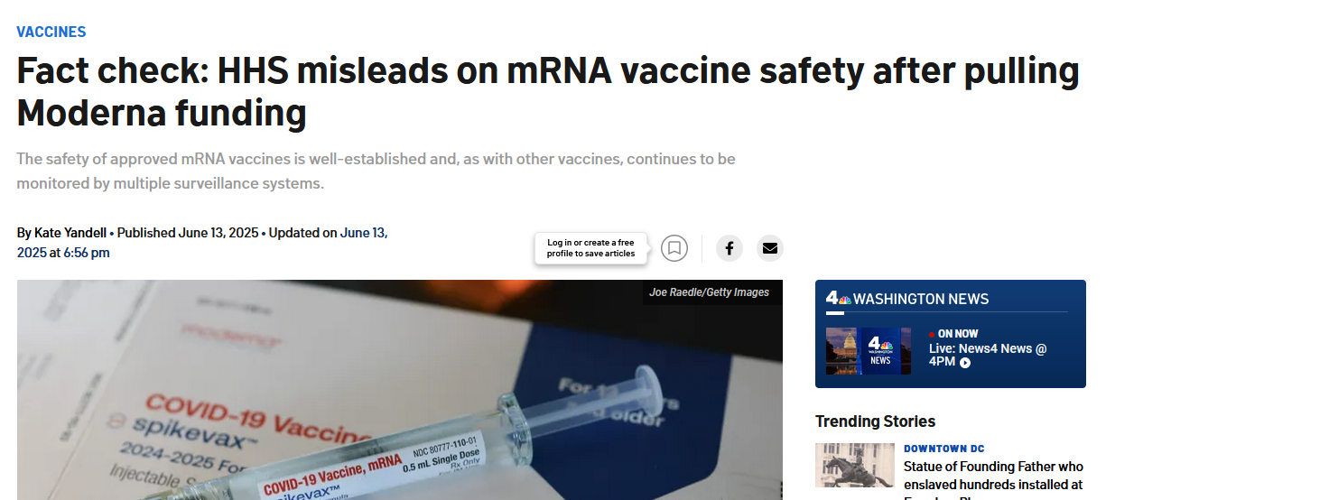

Slide 8
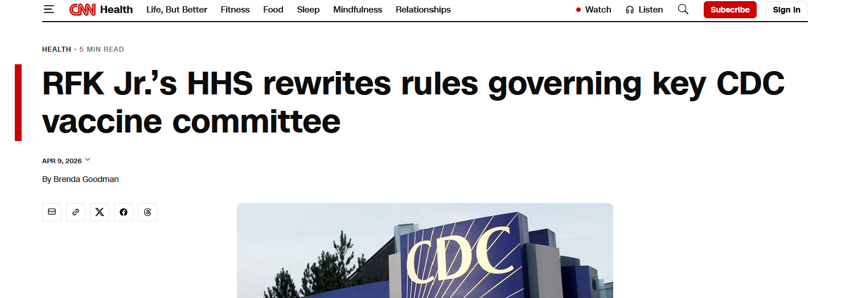

Slide 9



More than 420 anti-science bills attacking vaccines, milk safety and fluoride have been introduced in statehouses across the U.S. in 2025
Smith, MR & Ungar, L (2025 October 21) Anti-science bills hit statehouses, stripping away public health protections built over a century. Links to an external site. Associated Press

Slide 10

UPenn MPH Program
Elective, Spring 2026
Science Versus Anti-Science In Public Health Law & Policy

Slide 11
Course Objectives
Describe the anti-science policy landscape
Trace policy assertions to their sources
Communicate for evidence-informed policy advocacy

Slide 12
Course Content
Part I: The Landscape
Part II: Skills-building

Slide 13
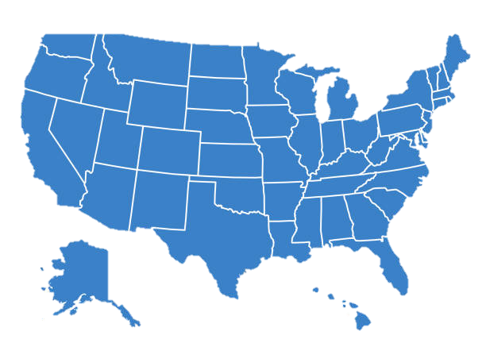


Part I: The Landscape
Anti-science trends & motivations

Slide 14

Part I: The Landscape
Anti-science trends & motivations
How evidence informs policymakers

Slide 15
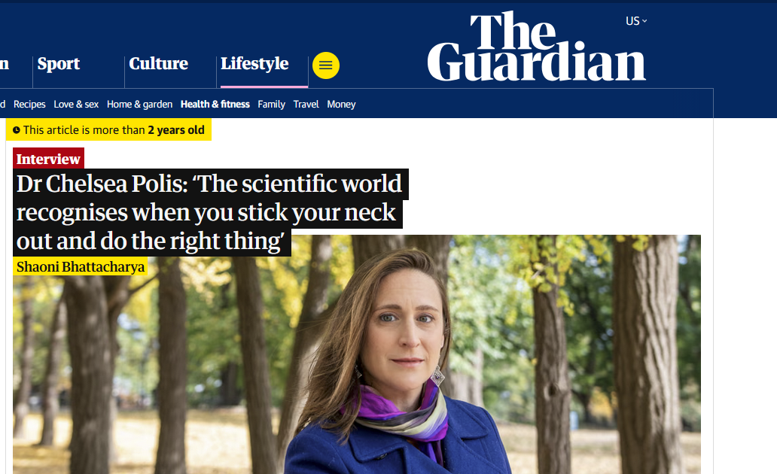
Part I: The Landscape
Anti-science trends & motivations
How evidence informs policymakers
Peer-review and redactions

Slide 16
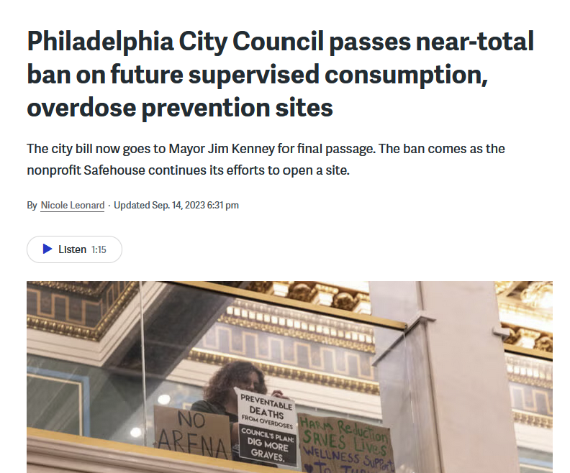
Part I: The Landscape
Anti-science trends & motivations
How evidence informs policymakers
Peer-review and redactions
Community buy-in (harm reduction, zoning)

Slide 17

Part II: Skills-building
Role play
Stigma and story-telling
Examples from congressional hearings
Tools & resources for advocacy, mis/disinformation

Slide 18
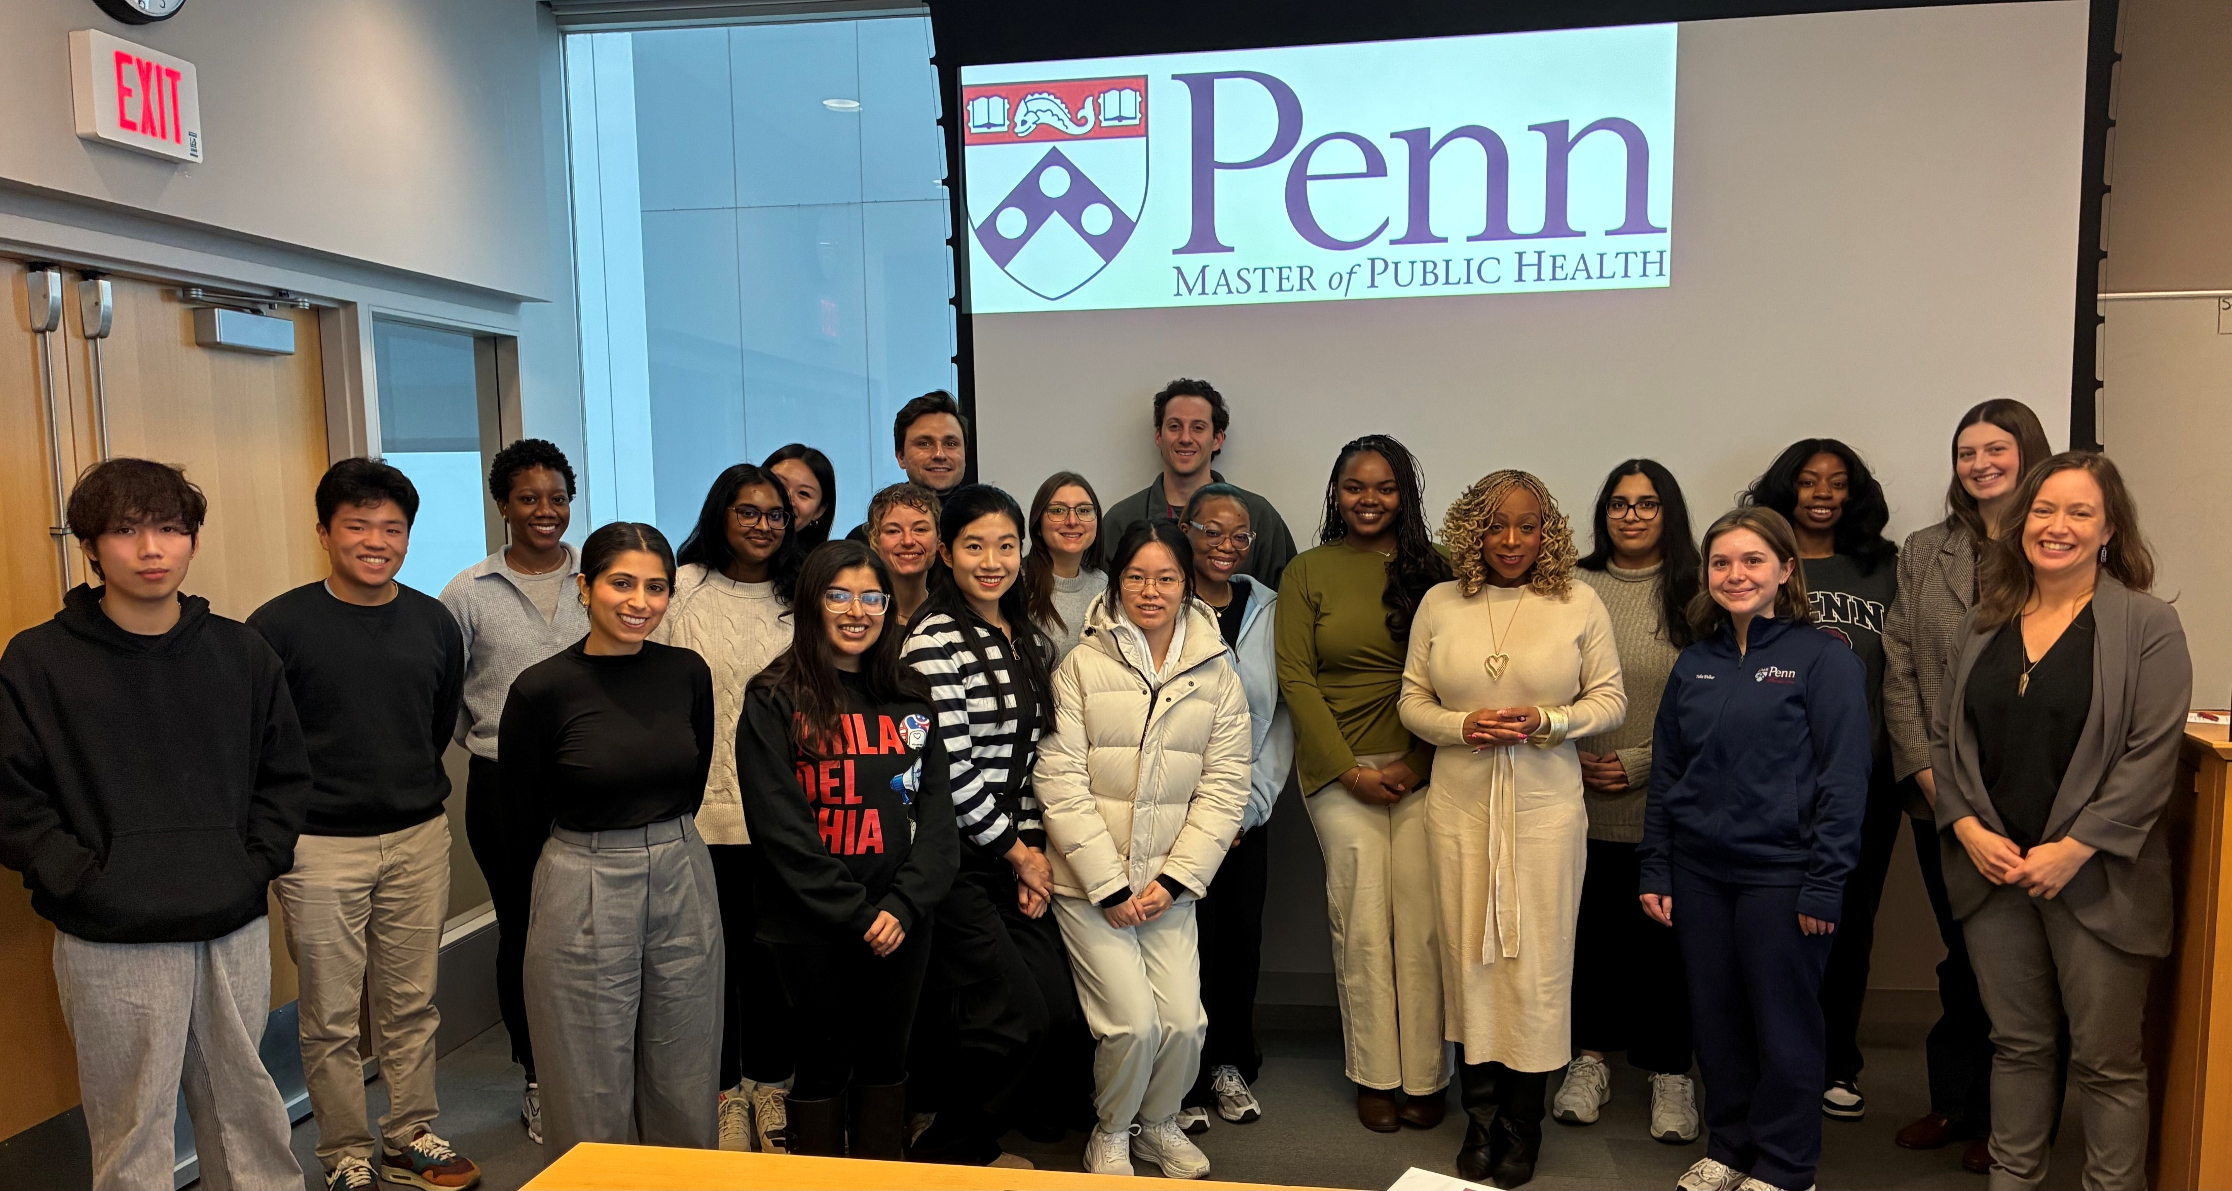
Guest speakers: State & local legislators, PH communication professional, multi-state issue advocate, researcher

Slide 19
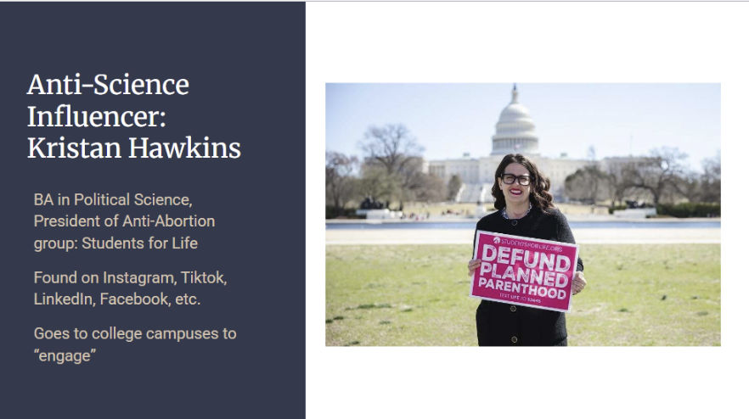

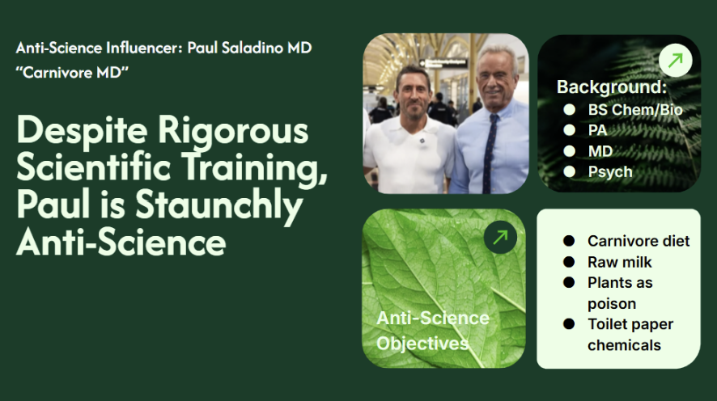
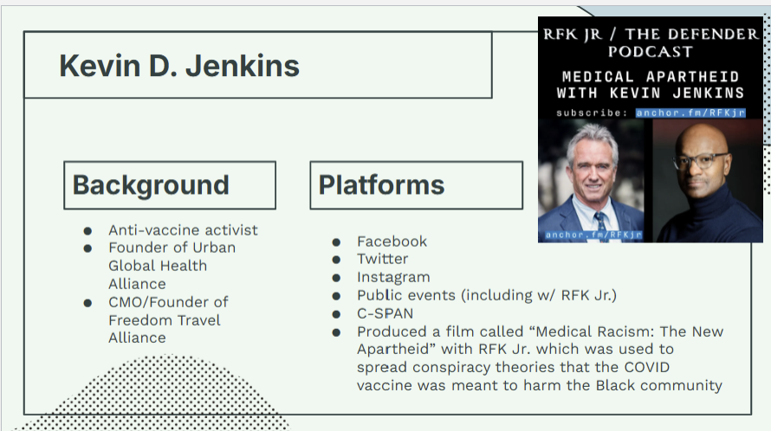
Assignments
Anti-science influencer presentation

Slide 20
Assignments
Anti-science influencer presentation
Science to policy pipeline
Briefing paper & presentation

Slide 21
Course Objectives
Describe the anti-science policy landscape
Trace policy assertions to their sources
Communicate for evidence-informed policy advocacy

Slide 22
Thank you!
Patty Skuster, JD MPP
University of Pennsylvania MPH Program
skusterp@pennmedicine.upenn.edu

