Slide 1
Is BearCare Bearable?
Melissa B. Alexander, Carl M. Williams Professor of Law & Ethics
University of Wyoming College of Law
Notes:
No, but neither is unaffordable care & ins in low pop states who are being left behind; it’s time to adopt a natl public option & cap geo rating

Slide 2
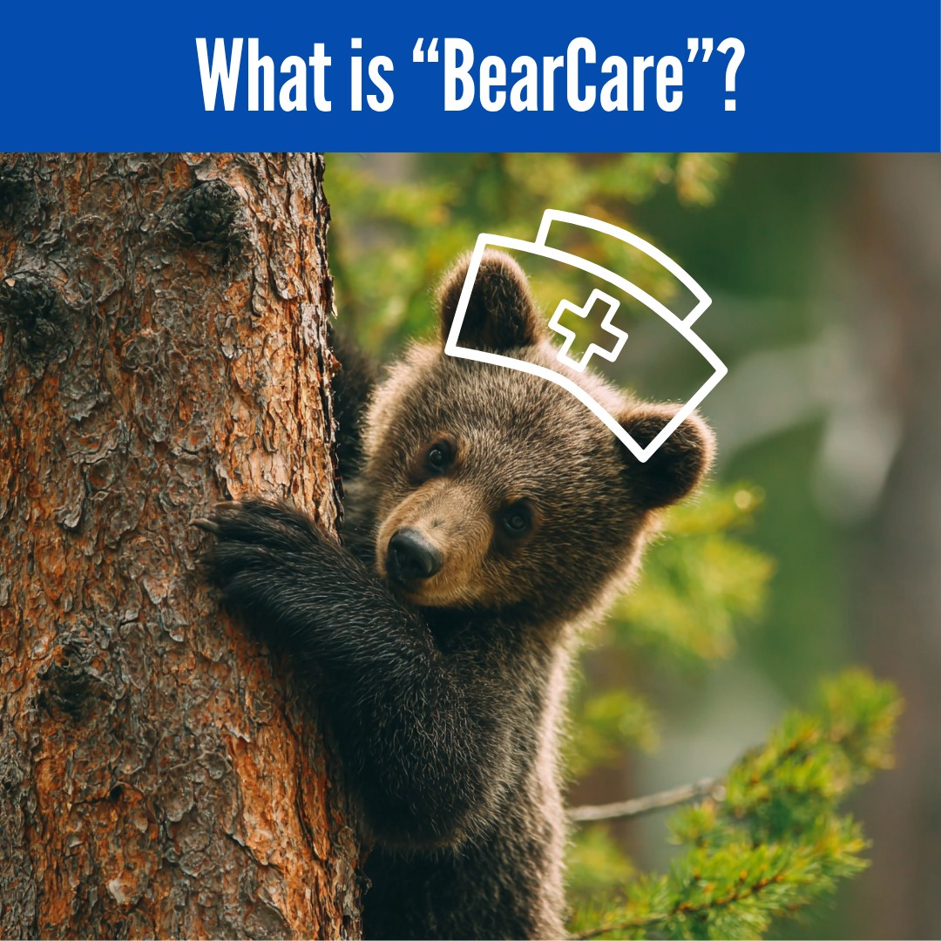
Is BearCare Bearable?
What is BearCare, unaffordability, & structural inequities
Why ACA likely won’t preempt
Pitfalls, promise, & more bearable alternatives

Slide 3
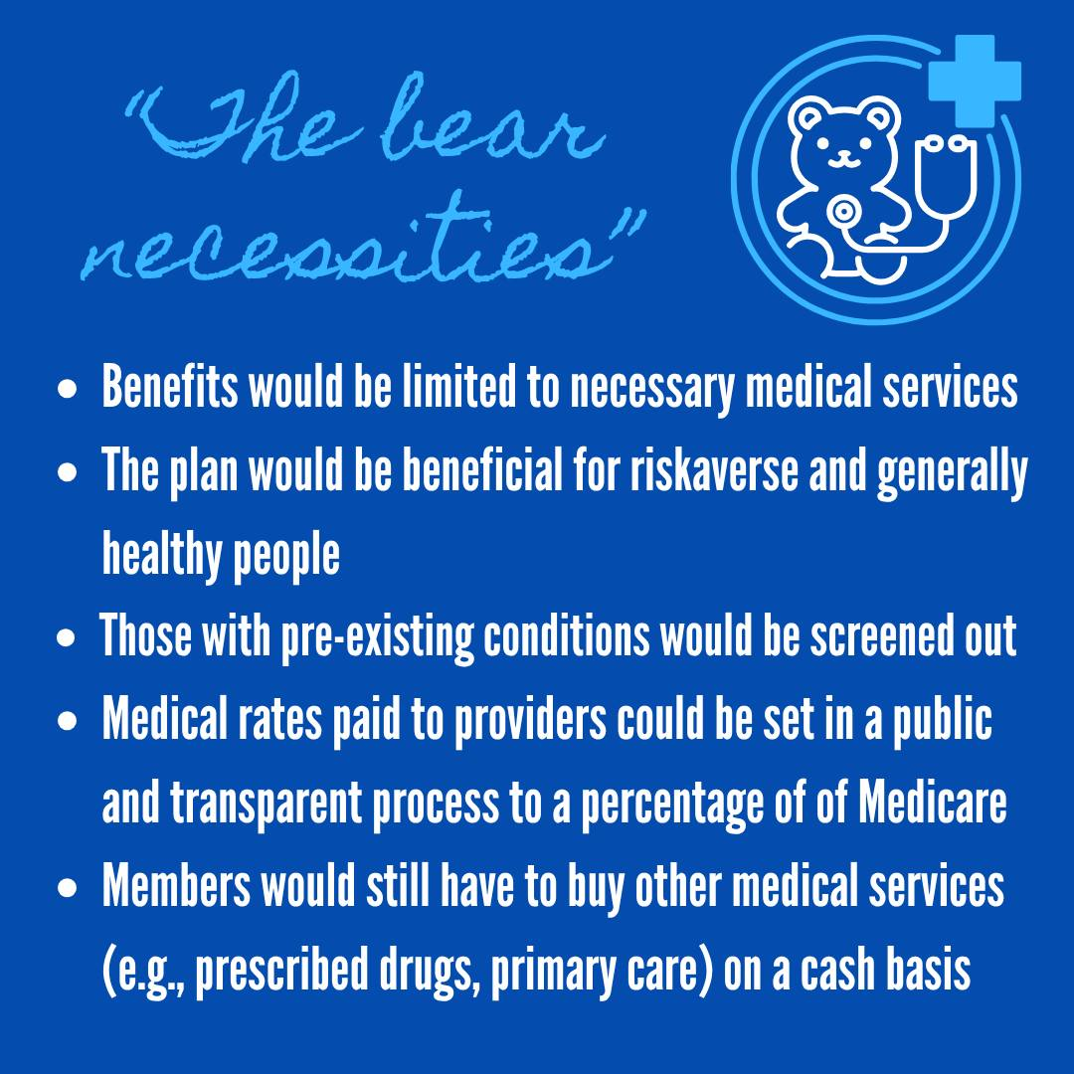
Non-Compliant State Public Option Health Plan
1st state public option health plan for emergency care only
  Not ACA-Compliant
    Deny enrollment/renew unless healthy
    Not cover EHB – no routine, preventative, prescription, or pre-existing condition care
    No consumer protections
  Providers paid % Medicare
  Indiv. & small group buy-in, at cost, under $200/mo.

Slide 4

Unaffordable
Wyoming before enhanced subsidies expired:
46th Access & Affordability
50th % Medical debt in collections – 2x natl. avg.
47th Uninsured adults >64
Wyoming in 2026:
11% dropped marketplace coverage - 25% ⬆️ cost
49th Affordability: $1,090/mo., 1.74x avg., 2.72x NH
  Household income below natl. avg.

Slide 5

Structural Barriers
Market: Care often requires high fixed costs, but rural states have low volume & little competition (providers & insurance) = higher costs
  Only 2 insurers in ACA marketplace; 1 hospital serves multiple counties; 2nd fewest physicians per capita
ACA: Market-based, state-based system with uncapped geographic rating
  3 least populous states = 3 of 4 highest ins. premiums

Slide 6
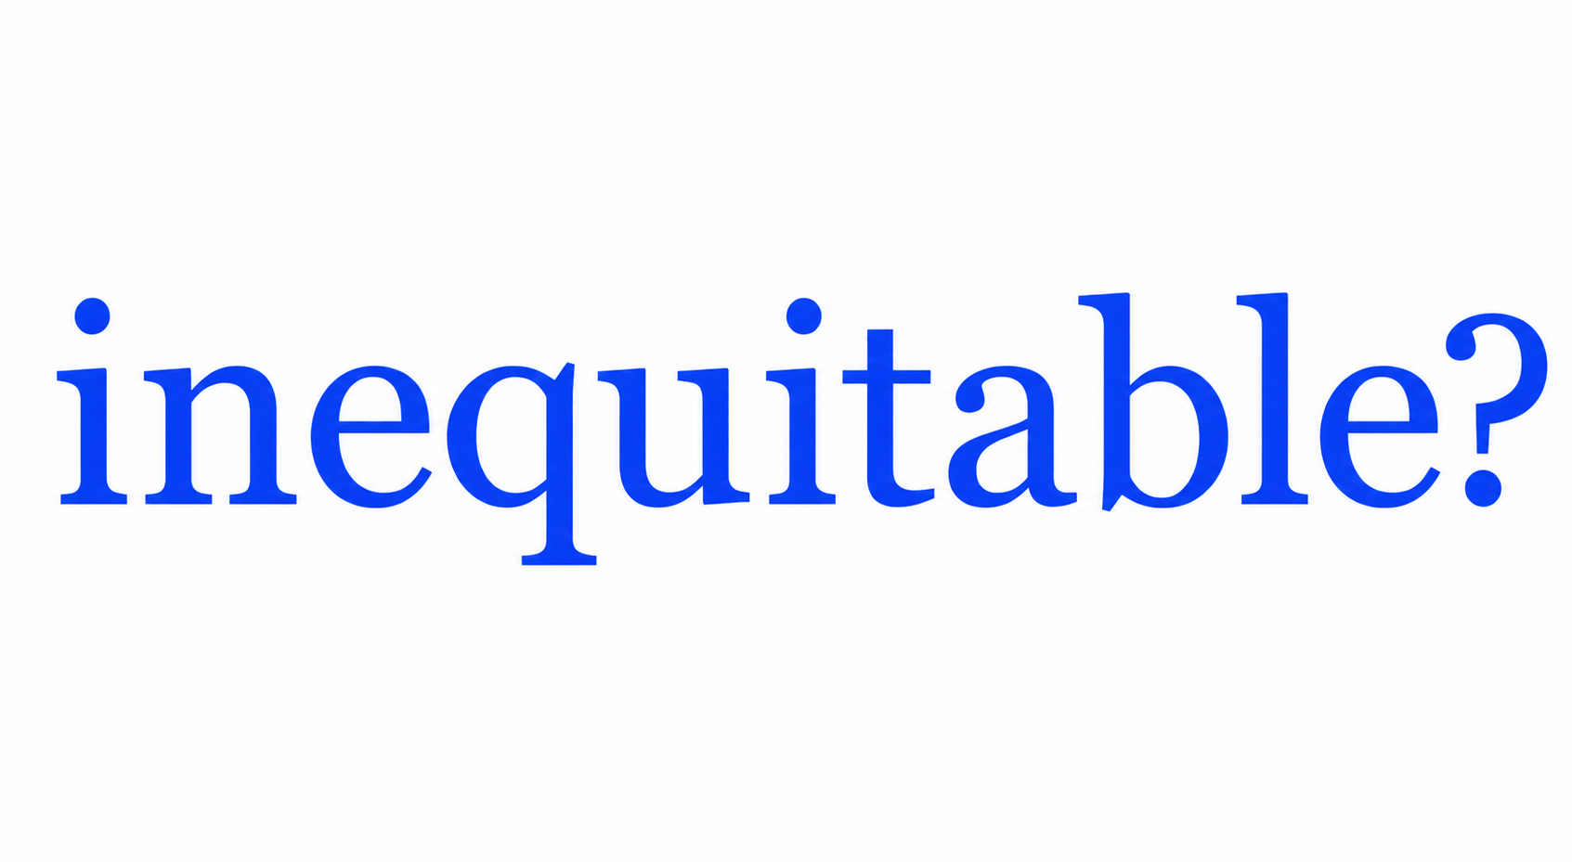
Inequitable?
Rural health disparities
Are state geographic disparities inequitable?
  Compare age, tobacco, & family size
    Geography not impact all equally
    Geography not moral hazard
    Geography (largely) not reflect actuarial reality
Without legal change, care will remain unaffordable

Slide 7

BearCare is (likely) legal
ACA (likely) does not preempt
No express nor field preemption
  State not “health insurance issuer”
  45 C.F.R. §144.103
Conflict preemption unlikely
  Not impossible
  Obstacle?
Freepik designed by Dooder

Slide 8
BearCare is (likely) legal
Obstable?
  Arguably obstructs ACA objectives re uniformity, regulatory floor (EHB, consumer protections, community)
    But ACA allows non-ACA compliant plans, narrow definition, & BearCare at cost
      HHS not enforce Biden’s 3-month restriction on short-term limited duration plans; New rule imminent
      Approved WY’s Rural Health Transformation Application

Slide 9

BearCare Pitfalls & Promise
Possible benefit: $200 premium for eligible, risk-averse = some protection, but unlikely need covered care, EMTALA guarantees, & bankruptcy protects
  6% adults > age 45 visit ER for injury/yr… 94% no benefit
Benefits or Harm? Rural hospitals
  Increase or decrease uncompensated care for uninsured?

Slide 10

BearCare Pitfalls & Promise
Pitfalls
  ⬆️ consumer confusion & transaction costs ALL
  Death spiral? ⬆️ premiums OTHERS
    Even small ⬆️ high-risk uninsured hurts financial viability hospitals - more likely to require uncompensated care
  Destabilize provider & insurance markets - reduced access ALL

Slide 11
More Bearable Alternatives?
National Public (Buy-in) Plan
  Negotiated rates with cost-effectiveness & cost-benefit controls; graduated premiums & individual mandate tax
At a minimum, cap geographic rating & couple plan offerings in 10 least & most affordable states
Wyoming should expand Medicaid & adopt rate review
  Reinstate 95% federal match; More robust natl. review

