Slide 1
Affordable Care Act
Retrenchment
Gabriel Scheffler
Health Law Professors Conference
June 4, 2026

Slide 2
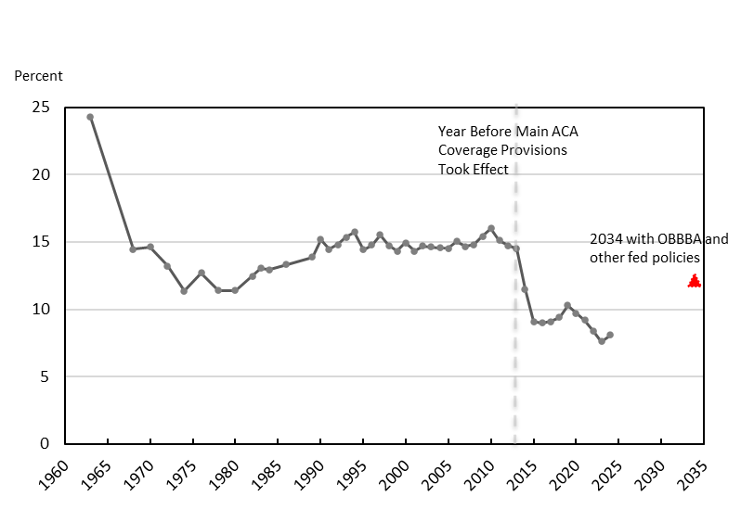
United States Uninsured Rate (Historical and Projected)
Source: Matthew Fiedler, Taking Stock of The Health Coverage Impacts of the House Reconciliation Bill, Health Aff. Forefront (Jun. 10, 2025), https://www.healthaffairs.org/content/forefront/taking-stock-health-coverage-impacts-house-reconciliation-bill.

Slide 3
Questions About the Health Care Provisions in the “One Big Beautiful Bill Act”:
1. How do they work?
2. How were they enacted, despite the conventional wisdom that social programs are hard to dismantle?
3. How will they be implemented? (Are states in a position to mitigate coverage impacts?)

Slide 4
Interview Methodology
34 semi-structured interviews of health care experts
Snowball sampling, cold email solicitations
Sector | # of Experts
State Government | 17
Non-Profit/Academia | 11
For-Profit | 6

Slide 5
Questions About the Health Care Provisions in the “One Big Beautiful Bill Act”:
1. How do they work?
2. How were they enacted, despite the conventional wisdom that social programs are hard to dismantle?
3. How will they be implemented? (Are states in a position to mitigate coverage impacts?)

Slide 6
Health Care Policies in the OBBBA
Source: All estimates are estimates from the Congressional Budget Office over ten years (2025-2034). Congressional Budget Office, CBO’s Estimate of Annual Changes in the Number of People Without Health Insurance Under Title VII, Public Law 119-21 (2025; Congressional Budget Office, Estimated Budgetary Effects of Public Law 119-21, to Provide for Reconciliation Pursuant to Title II of H. Con. Res. 14, Relative to CBO’s January 2025 Baseline, Title VII, Committee on Finance (2025).

Slide 7
Questions About the Health Care Provisions in the “One Big Beautiful Bill Act”:
1. How do they work?
[2. How were they enacted, despite the conventional wisdom that social programs are hard to dismantle?]
3. How will they be implemented? (Are states in a position to mitigate coverage impacts?)

Slide 8
Questions About the Health Care Provisions in the “One Big Beautiful Bill Act”:
1. How do they work?
2. How were they enacted, despite the conventional wisdom that social programs are hard to dismantle?
3. How will they be implemented? (Are states in a position to mitigate coverage impacts?)

Slide 9
Can State Officials Mitigate Coverage Losses?
“I’m extremely worried about how many people that are eligible are going to be removed from coverage.”
“I’m not hopeful about any of it... It’s just varying degrees of bad.”
“I don’t know if there’s anything we’re hopeful about.”
“I’m worried that [millions of people] will lose health care coverage… I’m worried their health will suffer. I’m worried they will have medical debt. I’m worried that hospitals will close. I’m worried about the ramifications that [being uninsured] will have on their lives.”

Slide 10
Constraints on States
Statutory Constraints
Administrative Constraints
State Capacity, Data Limitations, and Statutory Deadlines
Operational Constraints

Slide 11
Thank You

Slide 12
Q&A: More Questions About the Health Care Provisions in the “One Big Beautiful Bill Act”:
1. How do they work?
2. How were they enacted, despite the conventional wisdom that social programs are hard to dismantle?
3. How will they be implemented? (Are states in a position to mitigate coverage impacts?)

Slide 13
Social Programs Are Thought to Be Incredibly Hard to Dismantle
McDonough (“It is a truism that public programs, once established, are difficult to eliminate.”)
Ragusa & Birkhead (“[S]ocial programs are believed to be uniquely resistant to change.”)
Hacker & Pierson (“Today, it is conventional wisdom to describe major social programs as a ‘third rail’—touch and die.”)
Zelizer & Patashnik (“[C]onservatives in power have traditionally found that dismantling existing programs can be daunting even under favorable circumstances.”)

Slide 14
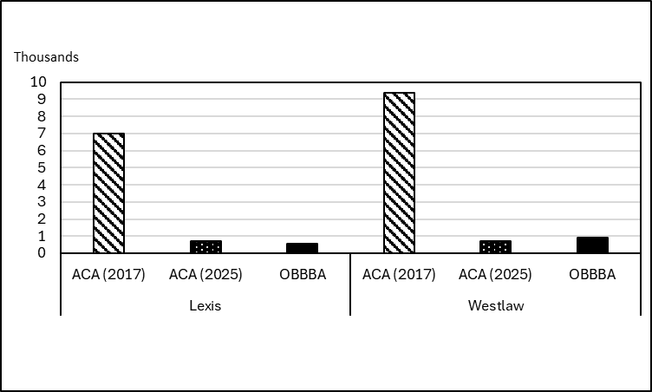
The OBBBA Has Gotten Comparatively Little Attention
Number of Major Newspaper Mentions of the ACA in 2017
Compared to the ACA and OBBBA in 2025
Source: Lexis’s Major U.S. Newspapers database, using the Headline and Lead Sections; Westlaw’s Major Newspapers, limited to the Lead/First Paragraph field.

Slide 15
Retrenchment Strategies
and Factors
Obfuscation
Division
Compensation
Reconciliation
“Muzzle Velocity”
Retribution and Polarization

