Slide 1

Regulating
Custom
Drugs
Walter G. Johnson, JD, PhD
Health Law Prof Conference 2026

Slide 2

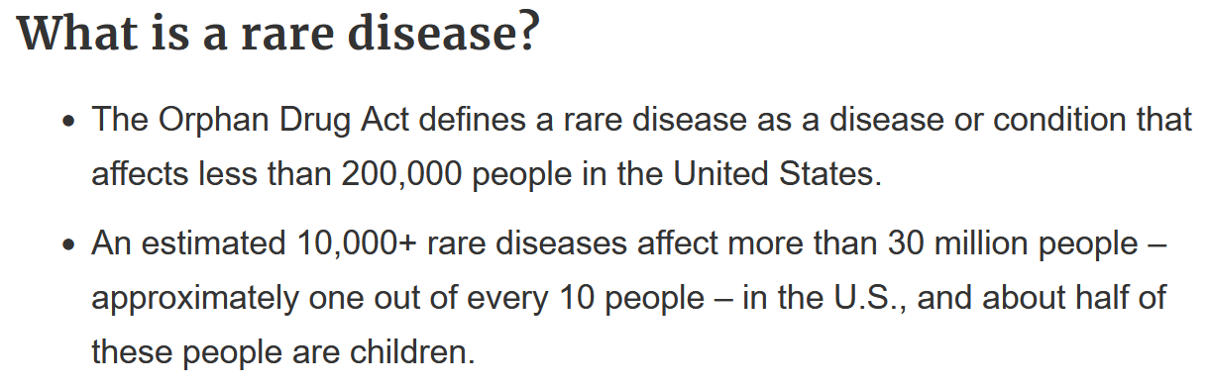
Notes:
Image from: https://biotech.ucdavis.edu/news/dna-base-editors-genome-editing

Slide 3
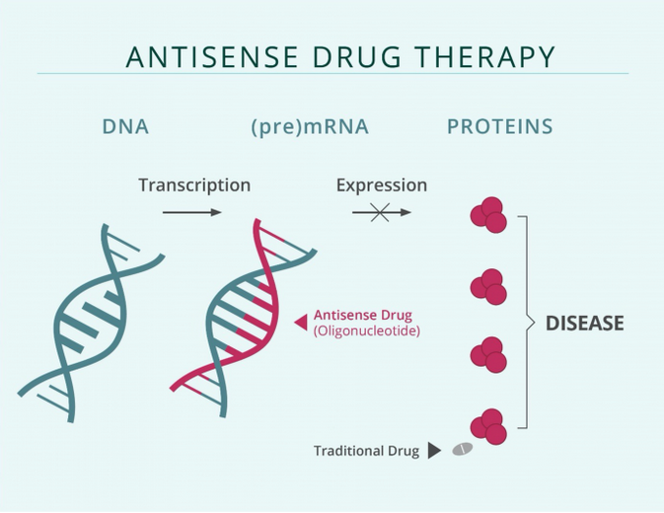
Notes:
Image from: https://www.openaccessgovernment.org/antisense-therapies-tackling-challenging-high-unmet-medical/156151/

Slide 4
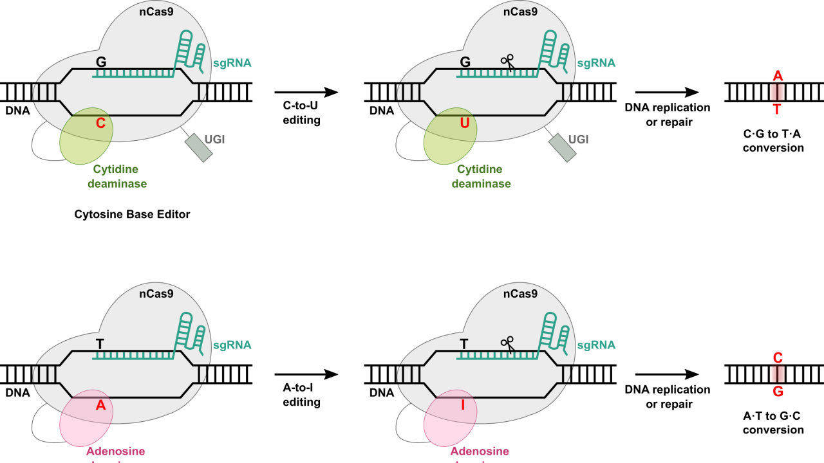
Base Editing
Notes:
Image from: https://biotech.ucdavis.edu/news/dna-base-editors-genome-editing

Slide 5
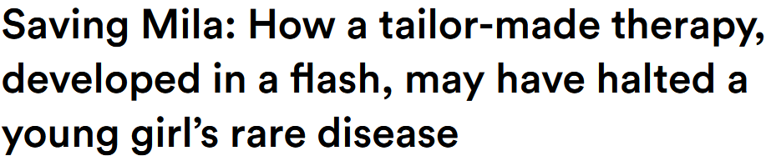




Slide 6

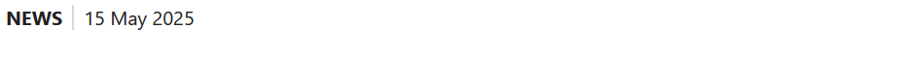
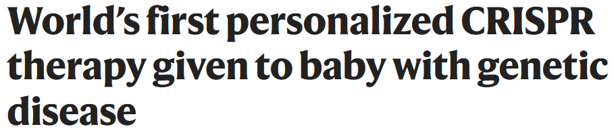
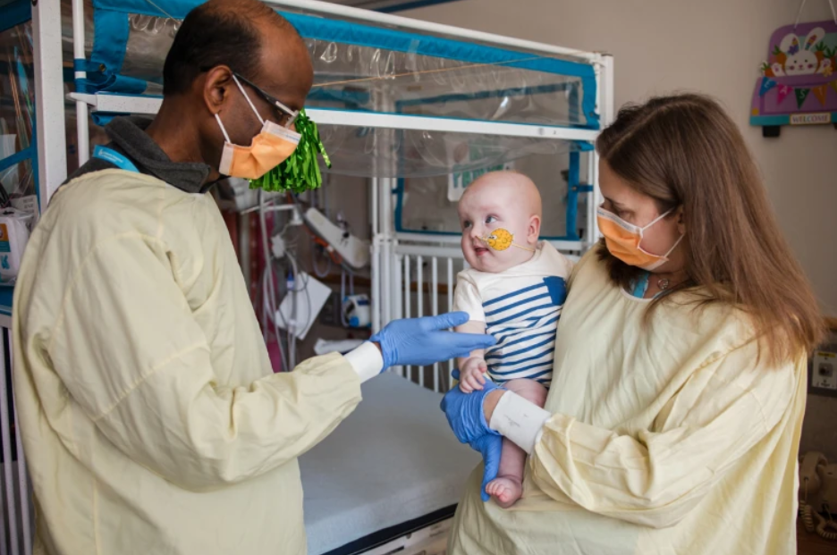

Slide 7
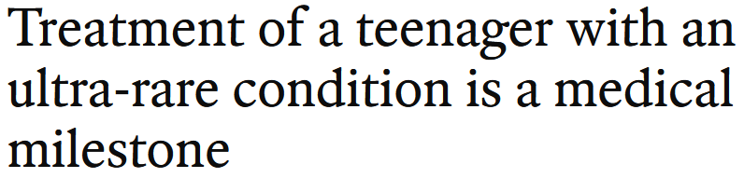



Slide 8
Regulatory Challenges

Slide 9
US FDA | UK MHRA
Safety and effectiveness | Safety, efficacy, quality
Investigational New Drug (IND) | Clinical Trial Authorisation (CTA)
New Drug Application (NDA) | Marketing Authorisation (MA)
Accelerated Approval, etc. | Conditional MA, etc.

Slide 10
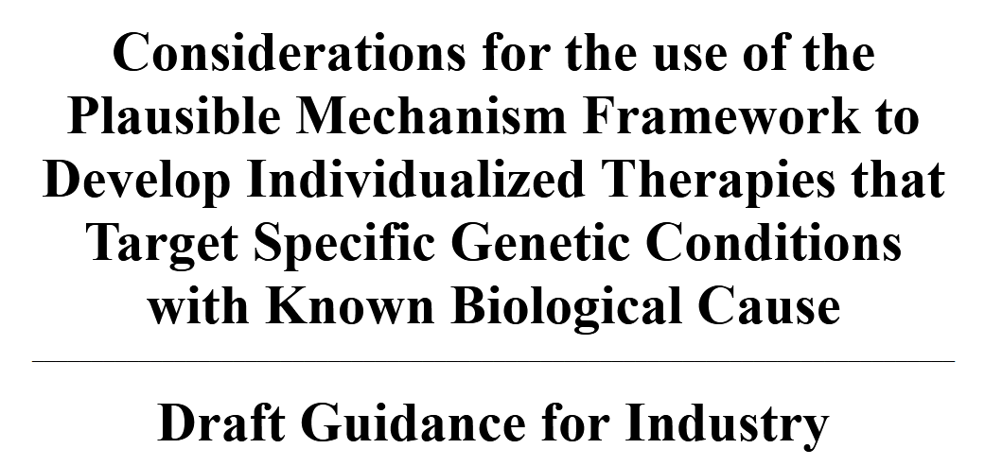
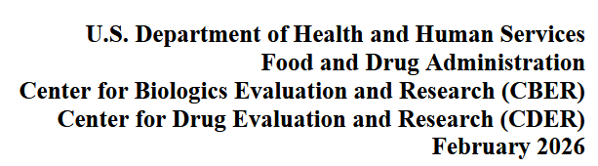

Slide 11
Plausible Mechanism Framework
A “framework,” not a “pathway”
Drug where “pathophysiologic abnormality” is “root cause”
Biological target, evidence of action, clinical benefit
Single trial + confirmatory evidence for approval
“master protocols” e.g., umbrella or platform trials

Slide 12
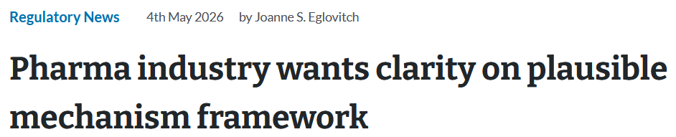

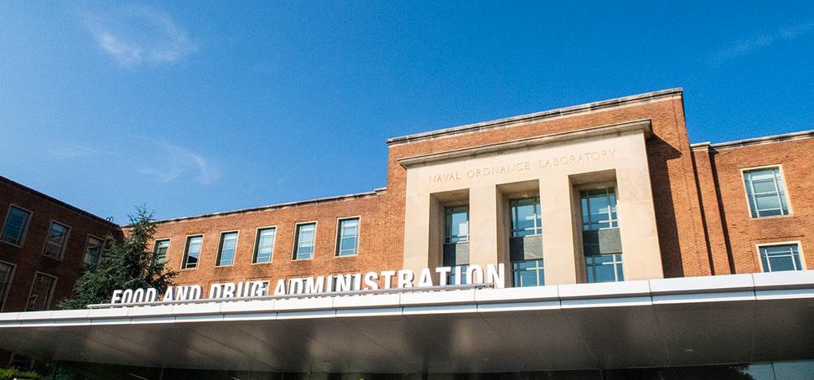

Slide 13



Slide 14
UK Rare Therapies Framework
for ‘products targeting rare diseases with unmet medical need’
‘Investigational Marketing Authorisation’ (IMA), requesting new legislative authority
Iterative review, long-term follow-up, Clinical Monitoring Plan
‘master files’, ‘prior knowledge’
No new authorisation needed for similar individualised therapies

Slide 15
 | US FDA | UK MHRA
New pathway, legislation | No? | Yes?
Eligibility | “pathophysiologic abnormality” as “root cause” | ‘products targeting rare diseases with unmet medical need’
Cutoff for “rare disease” | ≤ 200,000 in US | ≤ 5 in 10,000
New features | “Master protocols” | ‘Master files’, ‘Prior knowledge’
Political economy | Fragmented public/private payors | NHS, NICE, Genomics England
Global coordination | No comment | Yes

Slide 16
Regulating
Custom
Drugs
Walter G. Johnson, JD, PhD
Health Law Prof Conference 2026

