Slide 1

A Perfect Storm? The Intersection of Dobbs, Fetal Personhood and Tarasoff
Lauren Sydney Flicker, JD, MBE, HEC-C
Associate Professor, Albert Einstein College of Medicine

Slide 2
Objectives
Identify how fetal personhood legislation may intersect with Tarasoff-style duties.
Assess the ethical implications of treating abortion-related deliberation as a potential third-party threat, including risks of surveillance, coercion, partner disclosure, and chilled access to confidential care.
Evaluate proposed responses to these confidentiality conflicts.

Slide 3

Jenny
Notes:
Jenny is a 21 year old college student who lives with her boyfriend in his parents’ home.
She discovers she’s pregnant and is terrified to tell him.
She doesn’t want the pregnancy, but she knows that her boyfriend and his parents believe that abortion is murder.
Jenny is scared and overwhelmed and doesn’t know who to talk to.
She schedules an appointment with a therapist.
They live in Idaho/Arkansas/Mississippi/SD
The therapist practices in a state with fetal personhood language, a broad child-protection culture, and a Tarasoff-type statute.
The therapist wonders:
Is the fetus now an identifiable victim? Is abortion a threat of harm
Could disclosure to the other genetic parent be framed as protective?
What if nondisclosure later becomes the basis of a complaint?
This concern was at least partially anticipated by the Biden era 2024 HIPAA Reproductive Health Care Privacy Rule, which would have protected any communications about reproductive health from state investigations. This rule was vacated by a Texas Federal Court in Purl v. HHS in June 2025. The final rule was not specifically directed at mental health care, but was aimed at all patient care
It Prohibited the use or disclosure of PHI for investigations or imposing liability on individuals seeking, obtaining, providing, or facilitating lawful reproductive health care.

Slide 4
Overarching Questions
Is a fetus an identifiable person under state law?
What are that state’s laws concerning abortion?
  Is an abortion a serious threat of harm?
What is the Tarasoff requirement in that state?
  Mandated? Permissive?
  How is a threat determined?
  Who must be/may be warned?
Notes:
Fetal personhood laws predate Dobbs by decades, but Dobbs has given them new teeth. States have been experimenting with how far they can stretch fetal personhood, and with whether a groundswell of fetal personhood laws can create a national ban on abortion.
In an ideal world Tarasoff should not silently incorporate fetal personhood concepts unless the legislature clearly says so. Otherwise, clinicians are being asked to infer a massive confidentiality exception from cross-code personhood rhetoric. However….
Personhood functions as a translation device. It translates a pregnant person’s medical, moral, or therapeutic deliberation into the language of third-party injury.

Slide 5
Rethinking Tarasoff Post-2022
Traditional Tarasoff Framework | Fetal Personhood Driven Framing
Patient Threatens Violence | Patient considers abortion
Identifiable 3rd party victim | Fetus → Pre-born child → Identifiable 3rd party victim
Warning prevents violence | Warning prevents abortion
Confidentiality yields to public safety | Confidentiality yields to fetal protection
Clinician protects another person from patient | Clinician becomes part of reproductive surveillance

Slide 6
When potential victim is a minor, who may be warned?
Notes:
In some duty-to-warn statutes, when the potential victim is a minor, warning may go to a parent, guardian, law enforcement or other protective actor.
Personhood laws could invite an argument that disclosure to a pregnant patient’s partner, spouse, or other genetic parent is “protective.”
Disclosure to a partner in contested pregnancy contexts may increase coercion and danger, especially where intimate partner violence or reproductive coercion is present.
TX, Idaho, OK
In a “bounty hunter” state, (TX, Idaho, OK) a therapist could theoretically bring a civil suit herself.
In such a state, the therapist could also be viewed as complicit and the subject of a lawsuit if she is seen as aiding or advising a patient in obtaining an abortion.

Slide 7
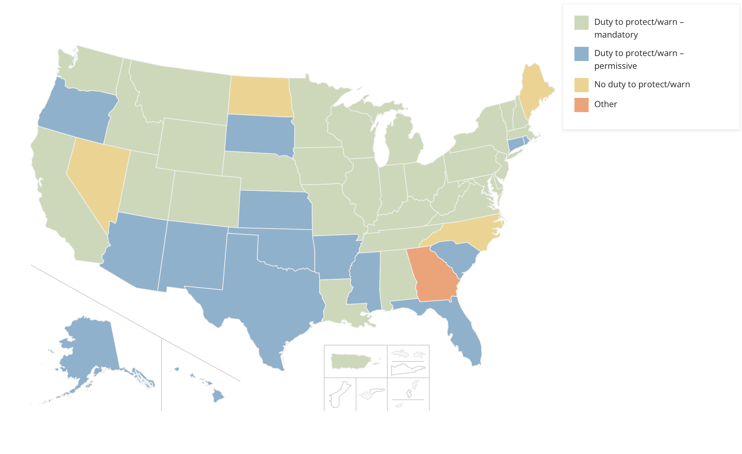
Tarasoff Across the US
Notes:
*National Conference of State Legislatures, updated 2022
Tarasoff is an exception to confidentiality. It is not a generalized license to disclose whenever a clinician, institution, or state disapproves of a patient’s legally or morally contested decision.
Various states mandate that the clinician report (some speicfiying to victim, others to authorities), other states are permissive, such that the therapist may break confidentiality without sanction.
23 states have codified Tarasoff in legistaiton with a duty to warn or protect
11 states – Tarasoff not codified in statute, but found in common law
10 states – neither codified, nor common law, but breach of confidentiality permitted if threat
6 states no guidance

Slide 8
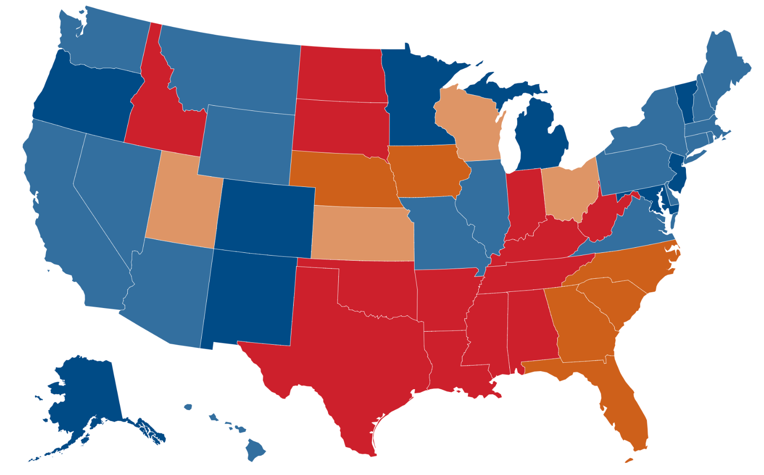
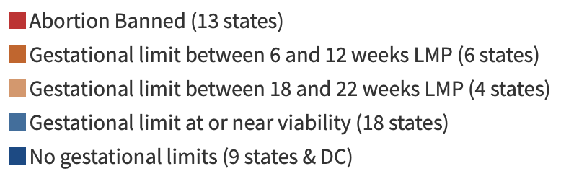
Post-Dobbs America
https://www.kff.org/womens-health-policy/key-facts-on-abortion-in-the-united-states/?entry=table-of-contents-what-is-abortion
Notes:
Fetal personhood laws predate Dobbs by decades, but Dobbs has given them new teeth. States have been experimenting with how far they can stretch fetal personhood, and with whether a groundswell of fetal personhood laws can create a national ban on abortion.
13 states have outright banned abortion
6 more states have banned abortion after 6-12 weeks
Guttmacher’s 2025 state policy analysis also describes pregnancy criminalization as intertwined with embryonic or fetal personhood concepts. Bills using fetal or embryonic personhood language were introduced in 19 states in 2025.

Slide 9
New York
Tarasoff Duty: N.Y. [Mental Hygiene] Law §9.46
  Mandatory
  If “reasonable professional judgment” … that a patient is “likely to engage in … serious harm to self or others,” must report to authorities.
Is the fetus an identifiable person?
  No
Is abortion a threat?
Notes:
N.Y. [Mental Hygiene] Law §9.46: When a mental health professional currently providing treatment services to a person determines, in the exercise of reasonable professional judgment, that such person is likely to engage in conduct that would result in serious harm to self or others, he or she shall be required to report, as soon as practicable, to the director of community services, or the director’s designee, who shall report to the division of criminal justice services
whenever he or she agrees that the person is likely to engage in such conduct. Information transmitted to the division of criminal justice services
Fetus explicitly not a person in criminal and civil statutes
Jenny in NY

Slide 10
Texas
Tarasoff Duty: (Tex. [Health and Safety] Code Ann. §611.004)
  Permissive
  “may disclose” to “medical or law enforcement personnel”
  “probability of imminent physical injury by the patient to the patient or others”
Is the fetus an identifiable person?
  Multiple statutes in civil and penal code include an unborn child “at every stage of gestation” in the definition of “individual”
Is abortion a threat?
Notes:
Tarasoff Codification: A mental health professional may disclose information only to medical or law enforcement personnel if the professional determines that there is a probability of imminent physical injury by the patient to the patient or others or there is a probability of immediate mental or emotional injury to the patient.
Tex. [Health and Safety] Code Ann. §611.004
Tex. Penal Code § 1.07(a)(26), (49). In the Penal Code, “individual” includes “an unborn child at every stage of gestation from fertilization until birth,” and “death” includes, for an unborn child, “the failure to be born alive.”
Tex. Civ. Prac. & Rem. Code §§ 71.001, 71.003. Texas’s wrongful-death statute similarly defines “death” to include an unborn child’s failure to be born alive and “individual” to include an unborn child from fertilization until birth, while carving out claims against the mother and certain lawful medical/drug-related conduct.
Tex. Health & Safety Code § 170A.001. In the trigger-ban chapter, “pregnant” means having a living unborn child in the body from fertilization until birth, and “unborn child” means an individual living member of the human species from fertilization until birth.
Abortion is a threat, but not a homicide
Jenny in Texas

Slide 11
Idaho
Tarasoff Duty: (Idaho Code § 6-1902)
  Mandatory
  A duty to “warn a victim” if “explicit threat of imminent serious physical harm or death”
Is the fetus an identifiable person?
  Not as clear as Texas
  Multiple statues refer to fetus as an “unborn child,” but don’t explicitly call a child a person.
  In common law, wrong death extends the definition of fetus to include person. Volk v. Baldazo (1982)
  HOWEVER, proposed legislation: Idaho Prenatal Equal Protection Act
Is abortion a threat?
Notes:
Tarasoff: “A mental health professional has a duty to warn a victim if a patient has communicated to the mental health professional an explicit threat of imminent serious physical harm or death to a clearly identified or identifiable victim or victims, and the patient has the apparent intent and ability to carry out such a threat.” Idaho Code § 6-1902
If the victim is a minor then in addition the mental health professional must make an effort to notify the parent, noncustodial parent, or legal guardian of the minor.
Personhood:
Idaho Code § 32-102 — “Unborn child as existing person.” Idaho provides that a child conceived but not yet born is to be deemed an existing person so far as necessary for its interests, if subsequently born.
Idaho Code § 18-4016. For Idaho’s homicide chapter, “embryo” or “fetus” means “any human in utero,” while excluding lawful abortion, medical treatment, and the woman’s own conduct from prosecution under that chapter. This is an unborn-victim statute rather than a universal personhood rule.
Idaho Code § 18-502(9). In the Pain-Capable Unborn Child Protection Act, “unborn child” or “fetus” means an individual organism of the species homo sapiens from fertilization until live birth.
Idaho Code § 18-622. In Idaho’s Defense of Life Act, when a physician claims the life-of-the-mother exception, the physician must use the manner that provides the best opportunity for the unborn child to survive, unless that would create a greater risk to the woman; the statute also says the pregnant woman is not subject to conviction or penalty under it.
PROPOSED Legislation: The bill defines a "preborn child" as a living human being from the moment a human sperm fertilizes a human egg, and aims to provide these embryos and fetuses with the same legal protections as born persons.
Abortion:
Abortion: Completely banned except for life of pregnant person, or for rape or incest in the first trimester if reported to law enforcement
(Idaho Code § 18-622): This makes performing an abortion a felony punishable by two to five years in prison, alongside the automatic suspension or revocation of a clinician's medical license.
“Bounty Hunter” Abortion Law: Idaho Code § 18-8807 — Civil Causes of Action
Limited Plaintiff Class (as oppsed to TX): the woman, the father, and certain relatives of the preborn child may sue over abortions performed in violation of the chapter. Min statutory damages of $20,000, enforcement is “exclusively through the private civil causes of action described.” The 2023 law that created Idaho’s abortion-trafficking crime also amended this section; the private-enforcement mechanism itself is § 18-8807. Idaho Prenatal Equal Protection Act
The "Abortion Travel" Minor Ban: 2023, criminalizes the act of an adult intentionally transporting a minor out of state to obtain an abortion without parental consent. While portions of this law regarding the "sharing of information" have been temporarily blocked by federal courts, the bans on physical transport and sheltering remain active.
Center for Reproductive Rights
Biggest threat is if patient is a minor.

Slide 12
Louisiana
Tarasoff: Mandatory, La. Rev. Stat. Ann. §2800.2
  When a threat is deemed to be “significant in the clinical judgment of the treating” [health care professional], they s’hall not be liable for a breach of confidentiality for warning of such threat or taking precautions to provide protection from the patient's violent behavior.”
Is the fetus an identifiable person?
  “An unborn child shall be considered as a natural person for whatever relates to its interests from the moment of conception. ”
Is abortion a threat?
Notes:
“When a patient has communicated a threat of physical violence, which is deemed to be significant in the clinical judgment of the treating [health care professional]… against a clearly identified victim or victims, coupled with the apparent intent and ability to carry out such threat …. and exercising reasonable professional judgment, shall not be liable for a breach of confidentiality for warning of such threat or taking precautions to provide protection from the patient's violent behavior.”
Civ. Code Art. 26. Unborn child
An unborn child shall be considered as a natural person for whatever relates to its interests from the moment of conception. If the child is born dead, it shall be considered never to have existed as a person, except for purposes of actions resulting from its wrongful death.
Acts 1987, No. 125, §1, eff. Jan. 1, 1988.
2025 IVF BILL: §129. Destruction
A viable in vitro fertilized human embryo is a juridical person which shall not be intentionally destroyed by any natural or other juridical person or through the actions of any other person.
Acts 1986, No. 964, §1; Acts 2025, No. 116, §1.
La. R.S. 40:1061.1 — Legislative intent / abortion construction Aboriton law: every unborn child is a human being from the moment of conception and is, therefore, a legal person for purposes under the laws of this state and Constitution of Louisiana.

Slide 13
Are therapeutic relationships at risk?
Notes:
Domestic Violence
Idaho HB 374, ID Code § 18–622 (“The professional license of any health care professional who …assists in performing or attempting to perform an abortion…..shall be suspended …”)
Oklahoma Attorney General Memorandum, dated Aug. 31, 2022, directing law enforcement to “pursue criminal prosecution of any person who …. assists with the performance of … abortion in Oklahoma…”
Oklahoma Stat. tit. 21, § 861 (“Every person who…….advises or procures any woman to take any medicine, …., with intent thereby to procure the miscarriage of such woman, …. shall be guilty of a felony punishable ..”)
Idaho Criminal Code § 18-8707(b) and (c) “No Public Funds for Abortion Act” (prohibiting school based clinics from “counseling in favor of abortion” or “referring for abortion”) and § 18-8702 defining “Health care provider” as “any person…who may be or is asked to participate in any way in any health care service…” and includes “…counselors, social workers”)

Slide 14

Mitigation Strategies
Professional Societies ethics mandates
Databases of abortion friendly therapists
Notes:
https://www.prochoicetherapists.org
Without explicitly mentioning Tarasoff, the American Psychological Association in it’s 2023 Resolution on Confidentiality and Reproductive Health made an explicit commitment to protecting confidentiality in reproductive health in light of Dobbs
THEREFORE, BE IT RESOLVED that the APA that the American Psychological Association, in accordance with the APA policy on reproductive rights, and human rights, affirms that a psychologist’s allegiance to the Ethics Code, including ethical standards related to patient confidentiality, should be given the utmost attention and significance especially when psychologists are faced with ethical conflicts with a law requiring the disclosure of confidential information regarding sexual and reproductive health, including birth control; fertility treatment; contemplating, seeking, or having had an abortion; and related issues.
Other governing bodies and professional organizations must follow suit.
APA, in accordance with the APA policy on reproductive rights, and human rights, affirms that a psychologist’s allegiance to the Ethics Code, including ethical standards related to patient confidentiality, should be given the utmost attention and significance especially when psychologists are faced with ethical conflicts with a law requiring the disclosure of confidential information regarding sexual and reproductive health, including birth control; fertility treatment; contemplating, seeking, or having had an abortion; and related issues.
National Association of Social Workers (NASW)
The Confidentiality & Privacy Stance: state-level restrictions and bans "decimate the nearly 50-year precedent that established abortion rights as an extension of the implied Right to Privacy.”
Protection of Practitioners: risk of criminalizing providers—including clinical social workers—"who may simply be doing their jobs by supporting a pregnant person in making decisions regarding reproductive care.”
American Counseling Association (ACA)
American Association for Marriage and Family Therapists (AAMFT)
Conclusion:
Tarasoff is supposed to be exceptional. It permits breach of confidentiality when disclosure is necessary to prevent serious violence. But post-Dobbs fetal personhood arguments threaten to make ordinary reproductive decision-making available for third-party monitoring, warning, and control. The question for health law is not only how Courts will deal with this question, It is how to support mitigation strategies as we weather this truly exceptional attack on legal and ethical norms.

Slide 15

Thank you
lflicker@montefiore.org

