Slide 1

Antitrust in the Quasi-Verse
Alicia Gilbert

Slide 2
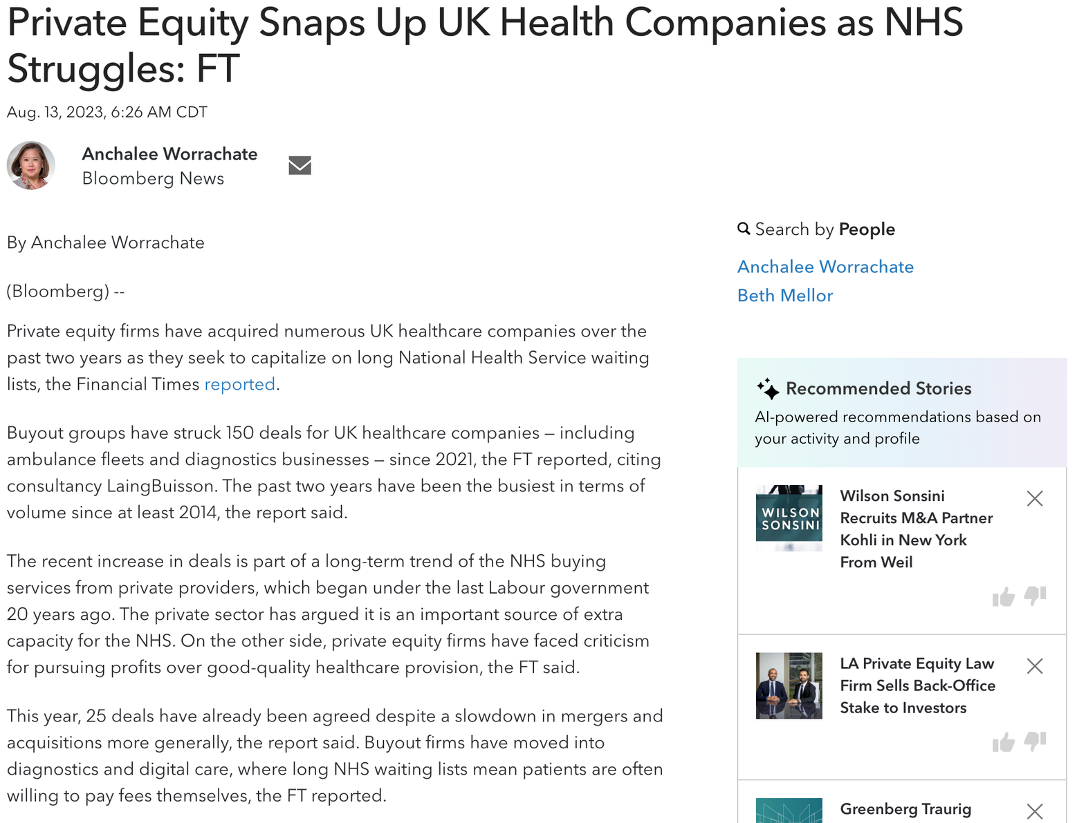
Healthcare financialization is not limited to for-profit entities.

Slide 3
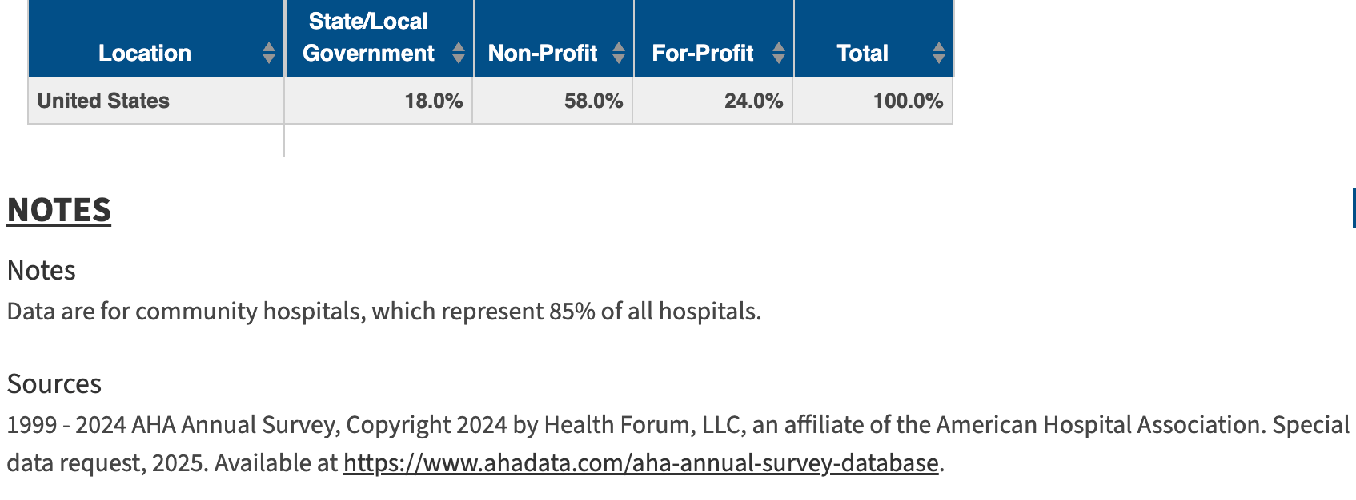
Public hospitals are those with a connection to the federal, state, or local government, including local districts, hospital authorities, or public trusts.

Slide 4
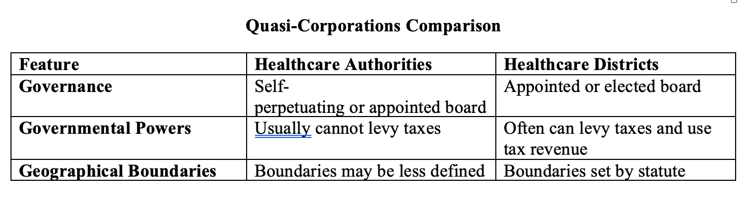

Slide 5
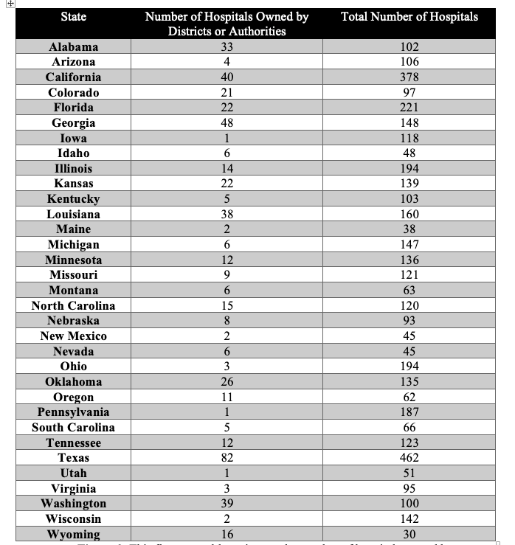
Quasi-Corporation Hospital Ownership
This figure roughly estimates the number of hospitals owned by Districts and Authorities, relying on CMS Hospital General Information data.
The first column shows the States that have enabling statutes that allow for the creation of Districts or Authorities.
The second column shows the number of hospitals owned by Districts or Authorities and that are certified by CMS in each of those states. The third column depicts the total number of hospitals certified by CMS in those states.

Slide 6
Parker or State Action Immunity
The entity claiming state action immunity must show that its challenged conduct was “clearly articulated and affirmatively expressed as state policy.”
S. Ct. assumed that municipalities act in the public interest. The Ct. also relied on the fact that municipal officers are “checked to some degree through the electoral process,” which, along with public disclosure laws, “provide[s] some greater protection against antitrust abuses than exists for private parties.”
Town of Hallie v. City of Eau Claire, 471 U.S. 34, 45 (1985).
The entity claiming state action immunity may also have to show that the state’s policy is “actively supervised by the State itself.”
California Retail Liquor Dealers Ass’n v. Midcal Aluminum, Inc., 445 U.S. 97, 105 (1980) (quoting City of Lafayette v. Louisiana Power & Light Co., 435 U.S. 389, 410 (1978)).

Slide 7
Parker Immunity and Quasi-Corporations
Healthcare Authorities in Alabama may “exercise all powers granted hereunder in such manner as it may determine to be consistent with the purposes of this article, notwithstanding that as a consequence of such exercise of such powers it engages in activities that may be deemed ‘anticompetitive’ within the contemplation of the antitrust laws.”
Ala. Code § 22-21-318.

Slide 8


Slide 9
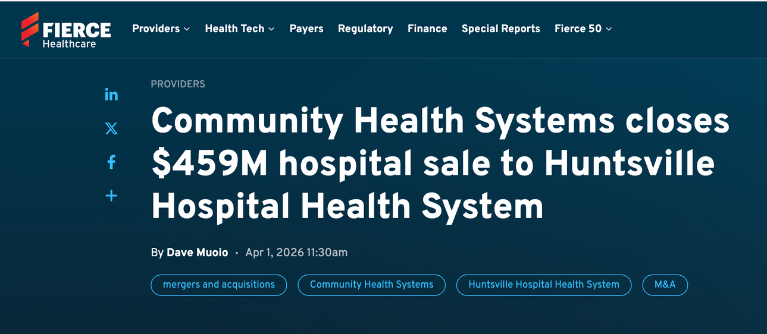
Parker immunity as a driver of financialization
  Financial actors, particularly PE, are attracted to market power. They are likely also attracted to antitrust exemptions while governmental entities may be attracted to investor-owned health systems to navigate financial challenges.
  Complex leases and management agreements can preserve Parker immunity.
  A separate but concerning trend: Quasi-corporations have also acquired hospitals from struggling investor-owned health systems.

Slide 10

Alicia Gilbert
Assistant Professor of Law
agilber8@samford.edu

