Slide 1
Undue Control of Physician Practices:
Model State Agency Guidance Project
Rob Gatter
Saint Louis University School of Law, Center for Health Law Studies
2026 Health Law Professors Conference, Georgia State University

Slide 2
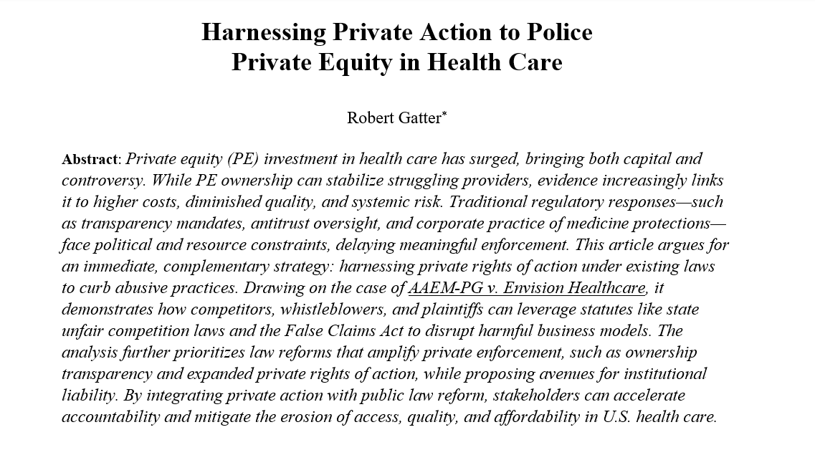

Slide 3
General Private Rights of Action
State Unfair Trade Practice Laws
State Antitrust Laws
State Tort Claims
State Contracts Claims
“Control” or “Undue Control” by unlicensed corporate interests of health care delivered by licensed providers

Slide 4
State Agency Guidance on “Control” Matters
Quantum Plus v. Hosp Internists of Austin, 2025 WL 420213 (Tex App 2025) (trial court instruction to jury on the definition of CPOM in TX was not overly broad when based on the description of the CPOM prohibition written by the TX medical board in an FAQ page on the board’s website)
AAEM-PG v. Envision Health Care, 2022 WL 2037950 (N.D. Cal. 2022)(complaint sufficiently alleged that Envision, despite complying with prohibition against owning a medical practice, nonetheless illegally controlled physician practices through its contracts, relying in part on CA medical board guidance on what constitutes improper corporate control under state’s CPOM prohibition)

Slide 5
Advantages of Issuing State Agency Guidance
Much quicker than state legislation or agency rule-making
Carries weight when a court must address the sufficiency of allegations or of evidence concerning undue corporate control of physician practices.
Flexible to permit later rule-making or legislation.
Authority exists in state licensing agencies whether or not state law prohibits CPOM

Slide 6
Structure & Governance
Corp. entity, shares, voting, Ds & Os
Financial operations
prices, payor contracting, coding, billing, collections
Clinical operations
provider mix, hiring/firing, equipment, scheduling
Medical decision-making
diagnosis, treatment plan, referrals

Slide 7
Thanks
Rob Gatter
robert.gatter@slu.edu
314-977-3355

