Slide 1
Misplaced Trust in Artificial Professional Advice
Claudia E. Haupt
Professor of Law and Political Science
Faculty Co-Director, Center for Health Policy and Law
Northeastern University

Slide 2
Technological innovation in healthcare occurs in a densely regulated space
Asymmetries of knowledge
Social relationships based on trust
Governed by a legal and ethical framework of professional advice-giving
Introduction of new technologies raises enduring questions about the nature of the provider-patient relationship

Slide 3

Professional advice-giving

Slide 4
Professionals have knowledge that their clients or patients lack but need to make decisions for themselves
Advice communicated between professional and client/patient within professional relationship
Legal limits on speech of professionals to ensure good advice
  Professional licensing & discipline
  Tort liability for professional malpractice
  Informed consent
  Fiduciary duties
Traditionally human interaction

Slide 5
AI-generated advice is untrustworthy. It undermines trust in human professionals, too, because it creates doubt where expertise lives.

Slide 6

Professional-use technology

Slide 7
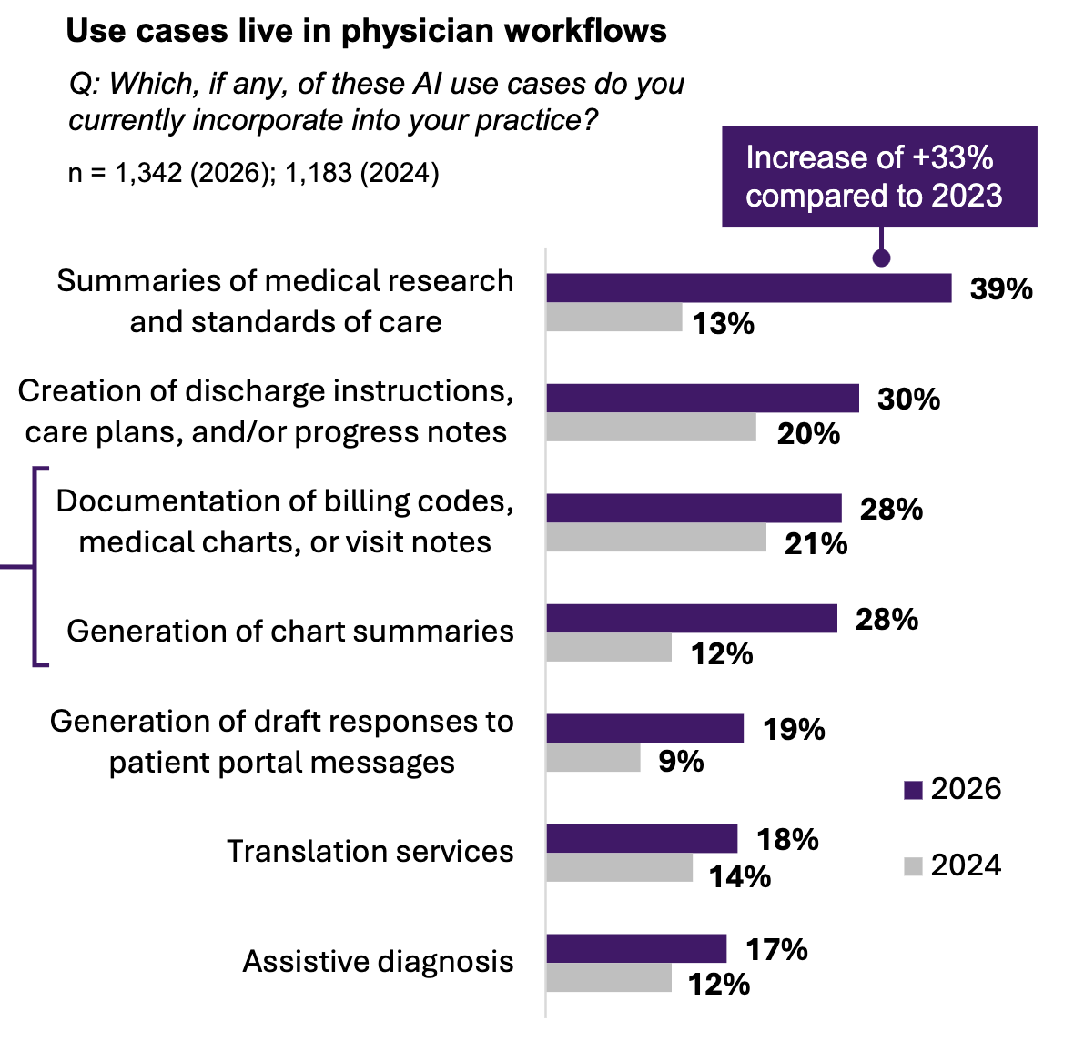
Potential uses of generative AI
  Research settings
    Formulate questions, develop study protocols, summarize data
  Medical education
    Interactive encyclopedia, simulate patient interactions, help develop various documents
  Clinical uses
    Repetitive tasks, clinical decision support, incorporation into electronic medical record platforms
https://www.ama-assn.org/system/files/physician-ai-sentiment-report.pdf

Slide 8
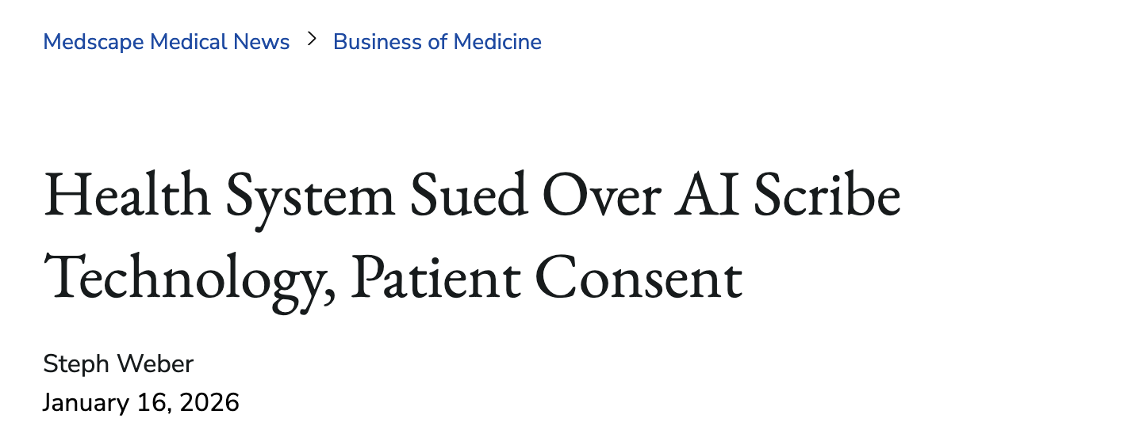
Trust resides in human professional
  Trustworthiness is a property of institutions, not AI systems
Even when unconnected to the content of advice (e.g., ambient scribes, patient portal messages) patients may feel sense of betrayal
Disclosure itself erodes the trust it’s supposed to protect

Slide 9
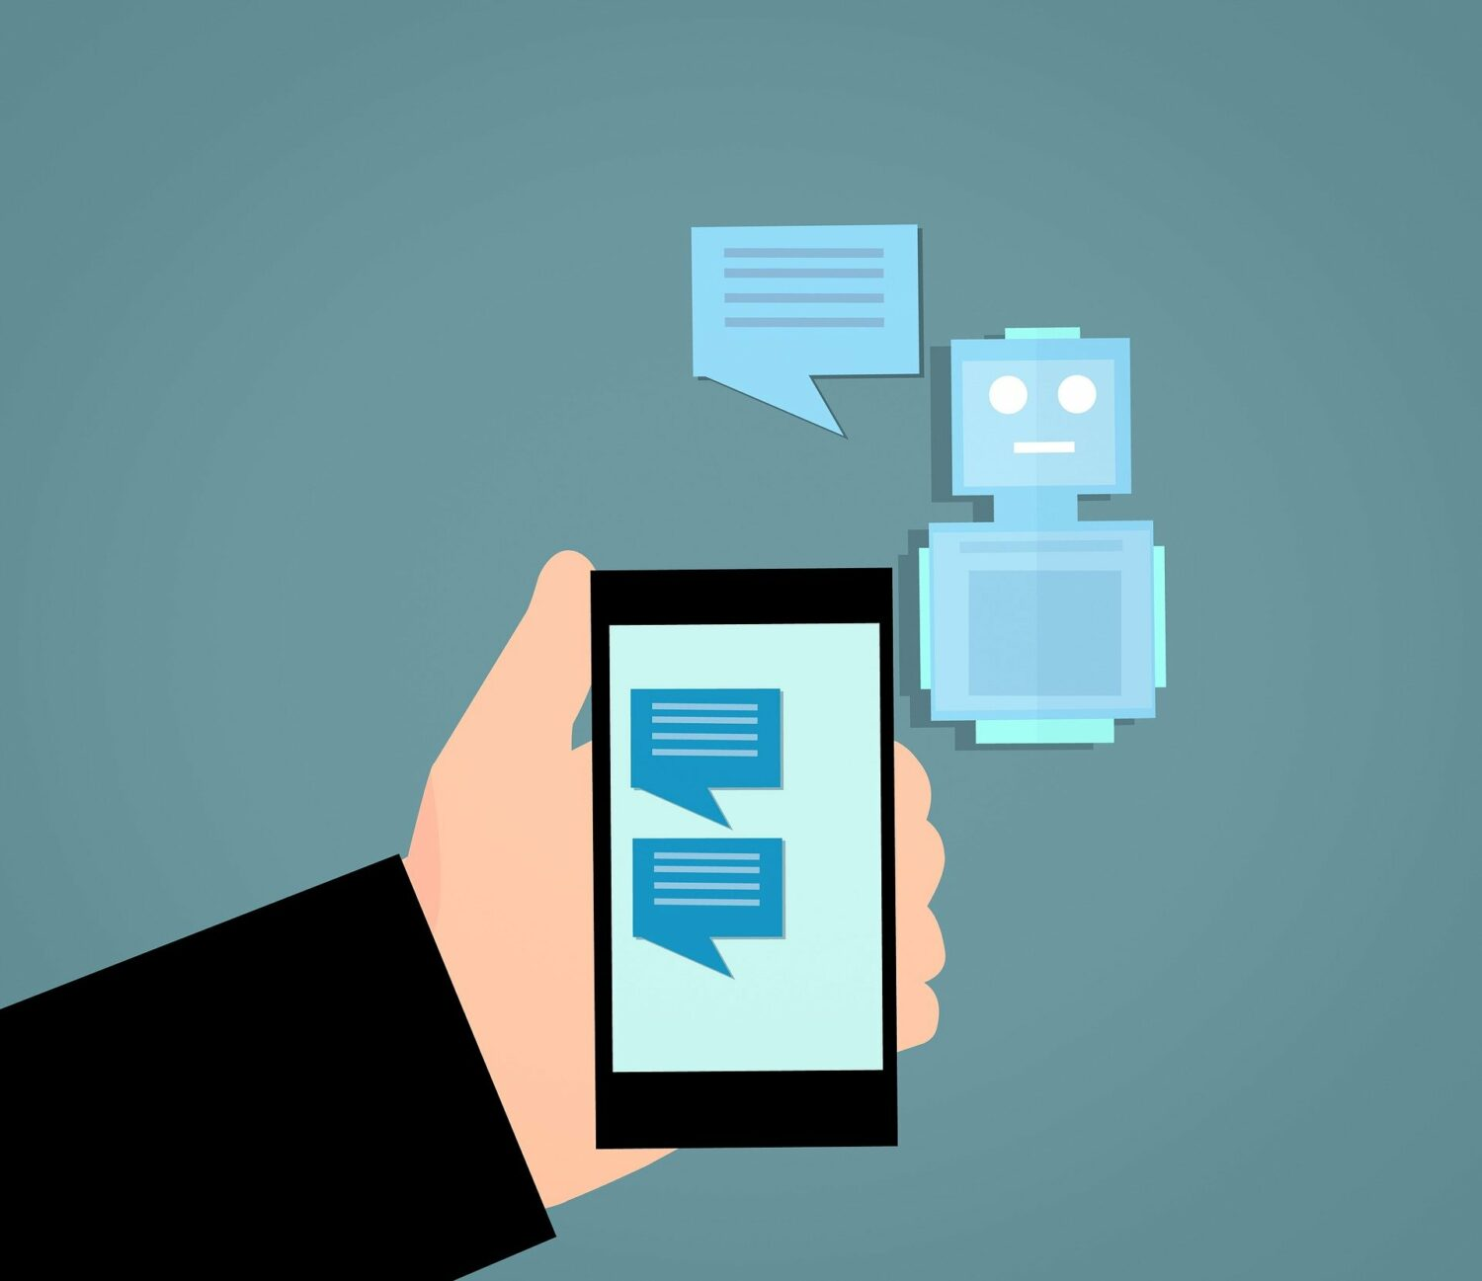
Consumer-facing technology

Slide 10
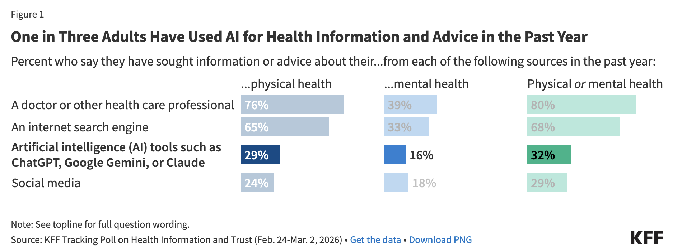
  Most problematic application
  Medical resource, but advice is not filtered through health care practitioner
    No legal framework to mitigate knowledge asymmetry between “speaker” and listener
  Harm to individual who relies on bad advice & collective/societal (e.g., public health) harm

Slide 11
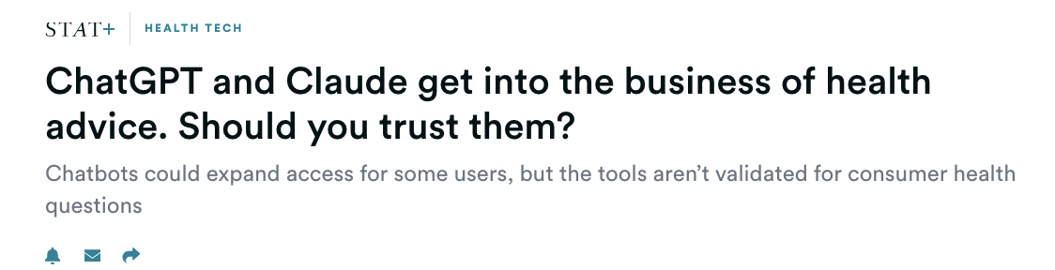
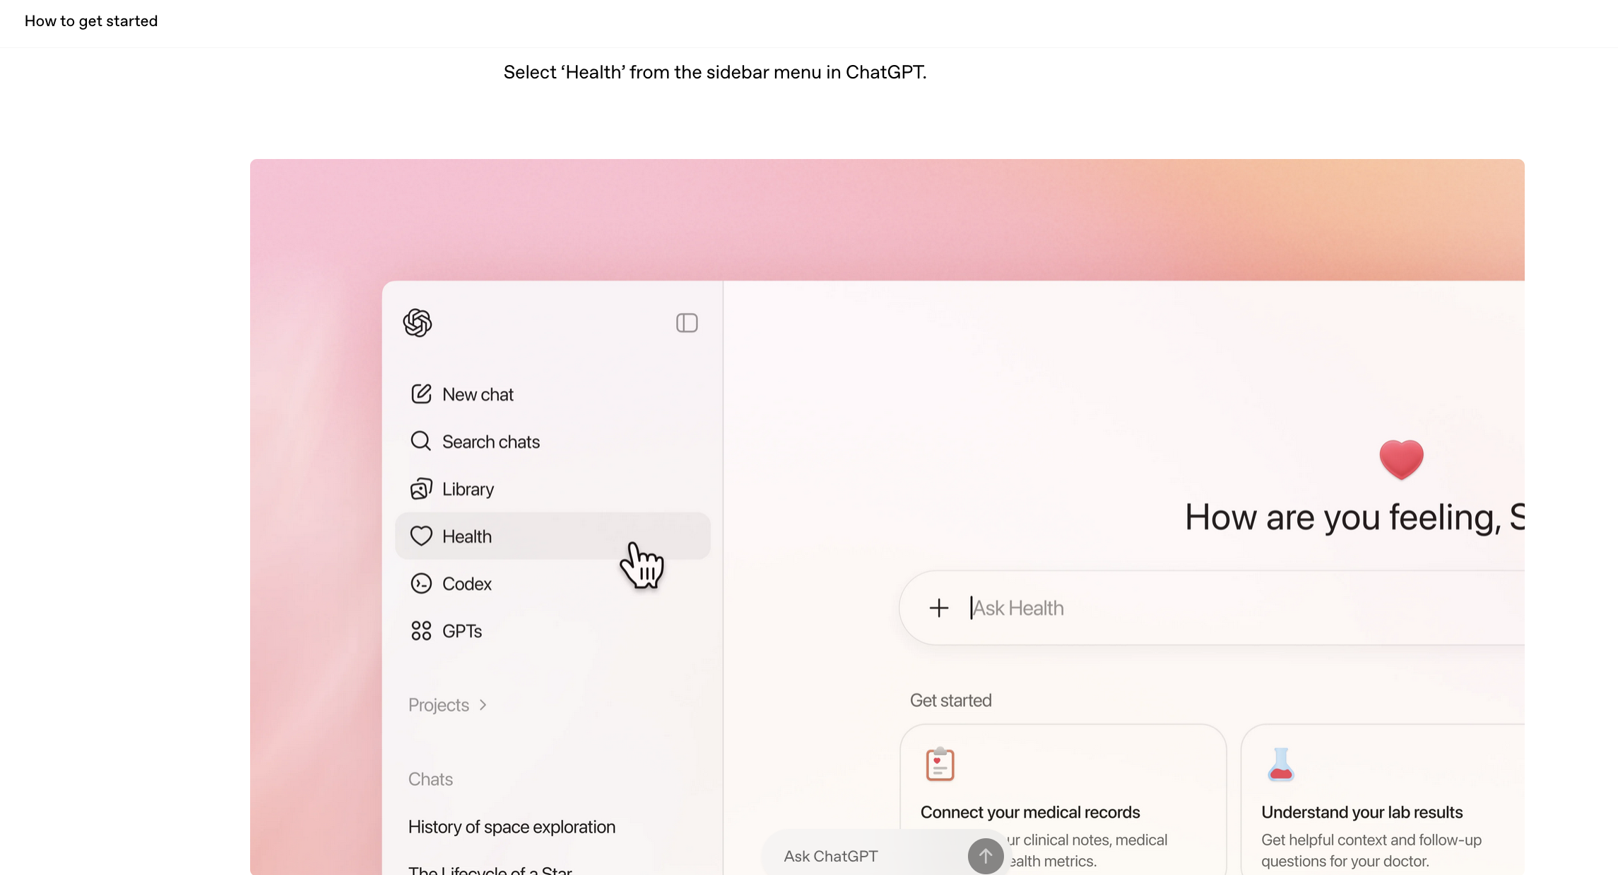
Since early 2026: 5 major tech companies (OpenAI, Anthropic, Microsoft, Amazon, and Perplexity) released/expanded consumer-facing AI health applications
Allow users to connect medical records, lab results, wearable data to receive personalized guidance
According to OpenAI, as of January 2026, more than 40 million people per day are asking ChatGPT their health questions
  Conversational style leads to misplaced trust
  Special problem: impersonation

Slide 12
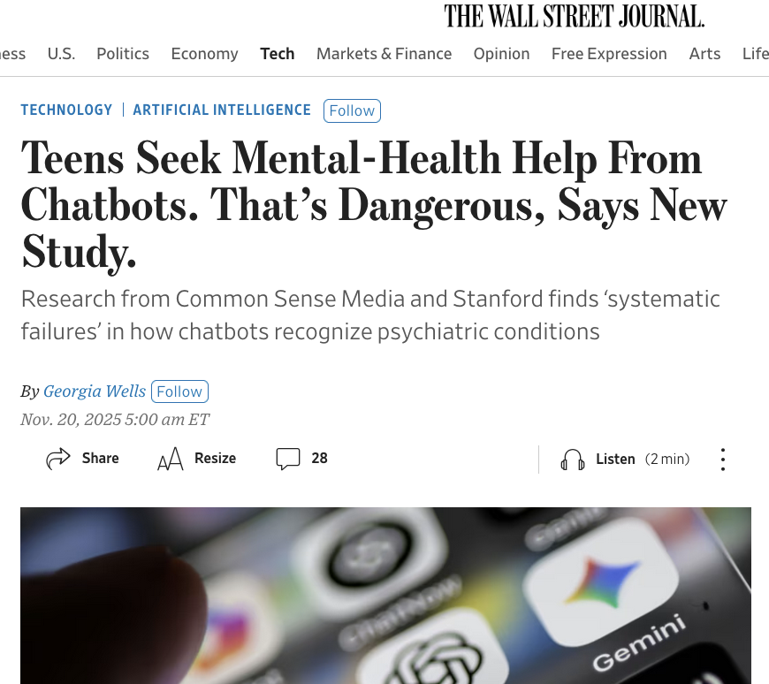
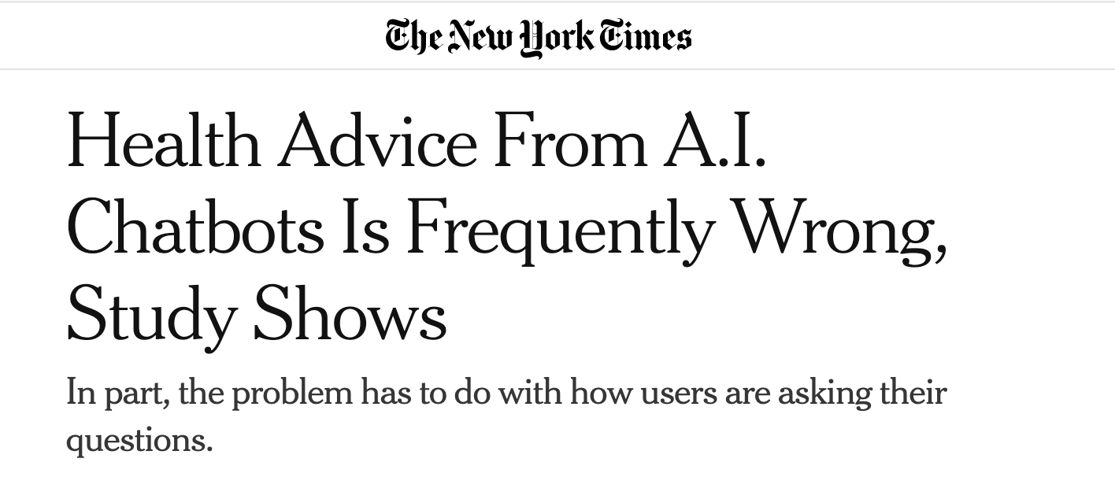
Potential harms of generative AI
  Frequent mistakes, hallucinations
  Reflect the biases of training data
  Bad actors can manipulate (disinformation)

Slide 13
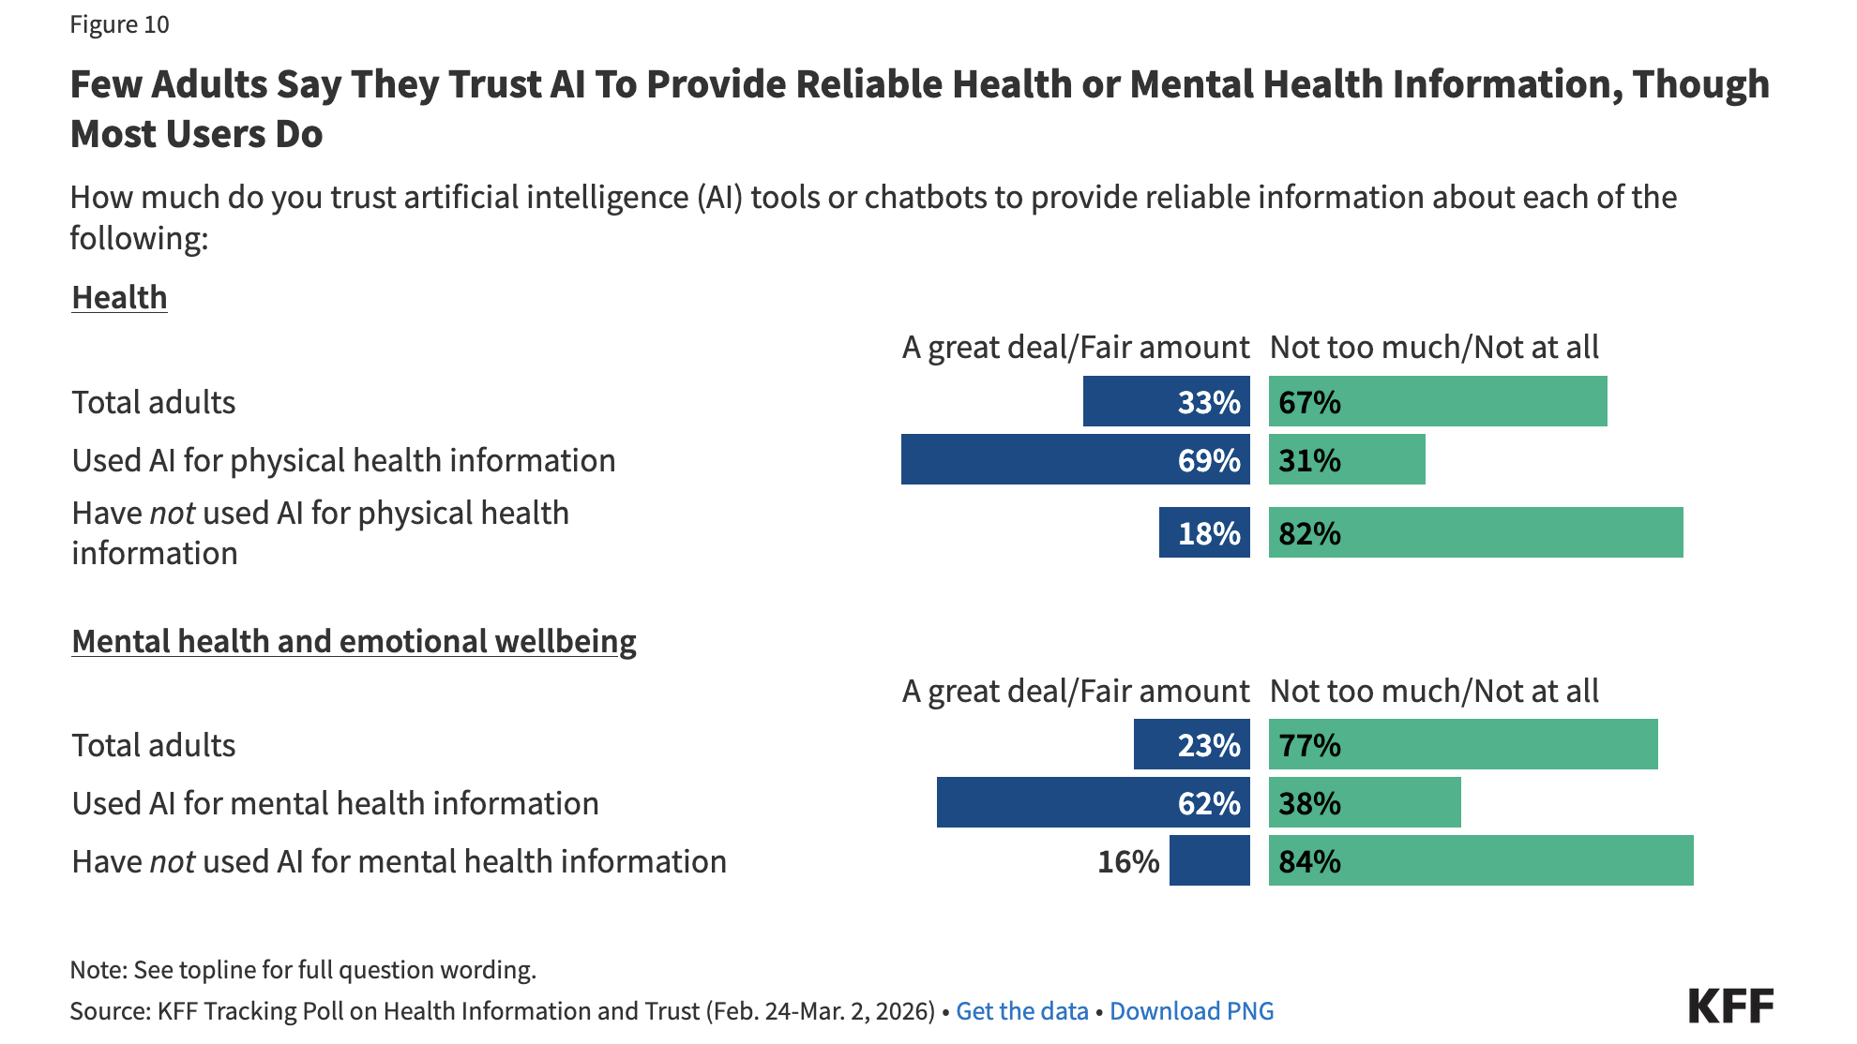

Slide 14
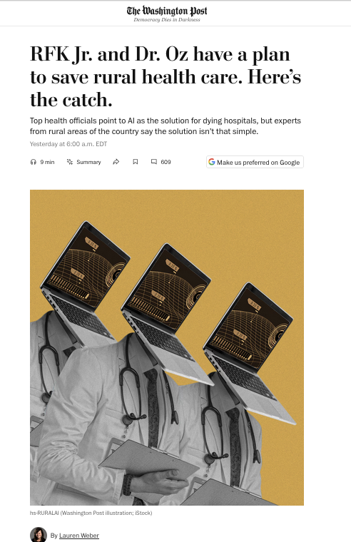
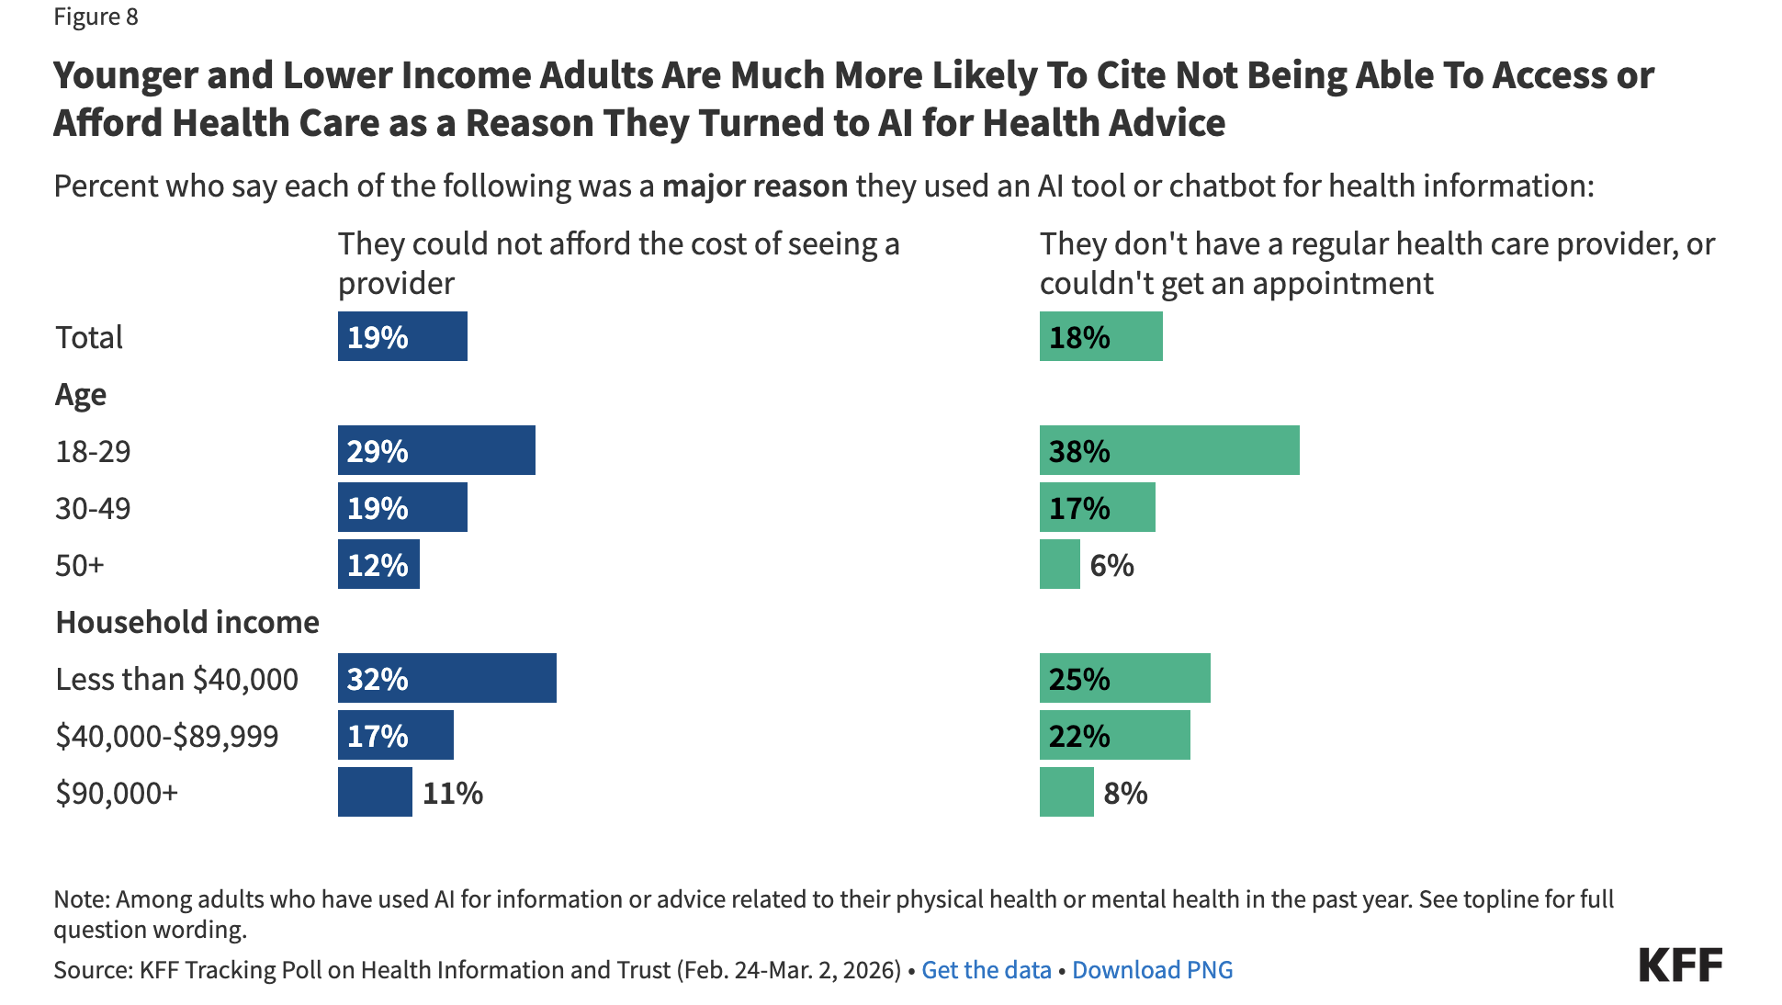
People use AI because care is inaccessible
Unaddressed underlying structural issue: limited access to (primary) care, healthcare costs

Slide 15
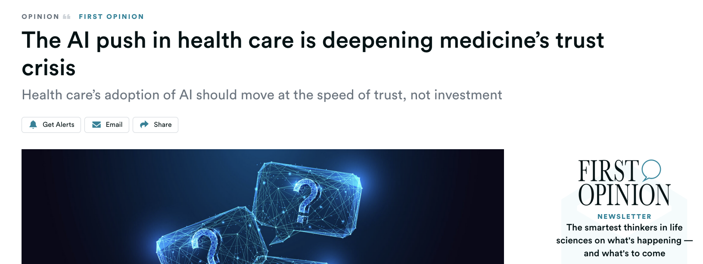
Moving fast is not moving at the speed of trust
AI professional advice is untrustworthy
AI undermines trust in professionals
  When AI and human professionals give conflicting advice, patients face an unanswerable question: where does expertise actually live?
Legal frameworks must protect the human relationship
Institutions govern AI; AI cannot self-govern
Fix access; don’t substitute broken care

Slide 16
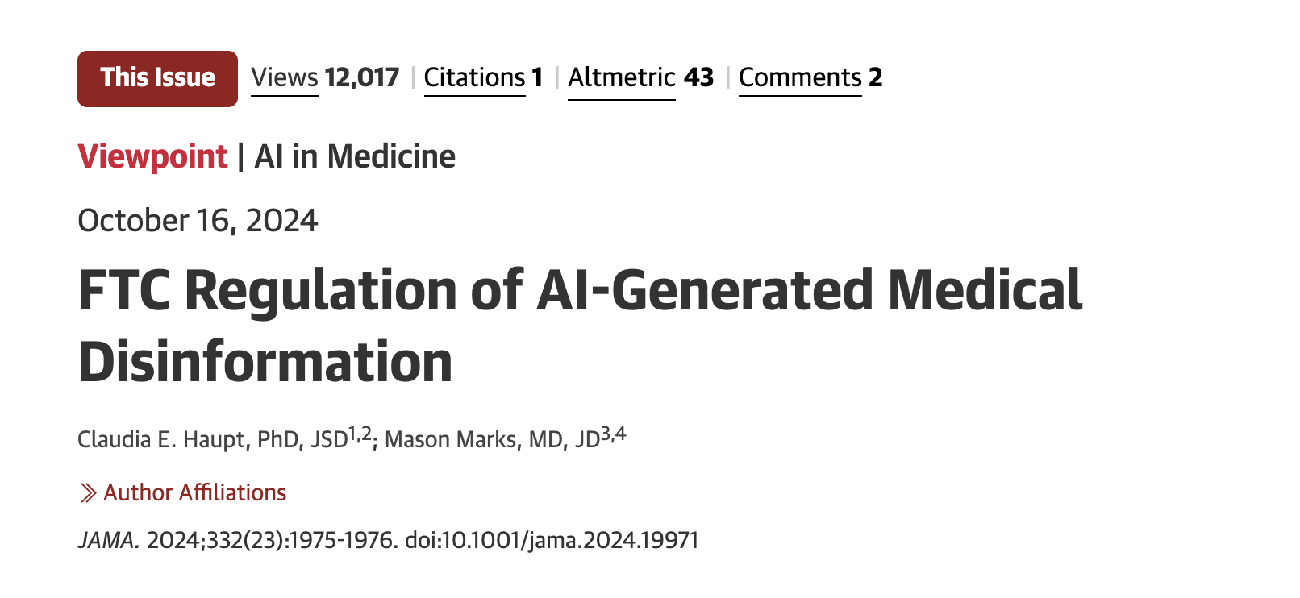
Prohibit impersonating individuals, including licensed advice-givers such as medical professionals
Because authoritative-looking disinformation “impersonates” or masquerades as authentic medical advice, also prohibit presenting medical disinformation, or misleading professional advice generally, as authoritative, accurate, or genuine.

Slide 17
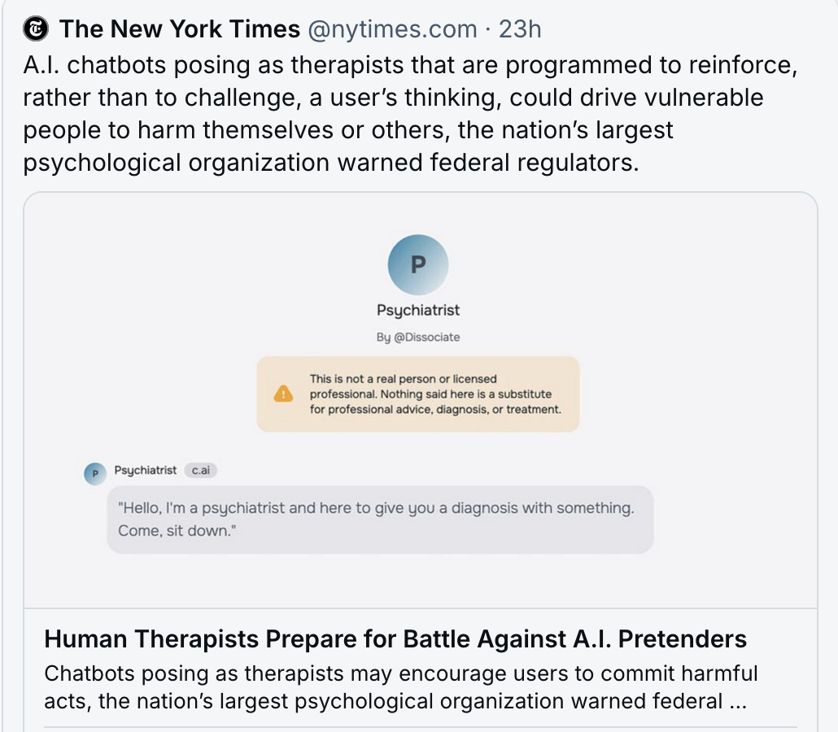
“The American Psychological Association has asked the Federal Trade Commission to start an investigation into chatbots claiming to be mental health professionals. The inquiry could compel companies to share internal data or serve as a precursor to enforcement or legal action.”
Ellen Barry, NYT, Feb 24, 2025

Slide 18
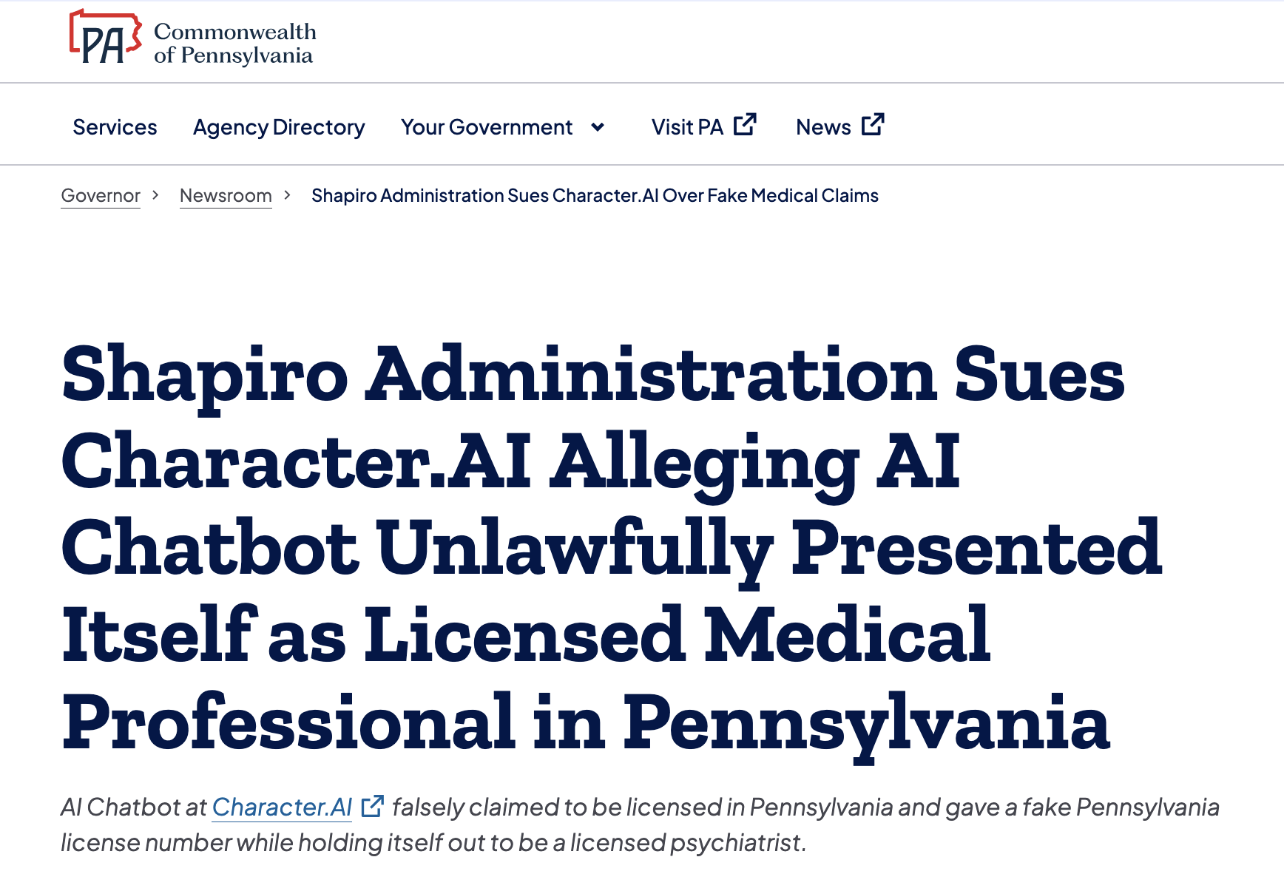
Complaint filed on May 1, 2026 on behalf of the Commonwealth of Pennsylvania, the Department of State, and the State Board of Medicine
  Alleges company’s violation of the state’s Medical Practice Act
  “Character Technologies, Inc. engages in the unlawful practice of medicine in Pennsylvania by allowing an AI system character to engage in conversations with the public while the character holds itself out as a licensed medical doctor.”

Slide 19
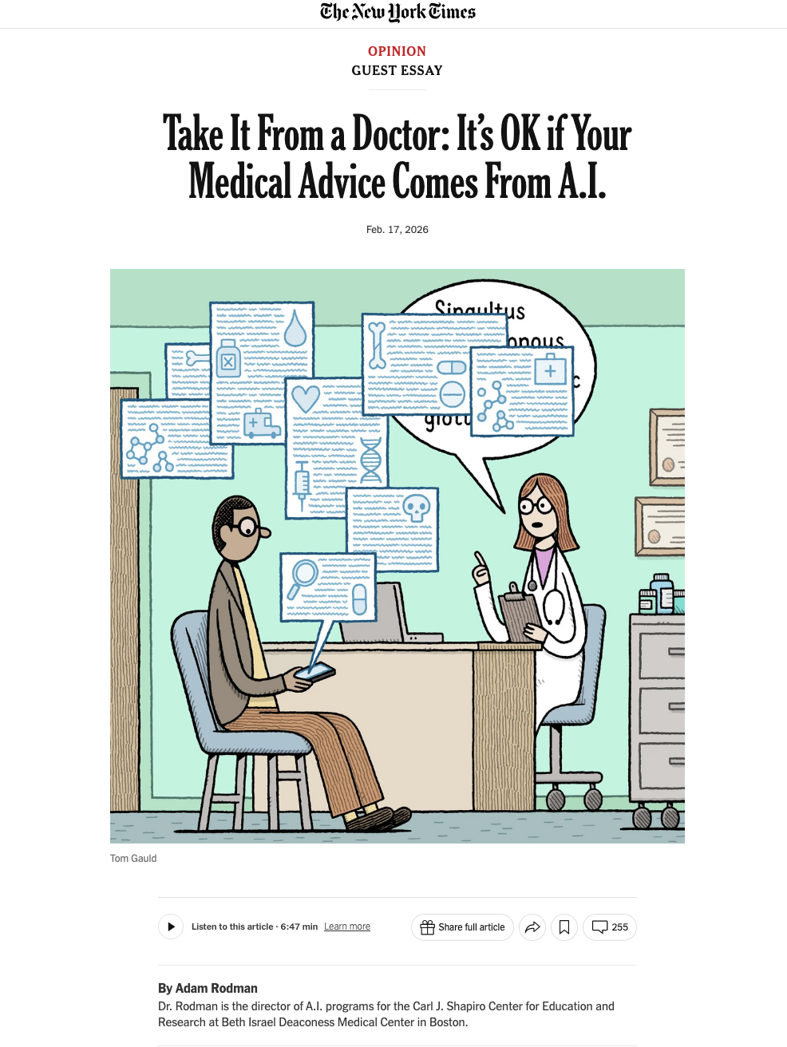
“Let’s say you are going to the doctor because of a bothersome cough. Here’s a tip: Pull up your medical notes and remove all identifiable information. Copy those notes into an A.I. tool and give the model a current update of your health and cough concerns. Then ask the chatbot to concisely summarize all this information.”

Slide 20
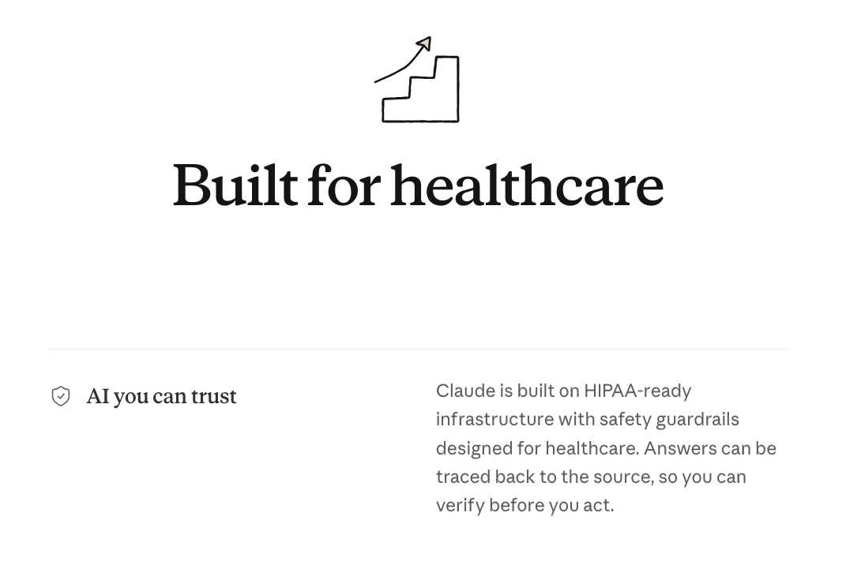
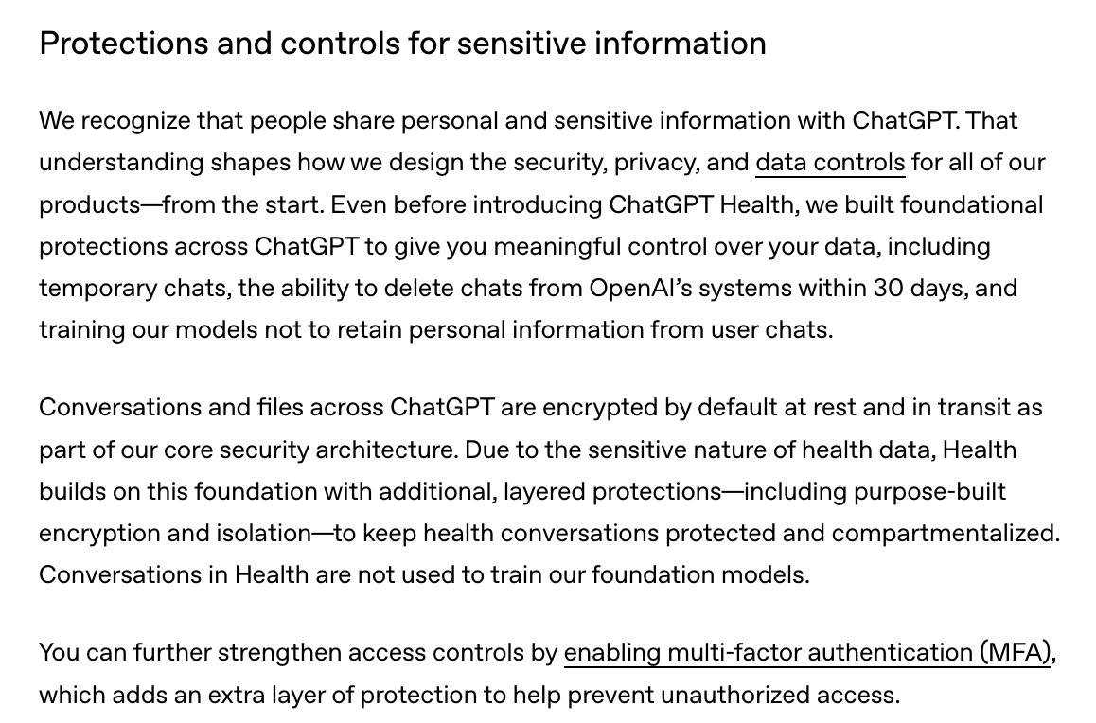

Slide 21
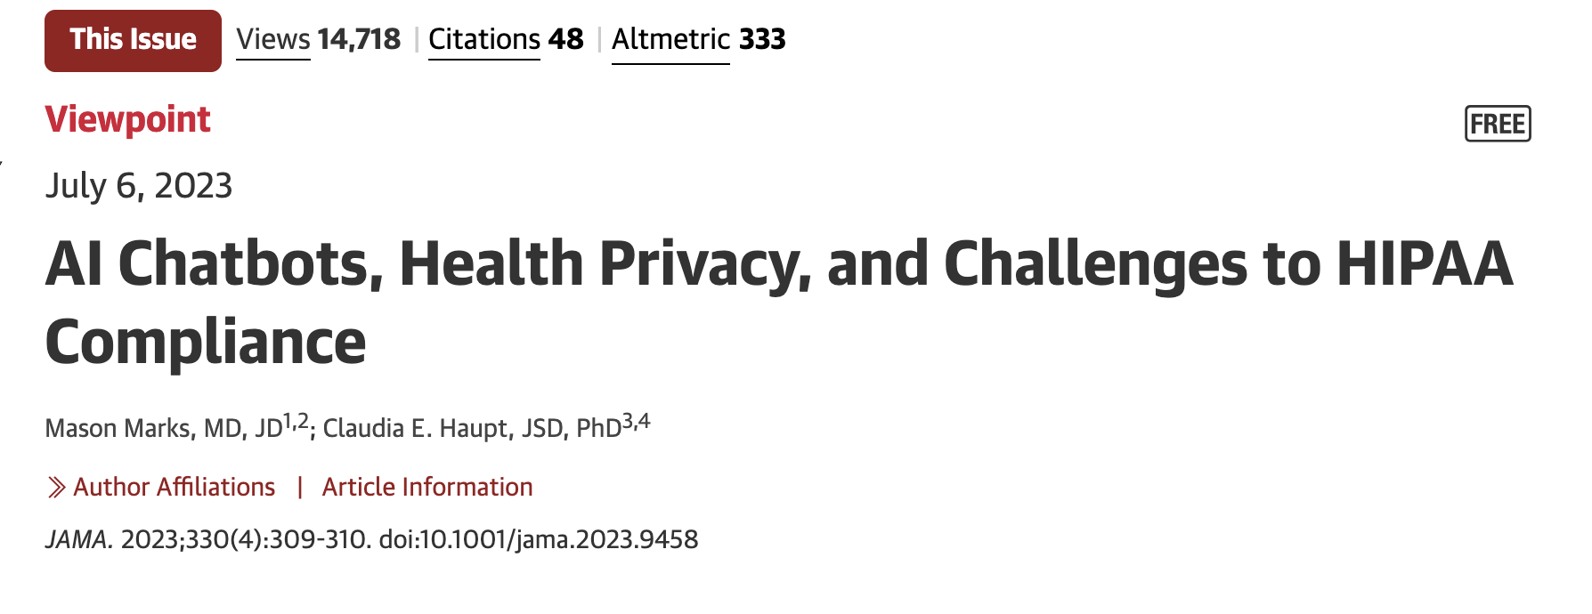
Chatbots cannot comply with the HIPAA in any meaningful way
Even if they could, it would not matter because HIPAA is inadequate to address AI-related privacy concerns
Professional use
  Resist disclosure of patient data
Consumer-facing applications
  De-identification impossible in era of big data
Data as power over patients and clinicians
  FTC regulation
  Clinicians’ role in protecting health data

Slide 22
Thank You!
Claudia E. Haupt & Mason Marks, AI-Generated Medical Advice—GPT and Beyond, 329 Jama1349 (2023)
Mason Marks & Claudia E. Haupt, AI Chatbots, Health Privacy, and Challenges to HIPAA Compliance, 330 Jama 309 (2023)
Claudia E. Haupt & Mason Marks, FTC Regulation of AI-Generated Medical Disinformation, 332 Jama 1975 (2024)
Claudia E. Haupt, A Roadmap Out of Health Law’s Privacy Fallacy for the AI Age, 31 Lex Electronica 23 (2026)
Claudia E. Haupt, Misplaced Trust in Artificial Professional Advice, Boston University Journal of Science & Technology Law (forthcoming)
Claudia E. Haupt, Professional Speech: Knowledge Communities and the Regulation of Expertise (Cambridge University Press, forthcoming)

