Slide 1

AI, Administrative Law, and Health Care: A Framework for When Technology Serves the Public Interest
Diane E. Hoffmann
Jacob A. France Professor of Health Law
University of Maryland Carey School of Law

Slide 2
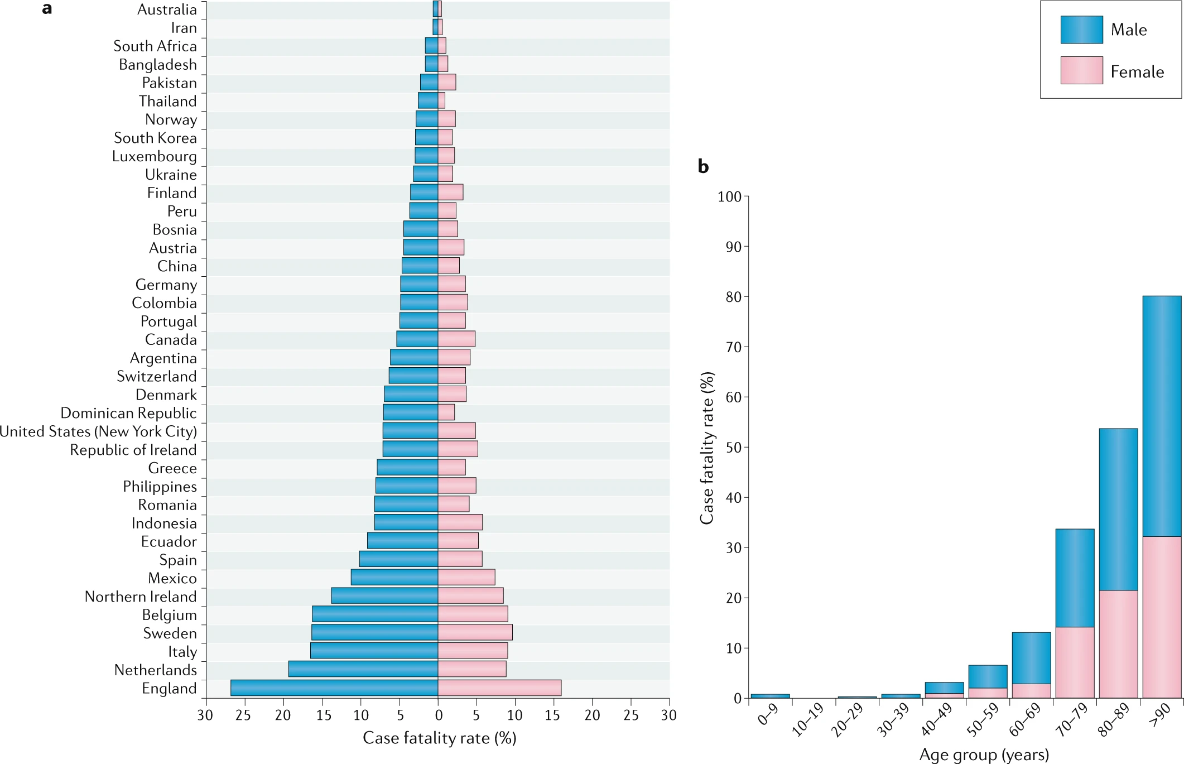
Sex & Covid-19 (June 2020)
https://www.nature.com/articles/s41577-020-0348-8

Slide 3

Can the state use an algorithm that favored men to allocate COVID treatment?

Slide 4

Critiques about government use of AI in Health Care
In 2008, Prof. Danielle Citron wrote:
“Automated systems jeopardize due process norms. Hearings are devalued by the lack of meaningful notice and by the hearing officer’s tendency to presume a computer system’s infallibility. Further, she asserted that: The opacity of automated systems shields them from scrutiny. Citizens cannot see or debate [government decisions].”
Source: Technological Due Process, 85 Wash. U. L. Rev. Issue 6 (2008)

Slide 5

2023 Medicaid “Unwinding” AI Fiasco
States had to review each enrollee’s income, household composition, disability status, and other criteria.
Many states’ eligibility systems had not been stress‑tested for years.
Some used outdated or flawed automation, leading to systemic errors—such as evaluating entire households as a single unit instead of individual members.

Slide 6
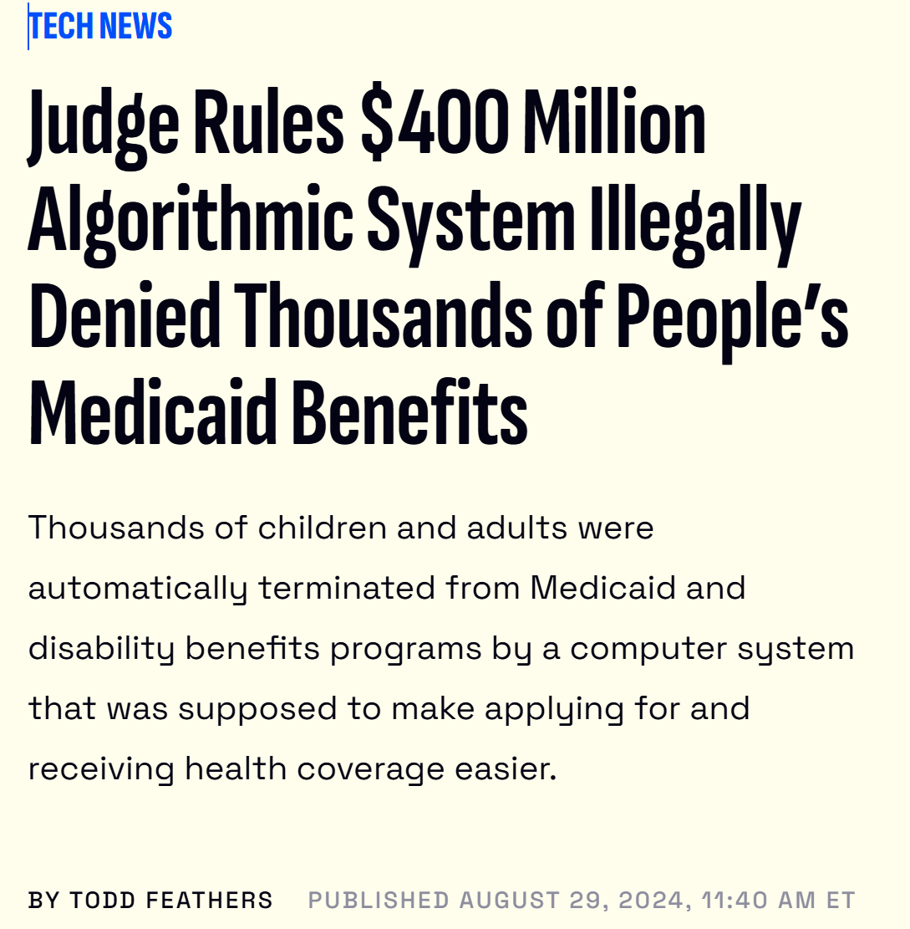
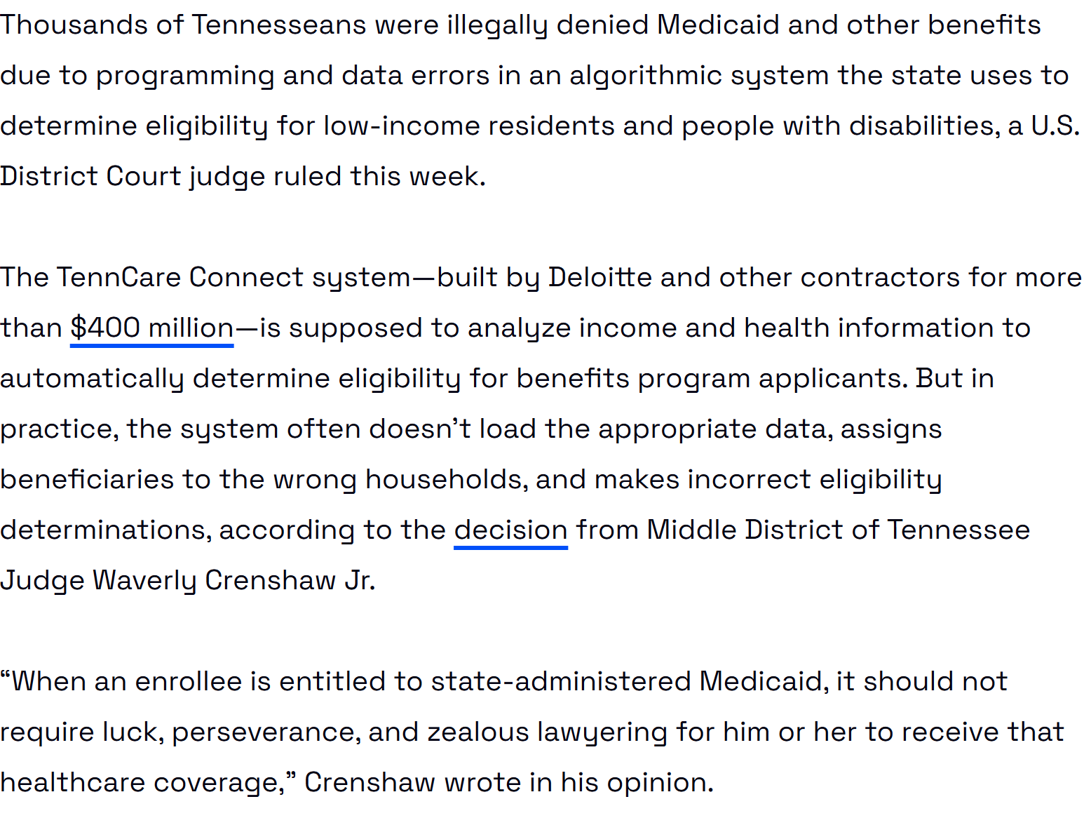
2023 Medicaid Unwinding Fiasco

Slide 7

Regulating by Robot: Administrative Decision Making in the Machine-Learning Era
When machine learning technology is properly understood, its use by government agencies “can comfortably fit within these conventional legal parameters.” They counsel against the alarmist approach of many scholars and “urge that governmental reliance on machine learning should be approached with measured optimism about the potential benefits such technology can offer society by making government smarter and its decisions more efficient and just.”
Source: Cary Coglienese and David Lehr, Georgetown L. Rev. (2017)

Slide 8



Health system uses of AI
Medicaid eligibility
State Medical Board Disciplinary Decisions
Federal Medicare Fraud determinations
NIH grant award determinations

Slide 9
Framework for Evaluating Health Care “Public Interest” Technology
What is at Stake?
Nature and Normative Structure of the Decision
The Characteris-tics of the AI/DM
The Role of Humans
What Laws are Implicated?

Slide 10
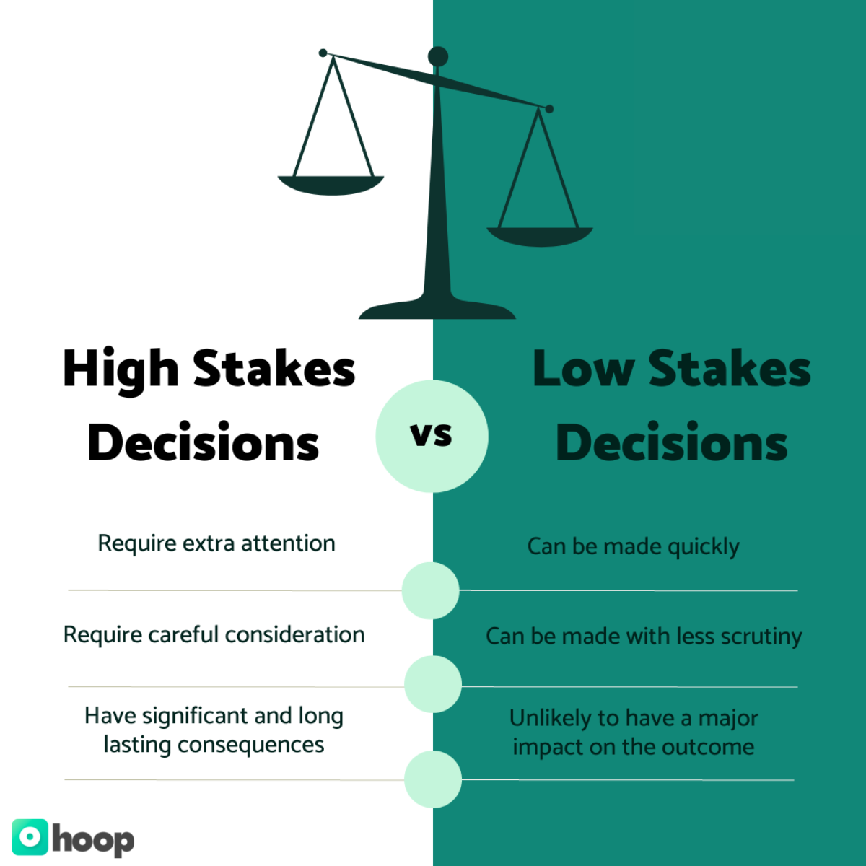
Decision Stakes
Core question: How much does this decision matter and to whom?
Sub-questions:
  Who is affected? (vulnerable class, individuals, large groups, children)
  What is at stake? (fundamental rights, essential benefits, severity of harm)

Slide 11
Converting Goals to Stakes
GOALS | STAKES
Maximizing Lives Saved | Number of lives saved or lost
Prioritizing the worst-off | How decision impacts the worst-off
Avoiding discrimination | Violation of antidiscrimination laws
Protecting essential workers | Loss or harms to essential workers
Maintaining the Public Trust | Public trust in government

Slide 12

Nature and Normative Structure of the Decision
Functional attributes (predictive/retrospective, binding/advisory)
Process attributes (speed, accuracy, transparency, individualized judgment)
Human‑judgment attributes (empathy, contextualization)
Normative values (fairness, dignity, autonomy, equity, social priorities)
Which errors matter more – false positives or false negatives?

Slide 13
Framework for Evaluating Health Care “Public Interest” Technology
What is at Stake?
Nature & Normative Structure of the the Decision
The Characteris-tics of the AI/DM
The Role of Humans
What Laws are Implicated?

Slide 14
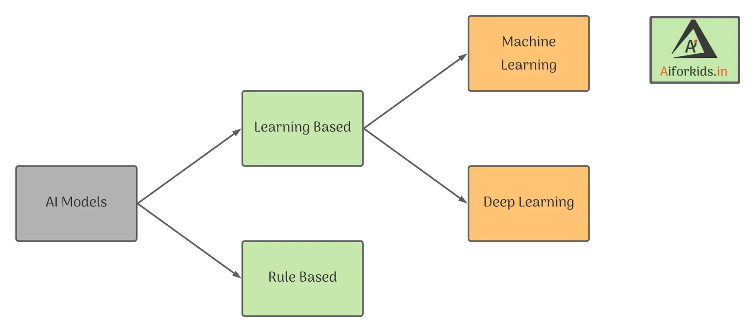
Characteristics of the technology
Types of AI:
  Rule-based
  Machine learning
  LLMs

Slide 15
Risk profile of different types of AI
Dimension | Rule-Based AI | Machine-Learning System | Autonomous LLM
Error Rate | Low if rules are correct; errors are systematic and traceable | Moderate; depends on training data, model architecture, and monitoring. Errors are statistical | Variable; can be low on familiar tasks but prone to hallucinations –fabricated reasoning , and context-sensitive inconsistencies. Outputs may look correct even when wrong.
Risk of Bias | Low from the system itself; bias comes from human-written rules (e.g., oversimplification) | Moderate to high; bias can be learned from skewed or historical data patterns | High; can reproduce training-data biases and generate new biased reasoning through language patterns
Sensitivity to Data Quality | Low as bad data does not change the system’s internal logic or behavior; behavior is predictable; garbage in -> garbage out | High; poor or unrepresentative data directly degrades performance and fairness | High; poor prompts or missing context can lead to fabricated or misleading outputs
Drift Over Time | None; rules do not change unless humans update them (more robust to drift) | High; model drift occurs as real-world patterns change + concept drift. Requires continuous monitoring | Not drift in the statistical sense, but behavioral inconsistency over contexts and versions; can degrade if not grounded or constrained

Slide 16
How AI Fares on Relevant Factors
Dimension | Rule-Based AI | Machine-Learning System | Autonomous LLM
Explainability | High — Every rule is explicit, traceable, and tied to statutory logic. Explanations map cleanly to inputs and rule paths. | Medium–Low — Model internals are opaque; explanations require post-hoc tools. Can describe correlations, not reasoning. | Low — Explanations are generated narratives, not faithful to internal processes. Reasoning cannot be inspected or validated
Administrative Feasibility | High — Easy to implement, maintain, audit, and integrate with legacy systems. Predictable behavior supports appeals and oversight. | Moderate — Requires monitoring, retraining, drift detection, and technical staff. Integration and maintenance burdens are significant. | Low — Hard to control, replicate, or audit. Staff training burden is high. Outputs are variable, making appeals and oversight difficult.

Slide 17

Administrative Feasibility
Operational capacity, i.e., Does the agency have the staff, expertise, and infrastructure to deploy the system, maintain it, update it, and respond to failures?
Other relevant factors may include:
  whether the AI can integrate with existing systems;
  if the AI was purchased from a vendor, does the agency have access to the model, the ability to audit it, rights to the data, and the ability to modify or terminate the system?
  cost of the system, which can include licensing costs, vendor support and staff time.

Slide 18
How AI Fares on Relevant Factors
Dimension | Rule-Based AI | Machine-Learning System | Autonomous LLM
Explainability | High — Every rule is explicit, traceable, and tied to statutory logic. Explanations map cleanly to inputs and rule paths. | Medium–Low — Model internals are opaque; explanations require post-hoc tools. Can describe correlations, not reasoning. | Low — Explanations are generated narratives, not faithful to internal processes. Reasoning cannot be inspected or validated
Administrative Feasibility | High — Easy to implement, maintain, audit, and integrate with legacy systems. Predictable behavior supports appeals and oversight. | Moderate — Requires monitoring, retraining, drift detection, and technical staff. Integration and maintenance burdens are significant. | Low — Hard to control, version, replicate, or audit. Staff training burden is high. Outputs are variable, making appeals and oversight difficult.
Programmer Error

Slide 19
Framework for Evaluating Health Care “Public Interest” Technology
What is at Stake?
Nature & Normative Structure of the Decision
The Characteris-tics of the AI
The Role of Humans
What Laws are Implicated?

Slide 20
Examples of Health Care Decision-making and Typology Outcomes
Example | Stakes Level (consequences of error) | Nature & Normative Structure of the Decision (internal structure) | Tech Risk (model related uncertainty) | Human Role Needed (procedural safeguards) | Legal Pressure (external constraints)
Medicaid Enrollment/ Disenrollment | Very High | Rights-determining, eligibility-based, highly rule-structured but normatively loaded (fairness, equity, access) | High | Strong human role needed | Very high
Physician Discipline | High | Retrospective, discretionary, dignity-affecting, requires contextual judgment and proportionality | Medium | Required | High
Fraud Detection | Medium | Predictive/flagging, probabilistic, low-normative content but high false positive cost | Medium | Review required | Medium
NIH Grant Review | Medium | Comparative, value-laden, expertise-driven, involves normative judgments about merit, innovation, and social priorities | Medium | Advisory Only | Low-Medium

Slide 21


