Slide 1
AI COMPETENCES AS DUTY
Healthcare professionals as
AI supervisors and AI mediators
Sofia Palmieri, PhD
Post-Doctoral Fellow in Medicine, Artificial Intelligence, and the Law
The Petrie-Flom Center for Health Law Policy,
Biotechnology, and Bioethics at Harvard Law School

Slide 2


Medical field
Competence building in the AI area
Key competences and Domains
Foundational AI knowledge
Critical appraisal of AI systems
Awareness of risks, bias and unintended consequences
Patient communication and explanation
…is there a duty to be AI competent?
…which implementation pathways?

Slide 3
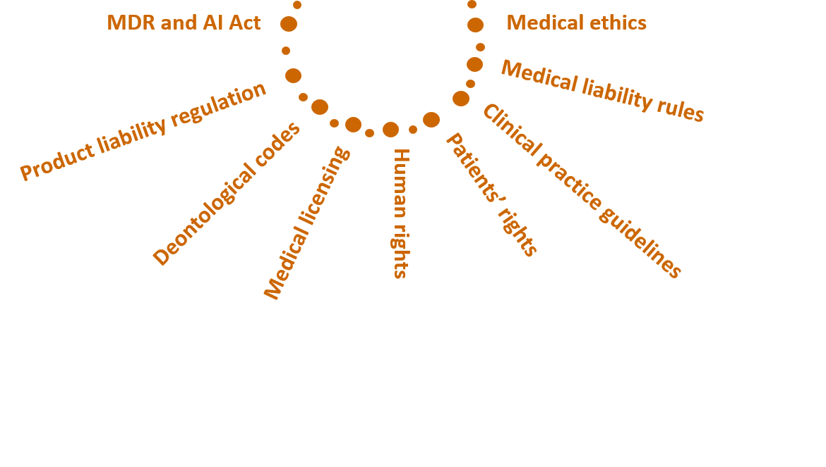
…is there a duty to be AI competent?

Slide 4
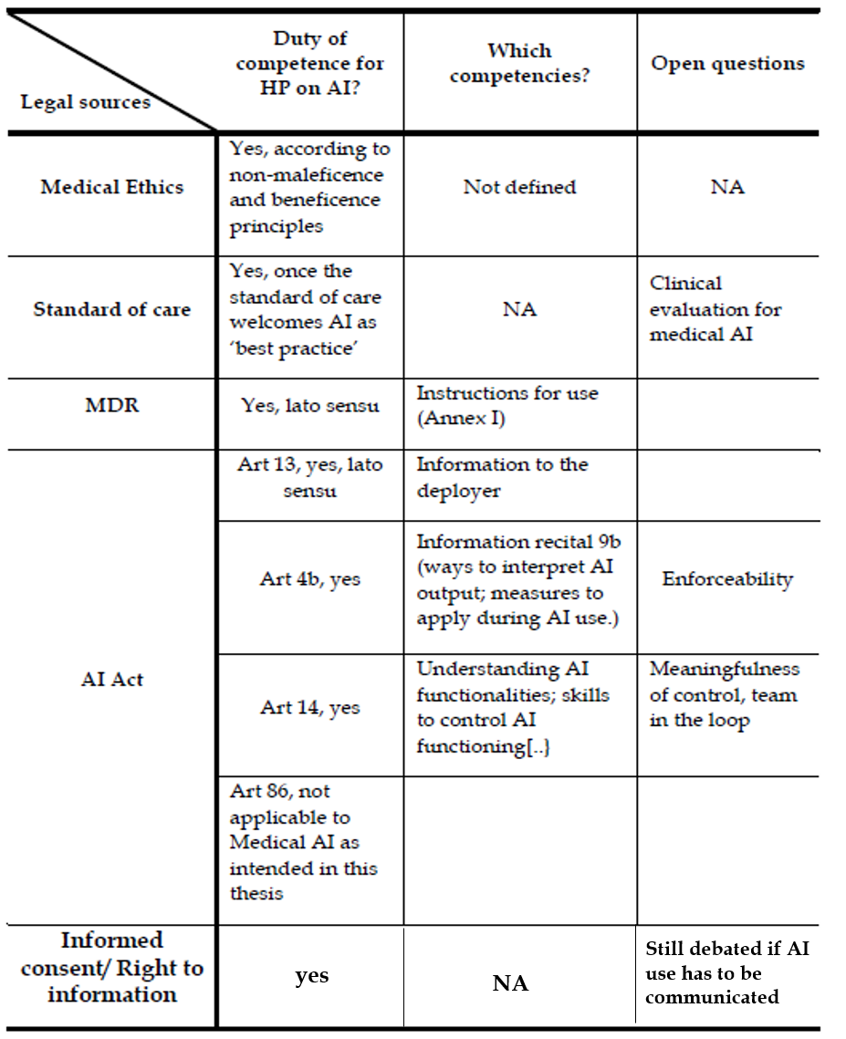
…is there a duty to be AI competent?

Slide 5
…is there a duty to be AI competent?
1. YES
Grounded in existing legal frameworks
Reinforced when sources are read together
Natural evolution from existing competences
Need of definition
2. AI mediator vs AI supervisor
…which implementation pathways?

Slide 6
Competence building set up by healthcare institutions (ex art 4 AI Act)
IT professionals
Healthcare professionals
ALG professionals
L 0
Foundations on AI
Covers basic AI background, capabilities & limitations, overview of Trustworthy AI and General Best Practice
L 1
AI technical (about the technology)
AI technical (about the technology)
AI policy and legal requirements
L 2
Data quality and Impact
AI tools in their field: specifics with sector expert
AI & Data Governance
L 3
Critical appraisal
AI & Liability
L 4
AI & patients rights

Slide 7
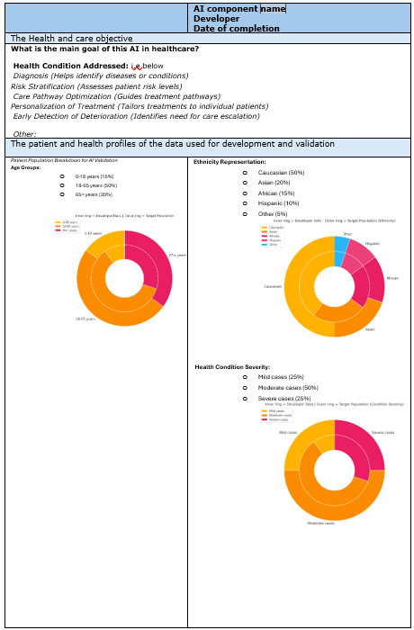
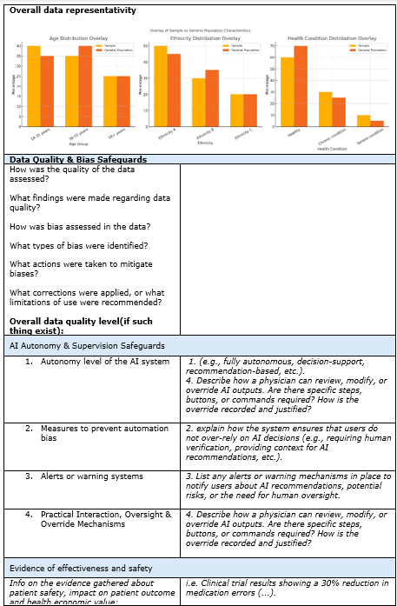

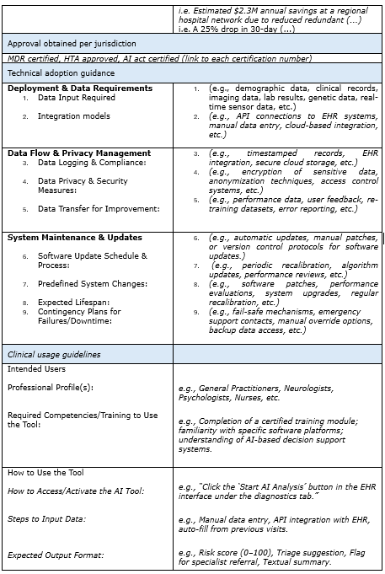
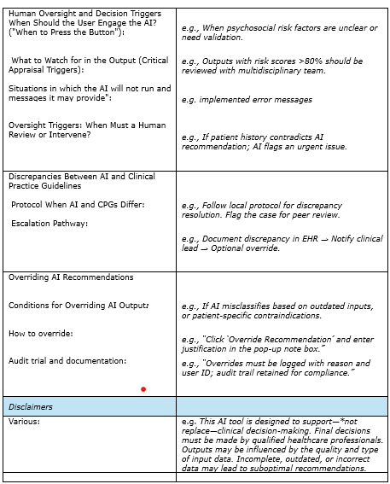
HCP factsheet content
The health and care objective,
Data used for development and validation,
Data Quality & Bias Safeguards,
AI Autonomy & Supervision Safeguards,
Evidence of effectiveness and safety,
Approval obtained per jurisdiction,
Technical adoption guidance,
Clinical usage guidelines,
Disclaimers

Slide 8
Thanks!
Do you have any questions?
spalmieri@law.Harvard.edu

