Slide 1
Demedicalizing MAiD
Reframing Autonomy and Accountability in Assisted Dying
Amirala Pasha, DO, JD, FACP, FCLM
Rick Silbert, MD
2026 Health Law Professors Conference
Georgia State University College of Law
June 2026

Slide 2
Disclosures
2026-2027 Voting Member of the American College of Physicians’ Health and Public Policy Committee.
2026-2027 Voting Member of the American College of Physicians’ Ethics, Professionalism and Human Rights Committee.

Slide 3
Disclaimers
The views expressed or implied in this presentation are solely those of the presenters; they do not necessarily reflect the views of Mayo Clinic, any department or division within Mayo Clinic or any other entity.​
The following information and any foregoing discussion is for general informational purposes only. It is not legal advice or a legal opinion, and it may not necessarily reflect the most current legal developments. You should seek the advice of legal counsel of your choice before acting upon any of the information presented. Your time to act may be very limited which can substantially impair your rights. These information are not intended to substitute for professional legal advice and does not create an attorney-client relationship.

Slide 4
The Problem
The current medicalized model creates unnecessary ethical tension because it treats MAiD as healthcare rather than as a legally authorized autonomous choice about the timing and manner of death.
Notes:
At its core the same tension also devalues patient autonomy.

Slide 5
The Goal
Transfer of conceptual ownership from medical practitioners to the individual patient through reframing the legal approach.
Notes:
Subgoal: Convince the largest specialty physician organization to support MAiD.

Slide 6
Definitions
1

Slide 7
Definitions
Assisted Suicide (AS): Patient is provided with lethal means which the patient self administers without requirement for terminal illness.
  Medical Assistance in Dying (MAiD) and Physician Assisted Suicide (PAS) (in the US context): Terminally ill patients are provided lethal medicine to be self administered.
    Terminal Illness: a condition that will, by reasonable medical judgment, lead to death within six months.
Euthanasia: An individual other than the patient (typically a medical practitioner) provides the lethal means and performs the act.
Notes:
However, many times, especially when looking at old literature, MAiD and PAS are used interchangeably to mean the same thing.

Slide 8
Overmedicalization
2

Slide 9
Overmedicalization
Concept of medicalization asserts that “treatment decisions must emanate from and be dispensed by qualified health professionals who, by virtue of their training and expertise, are insofar as treatment is concerned enjoined to stand superior to those they treat.”¹
“Overmedicalization describes the overreliance on medical terminology and frameworks to explain, assess, and address an issue.”²
“De-medicalisation can be defined as ‘stripping away medicine as a dominant frame of reference to reveal the “true”’ nature of a phenomenon.”³

Slide 10
Example of Shifting Framework
Overmedicalized
Demedicalized
“The attending physician, in consultation with his patient, is free to determine, without regulation by the State, that, in his medical judgment, the patient’s pregnancy should be terminated.”
Roe v. Wade, 410 U.S. 113, 163. 1973
“Every individual has a fundamental right to make autonomous decisions about the individual’s own reproductive health, including the fundamental right to use or refuse reproductive health care.”
Minn. Stat. § 145.409, 2023

Slide 11
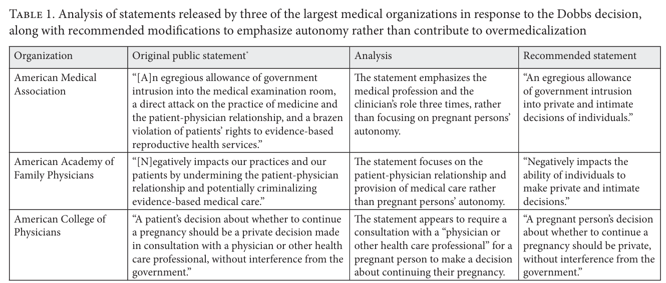

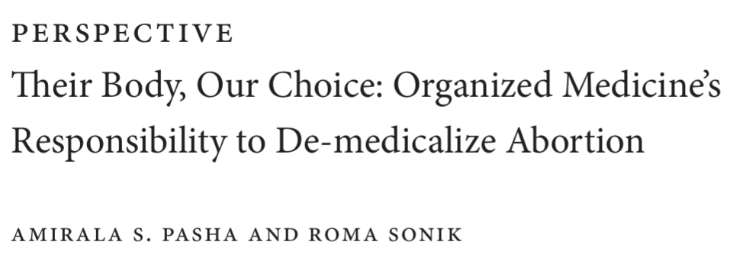

Medicine Loves Overmedicalization

Slide 12
Overmedicalization of MAiD
“Suicide began as a sin, became a crime, then became a mental illness, and now some people propose transferring it into the category called “treatment,” provided the “cure” is under the control of doctors.” Szasz T., Fatal Freedom: The Ethics and Politics of Suicide (Syracuse University Press, 1999
In the US and Canada, physicians are intimately (and in many cases unnecessarily) involved in the entire process.
  Determine capacity
  Determine eligibility
  Prescribe medication
To demedicalize MAiD means to transform MAiD from a medical framework to a purely legal framework.
  MAiD AiD
Notes:
It is still a crime to attempt suicide in Virginia. Other states have passed amendments over the years to first decrminimalize suicide then attempted suicide (originally part of common law)

Slide 13
MAiD Globally
3

Slide 14


United States of America
.
.
Oregon in 1997, now 13 states plus DC
Limited to physicians in most states
Physicians can refuse participation
MAiD/PAS only (euthanasia remains illegal)
Eligibility confirmed independently by 2 physicians
Mental health professional involved only if concerns about capacity (HI/NY require).
Notes:
In 2023, 560 people in Oregon were provided prescriptions, 367 used them – most often for cancer, followed by neurologic disease

Slide 15

Canada
.
.
Passed in 2016
Euthanasia and PAS
Open to physicians and nurse practitioners*
MAiD curriculum: accredited education program available for practitioners
Process
  Written request with independent witness
  Two independent medical assessments to confirm eligibility
  Final consent

Slide 16

Switzerland
.
.
1918 Swiss penal code: “suicide is not a crime…aiding and abetting suicide can themselves be inspired by altruistic motives”¹
  Initial conception for cases of honor or romance, not medical illness
Assisted suicide legal since 1942
  Only a crime if assistance is for selfish motive
  Police inquiry initiated for all assisted suicides
  Case closed if patient deemed competent and no evidence of selfish motive
Euthanasia or “murder upon request” is illegal
1. Hurst et al., BMJ Feb 2003

Slide 17
Switzerland
.
.
Open to residents and non-residents
Anyone can assist – physician and non-physicians
Doctors limited assessing capacity and prescribing the lethal drug
No medical criteria
  25% of those who perform assisted suicide do not have a serious or terminal condition
  Most old or “tired of life”²
Swiss Academy of Medical Science asserts assisted suicide is not within a physician’s purview
2. Andorno, Cambridge Quarterly Healthcare Ethics, 2013

Slide 18



Review
Overmedicalized
(partially) Demedicalized

Slide 19
Organized Medicine
4

Slide 20
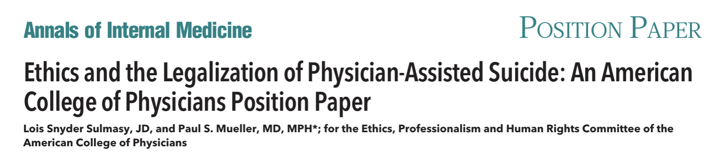
Organized Medicine’s Opposition
American Medical Association (AMA)
American College of Physicians (ACP)
“It is understandable, though tragic, that some patients in extreme duress—such as those suffering from a terminal, painful, debilitating illness—may come to decide that death is preferable to life. However, permitting physicians to engage in assisted suicide would ultimately cause more harm than good.”
AMA Code of Medical Ethics
Opinion 5.7 Physician-Assisted Suicide
The ACP does not support the legalization of physician-assisted suicide, the practice of which raises ethical, clinical, and other concerns.
Control over the manner and timing of a person's death has not been and should not be a goal of medicine.
Ann Intern Med. 2017 Oct 17;167(8):576-578.
Notes:
The AMA’s position is not one of neutrality and Opinion 5.7 articulates the AMA’s opposition to physician-assisted suicide. However, individual physicians who, after due moral consideration, exercise their conscience in accordance with Opinion 1.1.7 and legally engage in the practice of physician-assisted suicide will not have acted in violation of the Code.
ACP also says that as long as physicians are doing it legally they are not in ethical violations.

Slide 21
Organized Medicine and MAiD
.
.
American Medical Association has long opposed medical assistance in dying:
  “American Medical Association strongly opposes any bill to legalize physician-assisted suicide or euthanasia, as these practices are fundamentally inconsistent with the physician's role as healer” - Policy H-270.965, 2018
Stance softened in 2025, prioritizing preservation of physician judgment and autonomy:
  “Opposing criminalization of physicians who engage in physician assisted suicide, while simultaneously not supporting the legalization of this practice, will allow our AMA to uphold its existing core values” – B of T Rep. 18-A-25, 2025
Notes:
H-270.965 Physician-Assisted Suicide | AMA
2025 by Dr. Michael Suk
HOD Handbook - Ethics and Bylaws
When MAID is framed as healthcare, physicians become morally responsible for delivering death.
This creates resistance within the profession.

Slide 22
Summarizing Organized Medicine’s Objections
Not a traditional role of the medical profession
Harms the patient-physician relationship
Inconsistent with the role of the ”healer”
The answer to all of the above: DEMEDICALIZATION!

Slide 23
Current Model
5

Slide 24
The Role of The Medical Professional
Gatekeepers
  Doctor shopping
Prognosticator
  Hospice
Prescriber
  Legal requirement
Capacity determination
Physician involvement arose from administrative convenience rather than moral necessity.
Early MAID legislation often assumed medicine's role without deeply examining alternatives.

Slide 25
Objections to Demedicalization
.
Objection 1: Physicians Are Necessary for Safety
  Medical expertise remains available on demand
Objection 2: MAID Is Inherently Medical
  The choice to die is fundamentally normative, legal, and personal
    It does not require a medical opinion on whether you should end your life or not
    No different than the decision to terminate a pregnancy
Objection 3: Demedicalization Risks Abuse
  The medical profession is not the abuse police (also, see FCA litigations)
Objection 4: Public Trust Requires Physician Involvement
  The opposite is actually true

Slide 26
Alternative Model
6

Slide 27
Alternative Model
Medical professional (assessor role, none of which are unique to MAiD):
  Determines capacity
  Terminal illness certification (same requirements as hospice)
Alternative source for medication (non-physician agents):
  Non-profit organizations similar to the Swiss model (limited to terminally ill patients)
  The licensed facilitator model similar to psychedelics
  The dispensary model is similar to cannabis

Slide 28
Summary
7

Slide 29
Summary
MAID is often mischaracterized as healthcare rather than a personal liberty choice.
Medicalization places physicians in ethically conflicted roles.
Demedicalization may improve acceptance within the medical community.
Patient autonomy can be strengthened through legal rather than exclusively medical governance.
Robust safeguards can exist without making physicians the primary agents.
A rights-based framework may provide greater conceptual coherence and institutional legitimacy.

Slide 30

QUESTIONS
& ANSWERS
pasha.amirala@mayo.edu

