Slide 1
What does that Mean: Intent and Purpose of Medical Aid in Dying Laws
Presented by Jaspreet Chowdhary, Senior Legislative Counsel

Slide 2

Who We Are
Compassion & Choices is the leading nonprofit organization working to improve care, expand options and empower everyone to chart their end-of-life journey. For more than 40 years we have worked to change attitudes, practices and policies so that everyone can access the information and options they need to have more control and comfort at the end of life.

Slide 3

End-of-life Options
Comfort Care
Full Code
Life-Sustaining Treatment
Discontinue Active Treatment of Illness
Palliative Care
Hospice
Voluntarily Stopping Eating and Drinking
Medical Aid in Dying
Prolong life
Hospice
DNR
Treatment

Slide 4
What is medical aid in dying?
Medical aid in dying is a medical practice in which a mentally capable adult with a prognosis of six months or less to live may request a prescription for medication which they can choose to self-administer to die on their own terms.

Slide 5
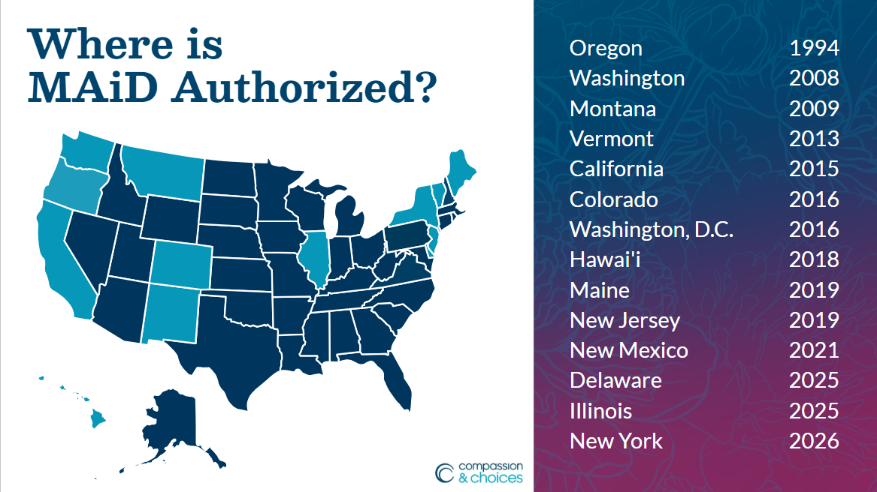

Slide 6
Language History
Compassion & Choices President Barbara Coombs Lee co-authored Oregon’s pioneering law.
Strict eligibility criteria, multi-step request process, and other provisions embedded in medical aid-in-dying laws ensure that anyone pursuing the option is protected.

Slide 7
Medical Aid in Dying Model Bill
Ideal legislation and viewed as a starting point for negotiations and bill drafting
Intended to strengthen language by being more precise
Reviewed and updated annually based on experience in legislative sessions, academic research, and national landscape
Important to note that each law reflects the unique landscape and legislative makeup of the jurisdiction in which it was authorized.

Slide 8
Eligibility Criteria

Slide 9

Who is eligible?
Adult
Terminally ill
Prognosis of 6 months or less to live
Mentally capable of making informed medical decisions
Able to self-administer
A person is not eligible for aid in dying due to age or disability alone

Slide 10
Six Month Prognosis

Slide 11
Definition from Model Bill
"Terminal disease" means an incurable and irreversible disease that has been medically confirmed and will, within reasonable medical judgment, produce death within six months.

Slide 12
Six Month or Less Prognosis
Defined by disease progression
Not treatment options
Confirmed by at least one healthcare provider
Six month prognosis is used as a guide for hospice eligibility

Slide 13
Considerations for Definition
Distinction between terminal with a six month prognosis and incurable
Access to medical aid in dying is NOT dependent on exhausting all other treatment options
“Incurable and irreversible”
“Disease” versus “illness”

Slide 14
Self-Administration

Slide 15
Definition from Model Bill
“Self-administer” means a qualified individual performs an affirmative, conscious, voluntary act to ingest medication prescribed pursuant to this Act to bring about the individual’s peaceful death. Self-administration does not include administration by others, parenteral injection, or infusion.

Slide 16
Self-Administration
Affirmative, Conscious and Voluntary Act
NOT injection or infusion
NO other person, including a healthcare provider or a family member
Person MUST remain in control of the procedure from start to finish
Assistance can be provided in preparation, holding, and bringing medication close
Accomodation under American with Disabilities Act

Slide 17
Consideration for Definition
A thorough and concise definition prevents varying interpretations of the term
Strengthens the principle of self-determination, and ensures that the patient remains in control.
In the absence of “ingest” in the definition of “self-administer,” some scholars have said that MAID medication may be administered intravenously.
Distinguishes practice from euthanasia

Slide 18
Barriers to Integrating Medical Aid in Dying Fully into End of Life Care and Practice

Slide 19
Misconceptions about Improvement Bills
Reducing mandatory waiting periods and/or allowing waivers of waiting periods
Including more qualified healthcare providers
Removing residency restrictions

Slide 20
ASFRA
Assisted Suicide Funding Restriction Act
  Limits access to medical aid in dying
  No federal funds can be used for care associated with medical aid in dying
  Prohibits individuals who receive health insurance from Medicare, Veteran Affairs, Indian Health Services, etc. from getting information about medical aid in dying.

Slide 21
Healthcare Entities and Providers Not Willing or Unable to Participate
Voluntariness is a key component of medical aid in dying
Some institutions choose not to participate in medical aid in dying or do let their providers participate in medical aid in dying.
Even in non-religious institutions, individual healthcare providers personal beliefs can complicate care delivery

Slide 22
Healthcare Entities and Providers Not Willing or Unable to Participate continued…
Creates tension with Informed Consent
Undermines patient autonomy and decision making
Can interrupt continuity of care based on end of life decisions

Slide 23
Resources

Slide 24

Resources for you & those you serve
2026 Policy Book
2026 MAID Utilization Report
End-of-Life Decisions Guide
Call Compassion

Slide 26
Notes:
Questions?

