Slide 1

Are Prison-Healthcare Consent Decrees Implemented? A call for causal research
Bryant Jackson-Green
Loyola University Chicago

Slide 2
Overview
Incarcerated people have substantial preexisting health conditions; they can arise in or be exacerbated by prison conditions (Maruschak, 2008; National Academy of Sciences, 2013).
Increased rates of HIV, viral hepatitis, tuberculosis, mental health challenges, and substance use disorders (CDC, 2023).
Increased mortality rates (Wildeman, 2016).

Slide 3
Motivation
Civil litigation is frequent response to prison healthcare conditions
Building on Estelle v. Gamble (1976) and progeny (Schlanger, 2006);
Policy innovation of interest: Consent Decrees “legally binding performance improvement plan” (McCann, 2023)
  Most often discussed in policing, antitrust, environmental contexts
  Prison conditions (Rubin & Feeley, 2000)
  For prison healthcare, analysis of 121 consent decrees shows national scope of policy instruments across general healthcare, mental health, and specialized conditions (Jackson-Green, Yuhm, & Vu, 2026)
Why litigation? Do consent decrees deliver on reform, or should other avenues be pursued?

Slide 4
Literature Review
Early studies (Harriman & Straussman, 1983;Taggart, 1989; Filter, 1996) suggest court orders had modest or uneven effects—typically increasing capital expenditures (e.g., prison construction), but not consistently raising operational spending.
Using more advanced methods like difference-in-differences, studies by Boylan & Mocan and Guetzkow & Schoon found significant increases in correctional spending—especially in operations and capital projects—following court orders.
Despite increasing healthcare costs and litigation-driven reforms, little research has examined the causal impact of correctional healthcare consent decrees specifically.

Slide 5
Research Questions
  Are healthcare-related prison consent decrees implemented, as measured by changes in correctional healthcare hiring and spending?
    If implementation effects emerge, when does this typically happen — in the early years of a consent decree or later in its lifecycle?
    How do implementation effects vary across jurisdictions — do some states show stronger spending and hiring responses than others?
    Do facility-level consent decrees produce different implementation effects than statewide consent decrees?
Notes:
Examples of spending – either explicit request for budget funding; or policy goal that necessarily implicates funding for implementation such as increased services or explicit request for increased staffing
In fact, the increased spending relates to those items seen as most key to health reform: (Baer & Bepko, 2007; Faria, 2014)
implementation of legal changes (e.g., via litigation) could lead to environmental changes (e.g., institution budgets), which could eventually impact public health outcomes (e.g., treatment utilization among prisoners). Therefore, as one approach to assessing changes in the environment that result from consent decrees, we could measure budgetary changes, specifically those applicable to healthcare spending and hiring.

Slide 6
Hypotheses
Even with those years, consent decree impact is likely longer-term since implementation takes time
  I hypothesize we would see 5-10 year impacts more than short-term, but this needs to be tested

Slide 7
Data and Methods - Are healthcare-related prison consent decrees implemented?
Data Collection
Methods
Collection of state budget correctional healthcare spending, typically from budget line items
Hiring will be a smaller data source; these are often acquired from Secretary of State or Department of Corrections
Staggered Difference-in Differences (Angrist & Jorn-Steffen Pischke, 2015)
  Enactment of consent decree as treatment (timing varies by state)
Two comparison groups
  States with system-wide consent decrees compared to those without
  Individual prison facilities compared to those without (within states)
Notes:
Discuss key assumptions of Diff in diff
Measuring the difference in trend over time and between cases

Slide 8
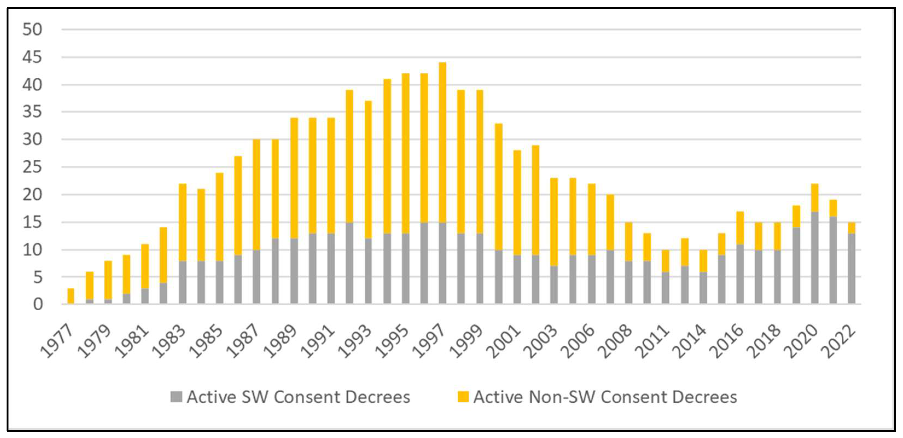

Slide 9
Data Collection
What we tried
Lessons
Budget data were gathered through online state budget archives, FOIA requests, and archival visits, as many online records only cover recent years.
FOIA responses were generally helpful but varied by state, with some charging fees or restricting requests to residents; archival visits were necessary for older data (e.g., pre-1990s).
Budget data requires multiple sourcing – not just FOIA but archival visits

Slide 10
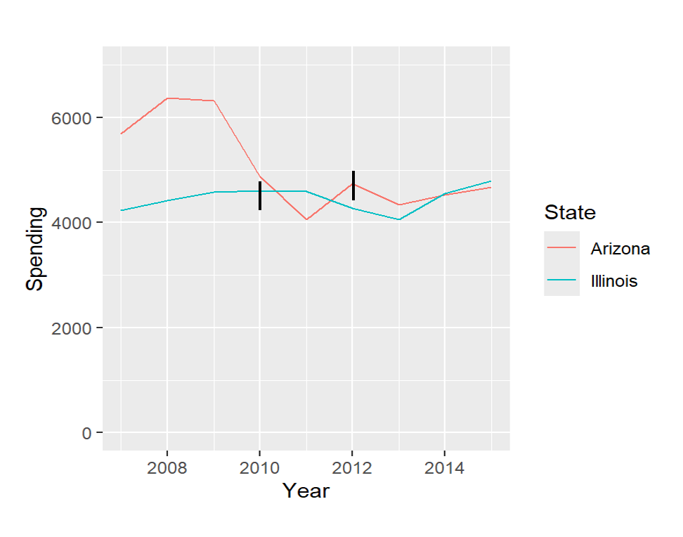
Two cases – Illinois and Arizona
 | 1 Year Difference | 3-Year Difference | 5-Year Difference
Arizona | -8.44 | -1.40 | N/A
Illinois | -0.20 | -11.82 | 4.054

Slide 11

Strengths & Limitations
More extensive data collection needed to estimate average treatment effects for these kinds of interventions
Fiscal measures do not wholly capture all elements of implementation (e.g. for goals that do not depend on budgets); they do, arguably, capture some of the most important ones

Slide 12
Questions
Email: bjacksongreen@luc.edu
Acknowledgments
This research was supported in part by the Robert Wood Johnson Foundation Health Policy Research Scholars Program and the California Policy Lab.

