Slide 1
Nonprofit Hospitals and Health Governance
Zack Buck
2026 Health Law Professors Conference
Georgia State University College of Law
June 5, 2026
instructions

Slide 2
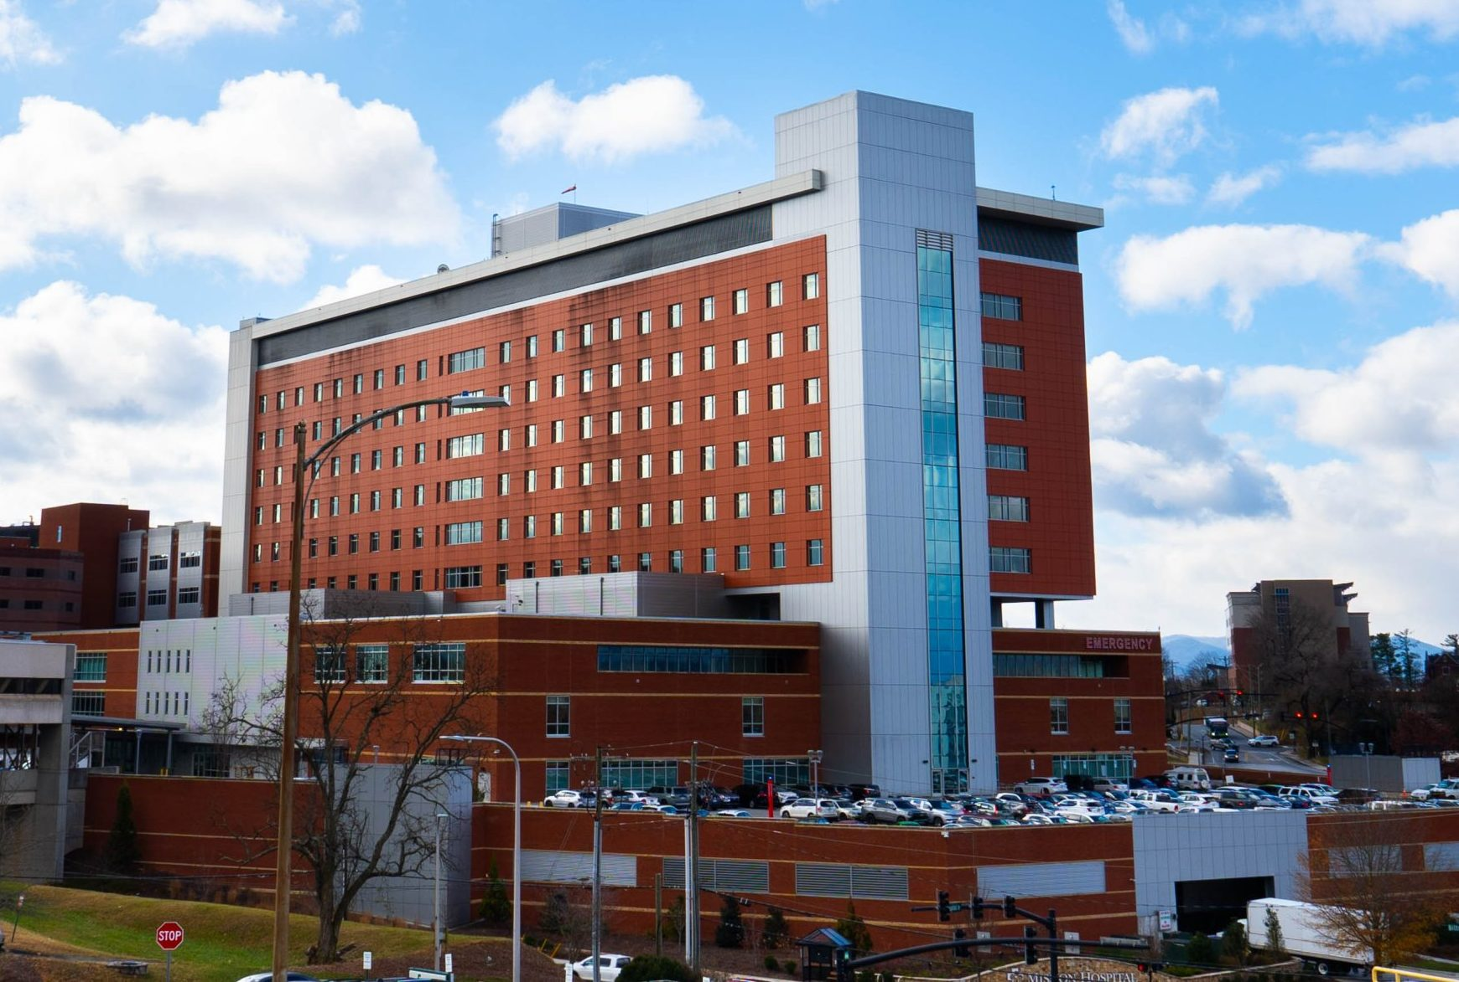
TRANSITIONAL
TRANSACTIONS
Mission Hospital, Asheville

Slide 3
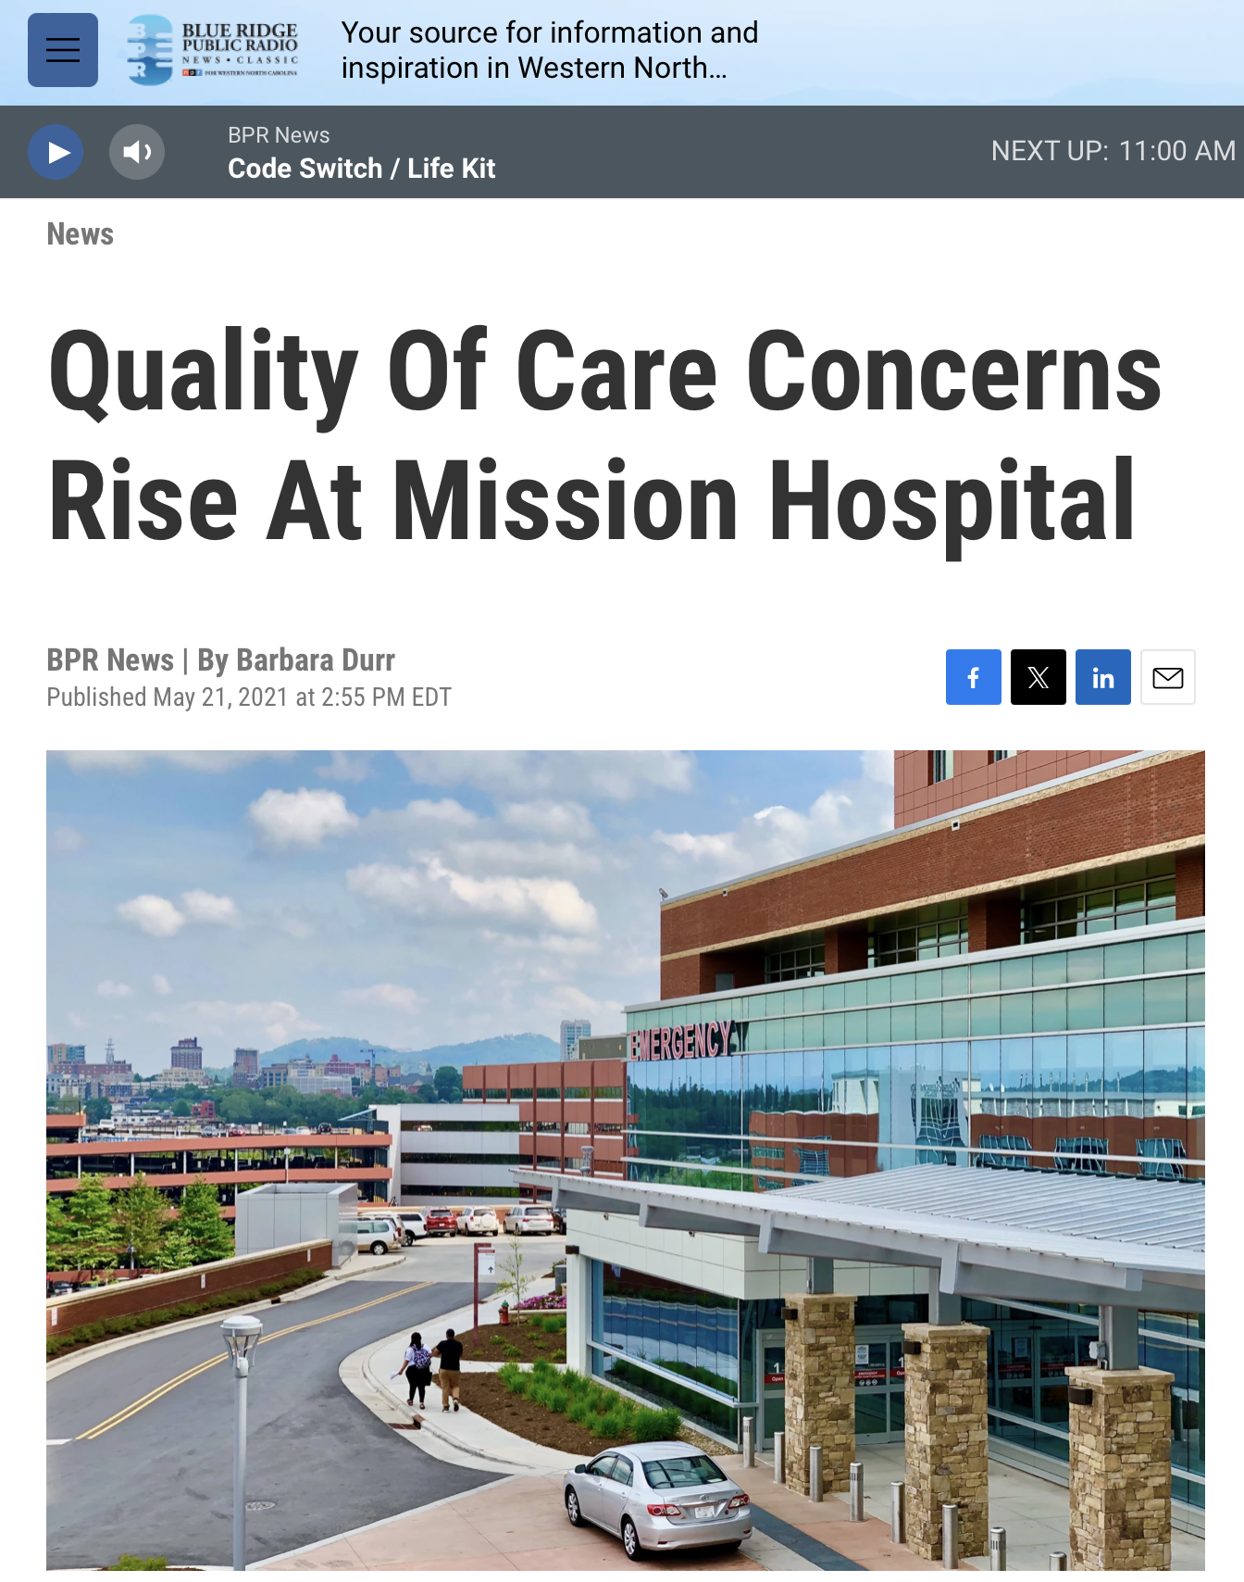
Mission Hospital, Asheville
Sold to HCA, deal closed Jan. 2019
Attorney General Josh Stein ”conducted a review ... To ensure that the price paid for the assets was fair and that any charitable assets remained dedicated to a charitable purpose” → entered into additional agreements as part of the Asset Purchase Agreement to “safeguard the public” (15 conditions), AG issued “Letter of Nonobjection”
Since has noted the office “had concerns from the beginning”
Mounting quality of care concerns

Slide 4
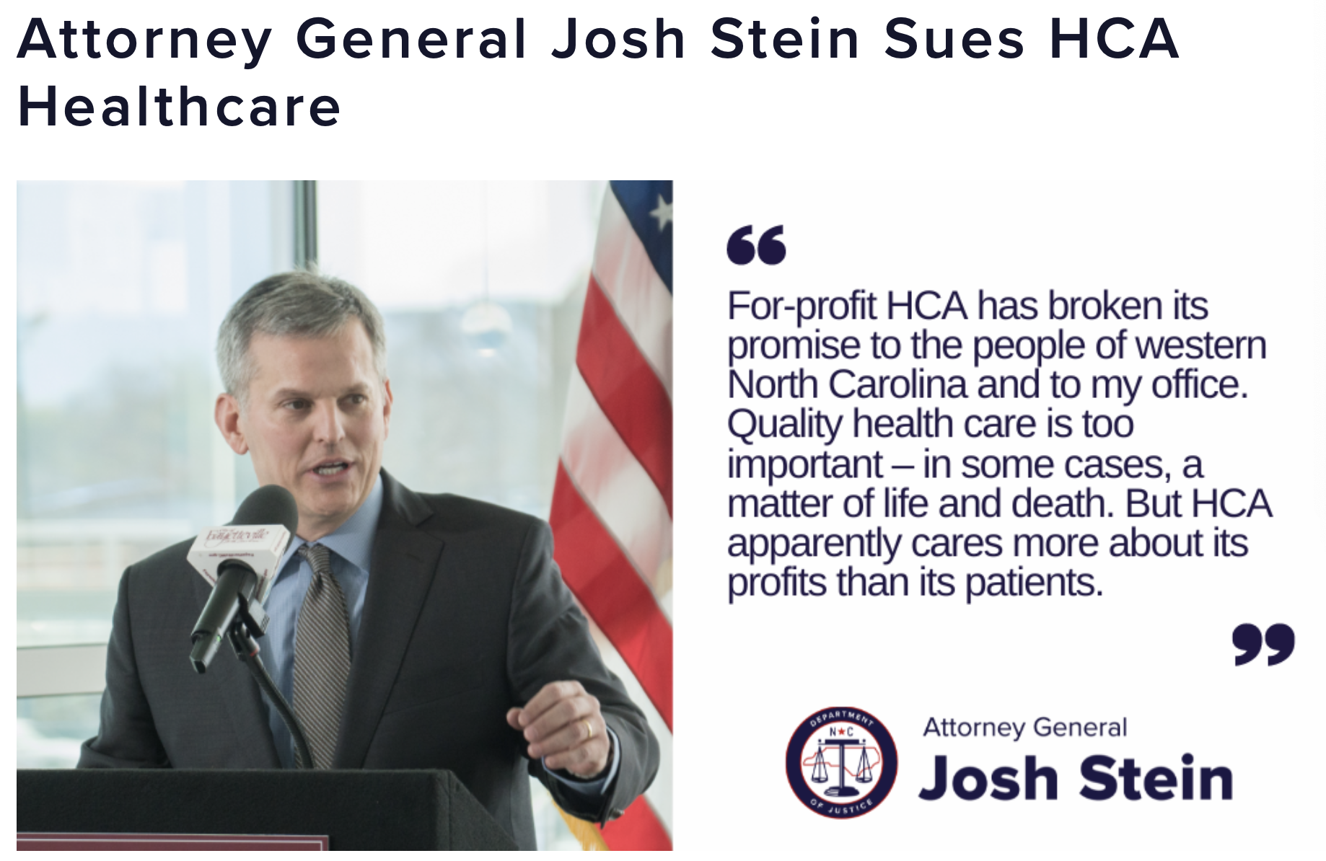
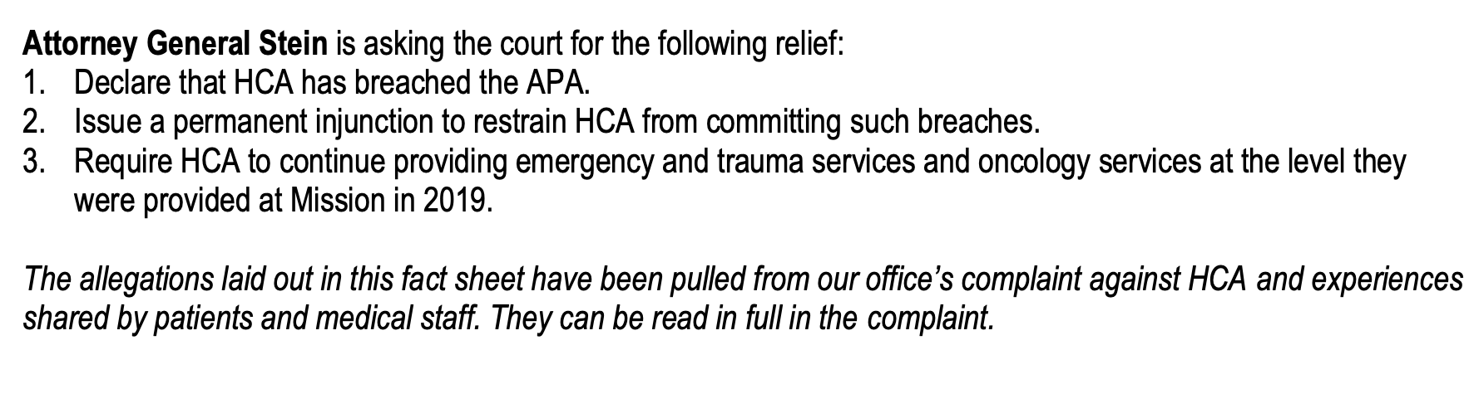
Mission Hospital
Concerns: charity care cuts, patient safety concerns due to staff cuts, poor morale
Dramatic margin and profitability increases; drop in patient-care costs per adjusted discharge; decline of staffing rates
SEEKING:

Slide 5
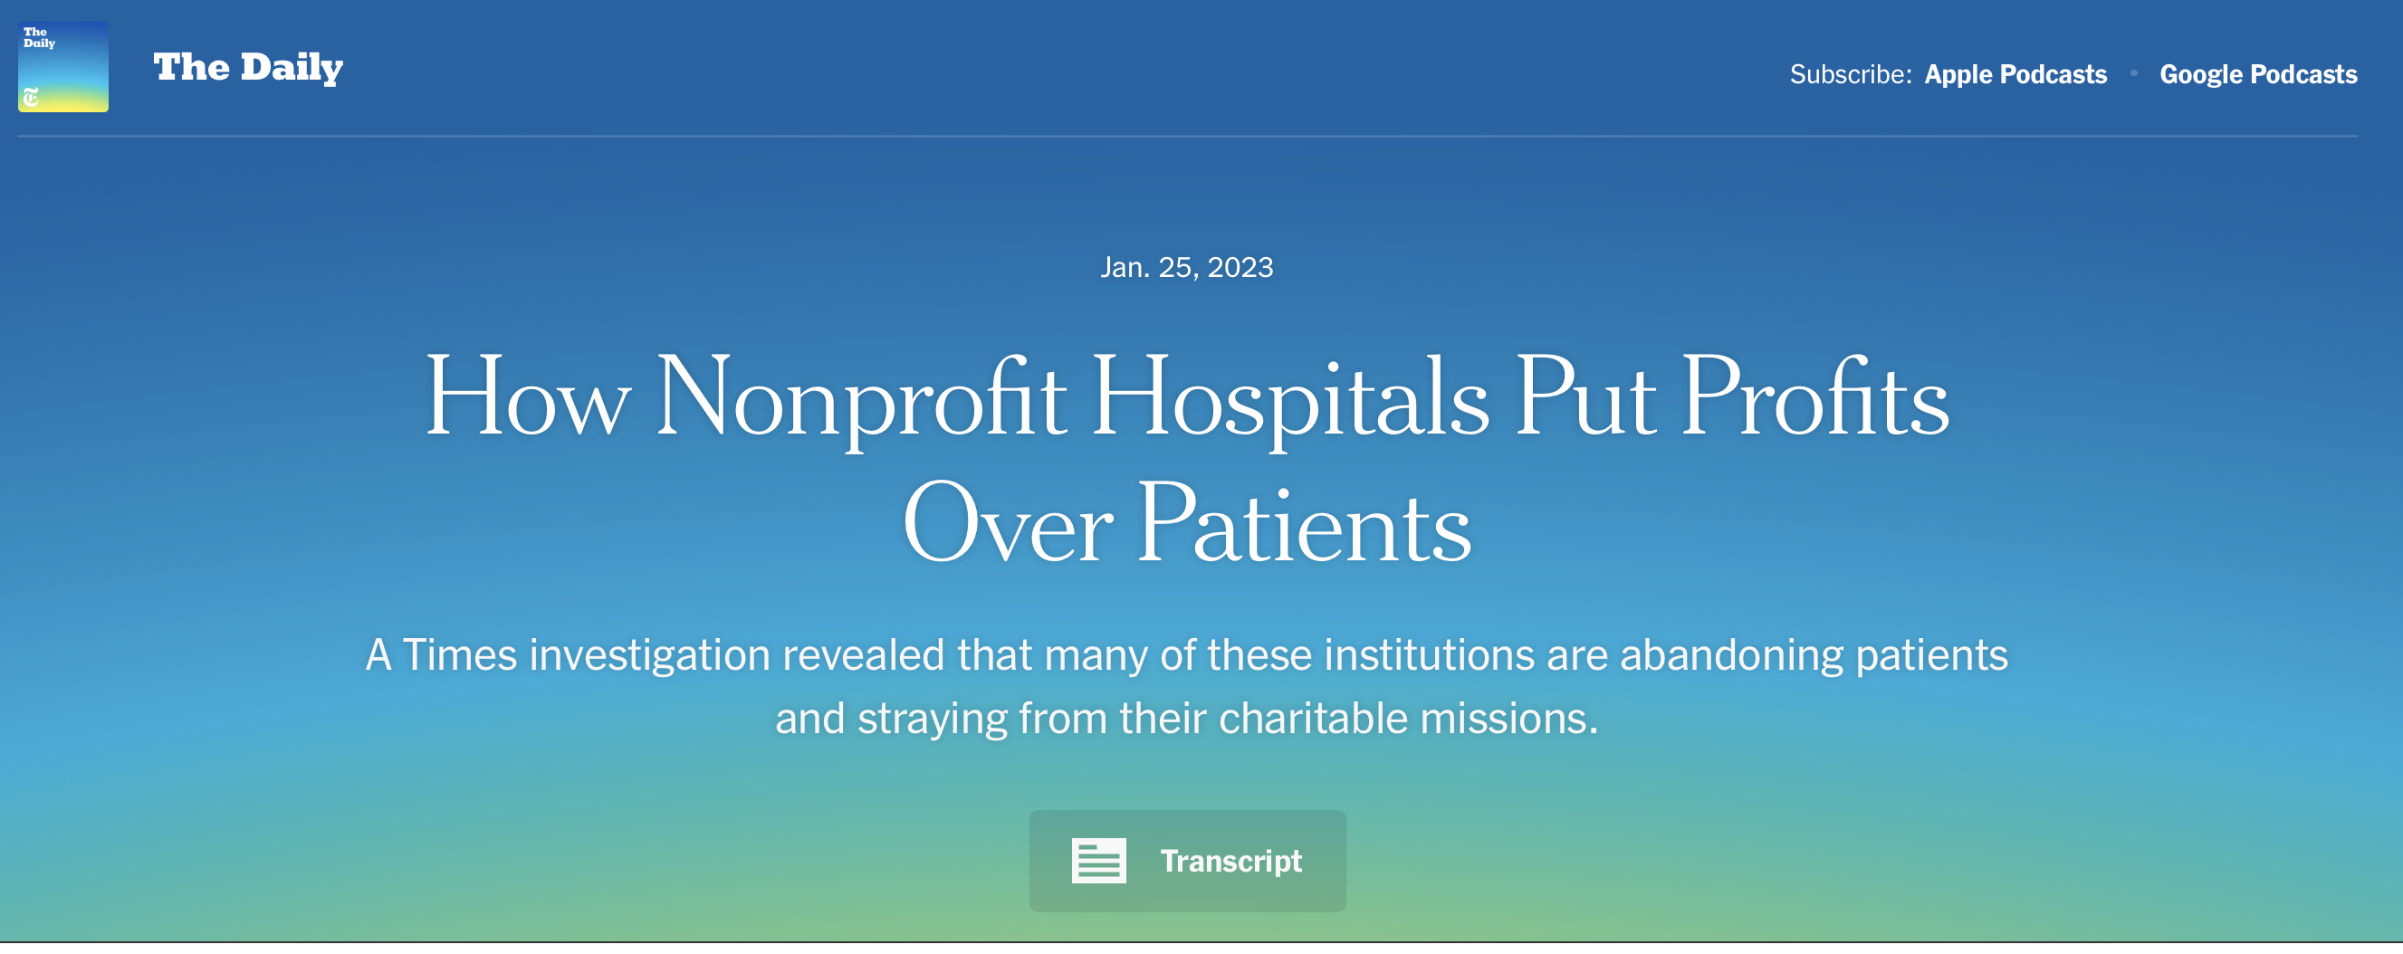
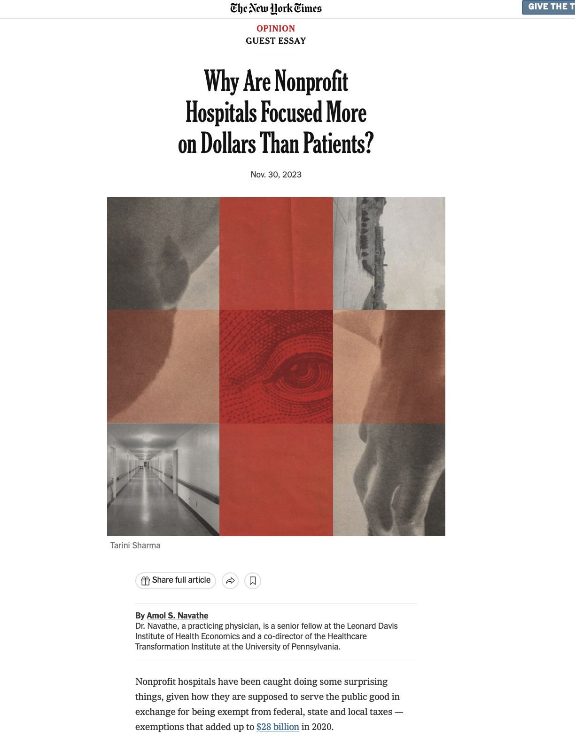
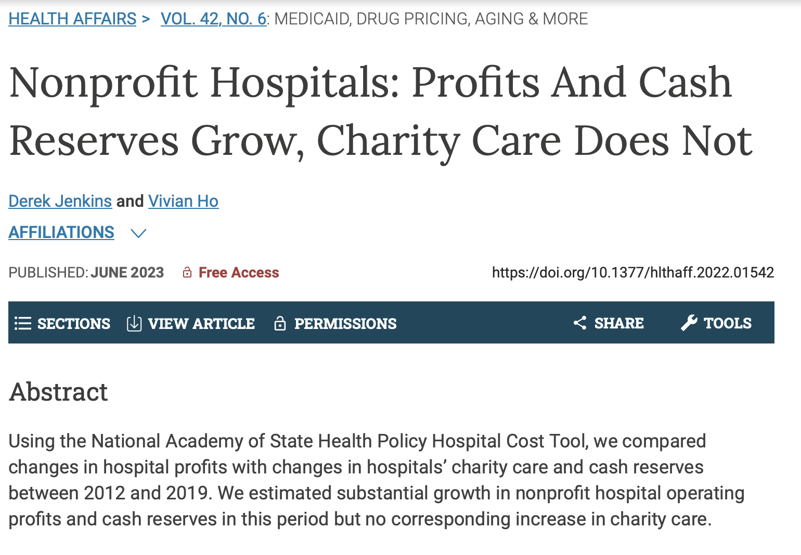
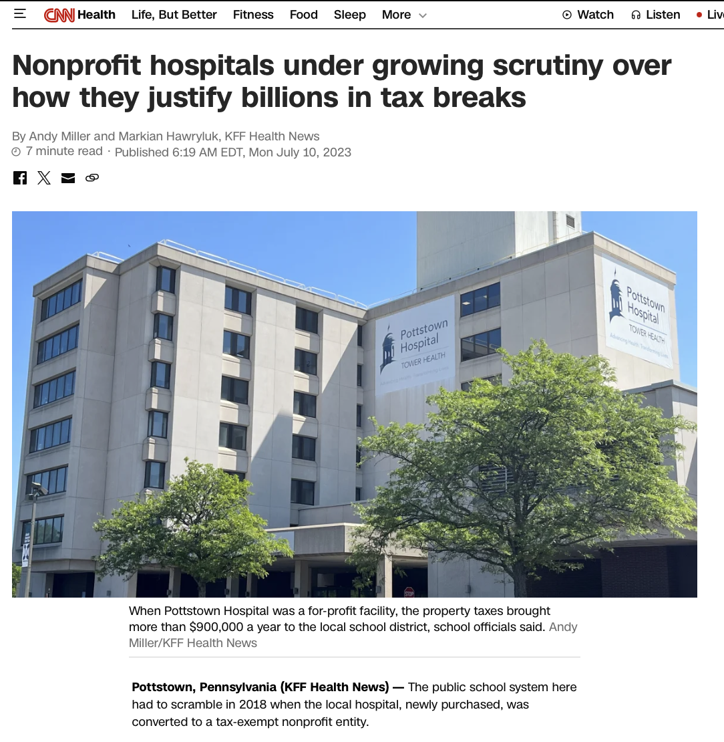
THE BACKSTORY:
Nonprofits Under Siege

Slide 6
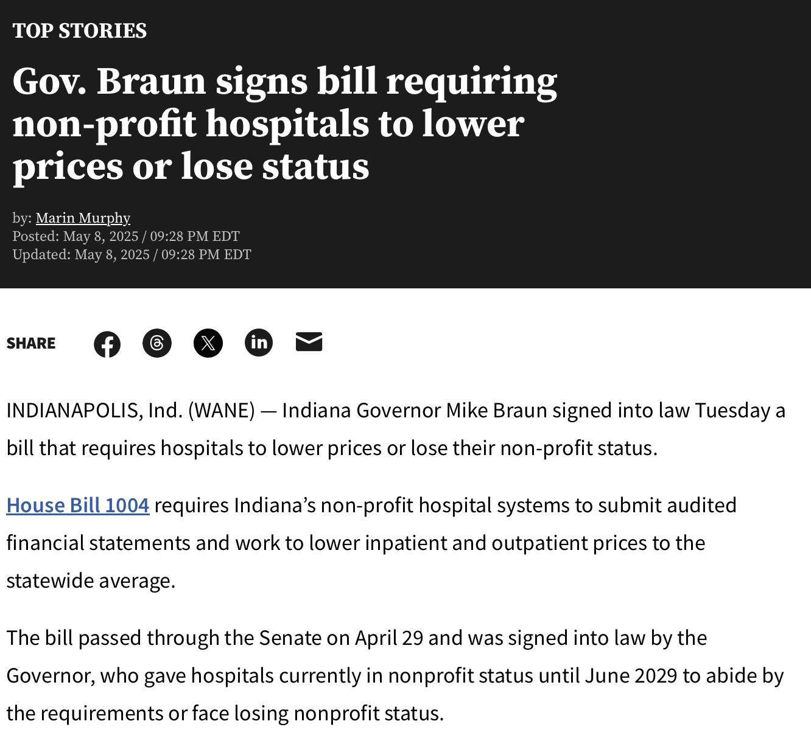
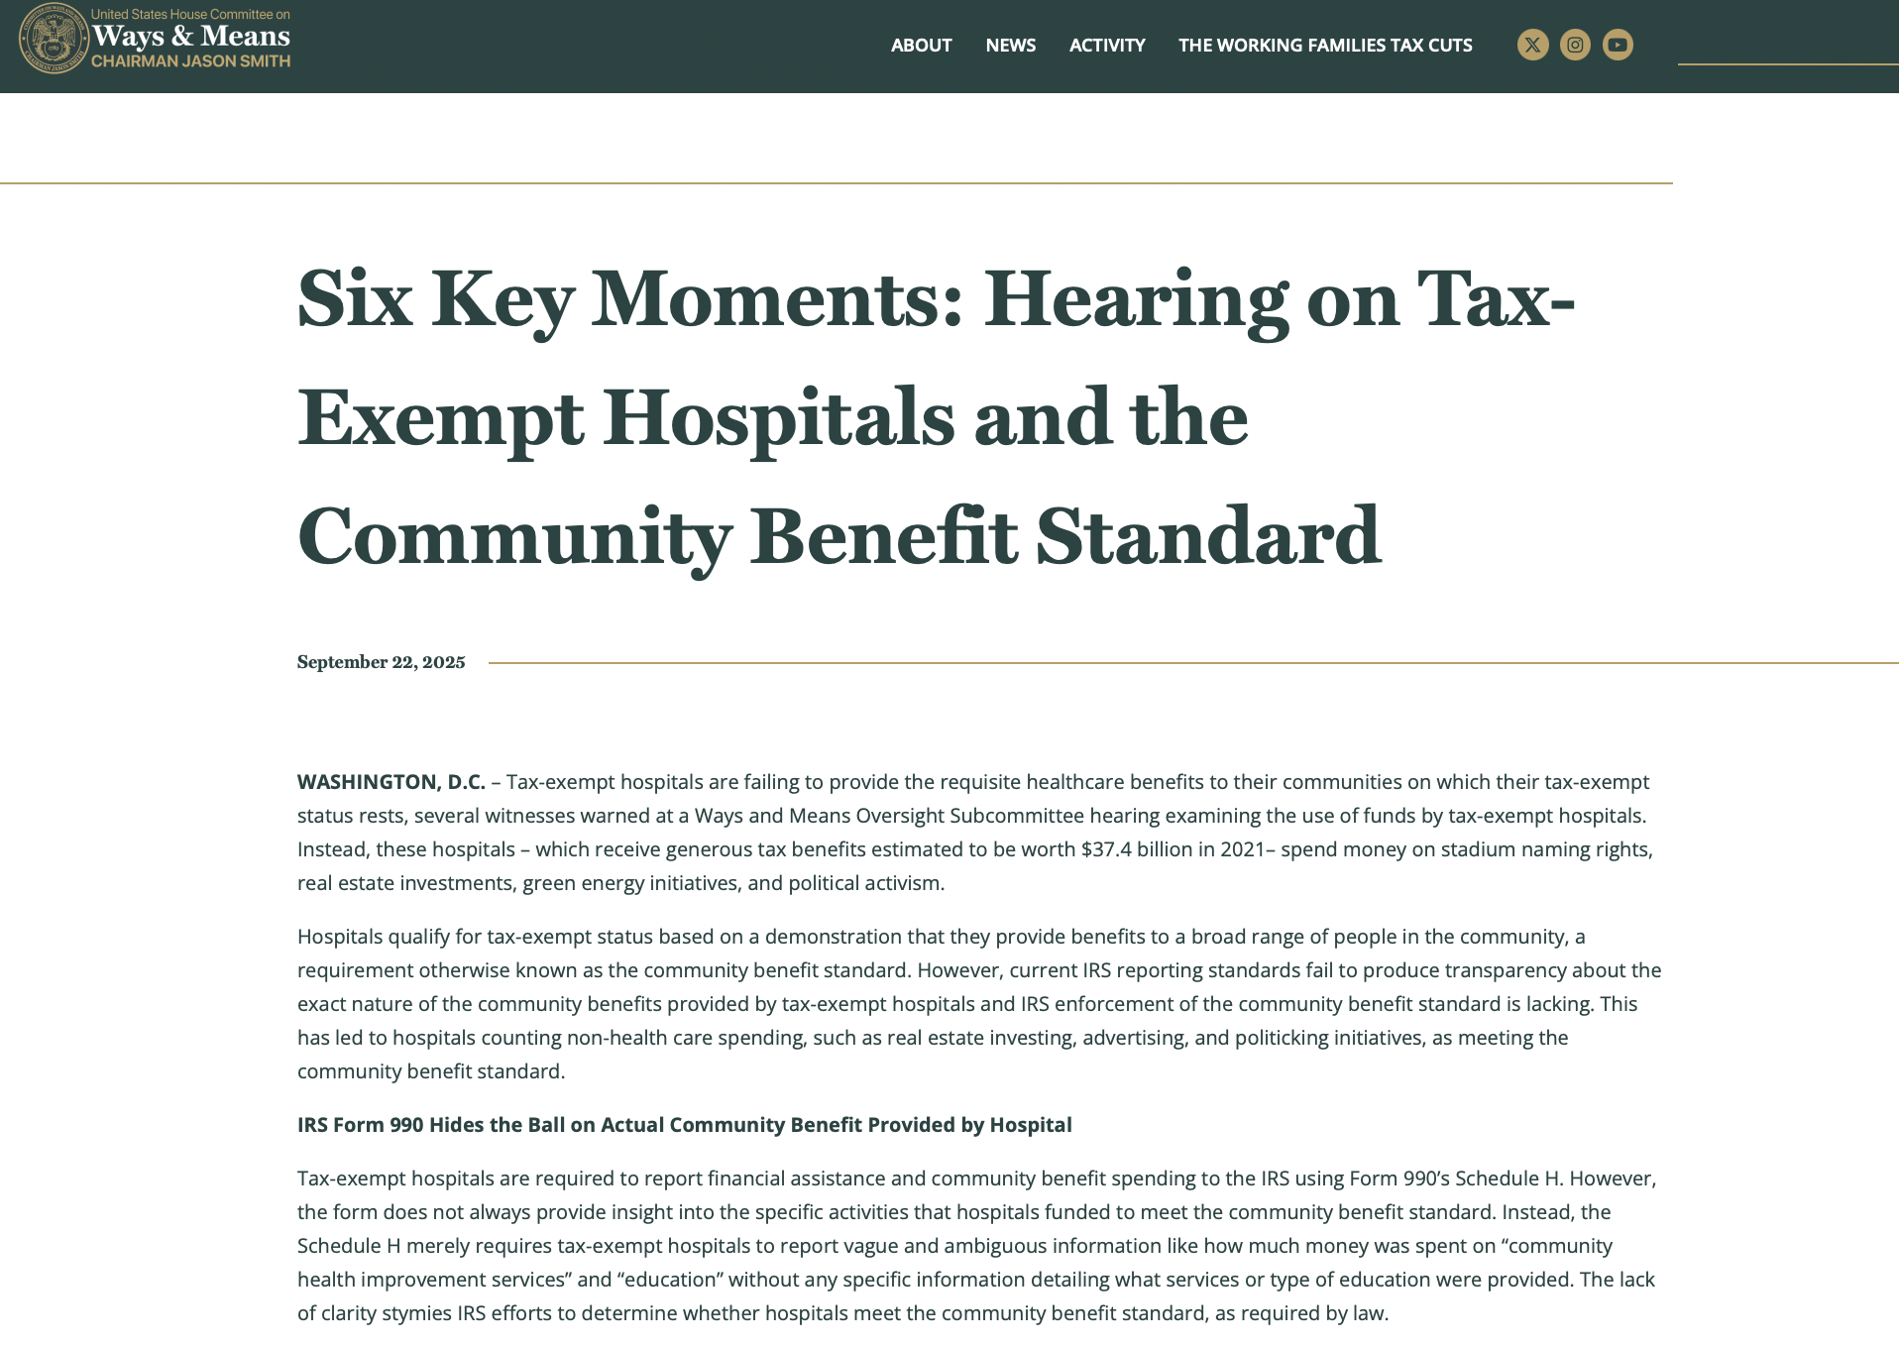
NONPROFIT HOSPITALS AND HEALTH GOVERNANCE
Public Attention

Slide 7

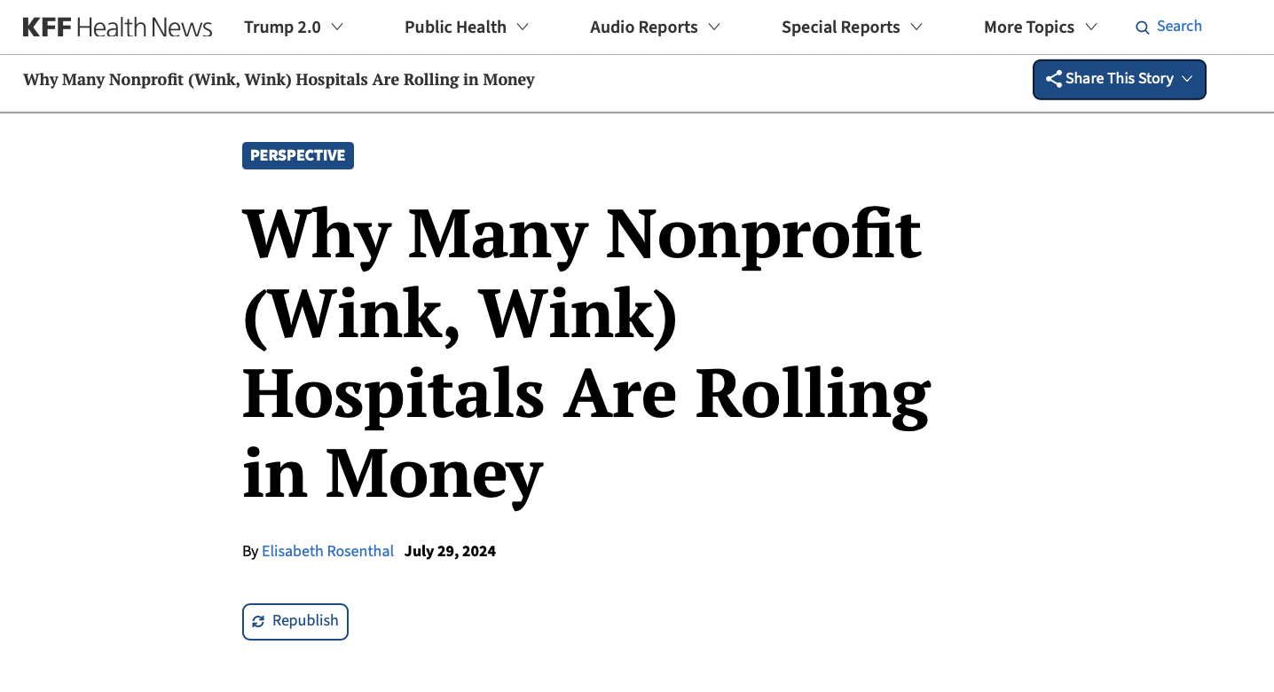
NONPROFIT HOSPITALS AND HEALTH GOVERNANCE
Public Attention

Slide 8
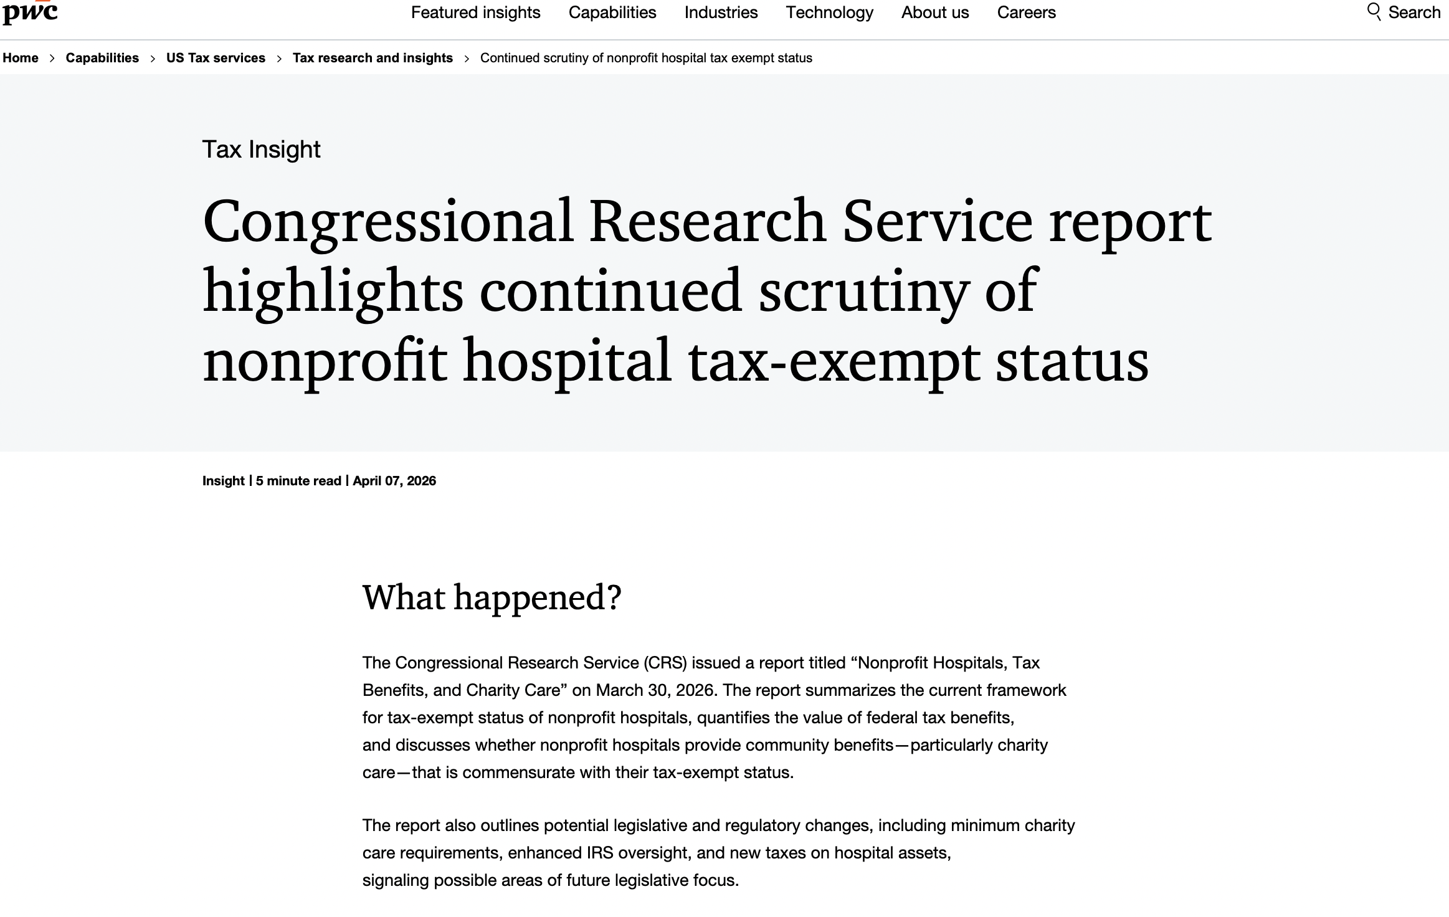
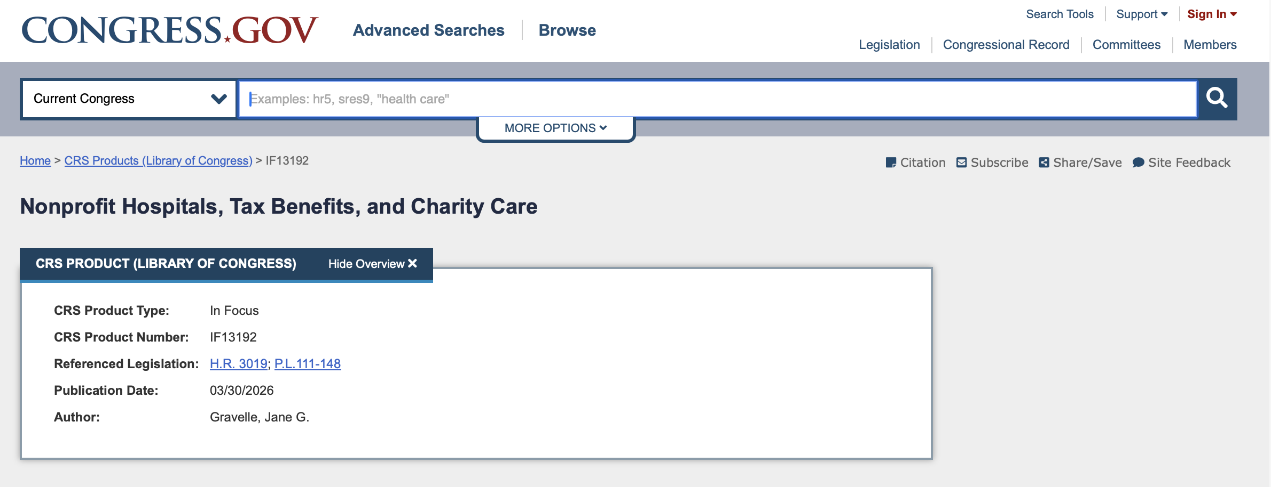
NONPROFIT HOSPITALS AND HEALTH GOVERNANCE
CRS Report
Regulatory changes (minimum charity care requirements)
Enhanced oversight
New taxes

Slide 9
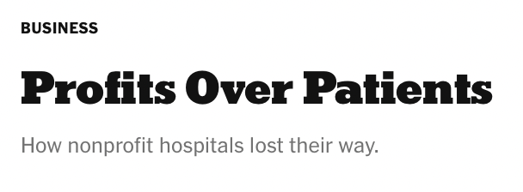

NONPROFIT HOSPITALS AND HEALTH GOVERNANCE
The Focus of Academic Work and Critique
Rising CEO Pay
Linked to profit growth
Insufficient Community Benefit
As compared to for-profits and the tax benefit
Patient Mistreatment
Study: “nearly half were billing patients with low incomes”
Staffing Cuts
Layoffs lead to poor care
Profitability-Focused Service Shifts
Nonprofits moving services to affluent areas

Slide 10
NONPROFIT HOSPITALS AND HEALTH GOVERNANCE
From Charity to Governance
The scope of the problem and the remedy (disintegration vs. bolstering)
The “publicness” of all hospitals
The understated upside: public regulatory oversight and leverage over the nonprofit (focus on governance) in an era of nearly no oversight and/or leverage over for-profits

Slide 11
NONPROFIT HOSPITALS AND HEALTH GOVERNANCE
The “Local” Governance Hole
Access Concerns
Shareholders
(dispersed)
For-Profit Hospitals
Nonprofit Hospitals
State AG
Limited Tools and Resources
Board of Directors (dispersed)
Board of Directors (effective?)

Slide 12
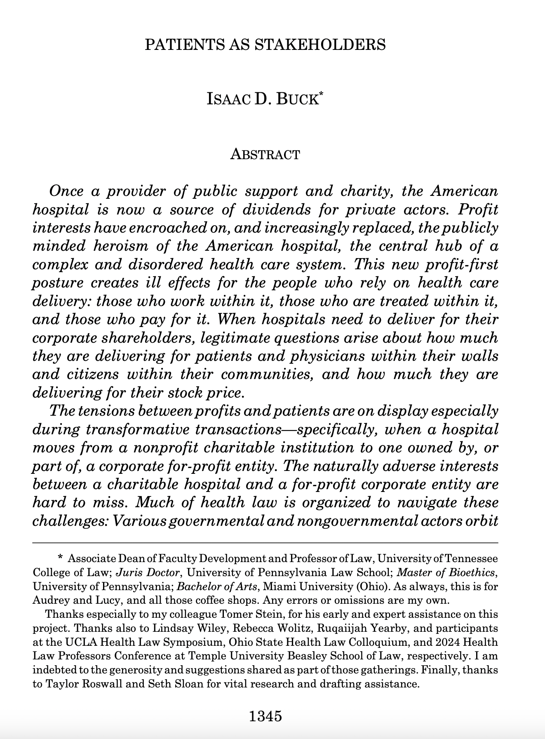
Nonprofit Governance
Does public oversight adequately protect the stakeholders of a nonprofit hospital?
  Address dispersal and strengthen local control
  Increased resources and broaden laws for state AGs (downsides?)
  Bolster internal governance reforms meant to protect workers
  Utilize state or federally-based reimbursement policy to incentivize certain behaviors
  Mimic shareholder-based corporate law tools (stakeholderism or private enforcement for nonprofits)
  Other models? Public Utility Commissions?

Slide 13
Zack Buck
Associate Dean for Faculty Development and Professor of Law
University of Tennessee Winston College of Law
zbuck@tennessee.edu

