Slide 1
Disruption of Care Arising from Equity Acquisition of Providers: Problems and Possible Solutions
Mark A. Hall
Professor of Law and Public Health
Wake Forest University School of Law
Joseph A. Singleton
Assistant Professor of Law
University of St. Thomas School of Law

Slide 2
Patient Care Disruption
Outside investors (e.g. PE firms) take control of a provider entity (e.g. physician group) and
    Fire or replace employed professionals, or
    Financialized Management Drives away medical professionals who dislike the changed environment or working conditions
    27.5% greater physician turnover rate after PE acquisition (Zhu)
Investors’ subsequent decisions to either disinvest or reduce services for financial reasons can remove support for existing treatment relationships
Hospital Bankruptcy impairs local physician contracts

Slide 3

Mission Hospital – Asheville, NC Case Study

Slide 4
Problems & Policy Goals
Problems
Medical Professionals Have Duty to Not Abandon Patients
Duty Rests ONLY w/Medical Professionals – Not Investors, etc.
Financialized Owners Withhold Permission/Support to Continue Care During Vulnerable Stage of Health
Three Policy Goals
Req. to Maintain Tx Relationships for Acceptable Length of Time
Financial Support to Meet Goal I
Mechanism to Enforce Tx and Financial Requirements

Slide 5
Our Proposed Solutions
Continuity-of-Care Requirement
Performance Bonds
Bankruptcy Reform
Guaranty Funds

Slide 6

I. Continuity of Care
Managed Care CoC Mandates (~50% States, 2001)
No Suprises Act (26 U.S.C. § 9818, 2021)
  CoC Requirements on All Health Insurers
  Triggered When Provider’s Network Membership Due to End (PT Noticed)
  Provider's Network Status Maintained for 90 Days for Any Patient
    Hospitalized, pregnant, terminally ill, scheduled for non-elective surgery, OR
    In the midst of treatment for a serious or complex condition
Pros/Cons
  No Issues w/CoC Mandates Since 2001 (e.g. Medicaid Postpartum)
  Only Avoid Immediate Disruption (90 Days), Alternative Provider
  Asheville → ~50% PT Couldn’t Find ANY Alternative Provider (1 Year)
  How To Define Triggering Event?
  Providers Leaving Area Entirely, Financial Burden on Providers?
  What Entity is Responsible?

Slide 7
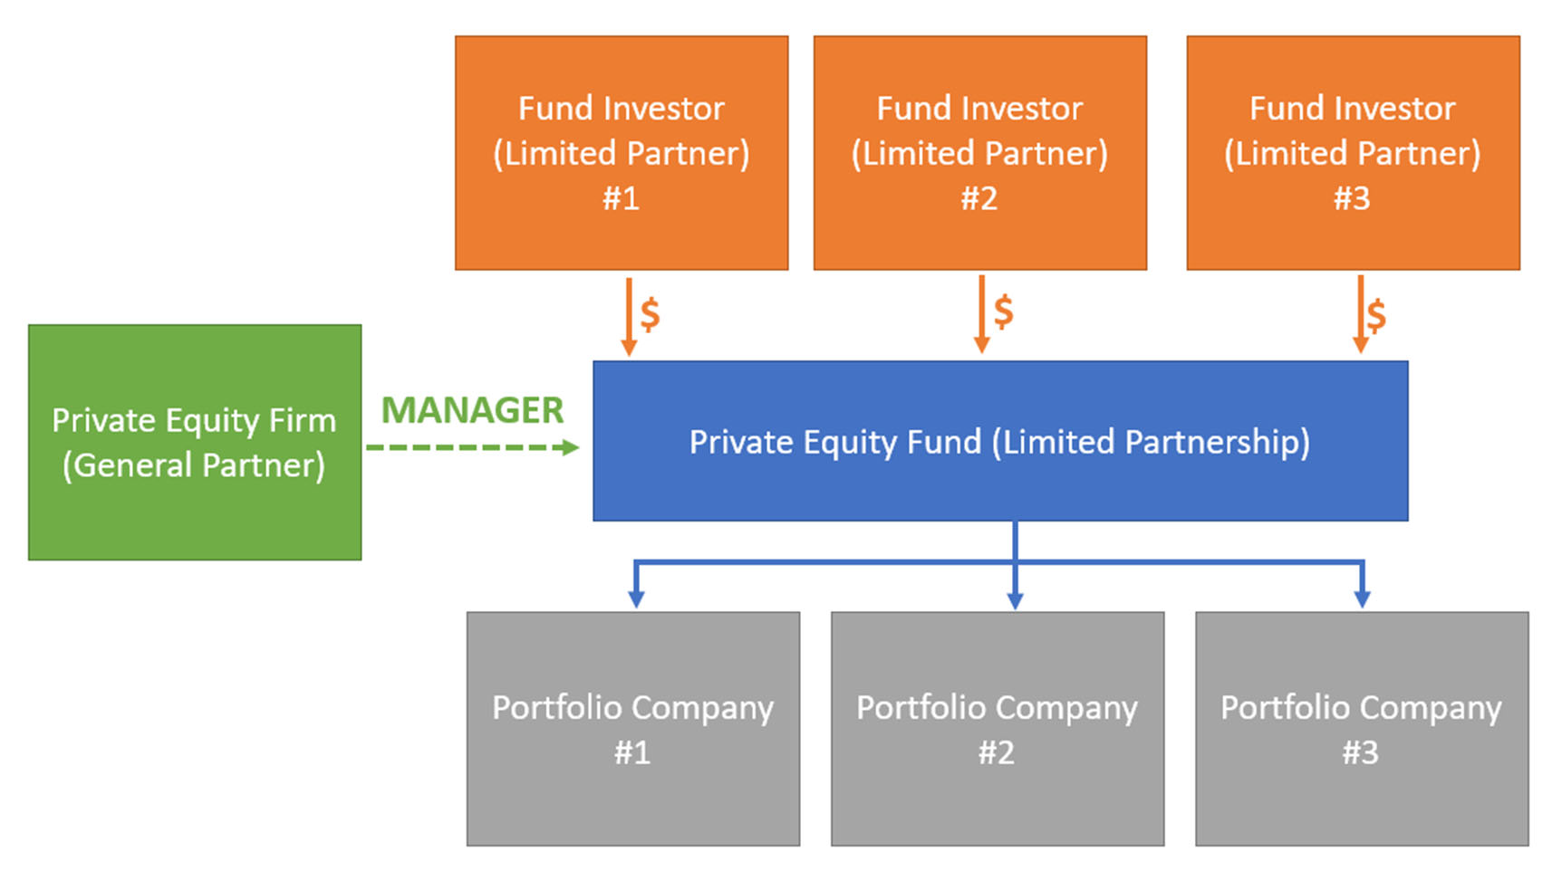
Sample Diagram of Financialized Investment/Management of Health Services

Slide 8
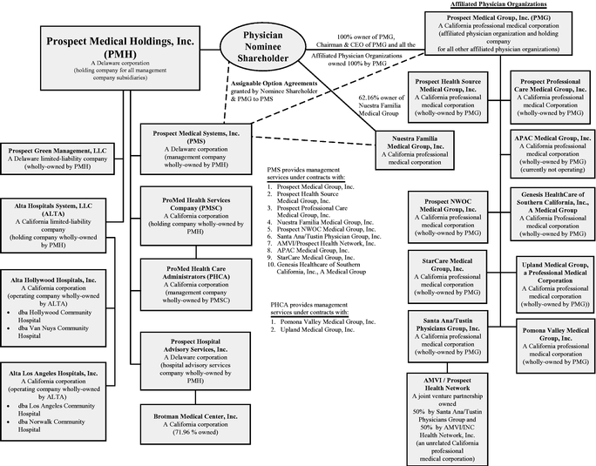
Prospect Medical Holdings
Organizational Structure
*Source: 2010 Form 10-K SEC

Slide 9
II. Performance Bonds
Continuity Bond
  Investor-Managed Providers Post Performance Bond
    Bond Attaches to Entity that Immediately Employs/Arranges for Care
    Funds Available for Clinicians to Support Vulnerable Patients for Prescribed Time
    Trigger Conditions: Provider Closing, Leaving, or Unavailable
Pros/Cons
  Longstanding Tool w/ Licensed Trades and Professional Services
    Approx. 300 types of license and permit bonds (e.g. construction, electricians, private investigators, financial fiduciaries, notaries, etc.) across all Jxs
    Guarantee Completion of Project
  Bond Insurers May Refuse to Bond Risky Investments Up Front
  BUT . . .
    How to Standardize? Variability in Revenue, Services, Patient Acuity/Size?
    Continuity Claims Dispute Process? Claims Denials? Time and Patient Care?
    Penalties? Enforcement Mechanisms? Private v. Public

Slide 10
III. Bankruptcy Reform
Key Aspect of Financialized-Driven Patient-Care Disruptions
  Purpose of Bankruptcy to Preserve Value of Underlying Entity for Creditors
Patient Care Ombudsmen (11 U.S.C.§ 333, 2005)
  Appointed to Monitor Quality of PT Care & Rep. PT’s interests in “Health Care Business” (Acute/Inpatient) Bankruptcy Unless Unnecessary
Amend 11 U.S.C.§ 333
  Empower Ombudsmen to Enforce CoC Requirements
  Require Continuity-Bond Insurers to Adhere to Legitimate Determinations Made by Appointed Patient Care Ombudsmen
Pros/Cons
  Pre-Existing Legislation, Some Demonstrated Efficacy
  Does Not Cover Clinician Turnover, Better Suited for Larger Providers
  Timeliness and Estate Costs of Ombudsmen Appointment

Slide 11
IV. Guaranty Funds
Regulated, Pooled Guaranty Funds
  How Insurance Industry Guarantees Its Own Performance
  State-Mandated and Regulated “Safety Net” if Insurance Insolvent
  States Require Pooled Backstop Fund Based on Insurer Size
    Usually Number of Policies w/in Area (e.g. Life, Annuity, Health, etc.)
Pros/Cons
  Pre-Existing in Insurance & Similar to Licensure Bonds
    E.g., Automobile Dealerships, About Protecting Consumers
  Smaller Providers, Reduce Transactional Costs in Bonding
  No Variation Among Risk/Type of Providers
  Medical Boards Regulate Physicians? Adjudication/Oversight?
  Medical Board Better Suited Than Surety Bond Companies or Bankruptcy Courts to Evaluate Medical Issues w/Patient Care Disruption

Slide 12


Untested Proposals with Lots of Complexities, But…

