Slide 1
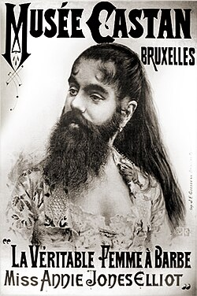
The Bearded Lady
A Case Study in the Concept of Freedom

Slide 2

“Two Concepts of Liberty”
Negative:
  Self-satisfy preferences without impediment
  No inquiry into objective validity of the preferences themselves
  Rationality: cost-benefit analysis (freedom need not extend to options that are not cost-benefit justified from the subjective agent’s perspective)
Positive:
  Empowerment to live rationally
  Mere preference-satisfaction is inadequate because preferences are socially constructed
  Rationality: what you would want if “you” were abstracted from your social circumstances (“noumenal self” in Kantian terms)

Slide 3
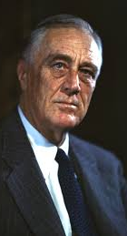

American Law
Historically, “negative liberty” is right-wing while “positive liberty” is left wing
  “Charter of negative rights” (Posner in DeShaney v. Winnebago County, 7th Cir.)
  vs. “Second Bill of Rights” from FDR
Today, we’re seeing an inversion
  Right-wing appeals to Christian virtue as a form of Kantian-style “rationalism”
  Left-wing appeals to the individual agent as the only legitimate arbiter of preferences’ validity (gay rights, trans rights)

Slide 4
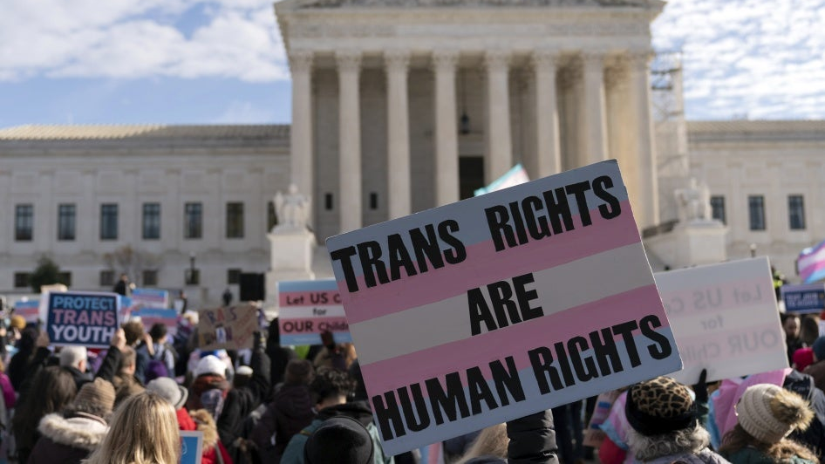
Trans Rights
Right-wing claim is that children need to protected from socially-ingrained, irrational preferences
Left-wing claim is that we should defer to and protect the child’s subjective preferences regardless of whether they are “rational” or not

Slide 5

The Bearded Lady
Gender is not binary!
But society is structured as though it were
There is no space, within society, for the bearded lady
The bearded lady thus lives on the margins, as a “circus freak”
No wonder, then, that a trans woman chooses to be a woman – to conform to the gender binary – rather than living with their own spectral blend of gendered characteristics

Slide 6

Gender-Affirming Care
So is the preference for gender-affirming care “rational”?
Would the noumenal self want hormones and surgical alteration?
There is no way of knowing!
We’re trapped in our social context. In fact, there is no such thing as a noumenal self.

Slide 7

Uncertainty vs. Pluralism
The problem is not, as Berlin argued, that values are plural and incommensurable
The problem is that, when the standard of rationality requires abstraction from society, there is no way to determine what is rational
Ineradicable uncertainty, then, is the justification for “negative liberty.”

