Slide 1

Autonomy & Vaccination:
UNDER ADDRESSED IMPLICATIONS FOR LAW, POLICY, AND PREVENTION
NANCY M. P. KING
CHRISTINE NERO COUGHLIN

Slide 2
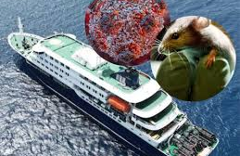
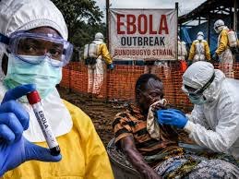
Hantavirus & Ebola:
A Wake-Up Call?
Craig Spencer, The hantavirus is a wake-up call. Will the Trump administration answer it? Stat News (May 13, 2026) (First Opinion); Josh Michaud & Jennifer Kates, Is The U.S. Stepping Up In the Fight Against Ebola, Kaiser Fam. Found. (May 21, 2026), https://www.kff.org/global-health-policy/is-the-u-s-stepping-up-in-the-fight-against-ebola/?utm_campaign=KFF-Global-Health-Policy&utm_medium=email&_hsenc=p2ANqtz-_RRsZ87joKar0l1FdIHaK0teDxUgVNBbuCLE0au5DH0PQAPFqjYLb9P3rs5npOJdIbLsAtmwMQ32quWKsYHiTzIAEiPA&_hsmi=420020072&utm_content=420020072&utm_source=hs_email

Slide 3
U.S. Evidence-Based Vaccine Infrastructure is being Dismantled
Institutional Changes
Replacing vaccine officials
ACIP restructuring
Leadership instability
Policy Changes
Childhood schedule revisions
Vaccine injury program restructuring
Vaccine approval policy changes
Funding Changes
Reduced NIH funding
mRNA funding cuts
Support for disproven vaccine-autism research
Global/Public Health Changes
USAID reductions
Weakened outbreak identification and coordination

Slide 4
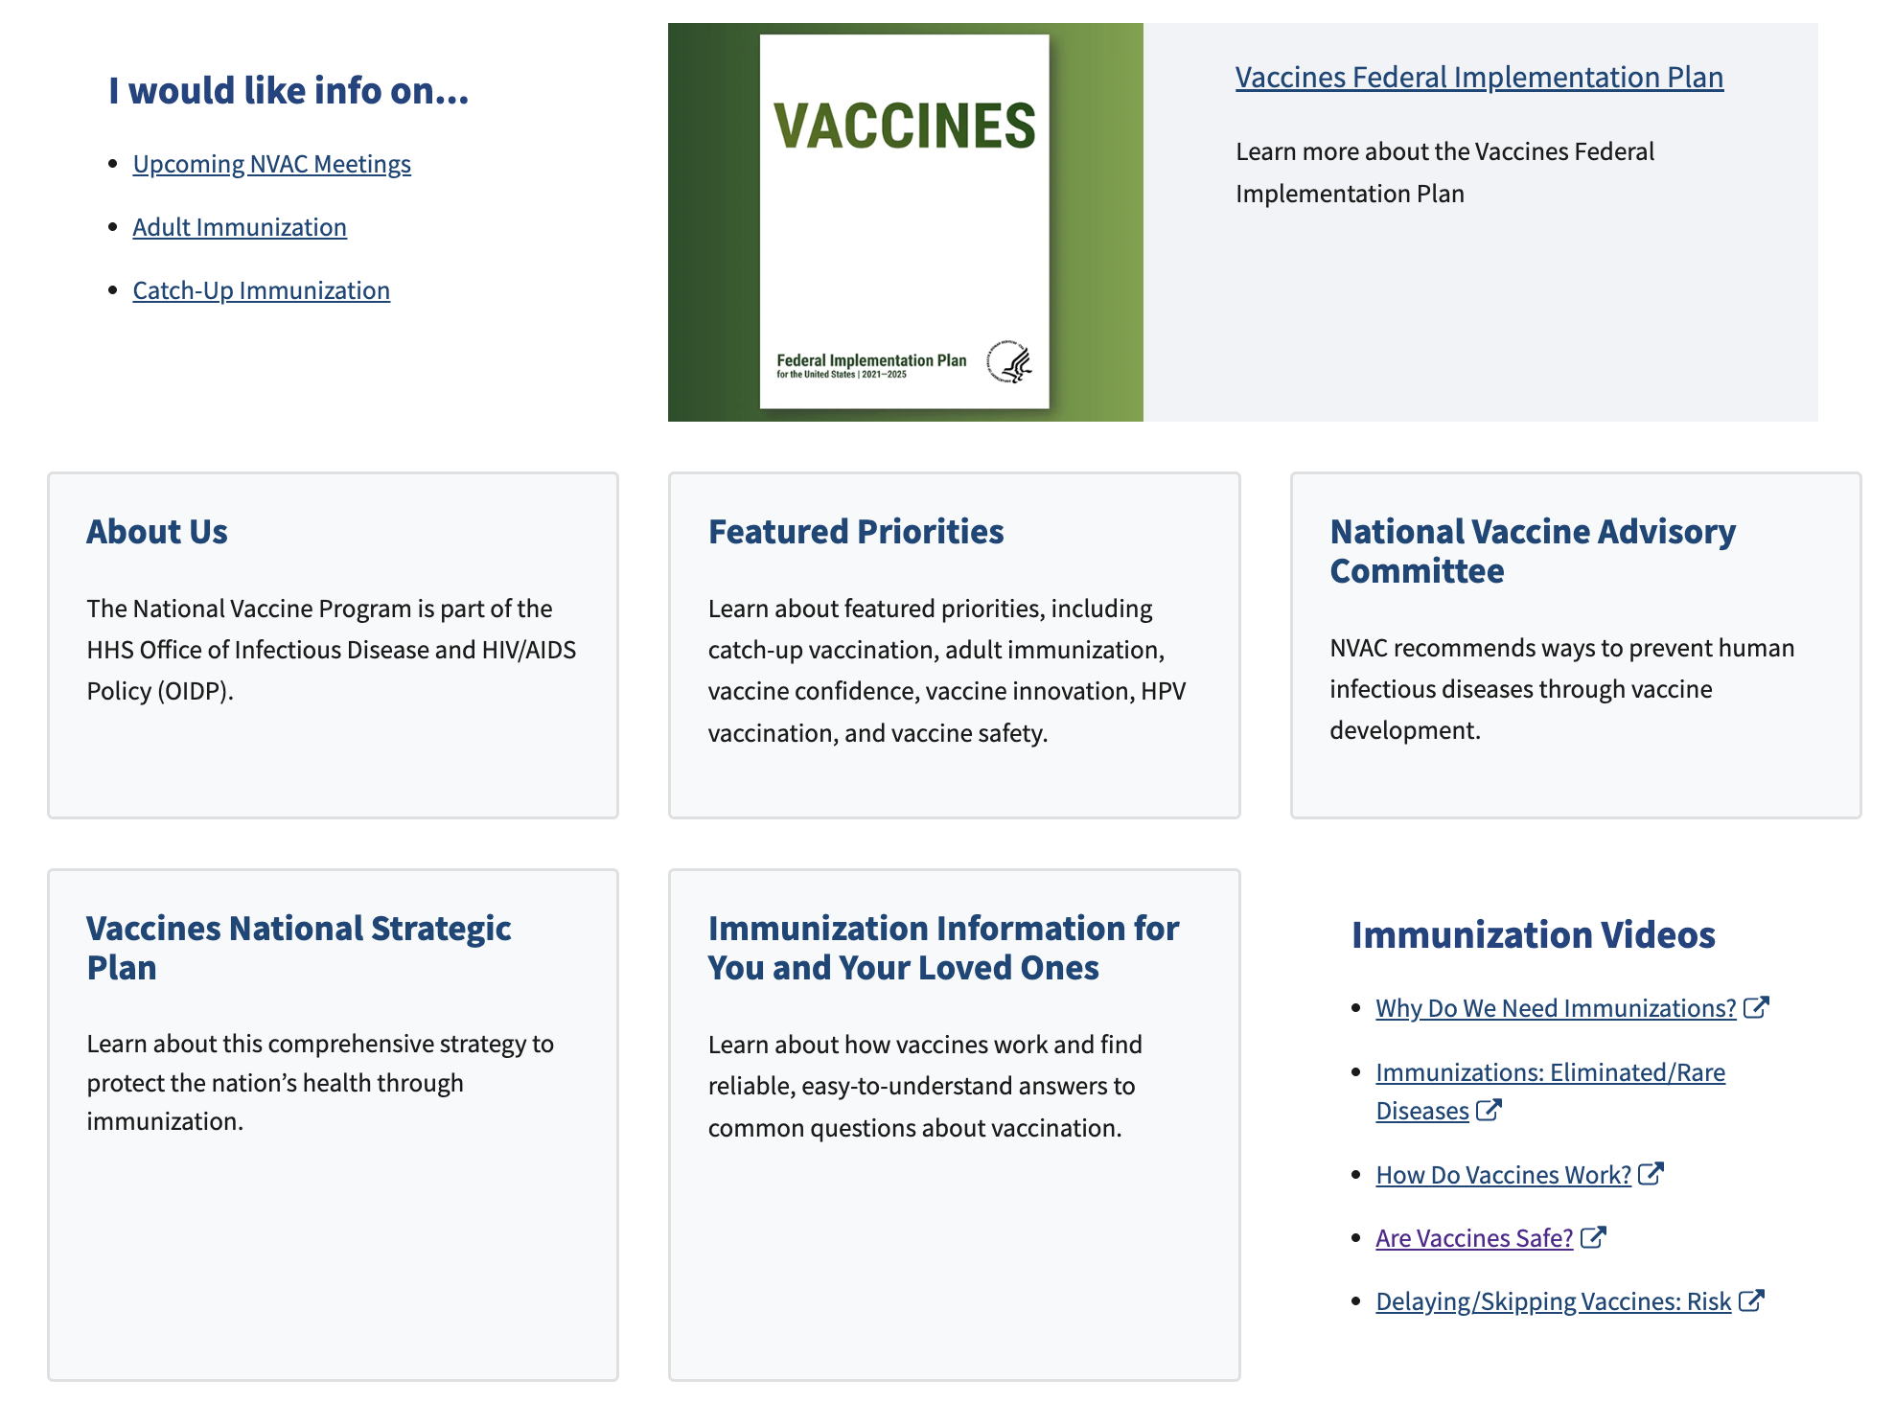
Current U.S. HHS Vaccines and Immunization Page
Link no longer works
U.S. Dep’t. of Health & Human Srvs., Vaccines and Immunizations, https://www.hhs.gov/vaccines/index.html

Slide 5

Essentially Labeling Vaccines as Low-Value or No-Value Care.
Most vaccines are not 100% effective at preventing illness.
But most vaccines substantially reduce illness severity, hospitalization, fatality.
And while many vaccines have side effects, these are less serious than the disease
Uche Blackstock, The Dangers of RFK Jr’s. Unscientific Vaccine Schedule, Time (Jan. 8, 2026),;
Cecelia Smith-Schoenwalder, How RFK Jr. Is Influencing America's Vaccine Playbook, U.S. News & World Report (May 6, 2026), https://www.usnews.com/news/health-news/articles/calling-the-shots-tracking-robert-f-kennedy-jr-s-moves-on-vaccines

Slide 6
What is the Low Value/No Value Care Movement?
Little to no benefit
Potential to cause harm
Waste limited resources
Unnecessary costs
Estimated 75-100 Billion Spent Annually
David D. Kim et al., An Evidence Review of Low-Value Care Recommendations: Inconsistency and Lack of Economic Evidence Considered, 36 J. Gen. Intern. Med. 3448 (2021);
Joshua R. Zadro & Christopher G. Maher, Overview of the Drivers of Low Value Care, Int. 11 J. Health Pol’y Manag. 1595 (2022)

Slide 7

Case Study: Antibiotics for a Viral Infection
Most low- and no-value care determinations are individually focused.
Estimated that 30% of 47 million antibiotic prescriptions written per year are unnecessary.
Prescribing antibiotics for a viral infection combines ineffectiveness with danger to others.
For example, 2.8 million antibiotic-resistant infections occur in the U.S. per year – 35,000 deaths annually
Alpesh N. Amin, It’s about the patients: Practical antibiotic stewardship in outpatient settings in the United States, 9 Front Med. 901980 (2022).
This Photo by Unknown Author is licensed under CC BY

Slide 8
Vaccines are a High Value Intervention
Vaccines are not low-value or no-value care AND forgoing them is dangerous to patients and others.
  154 million deaths prevented (including 146 million among children younger than 5 years of whom 101 million were infants younger than 1 year.
  10.2 billion years of full health (For every death averted, 66 years of full health were gained)
It is more cost effective to pay for prevention than risking illness and paying for treatment.
  Considering childhood vaccines for preventable illnesses, between 1994–2023, routine childhood vaccinations prevented approximately 508 million cases of illness, 32 million hospitalizations, and 1,129,000 deaths, resulting in direct savings of $540 billion and societal savings of $2.7 trillion.
Andrew J. Shaddock et al., Contribution of vaccination to improved survival and health: modelling 50 years of the Expanded Programme on Immunization, The Lancet (May 25, 2024), Fangjun Zhou, et al., Health and Economic Benefits of Routine Childhood Immunizations in the Era of the Vaccines for Children Program — United States, 1994–2023. MMWR Morb Mortal Wkly Rep 2024;73:682–685.

Slide 9

Autonomy, relational autonomy, and solidarity

Slide 10
Two Principles for Effective Vaccine Policy
Individual autonomy
  in health care decision making
Collective responsibility
  to maintain population health immunity against infection disease

Slide 11
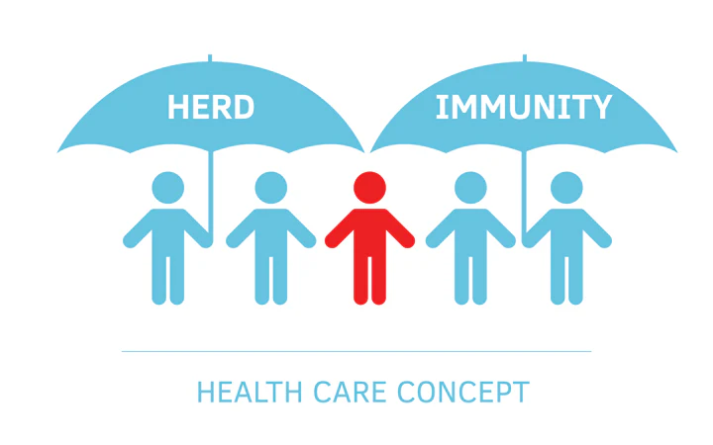
Herd Immunity is a
Collective Public Good
Two defining characteristics of a collective public good:
  1) It is non-excludable:
    It is not possible to exclude someone from benefitting from herd immunity, even if they do not contribute through vaccination.
    Everyone benefits in a society with herd immunity fewer resources need to be directed to care for the sick.
    Herd immunity reduces the risk of infection for those:
      Too young to be safely vaccinated,
      Who cannot be vaccinated for medical reasons;
      For whom vaccination is ineffective
2) It is non-rivalrous: Anyone benefitting from it does not reduce the extent to which others can benefit as well.
Alberto Giubilini et al., The moral obligation to be vaccinated: utilitarianism, contractualism, and collective easy rescue, 21 Med. Health Care Philos. 547 (2018); Hassan Vally, What is herd immunity and how many people need to be vaccinated to protect a community? Conversation (Aug. 1, 2019),

Slide 12
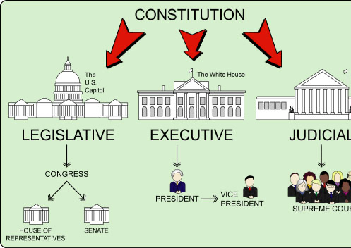
Congressional appropriations, oversight and statutory mandates
HHS Secretary does have significant discretion; but HHS offices, duties, and functions are mandated by law and funded through Congressional appropriations.

Slide 13
FDA/CBER
ACA/Vaccines for Children
CDC/ACIP
Public Health Services Act
HRSA/ National Vaccine Comp Program
BARDA
NIH
Jennifer Kates & Josh Michaud, How HHS, FDA, and CDC Can Influence U.S. Vaccine Policy, Kaiser Family Found. (Nov. 20, 2024),
https://www.kff.org/covid-19/how-hhs-fda-and-cdc-can-influence-u-s-vaccine-policy/

Slide 14

https://chatgpt.com/s/m_6a1074be51fc8191bb2864cdbdd946de

