Slide 1
Recent Developments in the Regulation of Organ Procurement Organizations and Implications for Access to Transplantation
May 2026
Notes:
Briefly recap where we have been

Slide 2
Disclosures
The author is employed by Econometrica, and Econometrica is under contract to AOPO to work with the OPOs to develop the measures discussed in this presentation.

Slide 3
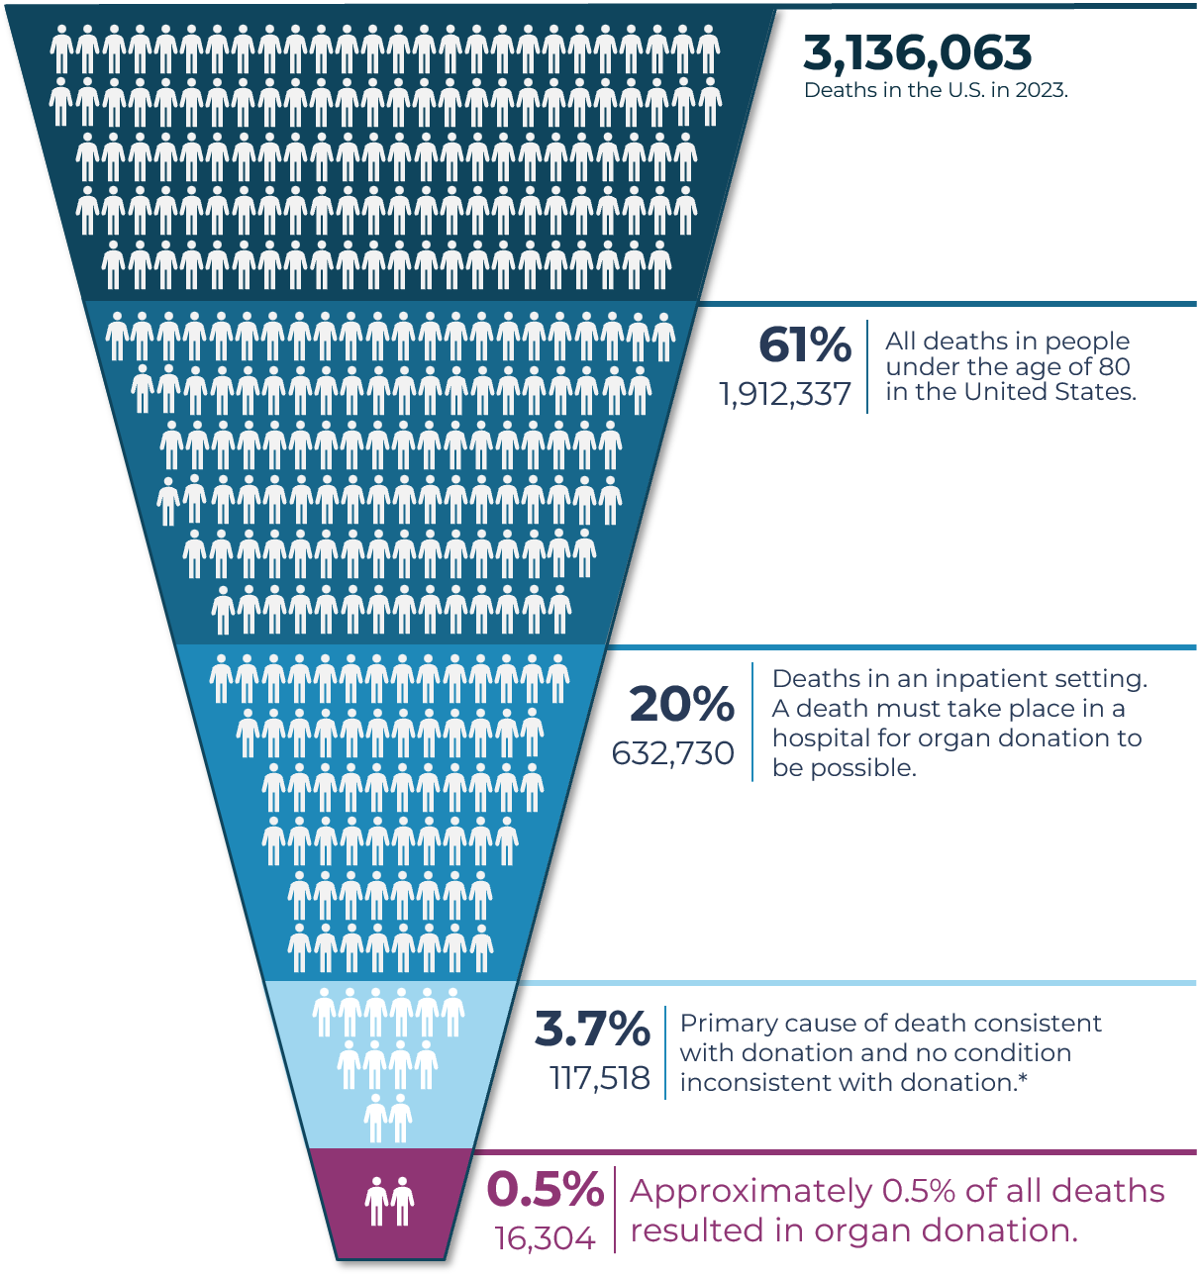
Understanding Organ Donation in the U.S.
The Problem
These .5% or 16,304 people donate about 3 organs each, meaning there are about 45,000 organs available in a year. This number was climbing until 2025, and now is declining.
At the same time, there are 103,000 people on the organ transplant waiting list. This number continues to climb each year.
Unfortunately, there is no effective national vision, strategy, or policy to close this gap.
*According to death certificate data. Death certificates do not contain all information necessary to determine donor potential.
All data is for 2023. Each icon represents approximately 10,000 people. Sources: Multiple Causes of Death file from the National Vital Statistics System at the U.S. Centers for Disease Prevention and Control. Scientific Registry of Transplant Recipients.
Notes:
These 16,000 people donate about 3 organs each, meaning there are about 45,000 organs available in a year. This number was climbing until 2025, and now is declining.
There are 103,000 people on the organ transplant waiting list. This number continues to climb each year.

Slide 4
Key Federal Laws and Entities
National Organ Transplant Act (NOTA) of 1984 (P.L. 98-507) was passed by Congress to address the critical shortage of organs, outlaw the sale of human organs, and establish a national, equitable system for organ procurement and transplantation.
  NOTA created the Organ Procurement and Transplantation Network (OPTN) and a scientific registry (SRTR) to manage data, both operated by HRSA.
  It also established Organ Procurement Organizations (OPOs) covering designated service areas to ensure that donated organs could be recovered and provided to matching recipients.
OPOs are heavily regulated by the Centers for Medicare & Medicaid Services (CMS) under 42 CFR Part 486 and must meet Conditions for Coverage for participation in Medicare and Medicaid.

Slide 5
OPO Conditions for Coverage Rules
§ 486.303 - Requirements for Certification: Establishes the criteria OPOs must meet to be Medicare and Medicaid certified.
§ 486.308 & 309 - Service Areas (DSAs): Defines the assignment of a single designated OPO per Donation Service Area (DSA) to ensure geographic monopolies.
§ 486.320 - OPTN Membership: OPOs are required to be members of and abide by the rules of the Organ Procurement and Transplantation Network (OPTN).
§ 486.322 - Relationships with Hospitals: Mandates that OPOs and hospitals have written agreements outlining duties regarding timely referral, screening, and recovery.
§ 486.342 - Requesting Consent: Requires OPOs to have written protocols for obtaining informed consent for organ/tissue donation from families.
§ 486.348 - Quality Assessment and Performance Improvement (QAPI): Requires OPOs to have an active QAPI program that CMS assesses to continuously improve organ yields.
§ 486.318 - Outcome Measures: The cornerstone of CMS oversight. It evaluates OPOs based strictly on two metrics: a donation rate and a transplantation rate. OPOs are tiered (e.g., top 25% are Tier 1 and automatically recertified; bottom tiers face competition or decertification).

Slide 6
Outcome Measure Regulation Controversy
With the goal of increasing competition among OPOs and therefore the supply of organs CMS issued updates to § 486.318
  The 2020-2021 Overhaul: In response to Executive Order 13879, CMS finalized sweeping revisions to § 486.318 on December 2, 2020 (effective February 1, 2021). This overhaul replaced older, self-reported metrics with two transparent, objective, and statistically validated outcome measures for OPO service areas:
    Donation Rate: The number of actual donors as a percentage of donor potential.
    Transplantation Rate: The number of organs transplanted per OPO.
  2026 Updates: CMS issued an NPRM to implement the 2020 rule that also includes:
    How the decertification process will work.
    Evaluating OPO performance based on medically complex organs and donors
    Requiring continuous Quality Assurance and Performance Improvement (QAPI) assessments.
    Updated surveyor instructions to enhance transparency and enforcement of these outcome standards.
Notes:
In the 2020-2021 overhaul, the process measures required by NOTA are not provided.
Also,

Slide 7
Decertification Problem
As mentioned, the 2020 rule uses two outcome metrics to measure OPO performance: donation rate and transplant rate.
  OPOs in the top 25th percentile are recertified, those above the median but below the top 25th percentile must compete to retain their service areas, and those below the median on one or both measures are automatically decertified.
  While OPOs play a critical role in facilitating donation, they do not control whether recovered organs are ultimately accepted and transplanted, as those decisions are made by transplant centers.
Under the 2020 rule, nearly half of all U.S. OPOs, which serve up to 72% of the U.S. population, will face automatic decertification or forced competition for their service areas in late 2026.
Unclear how this will increase the supply of organs as it appears it is likely to at least temporarily decrease the supply.
Notes:
The level of nationwide disruption this would cause is unprecedented in health care regulation, highlighting the urgent need for accurate, actionable performance measures to protect the more than 100,000 patients currently awaiting lifesaving transplants.

Slide 8
Ongoing Lawsuits
At least 4, if not more, OPOs have filed suit in federal court alleging the implementation of the 2020 rule violates the Administrative Procedure Act:
  Gift of Life Michigan (MI)
  New England Donor Services (MA)
  We Are Sharing Hope (SC)
  Lifelink Foundation (GA, FL, PR)
Primary claim in these suits is that the agency abused its discretion in the rulemaking process by failing to “adopt empirically based performance standards to assess OPOs for recertification based on their service areas as required by statute and instead adopted a competition-based recertification process, not sanctioned by law nor envisioned by Congress.”
  Essentially a no delegation + Loper Bright argument
Likely to be additional lawsuits related to the 2026 Implementation Rule, scheduled to be issued in December, and there are many potential issues of conflict between federal and state law as well in that rule.

Slide 9
OPO Measurement Initiative
The Association of Organ Procurement Organizations (AOPO), in partnership with 53 OPOs, launched a national effort to develop better performance metrics.
  These new measures are grounded in science, independently evaluated , built using CMS’ own measurement framework
  They focus on what OPOs actually do, like responding to referrals, supporting families, and managing the organ donation process.
The work is being conducted with Econometrica, Inc., an independent third-party research organization, to ensure the metrics are objective, scientifically sound, and trusted by policymakers.
There are eight process and outcome measures proposed for endorsement through the Partnerships for Quality Measurement (PQM) this year.
The goal is for CMS to ultimately adopt the measures into rule, and they can be used by OPOs for quality improvement purposes.
The Importance of Strong Metrics
Nationally, we cannot improve the organ donation system unless we measure it accurately.
Oversight should reflect what each part of the system actually does, not just the final outcome.
When metrics are off, they do not just affect organizations; they can affect patients waiting for lifesaving transplants.
Good measurement leads to better decisions, stronger accountability, and more lives saved.
OPOs are seeking opportunities to work with donor hospitals and transplant centers for shared accountability around system performance.
Notes:
PQM is the Measurement Entity designated under the Medicare Improvements for Patients and Providers Act of 2008.

Slide 10
CMS 2020/2026 Implementation Timeline
  CMS will highlight national priorities in organ donation and transplantation reinforcing expectations for access, collaboration, and accountability. Additionally, the public comment period will close on the proposed Conditions for Coverage revisions. See via the Federal Register.
  CMS will publish the 2026 OPO performance reports, based on 2024 data, on CMS QCOR, affirming CMS’s commitment to transparency and public accountability.
  CMS will complete onsite recertification survey reviews for applicable OPOs to ensure compliance with federal standards.
  CMS anticipates issuing the OPO Conditions for Coverage Final Rule (CMS-3409-P). Following the final rule going into effect 60 days after publication – CMS will initiate recertification or decertification actions for Tier 2 and Tier 3 OPOs, consistent with regulatory timelines.
  CMS current OPO agreements expire; if there is insufficient time prior to the expiration of an OPO agreement to allow for competition of an open service area and, if necessary, transition of the service area to a successor OPO, CMS will issue extensions as necessary to ensure continuity of the nation’s organ donation and transplantation system.
CMS Rule
Timeline
March 2026
Spring 2026
Summer 2026
Late 2026 (Projected)
January 2027
Measure Initiative
Timeline
  Metrics Project will complete Round 1 measure testing and ITS submission and meet with hospital and transplant partners.
  Metrics Project will complete Round 1 measure testing and FMS submission, continue working on the OPO data infrastructure for measurement.
  Metrics Project will participate in Round 1 measure endorsement processes, and continue preparing Round 2 measures for submission, and conduct quality improvement planning.
  Metrics Project will measure submission and work toward full measure rollout, including implementation of OPO and partner quality improvement training.
  Metrics project will begin releasing data on OPO performance on the new measures and continue quality improvement and data infrastructure efforts. We plan to begin work on structural measure development and shared measures with hospitals and transplant centers.

Slide 11
Thank you!
Ways you can reach me:
Jean.oconnor@uga.edu
joconnor@econometricainc.com

