Slide 1
Back to the Future:
Less Risky Business
Three 1990s Predictions That Came True — And Three More for 2046
Robert A. Bohrer
Emeritus Professor of Law | California Western School of Law | ASLME 2026
Notes:
I would like to thank Daniel Drane and all the folks at ASU for putting together this great meeting. I also want to thank Jake Sherkow for encouraging me to think about exercising my futuring skills again after reading my 1992 article on the future of gene therapy. I have posted a paper on which this presentation is based on SSRN though it may not yet have gone up there,.
As we approached the new millennium in the 1990s, there were numerous conferences devoted to "futuring", where experts in various fields attempted to predict what the new developments in their field would be, with "2020 Vision." I participated in a couple of those and, in looking back, I actually did pretty well. So here I am, back in the futuring game: hence :back to the future where, spoiler alert, I predict that drug development will be a much less risky business, AI, quantum computing, and in silico biology will turn the pharmaceutical industry upside down, making patents far less important to investors than long-term esxclusive contracts to provide a drug to a large payor.

Slide 2
My First Adventures in “Futuring”— 1990s
Establishing credentials before going back to the future
“20-20 Vision”
State Justice Institute
Nextmed (DARPA)
Predicting biomedicine in 2020 was the popular theme of those futuring conferences. The predictions that follow were correct. Now the target is 2046.
In a 1991 meeting co-organized with the Hawaii Supreme Court, I predicted the future of gene therapy and the complex legal issues it would introduce into courts and legislatures.
In 1998, I predicted advances in biotechnology and epidemic response, focusing specifically on genomic sequencing speed and the timeline for rapid vaccine development.
Notes:
so briefly, the two 1990s meetings where I ventured predictions about the future of biotechnology were The Hawaii Judicial Foresignt Conference in 1991 and "NexMed:: The End of Healthcare" in San Diego in 1998. The NextMed conference, sponsored in part by DARPA focused on how developments in biotechnology would affect healthcare in the future, with a focus in particular on rewponses to future pandemics and bioterrorism. My panel at the Hawaii meeting was all about the future of gene therapy. By the way, I am still available for meetings in Hawaii, Paris, and Haifa. No offense to Phoenix, Phoenicians, or ASU.

Slide 3
Predictions 1 & 2: Genomics and Protein Structure
Made in 1998
“Sequencing speed will follow a curve not unlike the curve that computer processing power follows — from a limit of 5k bp per day, we will reach 100k bp per day by the year 2010. At that point, not only will the whole human genome be sequenced, but any microbial genome could be sequenced in a matter of a week or two. We will then be able to take a microbe — viral or bacterial — sequence it in a very short time, and the computer will take that sequence information and give us a perfect three-dimensional structure.”
Context: DARPA-sponsored futuring conference, late 1990s. The question: what will biotechnology look like in 2020?
Notes:
Remember (I use that wiord loosely considering that anyone who is under 50 had not graduated from high school, when I made these two predictions in 1998) we had not yet completed a draft of the human genome, and that 5k bases a day 1998 speed is roughly one-third the size of the genome of a small virus such as influenza A. I predicted a 2—fold increase in speed that would provide a viral or bacterial genome in a day as well as the three-dimensional structure of the viral or bacterial proteins encoded by its genome/

Slide 4
Genomics amd Protein Structure Verdict — Speed Exceeded by Orders of Magnitude AND Protein Folding Solved.
360 Gbp
AlphaFold3
2024: accurate protein structures + protein-ligand and nucleic acid interactions predicted from sequence alone
per day achieved — vs. predicted 100k bp/day
✓ Fully confirmed — and far exceeded. Genome sequencing beat Moore's law on cost by a dramatic margin. Three-dimensional protein structure prediction, once speculative, is now routine, enabled by AI-powered AlphaFold.
Notes:
We went WAAAY beyond my then wildly optimistic of what we would achieve in the speed and cost of gene sequencing. We now can sequence the genome of a human cell in less than a day at a cost of less than a $1000l. Anyone treated for a serious malignancy at a major cancer center will have their tumors sequenced to steer their4 treatment. And Google omputer scientists won the Nobel Prize in Chemistry in 2024 for their contribution to using AI and deep learning to automate the solution of protein structures. It is worthwhile to say a bit more about the magnitude and importance of the 3-dimensional structure of proteins in our understanding of biological processes. Quite simply, structure is function- that is to say, understanding the structure of a protein provides a reasonably good insight into its function.. A hammer doesm what a hammer does because it has the shape for hammering, a wrench can provide grip and torque beacuse of its shape, and so on. The sam is true for enzymes, kinases, proteases, etc. etc. etc.

Slide 5
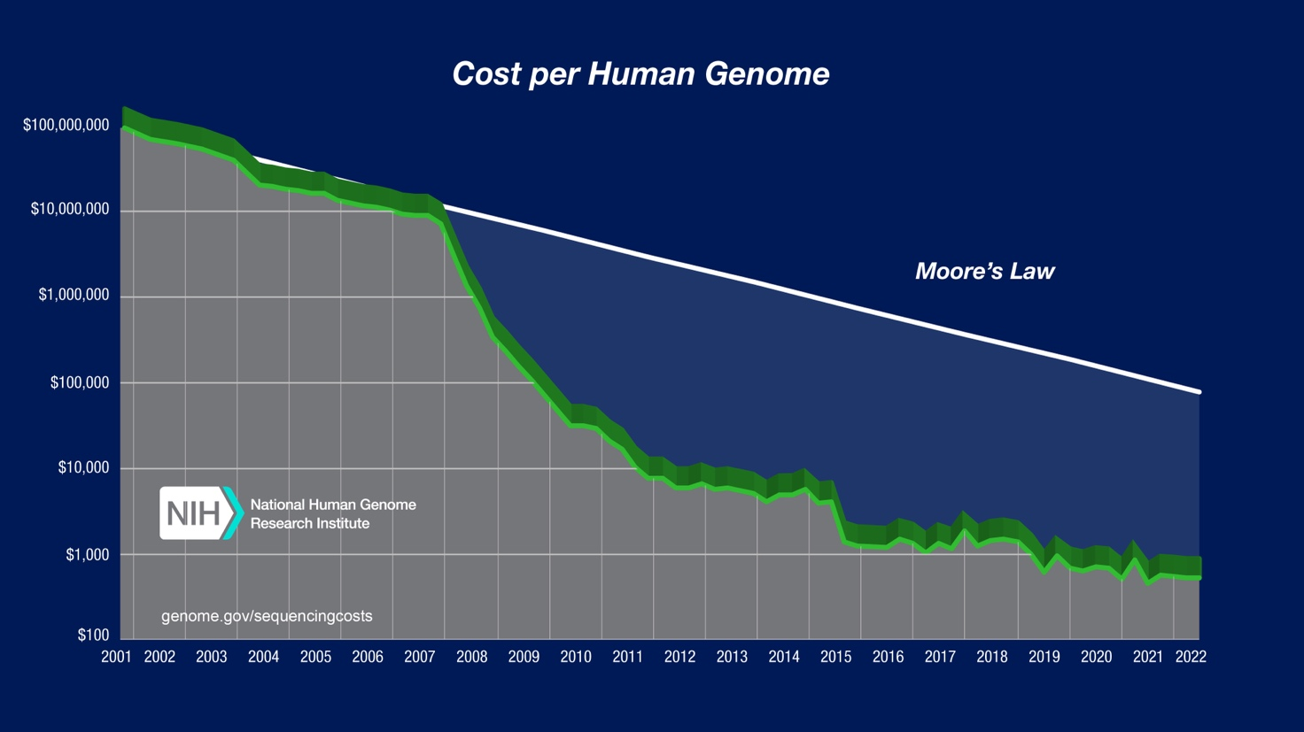
Cost Decline Far Steeper than Moore’s Law
Notes:
This just illustrates the advance in genomics in graphic terns.

Slide 6
Prediction 2: Immunology & Rapid Vaccine Response
Made at NextMed 1998
“The window will slam shut on the possibility of our being overrun by a third-world virus, another HIV or worse, a more widespread and contagious Ebola. Within days of the first cases being picked up, a blood sample would be sufficient to do a full genomic analysis of the pathogen. The pathogen's proteins would be fully analyzed for their function and antigenicity. The most antigenic regions would then be synthesized with an appropriate adjuvant, and a very effective vaccine would be coming off the production line a week or two later.”
Context: DARPA conference, late 1990s. At the time, this level of rapid response seemed almost impossibly optimistic.
Notes:
What I predicted about both advances in genomics and protein structure were the basis for my second big prediction at that 1998 conference. At this point it is my limited range of motion in my shoulders that is preventing me from vigorously patting myself on the back-

Slide 7
Prediction 2- Immunology and Rapid Vaccine Response: Verdict — COVID-19 Confirmed It
What happened in 2020??
Dec 2019 – Jan 2020
Jan – Feb 2020
Mar – Nov 2020
Dec 2020
SARS-CoV-2 gene sequence obtained and published within weeks of first cases.
Spike protein identified as the key antigenic target. mRNA vaccine design begins.
Phase I, II, III trials conducted at unprecedented speed. Efficacy confirmed.
Emergency use authorization granted. Vaccines off the production line.
✓ Substantially confirmed. The enabling vaccine technology — modified stable mRNA — was not foreseen. The outcome predicted was exactly right: the mechanism was the surprise, not the result. Vaccines were ready to test in 2 months, not weeks, but the prediction was largely accurate.

Slide 8
Prediction 3 (1991): Gene Therapy
Made at the State Justice Institute / Hawaii Supreme Court meeting, 1991
“It is virtually certain that within that time-frame — 10 to 20 years — we will develop the ability to treat, by preventive or ameliorative gene therapy, a variety of single-gene-defect pathologies and susceptibilities.”
The challenge: Single-gene disorders like cystic fibrosis, sickle cell disease, and Duchenne muscular dystrophy had no treatment options whatsoever in 1991.
Time horizon: 1991 + 10 to 20 years = 2001–2011. As we'll see, the prediction ultimately proved correct — though the timeline stretched.

Slide 9
Gene Therapy: Verdict — Confirmed and Exceeded
What has been achieved by 2026
41
37
Approved Gene Therapies
Including treatments for sickle cell disease, beta-thalassemia, Duchenne muscular dystrophy, spinal muscular atrophy, and inherited retinal dystrophy
RNAi Therapies Also Approved
Treating disease at the genetic level by silencing deleterious gene activity — an approach that didn't even exist as a concept in 1991
✓ Correct — on a longer timeline. The prediction is fully validated. There are now 41 approved gene therapies and a pipeline of hundreds more in development. RNAi therapy — an entire additional modality — emerged as a bonus.
Notes:
The number of projects underway is words, staggering. The FDA is confronting the challenge of modifying its traditional approach to drug approval to fit the new era of gene therapy for rare genetic diseases, with a very small number of patients. And, we are at long last confronted with how we can ensure fair and equitable access to a technology that can provide relief for serious genetic diseases while at the same time be offered to the very wealthy as yet another way to provide advantage to their offspring, one of the issues I addressed in the Futures article I published in 1992, based on my remarks at the Hawaii meeting.

Slide 10
Now Let's Go Back to the Future
Having established credibility — three new predictions for 2046-2056
We cannot predict the specific breakthroughs — Shotgun sequencing was just around the corner, while CRISPR and mRNA were completely unforeseeable. But we CAN predict with confidence that extraordinary breakthroughs will occur.
1. Artificial Intelligence
2. In Silico Biology
3, Quantum Computing
AI-driven target identification, structure prediction, and in silico toxicology will compress decades of drug discovery into years.
Virtual cells → virtual organs → virtual humans. Complete computational models reflecting individual genomic and epigenomic variations.
Quantum simulation of molecular interactions at scales impossible for classical computers — enabling true rational drug design.
Notes:
It was very much the case that my NexMed predictions were viewed as way too optimistic by most of those who attended that meeting. It may be that we are now so accustomed to extraordinary breakthroughs in the life sciences that my predictions for the next 20 years would be considered less far-fetched. Nevertheless, the advances that I am predicting will be equally transformative and perhaps change the world in even more profound ways.

Slide 11
2046 Prediction 1: The Virtual Human
In silico biology — from virtual cell to virtual organism
2026
~2031
~2046
TODAY
~5 YEARS
~20 YEARS
AlphaFold3
"AlphaCell"
The Virtual Human
Protein structures and molecular interactions predicted. The computational foundation is in place.
A complete in silico model of a human cell — all pathways, proteins, and interactions modeled together.
In silico models of individual humans reflecting their unique genomic and epigenomic variations.
Notes:
So this slide tracks from where we are now to where we will be in 2046, when I predict that we will have the data and the computing firepower to model the virtual human in silico, There is an ”AlphaCell” challenge That would also allow for us to also model any individual human by changing the genome and epigenome of the in silico model. I don’t mean that we will have the human in a computer that is sentient- I believe that would demand a long period of sensory input from the outside world and more, none of which would be the case- but the neurons would respond to perturbations, such as the introduction of a drug into the virtual digestive system just as actual neurons of that genotype would respond.

Slide 12
2046 Prediction 2: In Silico Drug Development
From high-risk trial-and-error to low-risk precision development powered by the in silico human.
1
2
3
4
Target ID
Structure & Activity
In Silico Tox
Synthesis
Druggable targets identified for any disease, including genomic variants across the human population.
Predict structure and activity of small molecules or peptides that bind to the identified target.
Safety profiled across common genomic variants — without animal testing or Phase I trials.
Efficient synthesis routes provided; large-scale production begins immediately.
Notes:
There are already a number of companies that are doing numbers 1 and 2 and we are also moving rapidly in building out #3, in silico toxicology, though with much less than a complete virtual cell. In 10 years in silico toxicology will be routine. In 20 years we will have begun in silico clinical trials as the baseline, with the possible requirement of small confirmatory human trials in drug s for larger populations.

Slide 13
2046 Prediction 3: Less Risky Business
Robotic factories, personalized medicine, and the end of the high-risk pharma model
What Changes
Truly Personalized Medicine
– Dramatically lower risk than today's industry-drugs developed in silico that are almost certain to work.
– Robotic AI factories manufacture GMP drugs at population and patient-specific scale.
–Far fewer employees; minimal marketing;
– Drugs procured by the government on a lowest-qualified-bidder RFP basis (finally true marketplace economics will arrive for pharmaceuticals).
– A much-reduced need for patent protection, investor value derived from long-term exclusive contracts to provide drugs to the largest payor, CMMS.
-NOT EVEN I CAN IMAGINE A SINGLE-PAYOR SYSTEM IN THE U.S.
– Population-scale drugs for most patients (like today's statins and ACE inhibitors)
– Small-batch drugs for patients with genomic variations in targets or drug metabolism
– Put a reminder in your calendar for 2046.
Write a nice letter to the editor of Science if I'm right.
Notes:
So if we take most of the risk out of the pharmaceutical business, we turn the whole enterprise on its head. We won’t need massive R&D funding to get one hit out of a thousand R&D employees producing a thousand leads.. And We won’t have a marketing driven competition between multiple drugs in a class. Instead we will produce the right drug for the right patients routinely, with larger patient populations that can all use the same small molecule provided with low-cost drugs produced for the largest payor (the U.S. government) on a lowest bidder basis. With no massive investments in drug development, my law take-away is that patents will become relatively unnecessary, making the debate about patentability an arcane exercise. The value will be in winning an exclusive contract to a large scale purchaser at the bid price for a number of years. However, even I am not so wildly optimistic as to predict we will have a single-payor system in the U.S. by 2046. And as for the letter to the editor, please do make that entry in your calendar so that your virtual assistant can draft that letter for you when the time comes….

