Slide 1
Patent Preemption Exceptionalism
Laura Dolbow
Forthcoming 76 Am. U. L. Rev. __ (2027)

Slide 2
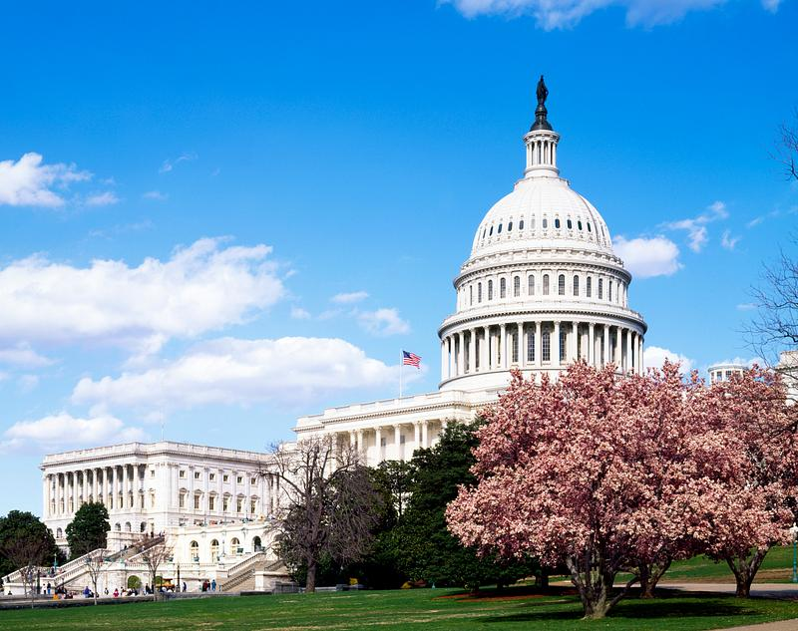
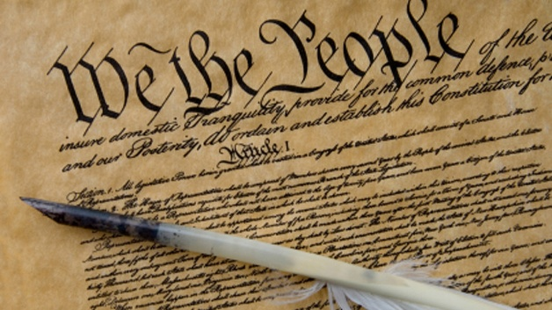
Federal Preemption
Supremacy Clause of the Constitution
Preemption can be:
  Explicit
  Implicit
    Field
    Conflict
      Impossibility
      Obstacle

Slide 3
Federal Preemption
Supremacy Clause of the Constitution
Preemption can be:
  Explicit
  Implicit
    Field
    Conflict
      Impossibility
      Obstacle

Slide 4
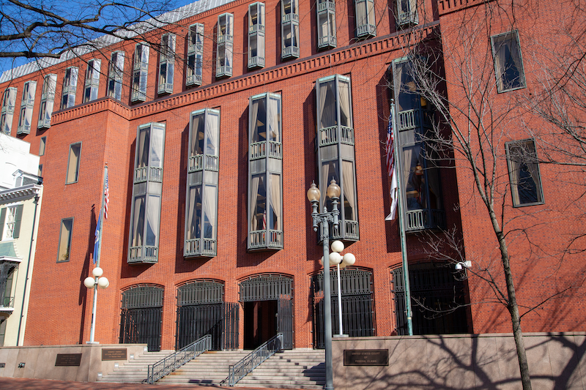
BIO v. DC (Fed. Cir. 2007)
D.C. law prohibited sales of patented drugs at excessive prices
Federal Circuit held preempted by patent law
  Obstacle preemption theory
En banc rehearing denied

Slide 5
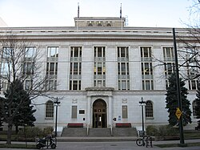

State Drug Price Regulation Efforts
Colorado Prescription Drug Affordability Review Board created in 2021
Pending lawsuit raises preemption challenge, relying on BIO v. DC
Opportunity to revisit precedent

Slide 6
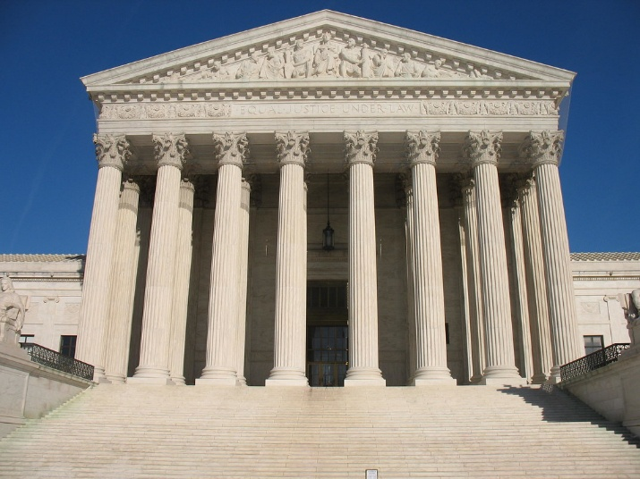
Supreme Court Precedent
Paper argues that BIO v. DC is inconsistent with Supreme Court precedent involving preemption in contexts of:
  Patent law
  Pharmaceutical regulation
  Price regulation

Slide 7
Examples of State Laws Not Preempted
  Regulation of patented products (Patterson; Webber)
  Trade secret laws (Kewanee Oil)
  Regulation of transactions involving patents (Allen)
  Tort claims based on warnings in drug labels (Wyeth)
  Prior authorization requirements for Medicaid programs (Walsh)
  PBM reimbursement regulations (Rutledge)
  Oil price regulation (Puerto Rico)
  Wholesale electricity rates charged by rural power cooperatives (Arkansas Electric Cooperative)
  Contract claims based on airline fares (American Airlines)

Slide 8
Preemptive Scope of Patent Law
The Federal Circuit held that the D.C. law interfered with the “full exclusionary power” of drug patents
  Price regulation of products does not impact exclusivity
In other contexts, the Supreme Court held that patent law does not preempt state regulations of patented products
  Patterson: KY prohibited sale of patented burning oil
  Webber: VA required license and tax to sell patented sewing machine
No federal law justifies treating drug patents differently from other patents (e.g., Hatch Waxman Act)
  Even with price regulation, exclusivity can still allow to earn greater financial rewards

Slide 9

Balancing Innovation and Access
The Federal Circuit concluded that Congress had exclusively reserved to the federal government judgments about how to balance innovation incentives and access to medicine
Supreme Court decisions, however, allow state regulations that impact this balance notwithstanding federal legislation
  Tort safety claims (Wyeth)
  Medicaid preauthorization requirements (Walsh)
  PBM reimbursement rates (Rutledge)

Slide 10
Federal Policy Goals
The Federal Circuit opinion relied heavily on legislative history from the Hatch Waxman Act about the goal of promoting incentives to innovate
Supreme Court decisions, however, focus on another goal of the Hatch Waxman Act: encouraging generic competition
  SCOTUS held that tort claims based on labeling are preempted against generics, but not against brand manufacturers
  Acknowledged this creates a system where tort claims can generally only be brought against patented drugs
  Explained that Congress sought to encourage generic competition
  Note: Inflation Reduction Act also seeks to lower drug prices, such as through the Medicare Drug Price Negotiation Program

Slide 11
Obstacle Preemption Analysis
The Federal Circuit held that the D.C. law created an obstacle because it impacted the federal policy goal of encouraging innovation
Supreme Court decisions, however, hold that the mere impact on a federal policy goal is not enough for obstacle preemption
  Consider extent of likely impact on federal policy goals
  Consistently rejected speculative, facial challenges, including for:
    Trade secret law (Kewanee; Aronson)
    Drug labeling tort claims (Wyeth)
    Medicaid preauthorization requirements (Walsh)
    Price regulation for rural cooperative wholesale electricity (Arkansas Electric)

Slide 12
Inference from Congressional Silence
The Federal Circuit did not place much weight on the lack of an express preemption clause in patent law
The Supreme Court, however, has been more reluctant to infer congressional intent to preempt through silence
  Wyeth: compared the statute regulating prescription drugs (which lacked an express preemption provision) to medical devices (which contained an express preemption clause)
    FDCA savings clause limited preemption to direct and positive conflicts
  Presumption against preemption
  Particular skepticism for implicit preemption when no federal regulation (Puerto Rico)

Slide 13
Lack of Federal Regulation
The Federal Circuit did not consider whether there was any federal regulation of drug prices
The Supreme Court, in contrast, consistently considered the presence of federal regulation when deciding preemption questions, including that:
  FDA had not considered proposed warning (Wyeth)
  No federal oil price regulation (Puerto Rico)
  No federal conclusion that rural cooperative wholesale power rates should be left unregulated (Arkansas Electric)
  No federal authority to oversee contract disputes between airlines and their customers (American Airlines)

Slide 14
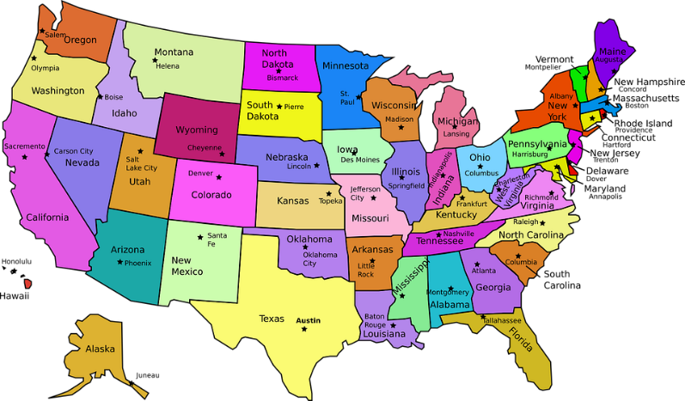
Problems with Exceptionalism
Harm to state sovereignty
  Particularly harmful because of regulatory void
Inconsistency in statutory interpretation approaches
Could lead to broader preemption challenges and increased litigation costs

Slide 15

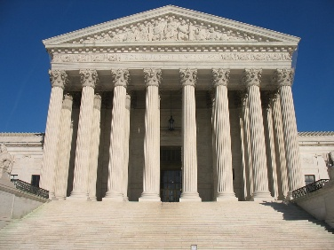

Proposed Reforms
Overturn BIO v. DC
  En banc Federal Circuit
  Supreme Court
Legislation to abrogate BIO v. DC

Slide 16
Questions?
Comments welcome!
Thank you!
laura.dolbow@colorado.edu

