Slide 1

Fruit of the
Poisonous Data
The Case for an Administrative Exclusionary Rule in FDA AI Approvals
Presenter: Gary Hsuanyu Liu
Washington University School of Law
Health Law Professors Conference 2026

Slide 2


The Real-World Stakes of AI
The Core Dilemma Should illegally collected health datasets ever be permitted to support official regulatory approvals?
Insatiable Demand Modern clinical AI demands massive, continuous streams of real-world sensitive health data to train effectively.
Unlawful Origins Opaque brokerage networks hide data provenance; de-identification masks ethical issues but never erases unlawful origin.

Slide 3
The Institutional Regulatory Gap
Regulatory Agency | Primary Focus & Mandate | Evidentiary Blindspot
Food & Drug Administration (FDA) | Is the generated AI evidence clinically useful, safe, and statistically sound? | Was the underlying training data gathered lawfully and ethically?
Federal Trade Commission (FTC) | Was the initial data collection deceptive, unfair, or a violation of privacy? | Will the FDA subsequently rely on this tainted data to authorize AI models?
The regulatory gap is not technical—it is institutional. The agencies do not coordinate on data integrity.

Slide 4




Epistemic Data Laundering
4. Validation
2. Masking
Sponsors submit it as RWE; FDA accepts it, validating poisoned data as official science.
Data is de-identified and tokenized to create the illusion of clean anonymity.
1. Extraction
3. Aggregation
Highly sensitive patient or location data is collected unfairly by modern trackers.
Commercial brokers pool and aggregate the data, obscuring illicit provenance.

Slide 5
Existing FDA Legal Authority
Mandate for Evidentiary Integrity The FDA is legally charged with ensuring the reliability of data. Rejecting evidence of compromised integrity is a core administrative function.
Application Integrity Policy (AIP) A powerful precedent already exists. Under the AIP, when data integrity is compromised by fraudulent or unreliable practices, the FDA systematically excludes it.
The Lopez-Mendoza Pathway Traditional legal frameworks leave an explicit opening: evidence arising from egregious violations of fundamental standards must be excluded.
Natural Extension, Not Revolution Evaluating data provenance is not a structural change; it is the natural modern adaptation of the FDA’s long-standing role as public-health gatekeeper.

Slide 6
The Principle of Data Loyalty
“
As a public-health gatekeeper, the FDA owes the public absolute loyalty in how it evaluates evidence. Because patients cannot verify clinical trials, they depend entirely on the FDA’s judgment. To accept illicitly harvested surveillance data is to ratify the exploitation of vulnerable groups. Genuine loyalty demands clean evidence.
— A FIDUCIARY DUTY FOR PUBLIC TRUST

Slide 7

The Administrative Trigger
FTC Standard Alignment
Shifting the Burden
The FDA should activate an exclusionary trigger whenever real-world evidence relies on data practices that violate FTC Section 5 standards.
Instead of assuming data is legally clean, the regulatory framework shifts the burden of proof directly to the drug or AI sponsor.
This applies directly to health-sensitive records, demographic profiling, and predatory location-based surveillance near clinical facilities.
Sponsors must actively produce verifiable, traceable records of lawful data provenance before their application can proceed.

Slide 8





Defining the Excludable Scope
1. Unclean Inputs
2. Tainted Models
3. Derivative Outputs
Covers raw commercial telemetry, illicit location trackers, tokenized patient networks, and commercial broker catalogs built without explicit consent.
AI models, neural weights, and diagnostics that were developed or optimized using datasets classified as poisoned or procedurally unlawful.
Downstream clinical trials, validation analyses, and regulatory evidence that carry the initial data taint. The poison flows from inputs to conclusions.

Slide 9
Incentives & Safe Harbors
Certified Fiduciary Brokers
Presumption of Admissibility
We propose a safe harbor for sponsors who acquire real-world evidence exclusively through certified, privacy-first data fiduciaries.
Sponsors presenting verified, audited chains of custody and clear provenance maps receive an expedited presumption of admissibility.
These fiduciaries must guarantee express, meaningful, and revocable user consent for healthcare development.
This structures market incentives to reward ethical actors, isolating bad data brokers while boosting reliable medical innovation.

Slide 10
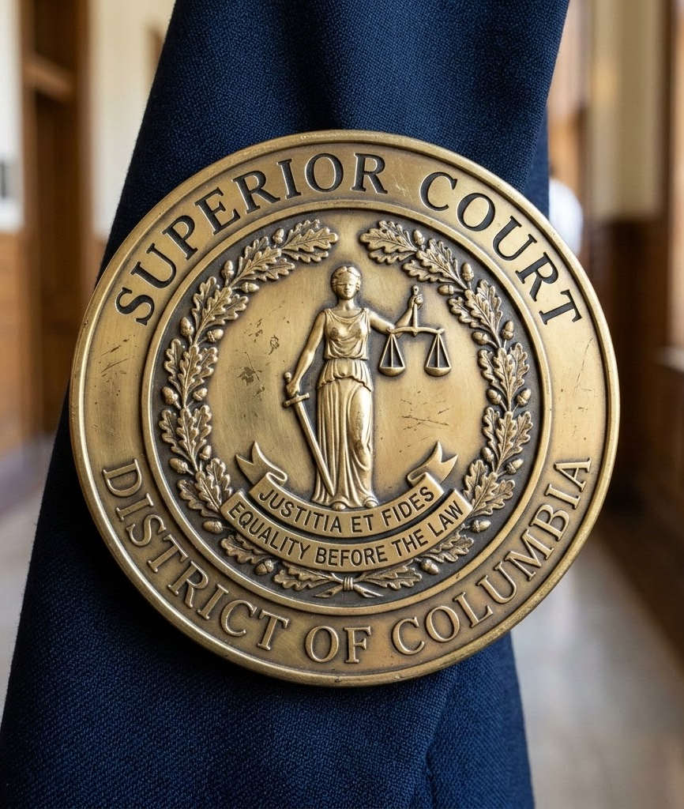
Trustworthy Medical AI
Innovation with Integrity
The core goal of an administrative exclusionary rule is not to slow down medical progress, but to ensure that AI-driven breakthroughs are built on clean, lawful evidence.
By enforcing strict data loyalty and legal provenance, we safeguard both scientific validity and patient civil liberties. There can be no black-box medicine without structural accountability.

