Slide 1
Making Toilets Public
68 Wm. & Mary L. Rev. (forthcoming 2027)
Rick Weinmeyer, JD, PhD, MPhil, MA
Assistant Professor, Loyola University Chicago School of Law
Faculty Member, Beazley Institute for Health Law & Policy
Friday, June 5, 2026

Slide 2
Outline
Public Health Implications
Government & Legal Failures
Progressive Property & Public Accommodations
Political Accountability

Slide 3
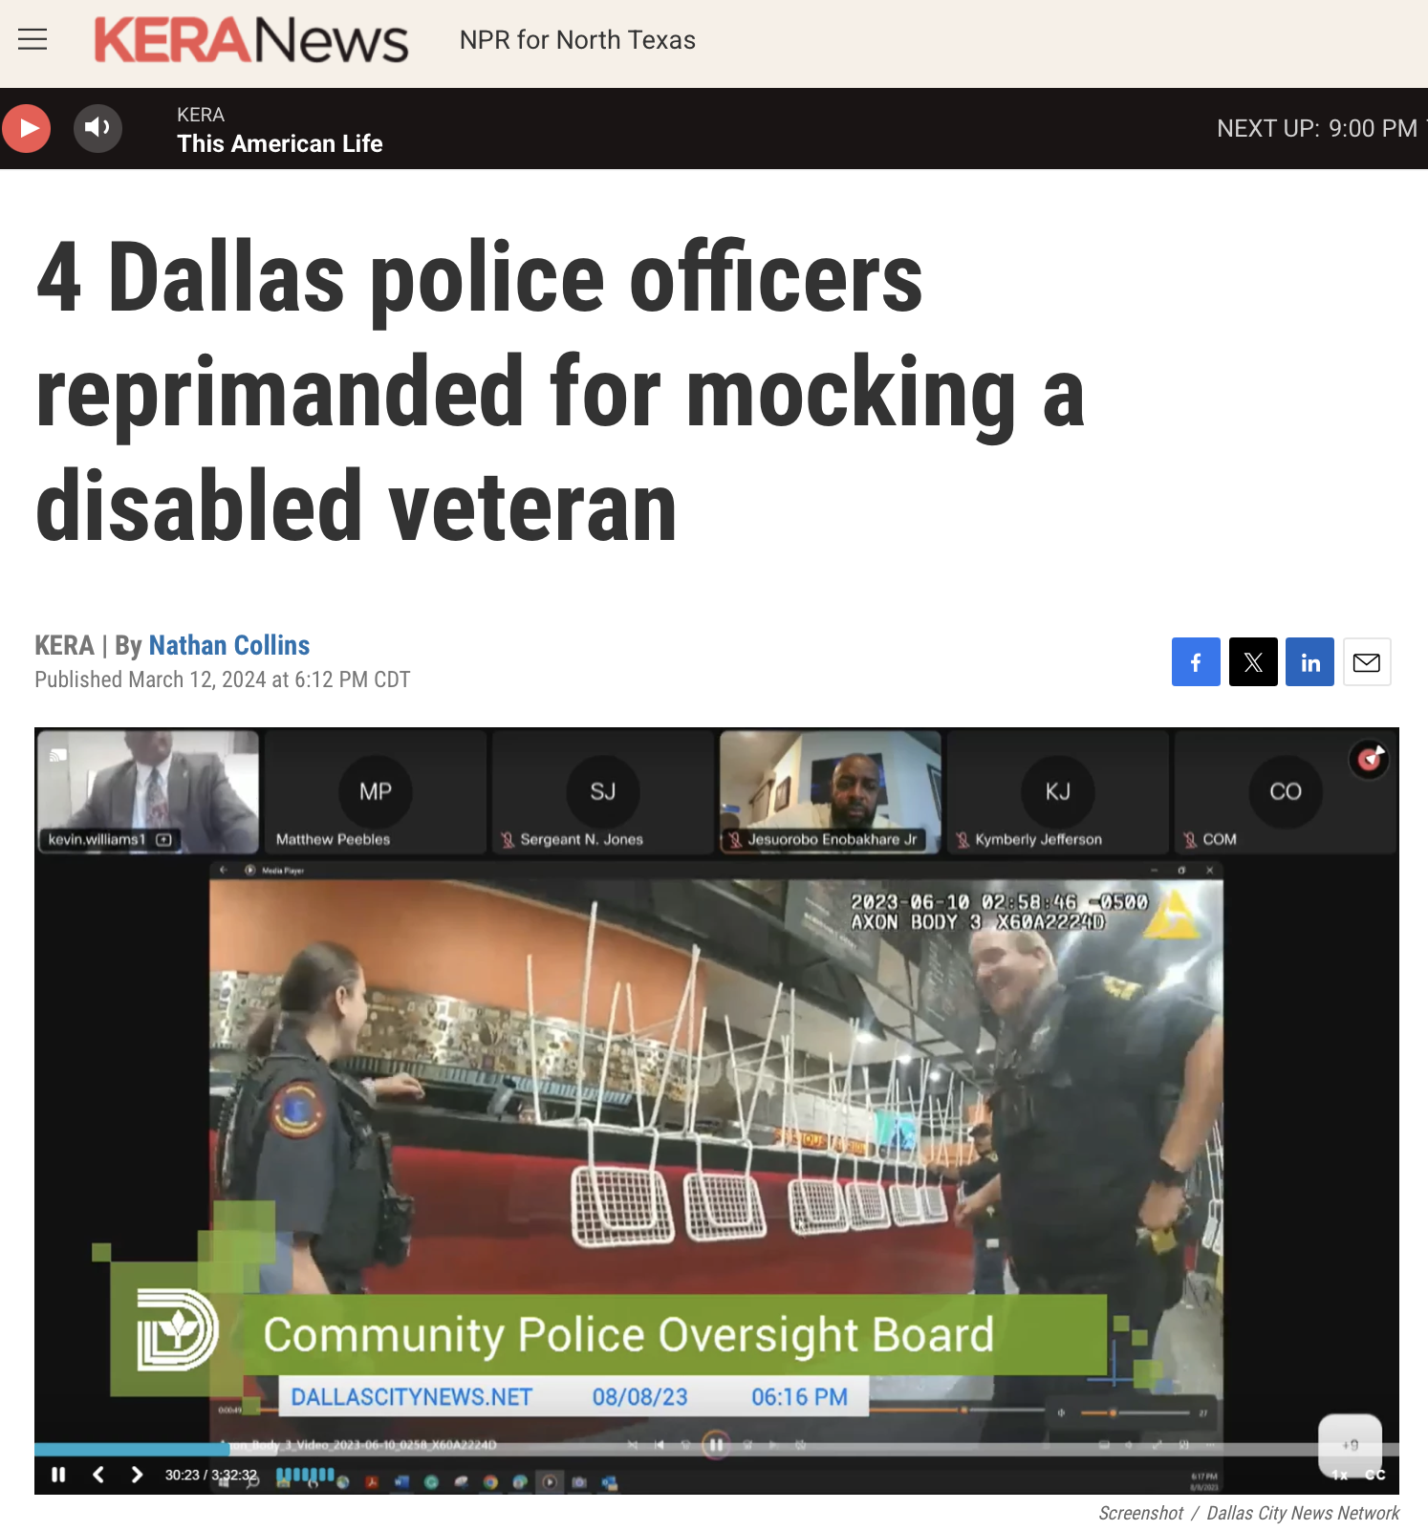
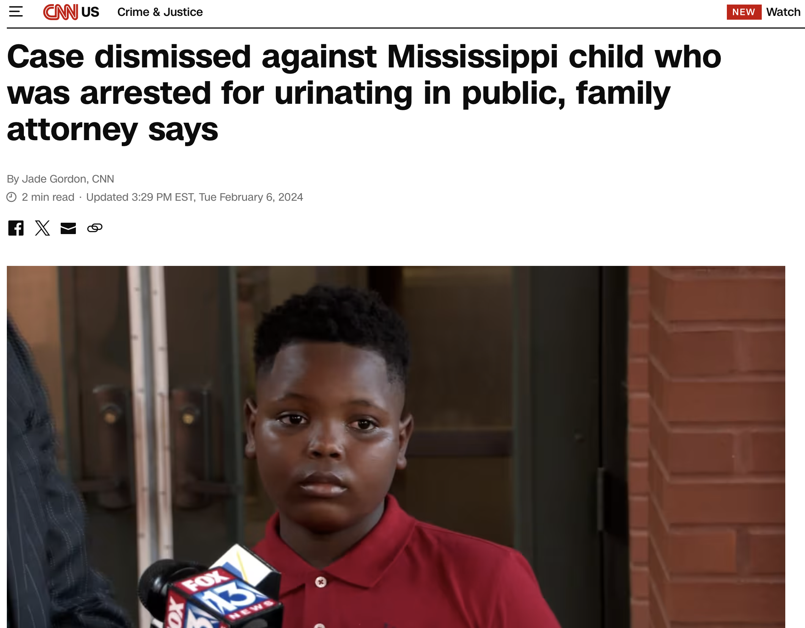
Public Health

Slide 4
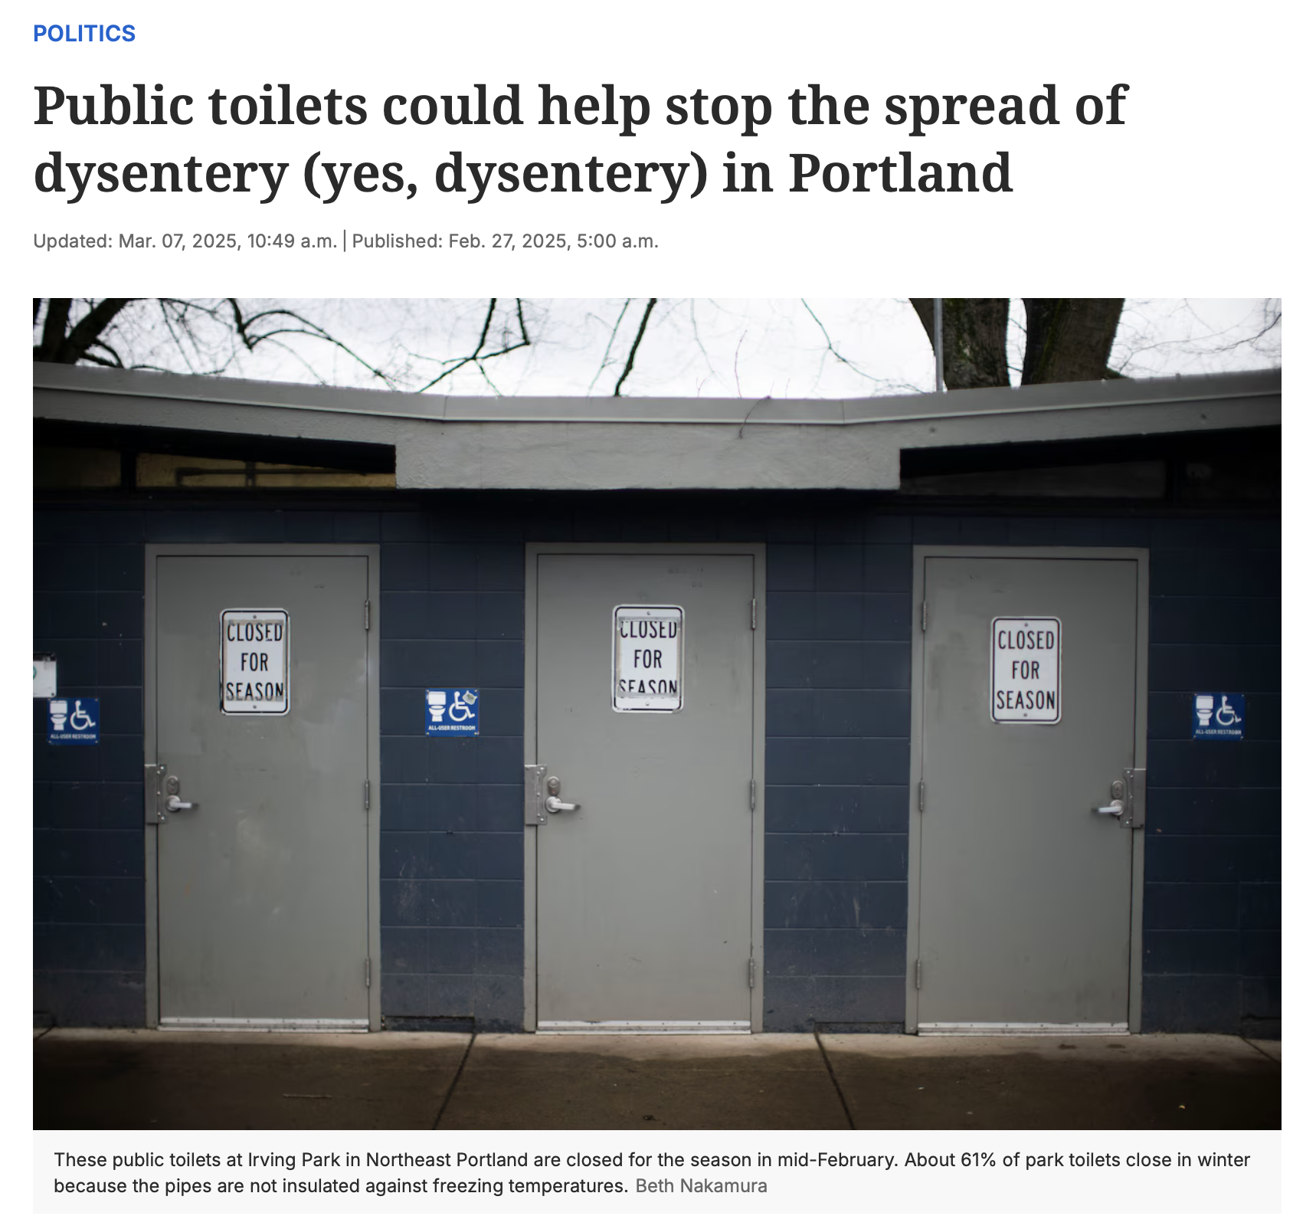
Public Health
Numerous Health Harms
Urinary and fecal incontinence
Inflammatory bowel disease (Crohn’s, ulcerative colitis)
Bacterial infection, organ damage
Social isolation, anxiety
Infectious Disease
Multistate Hepatitis A Outbreak
2016 - 2023
37 states
44,937 confirmed cases
27,461 hospitalizations
424 deaths
Hepatitis A Outbreaks Linked to Person-to-Person Contact, Ctrs. for Disease Control & Prevention (Apr. 30, 2024), https://www.cdc.gov/hepatitis-a/outbreaks/person-to-person/index.html.

Slide 5

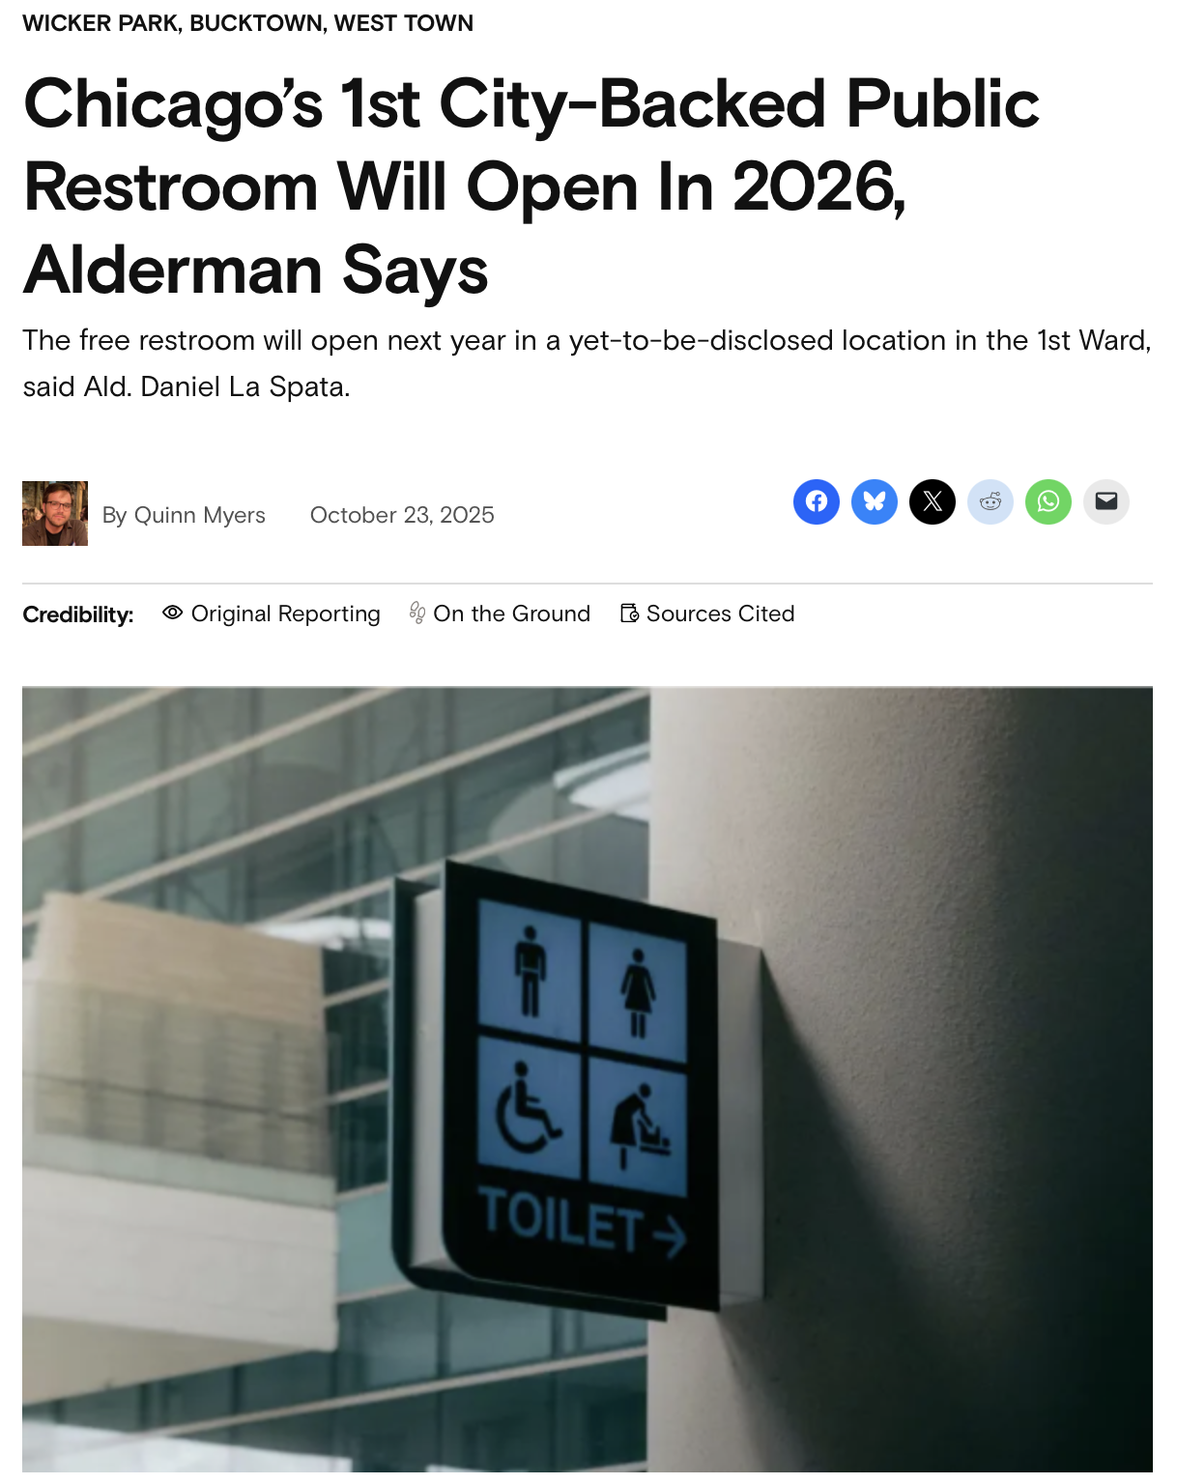
Government & Legal Failures
“[T]he Tribune identified fewer than 500 structures that contain free public restrooms with few or no barriers to entry, such as security checkpoints or client-only access, in a city of 2.7 million people.”
Emily Hoerner, Everybody needs access to bathrooms. Chicago doesn’t provide nearly enough of them, Chi. Trib. (Oct. 21, 2021, 5:00 AM).

Slide 6

Government & Legal Failures

Slide 7
Government & Legal Failures
Mahoney v. City of Sacramento,
(E.D. Cal. Feb. 10, 2020).
Plaintiffs asserted that “the substantive due process rights of privacy and bodily integrity include the right to eliminate bodily waste in private.”
“[T]here are few activities that appear to be more at the heart of the liberty guaranteed by the Due Process Clause of the Fourteenth Amendment than the right to eliminate harmful wastes from one's body away from the observation of others[.]”
Skinner v. Railway Labor Execs. Ass'n, 489 U.S. 602, 645–46 (1989) (Marshall, J. Thurgood, dissenting).

Slide 8
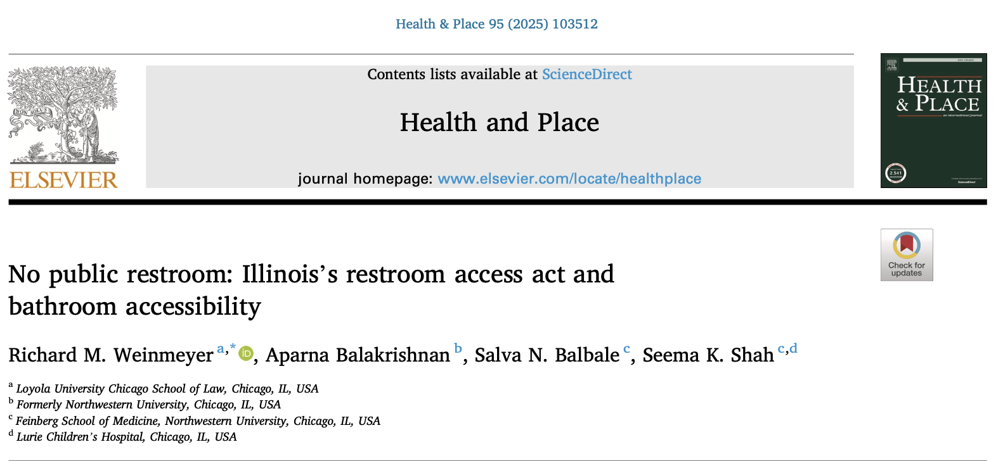
Government & Legal Failures
Existing Toilet Laws → WEAK
Example: Restroom Access Acts
Emergency toilet access for people with qualifying conditions
Poor knowledge of law
Weak enforcement mechanisms
Notes:
One important consideration is to understand the toilet laws we have in place and to find ways to strengthen the rights and obligations they provide.
For example, 20 states and D.C. have restroom access acts, which are laws that require that for people with qualifying medical conditions, a business has to allow them to use their employee restroom in the event the person is experiencing an emergency. How these laws operate depends on whether there is a public toilet in the vicinity, how many employees are working at the business in question, and so forth.
The problem: very few people know these laws exist, including those with conditions like inflammatory bowel disorders, who are the primary benefactors of these laws. Businesses, of course, have little to no knowledge these laws exist.
They also have extremely weak enforcement mechanisms because if a legislature is going to pass a law such as this, they need the support and buy in of the business community.
But for these laws to actually work, I believe they require higher financial penalties and private rights of action so that those who are denied bathrooms can sue if they are injured.

Slide 9
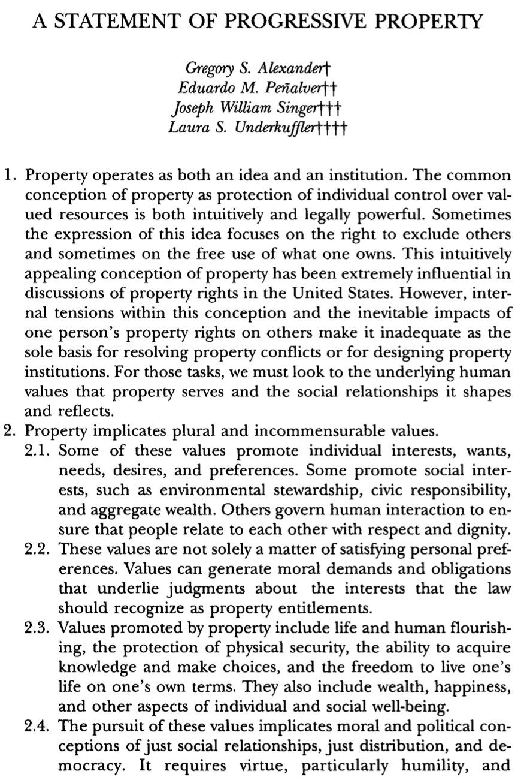
Progressive Property &
Public Accommodations
Human Flourishing
“Property owners are obligated to provide from their surplus, and in ways that are appropriate to them as property owners, to the communities to which they belong – upon which they are dependent – those benefits that the community reasonably regards as necessary for the development of the capabilities of human flourishing.”
Gregory S. Alexander, Ownership and Obligations: The Human Flourishing Theory of Property 7 (Cornell L. Fac. Pub., Paper No. 653, 2013), https://scholarship.law.cornell.edu/facpub/653

Slide 10
Progressive Property &
Public Accommodations
Amending Public Accommodation Laws
Municipal ordinances
Cities are public health innovators
Streamlined legislative process
Existing procedures, rights to seek redress
Features
Apply to specific businesses → harmonize with building codes
Liability waivers
Opt-out options → require public approval

Slide 11
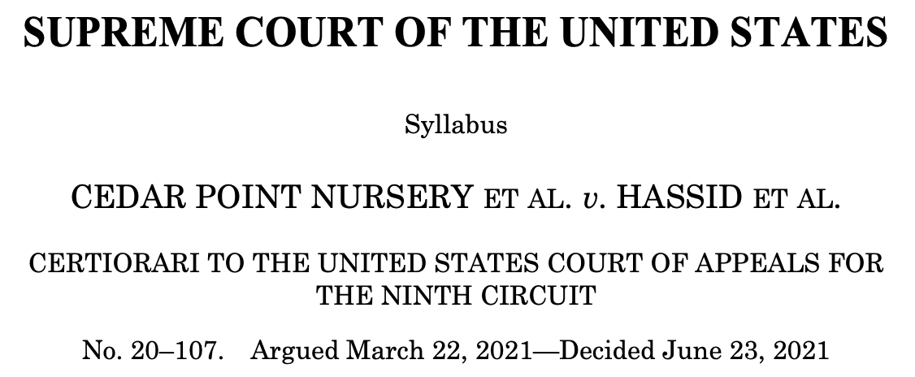
Political Accountability
“Because the government appropriated a right to invade, compensation was due. The same governs here.”
  But see PruneYard → “an already publicly accessible” business
Compensation programs used elsewhere to provide toilets = United Kingdom, Germany, Canada
Places pressure on local government to undertake further reforms

Slide 12
Thank You!
Email: rweinmeyer@luc.edu
Bluesky: rickweinmeyer.bsky.social

