Slide 1


CODING INJUSTICE:
How Anti-Woke Governance and AI Reshape
Inequality In American Healthcare
Dana G. Jones, LL.M | Assistant Professor of Law, North Carolina Central University School of Law |
ASLME Health Law Professors Conference, Atlanta, GA June 5, 2026

Slide 2

Introduction
The Myth of Neutrality
The Illusion of Objectivity: AI is frequently marketed as a neutral, efficiency-
driven tool, obscuring the human biases embedded in its development.
The Parallel Shift: Healthcare integration of AI is occurring alongside a
systematic rollback of DEI frameworks.
Architecting Inequality: These two forces act as mutually reinforcing systems,
creating a new digital infrastructure of inequity.
Disproportionate Impact: The primary victims of this shift are historically
marginalized and vulnerable populations, whose specific needs are erased by
standardized, 'neutral' algorithms.

Slide 3

Key Concepts
Theoretical Framework:
Supremacy Politics
Coding Injustice represents a confluence of technical design and
social power structures that perpetuate inequality.
Systemic Erasure: Systematic removal or denial of marginalized
identities within datasets and algorithmic outputs.
Misclassification: Intentional or neglectful labeling that reinforces
social hierarchies.
Devaluation: Reducing human experience to quantitative metrics
that lower the status of non-dominant identities.
The Myth of Neutrality: Utilizing claims of technical objectivity to
mask discriminatory design choices.
Supremacy Politics: The underlying power structure preventing
institutions from addressing or measuring algorithmic discrimination.

Slide 4
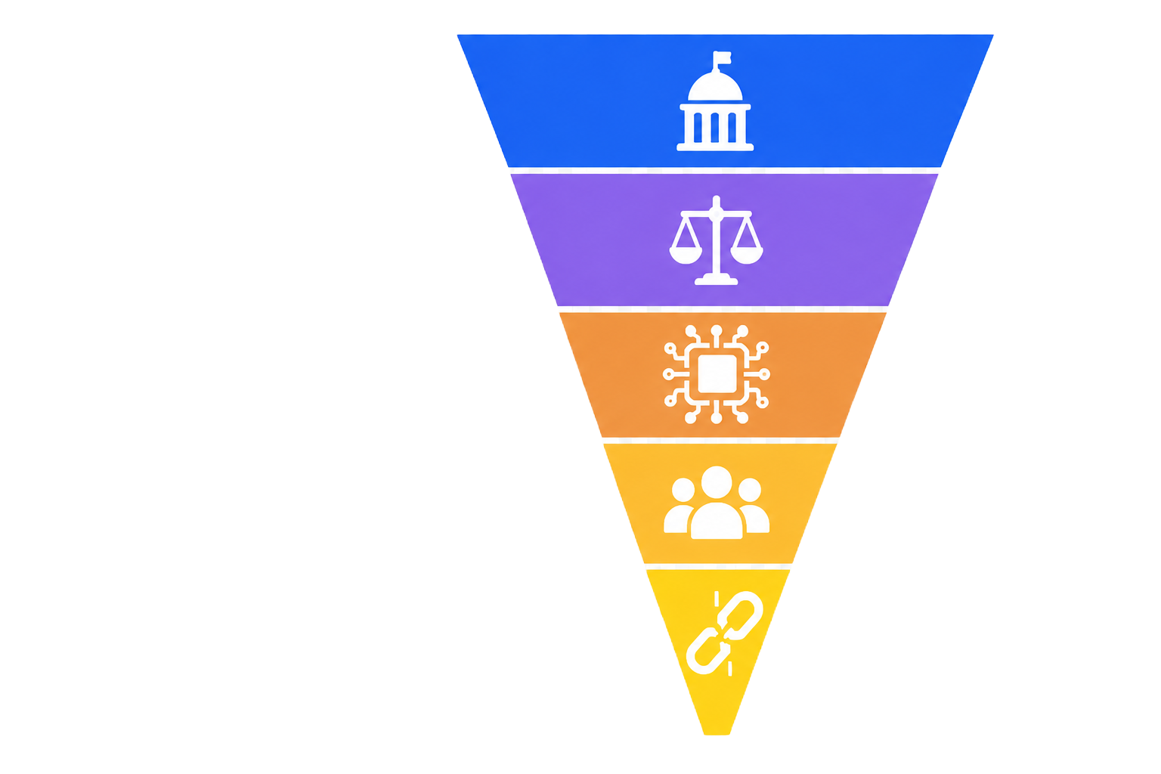
Anatomy of Coding Injustice:
The Architecture of Inequality
Systemic layers contributing to health and algorithmic inequity
Supremacy Politics
  Influences information control, ideological frameworks, regulatory
  retrenchment, and strategic resource allocation.
Institutional Enforcement
  Governs health law, insurance coverage rules, administrative oversight, and
  procurement standards.
AI Implementation & Infrastructure
  Involves clinical algorithms, risk-assessment systems, data governance, and
  physical data infrastructures.
Systematic Erasures
  Results in unequal access, biased algorithms, exclusion from care, and
  systemic stereotyping.

Slide 5

Analysis of Challenges
Legislative Barriers to Equity
Primary Legislative Examples
Florida’s Stop WOKE Act
Texas S.B. 17
Executive Order 13950
Core Objective
Intentionally hindering visibility into systemic inequities.
Consequences for Civil Rights Enforcement
Sabotaging protections under Title VI, Section 504, and Section 1557.
Preventing the systematic data collection necessary to detect discriminatory
patterns.
Creating structural barriers that make it difficult to prove disparate impact in legal
proceedings.

Slide 6
Anti-DEI Governance & AI: From Policy to Code
An analysis of recent EOs and their impact on AI development and oversight
Legislative Landscape (EO 14151 & 14173)
Detection Vacuum
Systemic dismantling of federal DEI offices and
rescission of affirmative action, restricting
mandatory demographic data collection.
Without demographic data collection,
identifying, measuring, and correcting
discriminatory AI performance becomes
technically unfeasible.
EO 14179: Preventing Woke AI
Prohibits federal procurement of AI models
utilizing intersectional, bias-aware, or
systemic-deficiency analytical frameworks.
Market & Oversight Migration
Federal procurement standards act as a
market benchmark; expect anti-DEI standards
to influence private sector AI deployment and
erode community oversight.
Rescission of EO 13985
Removal of legal infrastructure previously
designed to detect and remediate
discriminatory AI outputs.

Slide 7

The Accountability Gap
Failures of Oversight
in Critical Healthcare
Autonomy in High-Stakes Domains
AI systems currently exercise significant decision-making
power in Medicaid eligibility, Medicare Advantage benefit
management, disability evaluations, and clinical triage.
Regulatory Lag
Existing laws like HIPAA prioritize data privacy, 2026 DHHS updates on deidentification and protection health information; including online tracking technology use.
Diminished Monitoring & Accountability
Legislative changes have reduced internal monitoring
capacity
Human oversight removal creates vulnerabilities in patient
outcomes and equitable care delivery

Slide 8

Mechanisms of Coding Injustice
How algorithmic design choices contribute to systemic inequity
Restriction of Demographic Data
  Policy directives that block access to critical demographic metrics like
  race and disability status, hindering the identification and remediation of
  algorithmic bias.
Algorithmic Erasure
  The systematic flattening of culturally specific markers and diverse
  expressions, rendering marginalized identities invisible within technical
  outputs.

Slide 9
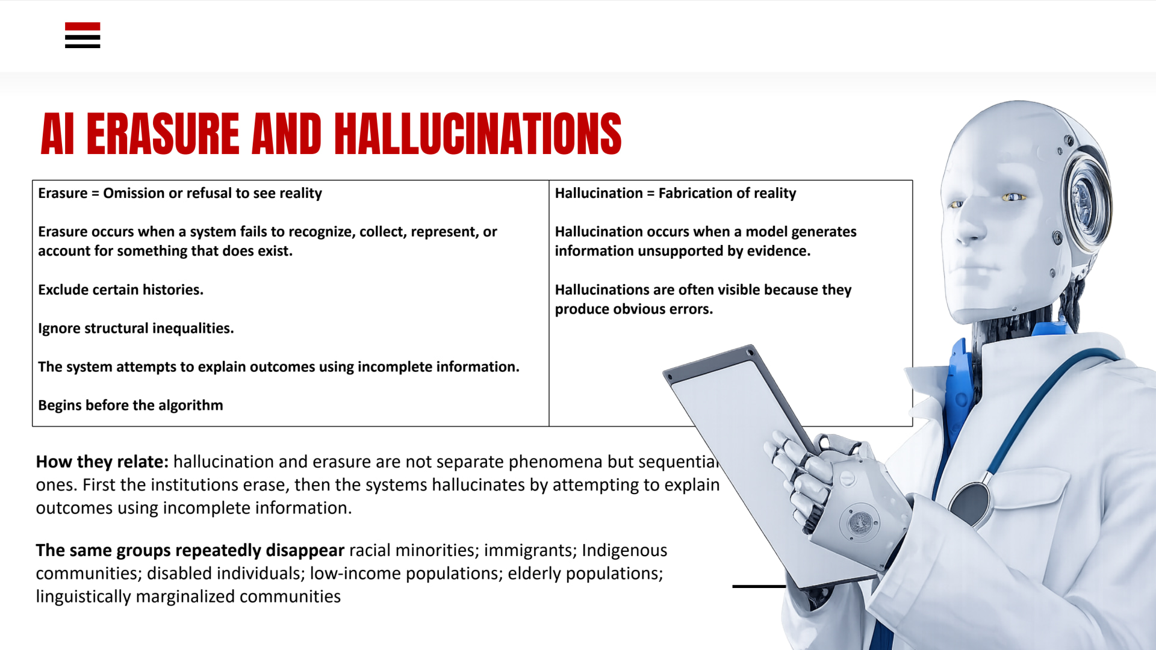
Notes:
Term of Art

Slide 10

Dimensions of Injustice
Physical and
Environmental
Dimensions
Digital Infrastructure Impact: Data centers and server
farms often impose significant environmental burdens,
including water and energy consumption,
disproportionately affecting tribal and rural nations.
Algorithmic Disenfranchisement: The automation of
sensitive political processes, such as redistricting, can
transform historical patterns of exclusion into scalable,
automated systems of disenfranchisement.
Systemic Scope: Coding injustice is not merely a
software issue but an embodied reality that reshapes the
built environment and democratic participation through
technological control….systemic erasure of marginalized populations.

Slide 11

Algorithmic bias is a choice, not a flaw.
Systemic oversight, equity infrastructure, and accountability are necessary to interrupt the reinforcement of power dynamics
in coded systems.

Slide 12

Strategic Priorities
Reform Agenda
and Path Forward
Reimagining Data Governance: Prioritizing structures
that enable continuous equity monitoring throughout the
AI lifecycle.
Strengthening Civil Rights Enforcement: Implementing
robust protections to prevent the systematic erasure or
misrepresentation of marginalized communities in data
sets.
Transparency and Accountability: Establishing clear
standards for algorithmic decision-making to ensure
systems are built on objective, inclusive data.
Strategic Shift: Moving away from exclusionary political
ideologies to ensure healthcare AI serves as a universal
tool for health equity.

Slide 13

Strategies Opportunities
Thank You For Your Attention!
Your Input & Support Are Appreciated.

