Slide 1

What Comes After Medicare?
Rachel E. Sachs, JD, MPH
Professor of Law, Washington University in St. Louis
Health Law Professors Conference | June 2026

Slide 2


Shadow Financing the Safety Net
Rachel Sachs, Professor of Law
Washington University in St. Louis

Slide 3

The 340B program is no longer a niche issue.
At $81.4 billion and growing, it shapes drug pricing, hospital strategy, rural sustainability, and the legal architecture of the safety net. And it urgently needs legal scholars’ attention.
Questions for Discussion
Is my assessment of the sparse role of the 340B program in legal scholarship on 340B accurate?
How should we weigh safety-net financing against pricing and system distortions in evaluating reform?
Have I framed the broader institutional design issues sensibly?

Slide 4
What Is the 340B Program?
The Basics
Created in 1992 as part of the Veterans Health Care Act, 340B requires pharmaceutical companies to provide substantial discounts on covered outpatient drugs to qualifying covered entities.
Covered entities include:
Federally Qualified Health Centers (FQHCs)
Disproportionate Share Hospitals (DSH)
Children’s, critical access, rural, and sole community hospitals (expanded by ACA in 2010)
How the Program Works
Covered entity buys drug at 340B discounted price
Entity bills insurer at standard (higher) price
Entity retains the difference = the spread/revenue
Purpose: stretch scarce federal resources to serve more patients and deliver more comprehensive services

Slide 5
340B Has Grown Into a Major Federal Program
#2
$81.4B
~1/3
79%
Largest U.S. government
pharmaceutical program
(behind only Medicare Part D)
Covered entity drug
purchases in 2024
Of all U.S. hospitals
are 340B covered
entities
Of 2024 purchases
made by DSH
hospitals
Top 10 drugs = 1/3 of all 340B sales | 73% of growth driven by cancer drugs, anti-infectives & immunosuppressants (CBO 2024)

Slide 6
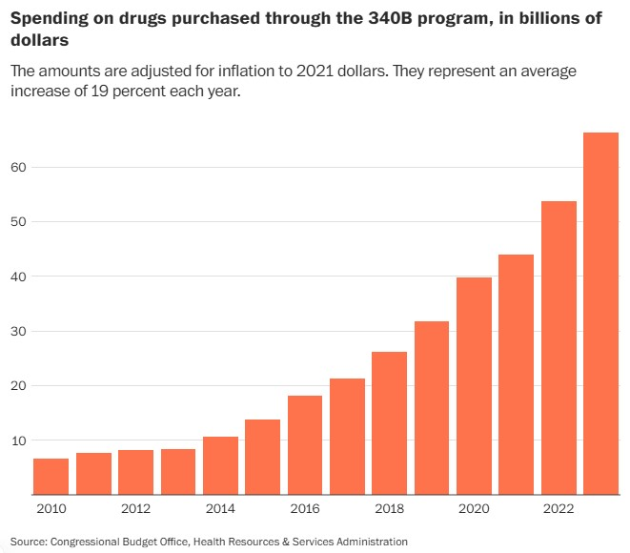
340B Program Growth: Drug Spending Over Time

Slide 7
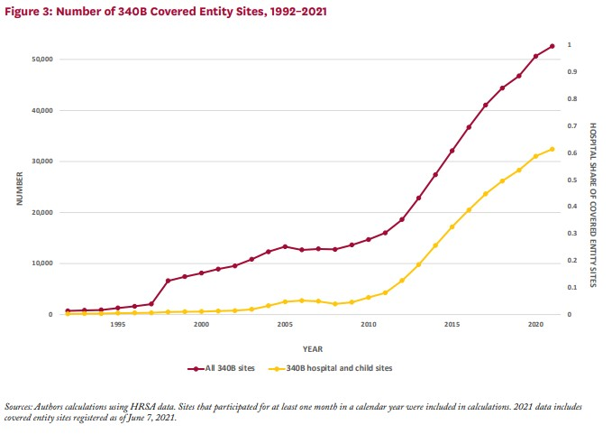
340B Program Growth: Covered Entity Sites

Slide 8
A Research & Policy Engagement Agenda
The 340B program intersects with core concerns of health law scholars across a range of subfields:
Drug pricing & access
Incentives relating to high-cost prescribing, biosimilar uptake, IRA negotiation interaction
Health system consolidation
Financial drivers of vertical integration, child-site location patterns
Rural health
Critical access hospital viability; risk of reform without transparency data
Health care safety net
Uncompensated care financing, FQHC obligations, Medicaid sustainability
Administrative & constitutional law
HRSA rulemaking limits, Loper Bright, state preemption doctrine

Slide 9
340B & Prescription Drug Pricing: Key Tensions
The spread structure creates powerful -- and sometimes problematic -- prescribing incentives.
High-Cost Drug Preference
PrEP / Biosimilar Evidence
Launch Price Incentives
Because the spread is a percentage of price, expensive drugs yield larger margins. 340B entities have financial incentives to prescribe branded over generic or biosimilar drugs.
Studies show 340B entities are significantly less likely to prescribe lower-cost biosimilars (11.8% vs. 34.7% biosimilar use near the eligibility threshold), potentially reducing overall biosimilar uptake.
Like the Medicaid Drug Rebate Program, 340B discounts are formulaically linked to average price, giving manufacturers reason to set (and maintain) high launch prices.

Slide 10
340B’s Broader Impact
Safety Net, Consolidation & Sustainability
Safety Net & Uncompensated Care
Consolidation & Rural Sustainability
340B may incentivize hospital acquisition of physician practices and off-site clinics (child sites), accelerating horizontal and vertical consolidation
Child sites often located in higher-income ZIP codes than parent DSH hospitals
For critical access and rural hospitals, 340B revenue may keep facilities open
93% of rural hospitals surveyed say savings help them stay open
FQHCs show clear safety-net use: more tobacco counseling, flu shots, HIV tests, and services for unhoused patients
Evidence for hospitals is mixed: some studies show higher-income patient focus and aggressive spread-seeking
The statute does not require covered entities to use revenue for charity care
Its design creates divergent effects across entity types.

Slide 11
Emerging Legal Issues for the 340B Program
1
2
3
HRSA’s Limited
Rulemaking Authority
Federal Preemption of
State 340B Laws
Federal Legislative
Reform Agenda
HRSA lacks substantive rulemaking authority over 340B. Courts have limited agency guidance (contract pharmacies, patient definition). Manufacturers are challenging program interpretations directly. The executive/legislative vacuum is letting both industry and courts reshape the program.
States are legislating to: restrict PBM reimbursement variations, protect contract pharmacy access, establish transparency requirements, carve 340B out of Medicaid. Courts are split on preemption, creating uncertainty for covered entities and manufacturers.
Reform proposals are circulating in Congress. Consider: (1) transparency-first legislation before substantive cuts, (2) granting HRSA substantive rulemaking authority, and (3) giving MACPAC/MedPAC oversight and data access to guide evidence-based reform.

Slide 12

Questions?

