Slide 1

The Legal Political Economy of the FDA
6/5/2026
Daniel G. Aaron, MD, JD
Associate Professor of Law

Slide 2
Potential COI
I am grateful for funding from Arnold Ventures.
These views are my own and do not necessarily represent those of the state of Utah.

Slide 3
Roadmap
LPE
Why LPE & FDA?
Potential Insights

Slide 4
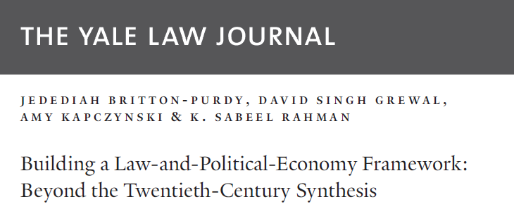
1. Law and Political Economy
Politics and economy are inextricably connected
Law is essential connective tissue between politics & economy
Reorienting law’s key questions from neutrality to power, equality, and democracy

Slide 5
Responding to the Twentieth-Century Synthesis
LPE responding to law & economics, neoliberalism
“Neoliberal political economy, with its underlying commitments to efficiency, neutrality, and antipolitics, helped animate, shape, and legitimate a twentieth-century consensus that erased power, encased the market, and reinscribed racialized, economic, and gendered inequities. By contrast, a legal imaginary of democratic political economy, that takes seriously underlying concepts of power, equality, and democracy, can inform a wave of legal thought . . . .”
—Britton-Purdy et al., 2020

Slide 6
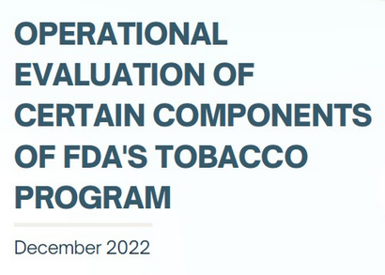
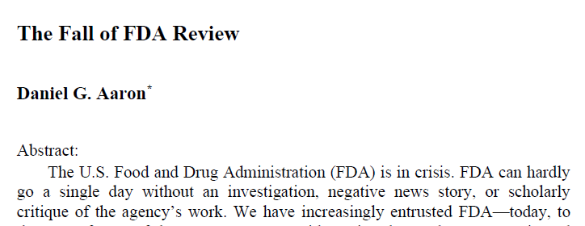
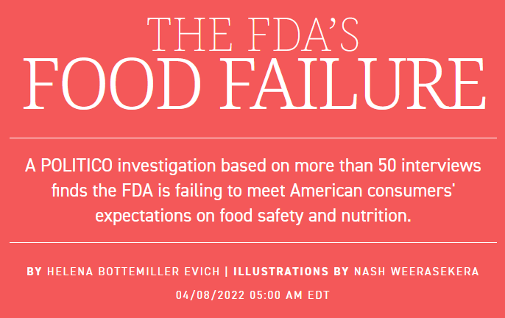
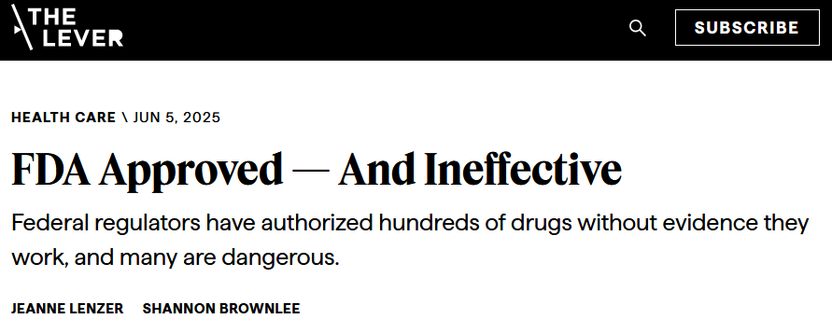
2. Why LPE & FDA?
Notes:
Questions about agency effectiveness

Slide 7
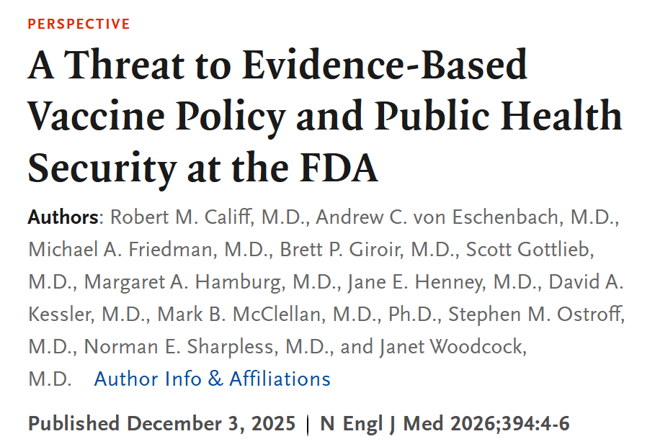
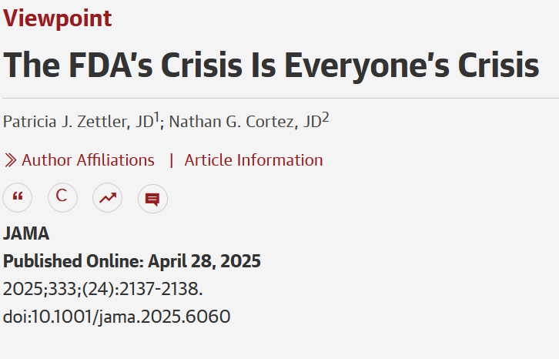
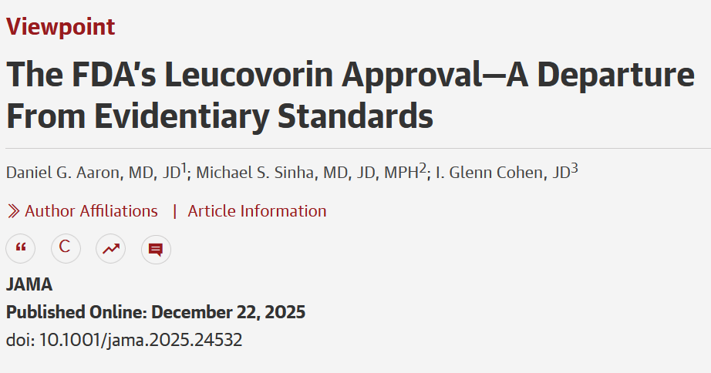
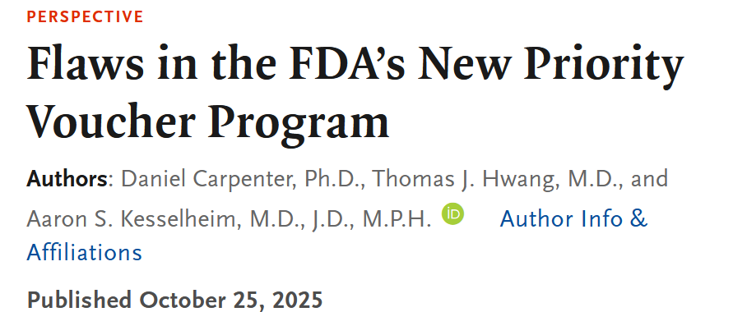
Notes:
Questions about influence of politics
NEJM – 12 former commissioners identify “threat” of new FDA vaccine policy

Slide 8

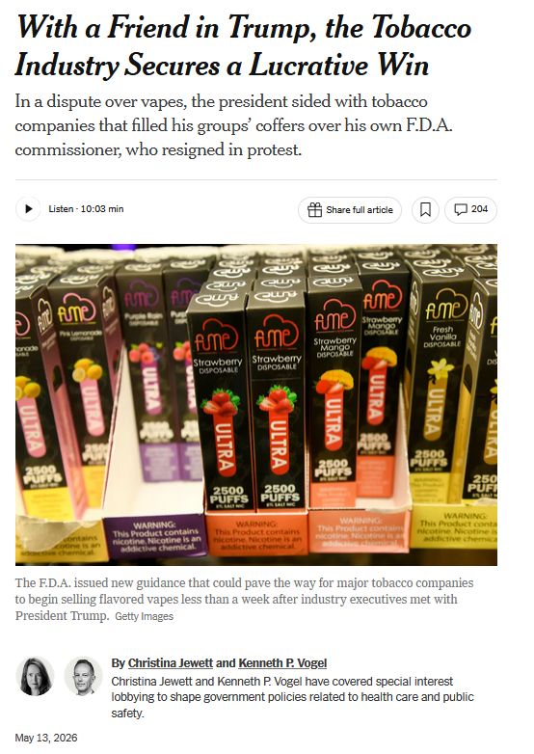
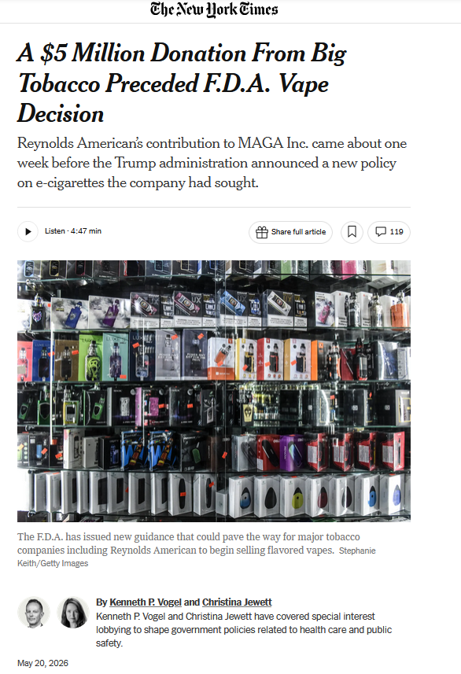
Notes:
Questions about influence of politics
NEJM – 12 former commissioners identify “threat” of new FDA vaccine policy

Slide 9
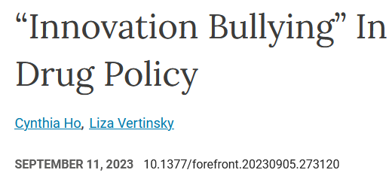
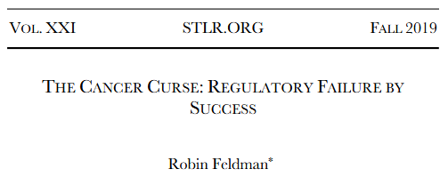

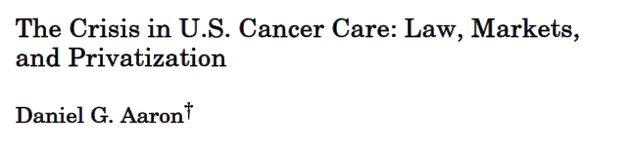
3. Potential Insights
a. Innovation –
  Innovation politics
  Innovation failures
    Malinvestment (antibx, vaccines, existing drugs, removing drugs)
    Problems with standards
    Robin Feldman, Matt Herder, Ana Santos Rutschman, Reshma Ramachandran
  Using one form of innovation to justify pushing for another
Notes:
Gannon 2024: [O]f the 161 drugs, approved by the FDA since 2017 for treating solid cancer in adults, only 35% were graded as “delivering substantial clinically meaningful benefit” on the European Society for Medical Oncology Scale, a standardized tool for assessing anticancer therapies.
Ideal for promoting innovation and public health?
Explain the vagueness of the term innovation means it is dangerous as an overarching policy goal.

Slide 10
3. Potential Insights
b. Democratic responsiveness
  LPE calls for this
  Top-down (executive meddling, terminations) & bottom-up (PAGs, MAHA) dysfunction
  Movements have sometimes fought agency injustice
    → Aziza Ahmed, Daniel Carpenter, Lewis Grossman
  Scholarly debate
    → Former leaders, Patti Zettler, Rachel Sachs, Holly Fernandez Lynch, Glenn Cohen
  Key question: What configurations optimize FDA’s ability to promote public health & health equity?
  My answer: Internal administrative law + Congressional accountability, not executive
    (But see SCOTUS)

Slide 11
Congress As Source of FDA Accountability
Cons
Lobbying
Dysfunction
Political Whims

Slide 12
Congress As Source of FDA Accountability
Cons | Pros
Lobbying | All three branches experience these problems
Dysfunction | Stability-protective (vs. exec/judicial)
Political Whims | Majoritarian; not juristocratic
Congress has rejected the administration’s suggested budget cuts at scientific agencies AND created significant underappreciated FDA reforms over the past five years (e.g., accelerated approval reform, synthetic nicotine, pediatric research)

Slide 13
3. Potential Insights
c. Public Health
  Main FDA mission
  Prioritization problems
    User fees prioritize product review, not PH regulation
      → Peter Barton Hutt: User fees have led to the “systematic dismantling of the FDA’s core mission”
    Admin law changes & exec intrusion slant against ‘legislative rules’ (see LDT rule, cigarette health warnings, menthol cigarette ban)
      SCOTUS has upheld product decisions (mifepristone, flavored e-cigs)
  Public trust/MAHA
    Fell after COVID-19 (debacles over hydroxychloroquine, ivermectin, convalescent plasma) & various FDA scandals
    Threatens industry profit – potential for an alliance
Notes:
McCoy: https://www.nejm.org/doi/full/10.1056/NEJMsr1610625
Public trust issue could go under politics

Slide 14
Thesis
We need to move from a neoliberal-reactionary political economy to a public health political economy. This could improve public health, innovation, and public trust.
Steps:
1. Reclaim the word innovation (Kenji Yoshino)
2. Marshal reconfigured politics – corporations need public trust
3. Internal admin law & legislature as main checks – not the president
Notes:
Still evaluating what a public health political economy might entail, but I’ve given some hints throughout this talk

Slide 15



Questions?
Daniel.Aaron@law.utah.edu
medlawdan

