Slide 1
Conflicts of interest among public speakers and committee members at FDA advisory committee meetings
Leah Z Rand
5 June 2026

Slide 2
Disclosures
This work is funded by a Making a Difference Grant from the Greenwall Foundation
Other funding: Arnold Ventures

Slide 3
Overview
Background
What is known about COI at advisory committee meetings
Perceptions of COI
Addressing COI going forward

Slide 4
Background
Advisory committees are independent, expert panels that make non-binding recommendations to the FDA
Conflict of interest (COI)
  Financial: current financial interests related to the product or its competitor
    e.g.: consulting or speaking fees, research support, stock ownership, employment
  Non-financial: other interests or relationships that will be affected by the regulatory action (“appearance issues”)
    FDA includes past financial relationships as an “appearance issue”
Committee members with COI undermines the independence and credibility of the recommendations
  Specific meetings have drawn attention to industry influences at meetings: rofecoxib (Vioxx) 2001; lecanemab (Leqembi) 2023 and donanenmab (Kisunla) 2024
In 2007 the FDA stopped allowing members to participate if they had an interest of ≥$50,000 and capped the number of waivers issued for smaller interests (waiver cap removed in 2012)
Public speakers—may not be evident who has a COI, provides further opportunity to contribute to meeting
Former Commissioner drew attention to reducing COI and increasing transparency

Slide 5
COI at FDA advisory committee meetings—systematic review
Systematic literature review of publications through November 2024
Identified 18 studies, published 2006-2022
Key findings:
  Committee members
    2007 waiver cap was effective: COI among AdCom members decreased
    Mixed results on whether committee members’ COI associated with voting in favor of products
    COI prevalence among members ranged from 15%-71%
    One study found payments after meetings >$100,000 for 9% of members
  Public speakers
    1 in 4 public speakers disclosed COI
    Public speakers with financial COI were more likely to speak in favor of the product
Gentilini A, Raymakers A, Rand LZ. Conflicts of Interest in FDA Advisory Committees: A Systematic Literature Review. Value in Health, online February 2026

Slide 6
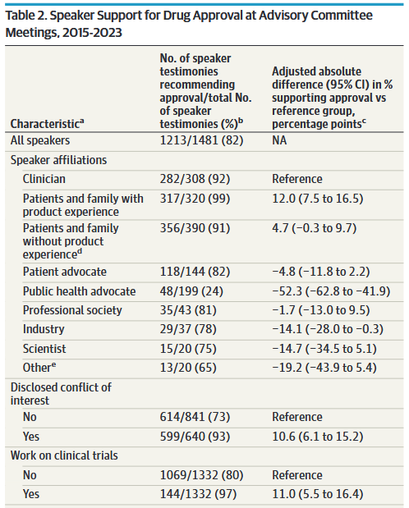
COI at FDA advisory committee meetings—public speakers
Reviewed meeting minutes and transcripts for all Human Drug advisory committee meetings 2015-2023
161 meetings on new drug or indication approvals; 155 had public speakers (1,481 comments)
  640 (43%) disclosed COI and were 10.6% more likely to recommend approval than those without COI
  Most frequent disclosure was travel support
Rand LZ, Mooney H, Hong D, Eisenkraft Klein D, Kesselheim AS, Rome BN. Characteristics of Speakers at US FDA Advisory Committee Meetings on Drug Approval. JAMA Intern Med. 2025 Nov 24. doi:10.1001/jamainternmed.2025.6107

Slide 7
Perceptions of COI
We interviewed former FDA staff, current and former AdCom members, and patients or their family members who had spoken at an AdCom meeting
  Identified participants from meeting minutes and transcripts
Patients/Family expressed their own, independent
motivations for speaking, even though they aligned with the sponsor’s interests
FDA staff/AdCom members expressed skepticism of many speakers’ motivations and likely COI, including patients’
quotes edited for clarity
Participants | Number
Total | 41
Former FDA staff | 9
Advisory committee members | 18
Patients and family members | 14

Slide 8
Perspectives on COI: patient speakers
Speaking independently and authentically
“I realized I was speaking on behalf of the pharmaceutical company—but my goal was [that] I wanted to help get this drug approved so that more patients would be qualified to be on it because in my mind I knew that it worked. It was a very successful drug.” (Speaker 9)
“[The sponsor] had invested a lot of time and a lot of money into getting [the drug] approved, and I was all in favor of that because it quite literally saved my son's life. I wanted to speak before this panel of researchers as independently as I could.... I just didn't feel great being shuffled in by a pharmaceutical company and told to tell my story.... I'm in a position financially where I could afford my ethics.” (Speaker 11, who paid for their own travel to the meeting)
“The pharmaceutical industry can be, let's just be honest, pretty controversial.... I wanted to make sure that I'm aligning with someone who also identified with my own morals and values, and they did. So they reached out to me asking if I was interested in being a part of this testimony as they were going before the FDA, and I wholeheartedly agreed and wanted to do anything I could to support this medication going to market.” (Speaker 3)

Slide 9
Perspectives on COI: FDA staff and AdCom members
Views on patients—selected by the sponsor but more likely to be a permissible/understandable conflict
“The patients are just paid by the company to voice whatever it is they're going to say.” (FDA 3)
“I completely discount [them] as soon as they tell us that they are drug company supported. I don't find their information useful. It's tainted by conflict of interest....I'm probably middle of the road on [patients]. The reality is not everybody can travel across the country to come and say their piece. So, there I'm a little bit more equivocal.” (Committee 16)
Views on clinicians—usually they have significant COI
“It's a hard thing to find somebody who's expert because they do a lot of this treatment but whose income would stay as high as it is if he suddenly kills that treatment... you have to judge the sources of the information.” (Committee 11)
“The clinicians, the investigators who came in with some of these weak arguments that were funded [by industry]...there was not much that we took from that.” (FDA 7)

Slide 10
Perspectives on COI: disclosures as context
Disclosures provide important context for the comments
“We deal with conflicts of interest all the time.... We hear from investigators at public meetings who appropriately have ties with industry.... In hearing somebody, it's appropriate to understand where they're coming from, and that has to play some role in how you interpret what they say, but it doesn't invalidate what they say, it just provides a certain context. The place where it becomes problematic is when every slot has been taken by some party that's basically seeking to supplement the case in favor of approval.” (FDA 4)

Slide 11
Addressing COI—new policies
Advisory committee members
Limited action: 2025 Commissioner’s announcement removing industry-affiliated members of AdComs
FDA has yet to finalize guidance on AdCom member COI review and waivers
Identified gap: future financial interests
Speakers at meetings
  Different standards than committee members
Lack of enforcement mechanisms → disclosure norms
  Pre-meeting written disclosures for speakers and for written comments
  Ask speakers who have not disclosed
Broader disclosures: help preparing comments, research alignment/interests

