Slide 1

Qualitative Study of Pathways to Obtaining IVF Benefits
Valarie Blake, JD, MA
Professor

Slide 2
Project aims
Given well-recognized gaps in health insurance coverage of IVF, explore how individuals access IVF care through a qualitative content analysis of publicly-available posts in online communities by self-identified affected individuals
Focus on secondary employment/secondary insurance strategies

Slide 3
Methods
 | Concept 1: Insurance Coverage | AND | Concept 2: Employment | AND | Concept 3: Known Employers
Primary Key Terms | Insurance Coverage |  | second job |  | Starbucks
 | OR |  | OR |  | OR
Secondary Key Terms |  |  | part-time job; work; gig; side job; side gig; temporary; seasonal |  | Amazon, WalGreens, Target, Wayfair, Tractor Supply
Truncation* and wildcard search term | insurance*; insur* |  | temp* |  | Amazon, WalGreens, Target, Wayfair, Tractor Supply
 | OR |  | OR |  | OR
Synonym,alternative spelling |  |  | Part time; parttime; creative ways to pay for IVF
Searched discussion threads in four subreddits over 5-year period (Jan 2020- March 2026)
r/IVF
r/infertility
r/InfertilitySucks
r/TryingForABaby

Slide 4
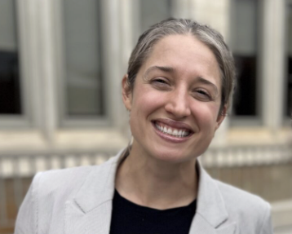
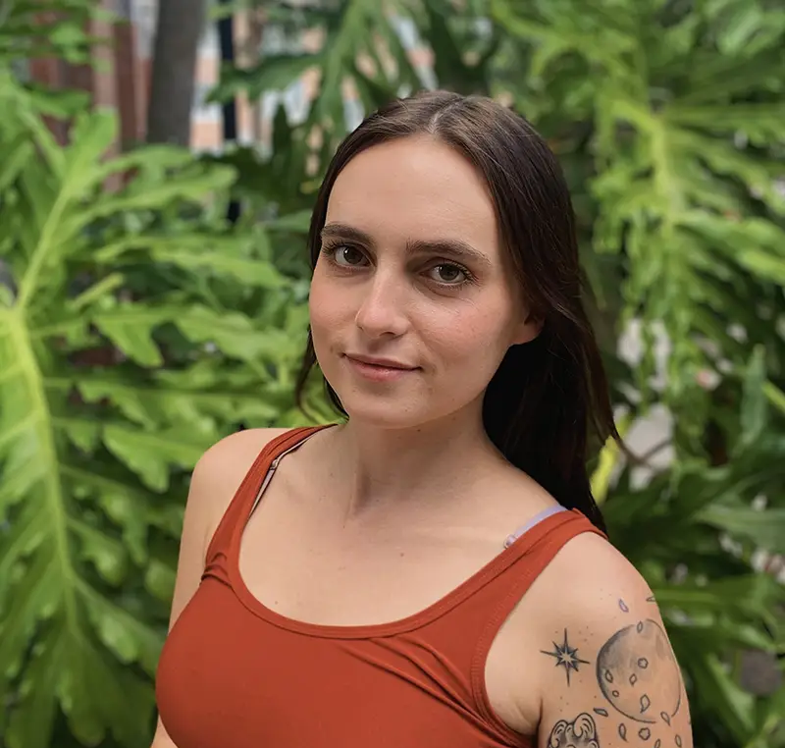
Methods (cont.)
Resulting data: 287 relevant threads
Data uploaded to ATLAS.ti
Iterative code development followed by coding and thematic analysis (ongoing)
Thanks to collaborators!!!
  Dr. Kendra Hutchens (postdoctoral research fellow at University of Tennessee’s Appalachian Justice Research Center) & Beth Holden (PhD candidate in Sociology, University of Tennessee)

Slide 5
When Insurance Works
Some posters reported sufficient insurance coverage to make IVF affordable; typically employer/state-mandated benefits
BUT insurance coverage sometimes made treatment more expensive.
  “We are lucky to have my company pay for a large chunk (Progyny) but if we didn’t… hands down, would not be able to afford this. Maybe we could do 1 or 2 rounds. Maybe.”
  “Current employer covers up to 30k lifetime IVF benefit, but the meds alone would have exhausted that bc they charge insurance more than they charge out of pocket to individuals.... so we do the meds outside of Insurance and everything else in.”

Slide 6
Employer Benefits Presented Tradeoffs
“My husband has stayed at a job thats driving him into the ground mentally and physically because we knew we needed the fertility coverage his employer-sponsored health insurance offers. He wants to leave now that we have one round under our belts and some embryos in the freezer (and I’m very early pregnant from our FET), but he will likely stay in case this pregnancy doesn’t work out and we need to do another round to get more embryos.”
Job Lock
OOP Costs
“My job offers great benefits, but still, hubs and I have paid a hefty amount out of our own pocket, between 3 ERs and meds, I'd say we spent close to $17,000. It would have probably been 3x that without insurance!!!”

Slide 7
State Mandate Limitations/Exclusions
  “I happen to live in a mandate state but even with coverage this year I only have 3 covered treatments…I still anticipate we’ll be spending close to $20k again next year. Insurance coverage isn’t all its cracked up to be so before you leave a job you may love … you may still be shocked at how much it still costs to do ivf.”
Insufficient Coverage
Exclusions of single people, LGBTQ+, age, sterilization based “medical necessity”
  “I live in a state that mandates IVF coverage but I'm doing IVF as a single person so I'm not covered. Straight couples can just claim they've been "trying" and they're fully covered but I would have had to do six IUIs paid completely out of pocket plus the cost of sperm. It would have cost close to $20k just to get the same coverage that straight couples get automatically.”
  .
  “I've gotten two jobs temporarily to get Progyny insurance and then went on Cobra. I'm about to do that for a third time because I need more coverage. Progyny is gold standard for same-sex couples and SMBC because they don't make you jump through any hoops to "prove" infertility. You can just go straight to IVF if you want.”

Slide 8
State Mandate Limitations/Exclusions (cont.)
  “Yeah “self-insured” companies suck. It’s just a sneaky way for them to get around mandated coverage, not just for IVF but for anything. …It’s become one of my go to questions when negotiating a job offer. I won’t work for a company that has it.”
ERISA self-funding
Federal workers/federal benefits programs
Religious exemptions
  “I live in a state that mandates fertility coverage, but we are a military family, and unfortunately they cover NOTHING! Even in the case of cancer, which is unfortunately my situation.”
  “Texas has [a mandate] and I was so excited to move there only to be denied because apparently Texas has a clause that allows religious organizations who don’t believe in IVF to not cover it. My spouse works for a catholic org. I didn’t find out I wouldn’t be covered until I had paid 2800 to meet my deductible."

Slide 9
Alternative Pathways to Coverage: Changing Jobs/Relocating
Career Sacrifice
Relocation
“I put my real estate career on hold and got a job at Target. I promoted to a team lead so the money is decent now - but it very much turned into only applying to jobs that were public with their fertility benefits.”
“We moved from Los Angeles to Maryland just to get mandated fertility coverage for embryo banking.”

Slide 10
Alternative Pathways to Coverage: Part-Time or Second Jobs
“I got a part time job at Tractor Supply for the Progyny Fertility benefits. I also kept my full time job. For one year I worked 7 days a week, 70hrs a week without a single day off. My baby is 14mo. It was worth it. All of it.”
“I work 10 hours at [Tractor Supply Company] every Monday from 6am-4:30pm for the Progyny benefits. It’s very hard physical work (stocking shelves with 50lbs feed bags for 10 hours straight) just FYI, but well worth it! Motherhood, I figure it will be worth it.”
“Oh my gosh with Starbucks you HAVE to pay upfront ??? Then wait for them to reimburse you???? CAN SOMEONE please let me know?? I can’t believe this I just got hired only for this . We wouldn’t have money like that to come up front before they cover.”

Slide 11
The Rise of Quit and COBRA
I did Amazon. Was going to work just the one day but got assigned to pick (the shopper position) and really wanted to do it because I thought it would be fun, and it was. So I did two days, then quit. OOP max is $2000 including all meds. COBRA is $690 a month.

Slide 12
Employer Backlash to Quit & COBRA
“[I]f you are planning on working in a delivery station, sort center, fulfillment center, etc (not in corporate) that you will more than likely be hired as seasonal and will not have access to Amazon benefits until converted to a full time permanent role. Some people are hired and converted in a few weeks, some work a year as seasonal and are let go. It’s iffy and not guaranteed based on the time of year/site type.”
“Everyone employed with Tractor Supply for progyny received an email today that as of September 28, 2023, everyone, regardless of length of employment or amount of smart cycles used, will only be given 1 smart cycle. This cuts the benefits IN HALF. It does not matter if you have a prior authorization already.”
“Starbucks just changed their fertility coverage. No more IVF, just IUI and surrogacy!! It was a min of 25 hrs a week for 3 months to be eligible for coverage. Also Tractor Supply was 10 hrs a week and avail after 30 days. LOL, they changed that over the summer. Now you have to work a f****** year PT for any fertility coverage.”

Slide 13
Non-Insurance Strategies Abound, Often in Multiples
  Budget clinics & pharmacies; coupled with extensive domestic travel
  Medical tourism
  Savings
  Loans
  0% interest credit cards as loans
  Debt
  Family Help
  Clinic financing specials, discounts, “shared risk” programs
  Budgeting
  Tax Strategies (deductions, HSA/FSA)
  Refinancing home
  Grants
  401k loans
  Donor medicine (“IVF garage sales”)
  Gigs (eBay, OnlyFans, UberEats, Etsy, Airbnb)
  Crowdsourcing/Donations
  Selling houses, cars, stock
  Donor embryos

Slide 14
Examples of Non-Insurance Strategies
“We chose CNY, and paid $3795 per cycle
Used donated meds
Charged all to a frequent flyer card to get miles to pay for travel to clinic
Are sharing one vehicle (early 2000’s compact)
We do nothing else that costs money
Continuously save
Had already saved money for hypothetical baby and deductible for hypothetical baby and other savings which we have used all of now
Asked for help from family who could help- frequent flyer miles, some small cash gifts, etc. anything to help us slow down the spend”
“I’ve spent $104k on IVF from 2019-2023. I inherited $15k from my great aunt specifically for IVF. The rest we paid out of pocket. My husband worked an insane amount of overtime. I had multiple jobs. I would do 16 day work stretches without a day off. I donated plasma twice a week. We lived incredibly frugally. It was 100% worth it. I have no regrets.”
“Airbnb-ing our extra bedroom (we also in a high COL and highly touristed area).
Going to a travel clinic because it's less expensive.
Finding meds on reddit or through Facebook groups.
Using our "house down payment" savings.
Is any of it convenient... no, but having a family is very important to us. I'd rather be broke and have kid(s)."

Slide 15
Next Steps
More data analysis
Publication outlets
Areas of focus

